Slide 1
Apprenticeship Presentation
July 15, 2021
Martin Stringer, Interim Vice President of Academic Affairs

Slide 2
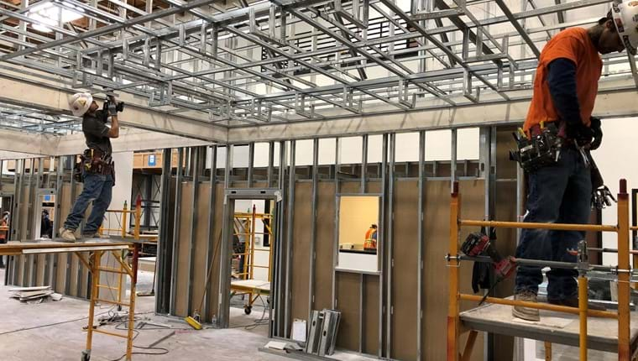
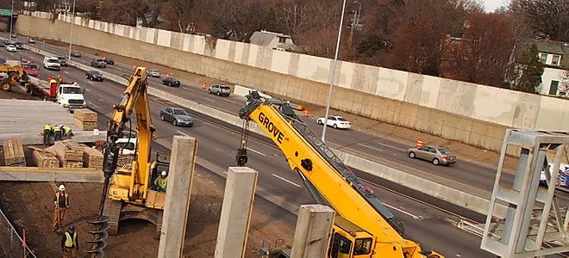
Apprenticeship
How does it work?

Slide 3
How does apprenticeship work?
Industry trains workers to master skills.
Industry develops a Training Trust to oversee such work.
Apprentices work full-time in the industry, getting on-the-job training.
Apprentices are also required to have 144 hours per year of Related Supplemental Instruction (RSI) in the classroom.

Slide 4
SCC is the Local Education Agency for seven training trusts. We track attendance/grades, and provide college credit for the classroom portion of the training. SCC does not schedule the classes, however some courses may be held on our campus.
Students need to be accepted into the program prior to applying to the college. They must first contact the training trust of the industry they are interested in to apply.

Slide 5
The apprenticeship program at SCC, in conjunction with various employers and the Division of Apprenticeship Standards, offers training programs in:
SCC
Carpentry (Southwest Carpenters Training Fund)
Electricity (OC Electrical Training Trust)
Maintenance Mechanic/ Electrician (Metropolitan Water District)
Power Lineman (Cal Nevada JATC)
Surveying (Southern California Surveyors)
Cosmetology (JTS Services)
Operating Engineers (Operating Engineers Training Trust)

Slide 6
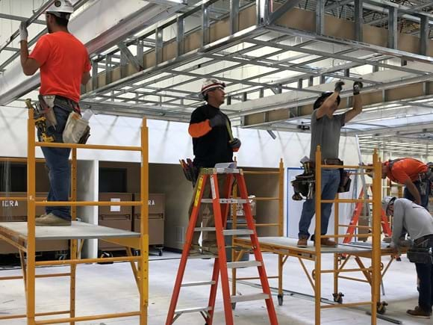
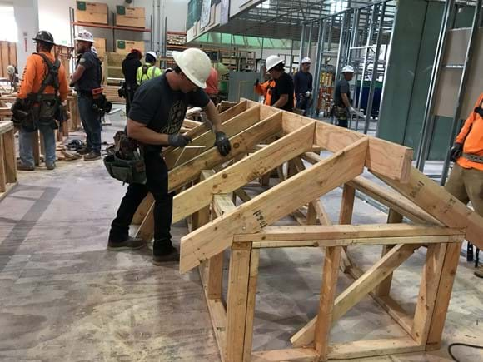
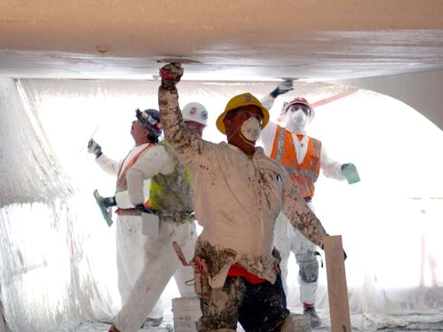
Carpentry
Acoustical Tile
Concrete
Drywall Finisher
Drywall/Lather
Finish Carpentry
Framing
Insulator
Millwright
Modular Furnishing Installation
Pile Driver
Plastering
Tilt-Up
Notes:
These Apprenticeship Training Programs are three-year programs. The apprentice must furnish his/her own tools and be working as an indentured apprentice. Employment within the trade depends upon a willingness to work and available work in the industry. Apprentices are also required to attend daytime college credit related and supplemental instruction for two weeks, 40 hours per week, every six months.

Slide 7
Cosmetology
Students take 39 hours of pre-apprentice training
Students work at a sponsoring salon
Full-time two-year program
Students attend at least 220 hours of college credit related supplemental classroom instruction
Earn a certificate. Pass the State Board exam to
become a licensed cosmetician.

Slide 8
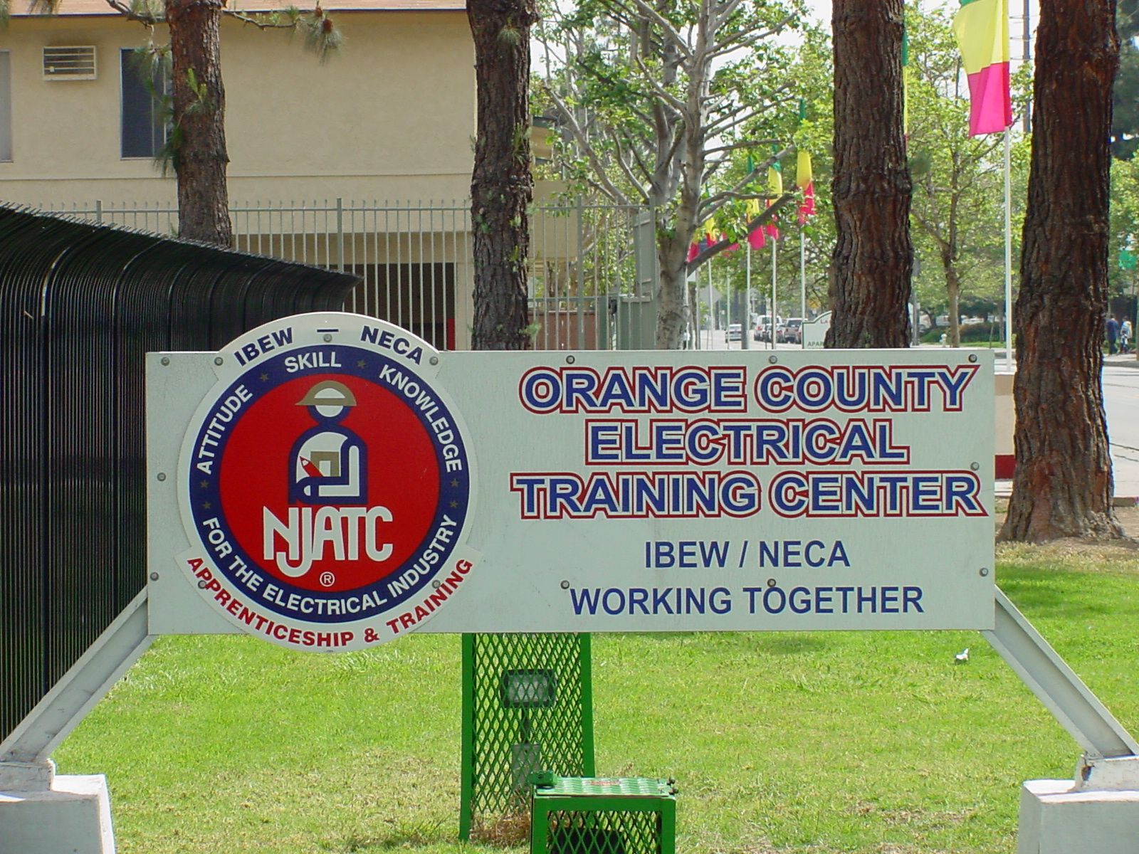
Electrician
Inside Wireman
Intelligent Transportation Systems
Sound and Communication
Notes:
The Orange County Electrical Apprenticeship program is a State registered program dedicated to the training of electrical construction Apprentices

Slide 9
Maintenance Electrician/Mechanic
Maintenance Mechanic
Maintenance Electrician

Slide 10
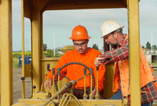
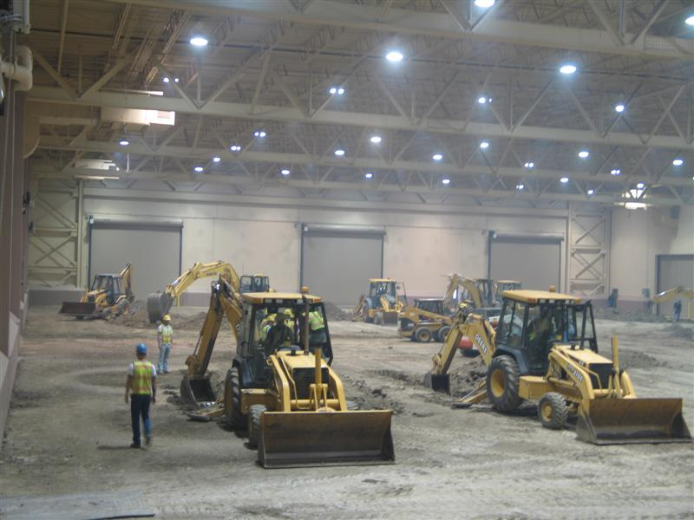
Operating Engineers
Heavy Duty Repairer
Heavy Equipment Operator
Inspection
Plant Equipment/Rock, Sand and Gravel

Slide 11
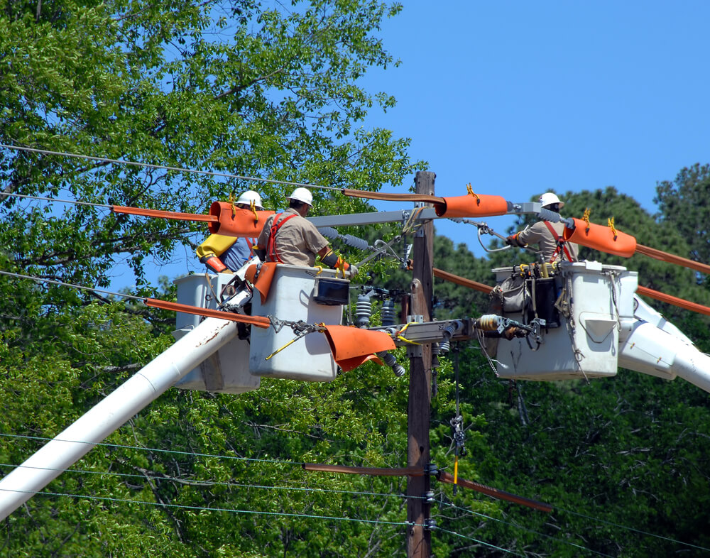
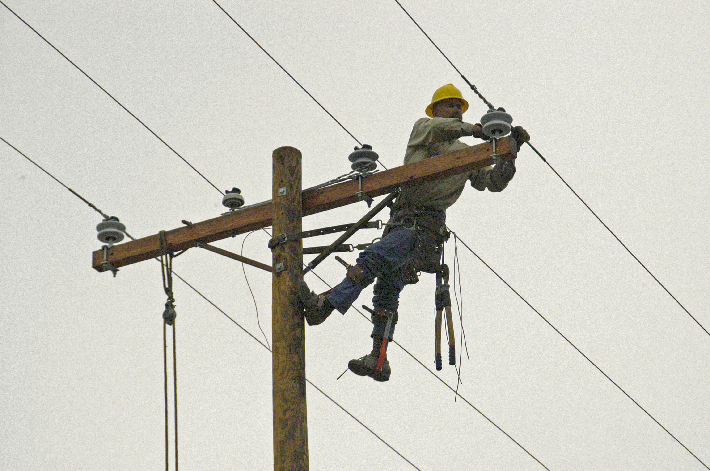
Power Lineman
Power Lineman

Slide 12
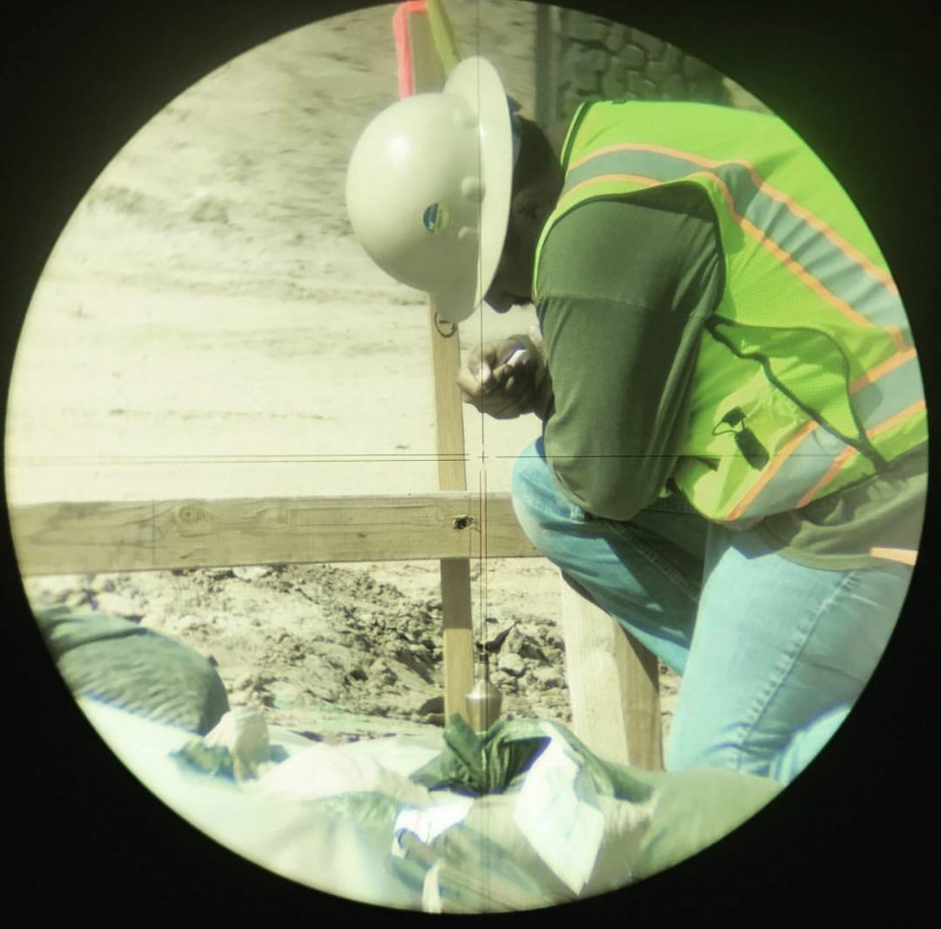
Surveying:
Chainman
Chief of Party

Slide 13
Benefits to students
High wage industries
Earn while you learn (Trust pays salary)
No college tuition to the student (Trust pays)
Regular increases in salary
Great jobs with benefits
Industry connections once they graduate
Completion of training leads to journey worker status

Slide 14
Benefits to students
Programs range in length from two to five years. During this time, you will work full-time as a paid apprentice under the supervision of a journeyman. You will receive raises in pay for each successfully completed period of apprenticeship.
Upon successful completion, apprentices become journeymen and begin earning the journeyman wage. They will receive a Journeyman Certificate and Card from the State of California. They may also be eligible for a degree or certificate from Santiago Canyon College.

Slide 15
How Students Get Started
Identify the occupational skill to pursue
Contact Training Trust
Students need to be accepted into the program first by the trust. If there is a waitlist, they get on the waitlist until there are openings available.
Once accepted, the training trust tells the student where they work, and when to attend classes.
Notes:
Certificates tracked are computed by using an “auto-awarding system”
Associate Degrees are only tracked if a student manually petitions for graduation by submitting the petition form to Admissions

Slide 16
How Students Get Started Continued
When students attend classes, that’s when the apprentice apply to the college and become an SCC student.
Business & Career Education office and Admissions and Records track attendance hours and grades, and gives college credit to students for classroom instruction only. Apprentices can earn a certificate from SCC when they journey out. That certificate can become an Associate of Science degree.
Notes:
Currently we leave thousands of dollars on the table due to the current procedures in place when tracking hours
The new governor is looking to expand and infuse monies into the Apprenticeship sectors
Each trust will be receiving their allocations and will need to sign and return

Slide 17
Thank you!
Questions?

