Slide 1
EL Civics
Overview & COAAPs
Spring 2026

Slide 2
What is EL Civics?
EL Civics falls under the umbrella of WIOA (the Workforce Innovation and Opportunity Act).
CASAS defines it as "The purpose of the EL Civics program is to support projects that demonstrate effective practices in providing and increasing access to English Literacy programs linked to civics education."
Schools receive funds to teach students the skills needed to become better workers, parents, and community members.

Slide 3
What's a COAAP?
COAAP is the acronym for Civic Objectives and Additional Assessment Plans
These are the pre-approved topics and tasks set up by CASAS in the various areas: work, community, health, etc.
Lessons are created according to the rubric for that particular COAAP
Students are assessed after the lessons to determine mastery of the skill taught

Slide 4
Materials Provided:
Student Activity Packets: packets for students are available for download on the Employee Intranet (remember, you need to sign in).
If applicable, there are 2 versions: online (accessible) and paper (in person)
Canvas Modules are available: you are encouraged to utilize the material and build around it, since they are ‘basic’ modules. Search Commons under my name “Sandra Watts”, then look for the topic and your level, or use the links on the Intranet. The drop-down menu can be changed to “updated, newest first”.
Teacher Guides/Keys, rubrics and Assessment Keys are also on the Intranet.
Any material used for in-person teaching is also at Duplications: you can order copies there. There is a new online form to request copies: Copy Request

Slide 5
EL Civics by Modality
In person classes: Request copies from Duplication. Teach the lessons and give the assessments in class. Turn in Assessment packets and rubrics to the CASAS office.
In all other courses (Remote Live, Hybrid, Online), Upon completion of the COAAPs teachers are to contact the CASAS office (casas@sac.edu) and ask for their classes to be assessed. Alternately, you can be trained to do your own remote assessments.

Slide 6
Timelines and Requirements
This semester, ONE COAAP is mandatory, the others are optional. 3 COAAPs are given for you to choose from.
The due date is May 1 for the mandatory COAAP.

Slide 7
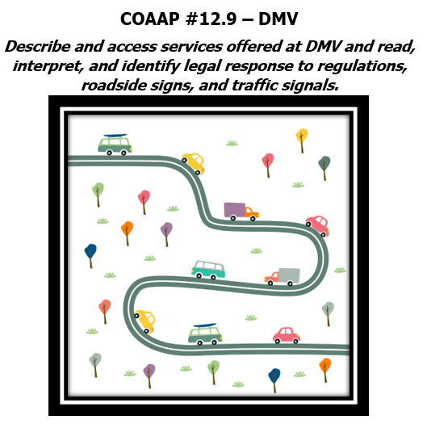
Spring COAAP 12.9
Task 1: Understand road signs & signals (written or oral, BL-BH)
Task 2: Identify car types and car parts (written or oral, BL-BH)
Task 3: List driver’s license requirements (written or oral, BL-BH)
Task 4: Respond to a traffic citation (written or oral, IL-ADV)
Task 5: Write an email to persuade someone to follow safe driving laws (written IL-ADV)

Slide 8
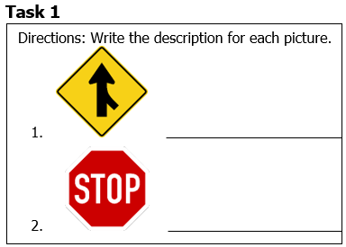
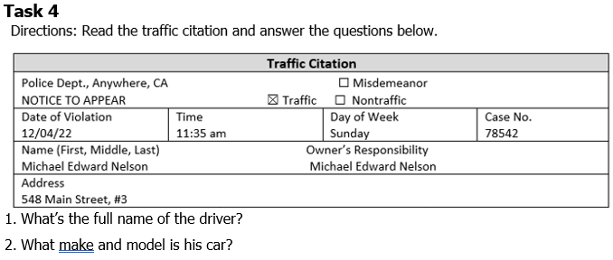
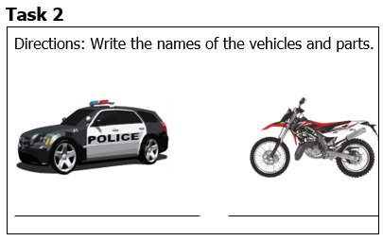
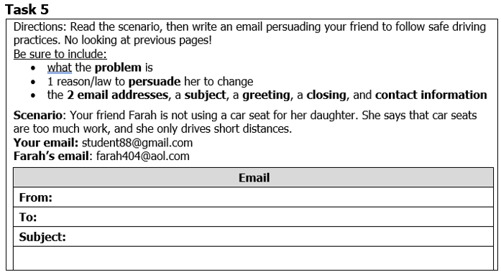
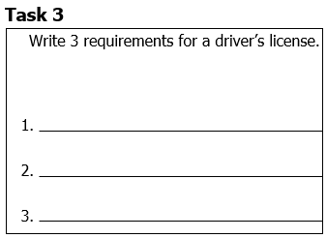
12.9 DMV: Task Examples

Slide 9
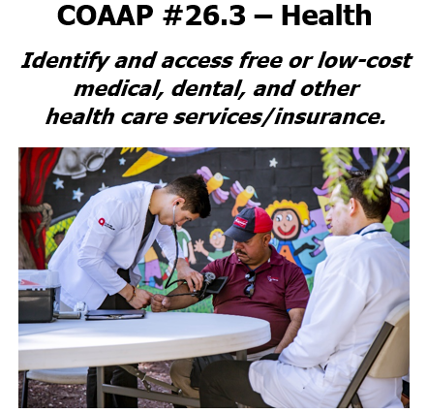
Spring COAAP 26.3
Task 1: Find information on low-cost health care (written or oral, all levels)
Task 2: Complete an application form for low-cost health insurance (written, all levels)

Slide 10
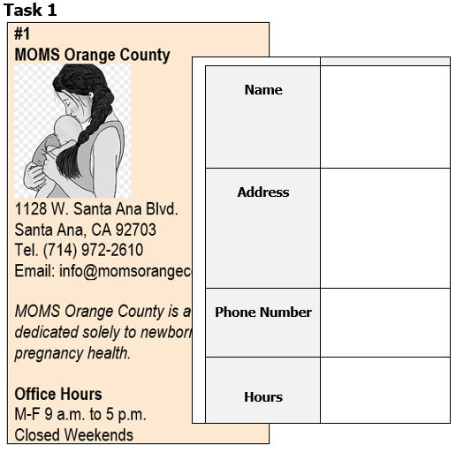
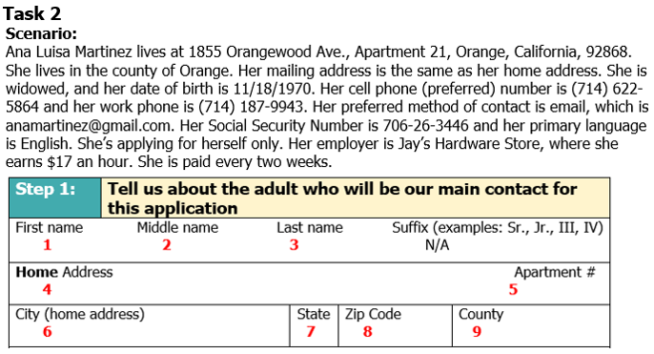
26.3 Health: Task Examples

Slide 11
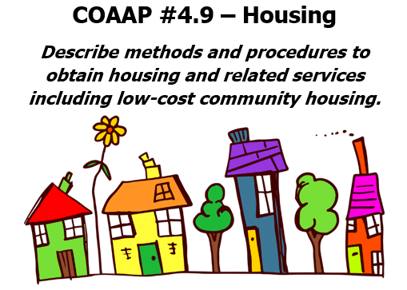
Spring COAAP 4.9
Task 1: Complete a rental application form (written, all levels)
Task 2: Write a note about a housing problem (written, BL-BH)
Task 3: Write an email about a housing problem (written, IL-ADV)

Slide 12
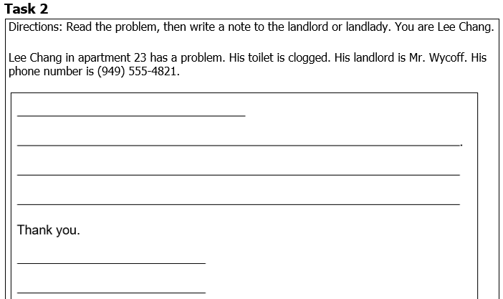
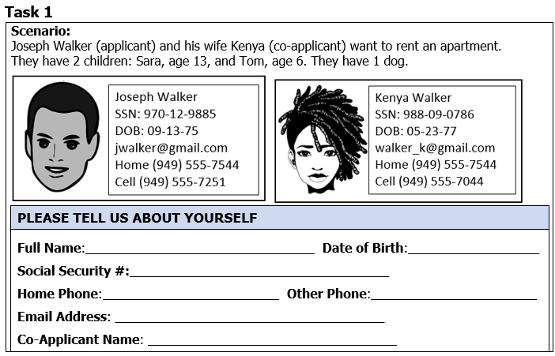
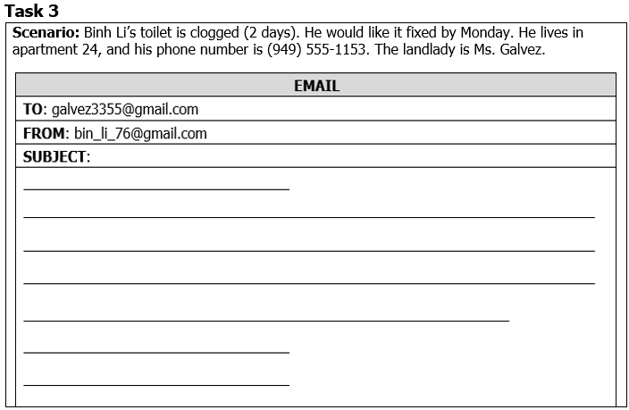
4.9 Housing: Task Examples

Slide 13
Questions & Concerns?
I will not be doing EL Civics at this time, but feel free to email me with any questions about current materials (watts_sandra@sac.edu).
For questions about remote assessments, contact the CASAS office at casas@sac.edu. Or contact your proctor.
Any questions about EL Civics or WIOA, our WIOA coordinator is
Dr. Jarek Janio; Janio_Jarek@sac.edu

