Slide 1
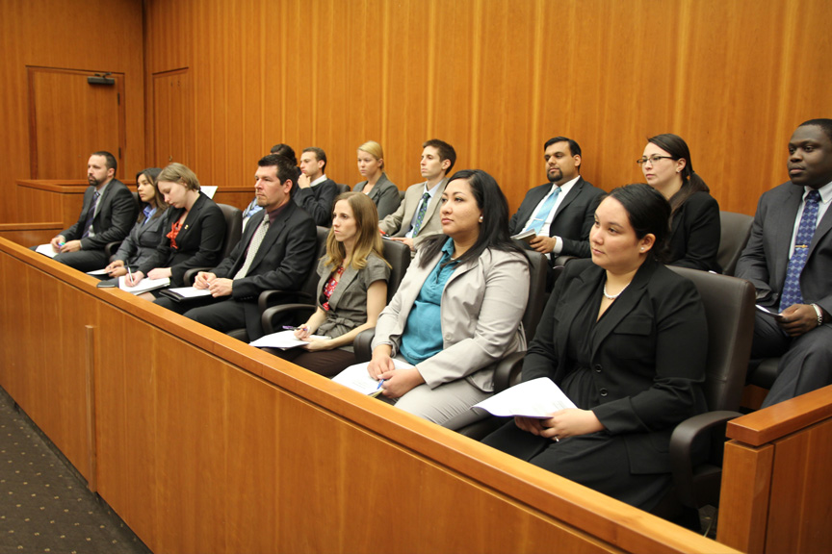
Jury Duty Summons
Government & Law Adv High Introduction

Slide 2
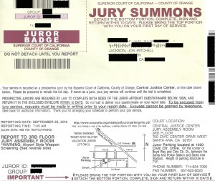
What is a Jury Summons?
A jury summons is a form that the court sends to tell you to report to court for jury duty.
They usually look like this in Orange County.

Slide 3
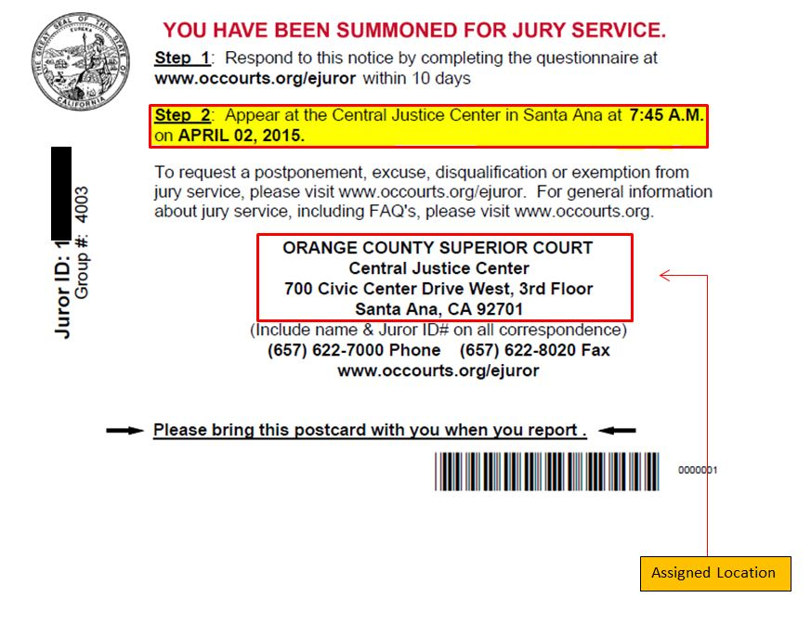
Sometimes you might get a postcard like this:
It tells you when and where to show up for the jury duty.

Slide 4
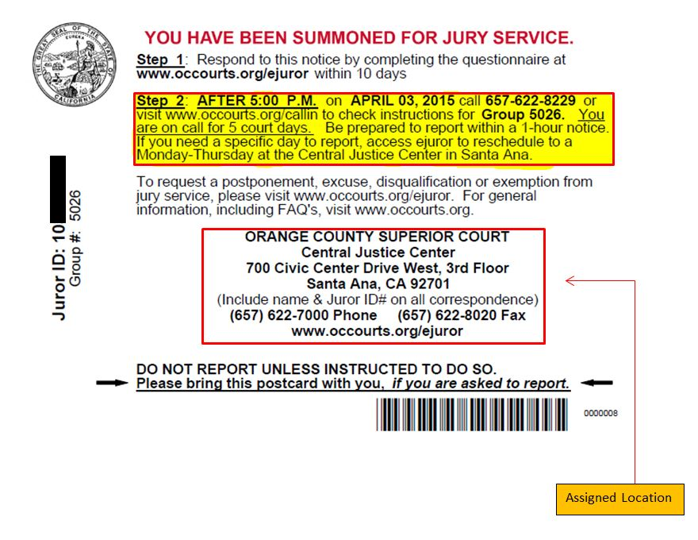
Sometimes, you may be a call-in juror.
This means that you call every day for 5 days to see if you have to go to the court.
If the court doesn’t need you, you don’t have to serve as a juror.

Slide 5
Resources
Jackson and Wilson.com (jacksonandwilson.com)
OC Courts.org (occourts.org)
Hasty Pope.com (http://www.hastypope.com/wp-content/uploads/2016/10/Jury.jpg)

