Slide 1
Community Issues
HOMELESSNESS

Slide 2
https://YouTube/lkh72q6XmY8
Have you seen these images before?
Who are these people?
Why do you think they live this way?
What do you do when you see a homeless person?

Slide 3
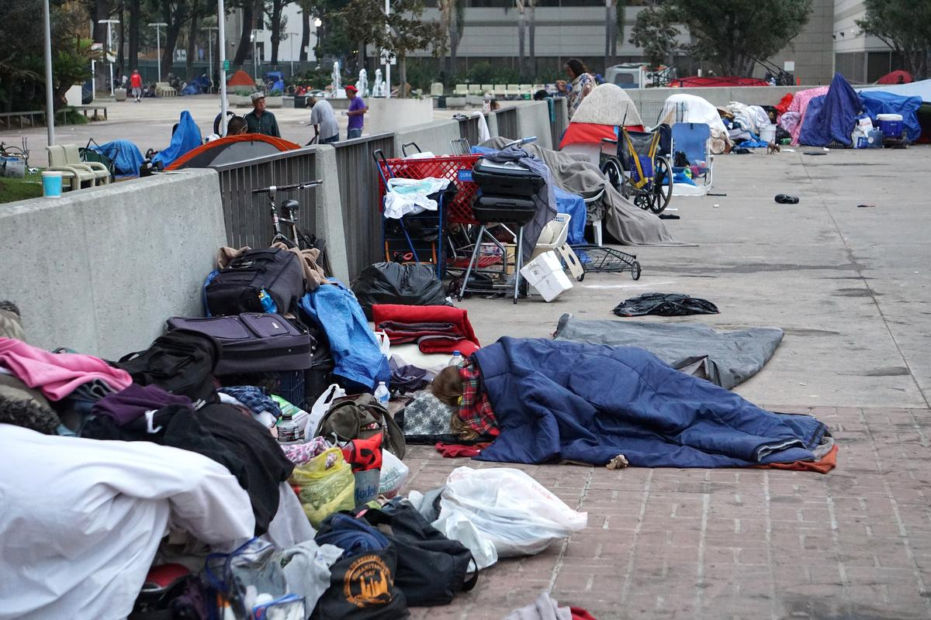
Homelessness is a major issue in this community.

Slide 4
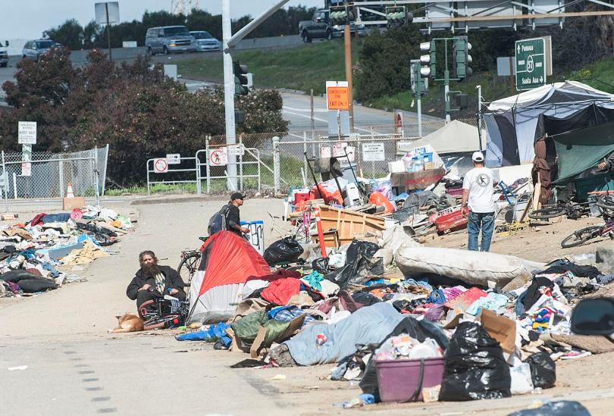
Many people live in the streets and along the Santa Ana River without any hope for a better future.

Slide 5
What do you think can be done to solve this problem in the community?
Do you think city authorities are working on improving this situation?

Slide 6
https://action.aclu.org/secure/el-nino-shelter-oc
Did the authorities do anything to change things for the homeless in Santa Ana?
Did the authorities do anything to change things for the homeless in Santa Ana?
What did the authorities promise ?

Slide 7
Homelessness is a significant community issue that have to be resolved. The homeless are in need of permanent shelter. Unfortunately, Santa Ana City and county authorities are not in a hurry to act. The winter season is here and the weather tends to be very cold for those who live without a permanent shelter. The deadline has passed and nothing has been done for the residents of tent city.
What can each of us do to improve this situation?

Slide 8
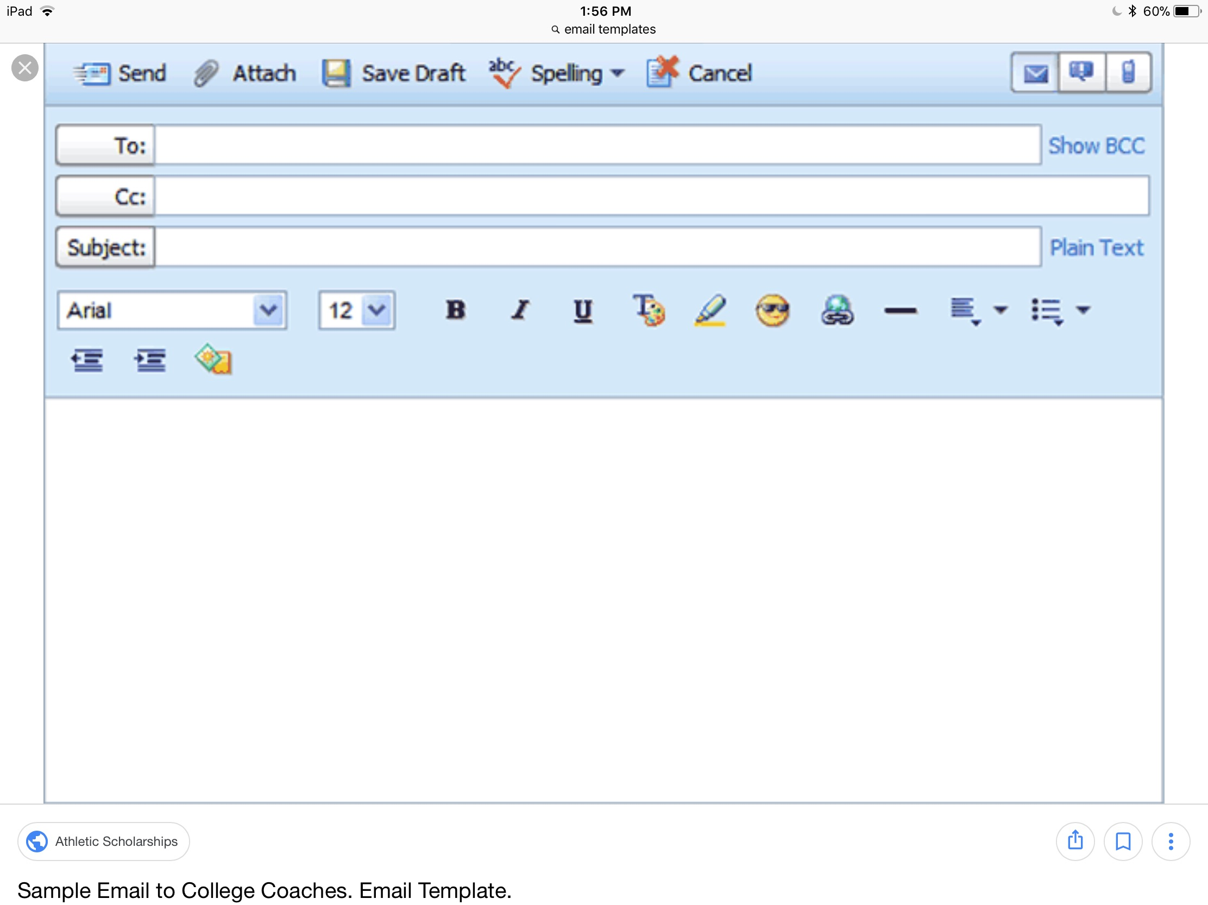
What are the main components of the email?

Slide 9
The difference between CC and BCC is that carbon copy (CC) recipients are visible to all other recipients whereas those who are BCCd are not visible to anyone. It is good “netiquette” to use BCC when copying a message to many people instead of the direct email to keep the emails private from everyone else.

Slide 10
FUTURE CONDITIONAL SENTENCES
A conditional sentence is a complex sentence that consists of a main clause and a subordinate clause . The “if” clause expresses the condition, and the main clause gives result or outcome .
Future conditionals include a strong condition and result sentences which express future plans and contingencies.
If clause (simple present), + main clause (future tense)(point out that a comma is necessary only if the sentence starts with if clause).
Main clause (no comma is necessary if the sentence starts with main clause) + if clause (simple tense).
If the local authorities recognize the need for affordable alternative housing, people who are currently living outdoors will avoid public health and safety catastrophes in the future.
Sometimes the future outcome is expressed in the result clause is not sufficiently certain to warrant the use of will and be going to, in which case a weaker modal of prediction such as may, might ,or should is used.
Examples:
Orange County officials should act immediately if they want to ensure safety of people living outdoors.
The city authorities should not give eviction notices to Santa Ana River homeless campsite residents if they don’t provide alternative housing.

Slide 11
EXTRA GRAMMAR PRACTICE
Put the sentences in the right order. Check your answers with sample email Handout #5.
don’t move, they may have residents serious problems the campsite with the law If .
the homeless residents at the Santa Ana Civic Center and along the Santa Ana River bend don’t receive soon, it can lead to the safety and health assistance catastrophe’s in the future If .
you don’t act urgently and provide for the homeless population as well as various assistance programs to help them to get off the streets, If you will not be able to meet alternative housing your ten-year plan deadline to end the homelessness.

Slide 12
EXTRA GRAMMAR PRACTICE
Fill in the blanks with the correct forms of the verbs. Add commas where it is necessary.
If the city officials ___________(follow) the established deadlines, they ______(provide) many homeless residents with the alternative housing before the cold season.
If you_______(write) a letter to the local representative you __________(can, should, might)_____(keep) it positive and polite.
A formal email ________(be effective) if it _______(address) the issue clearly and concisely.
The recipient of the email _______(not see) who else is getting email if you Bcc all other recipients.
If the catastrophe_____(happen) you _________(have to act) quickly to stop it.
If you _________(write )a business letter you_____________(might want to avoid) informal or personal topics.

Slide 13
Grammar link for extra practice
https://www.learnamericanenglishonline.com/Orange%20Level/O12%20Future%20Conditional.htm

