Slide 1
The Fine Print
A lesson on Analyzing Text
Consumer Economics – Advanced High

Slide 2
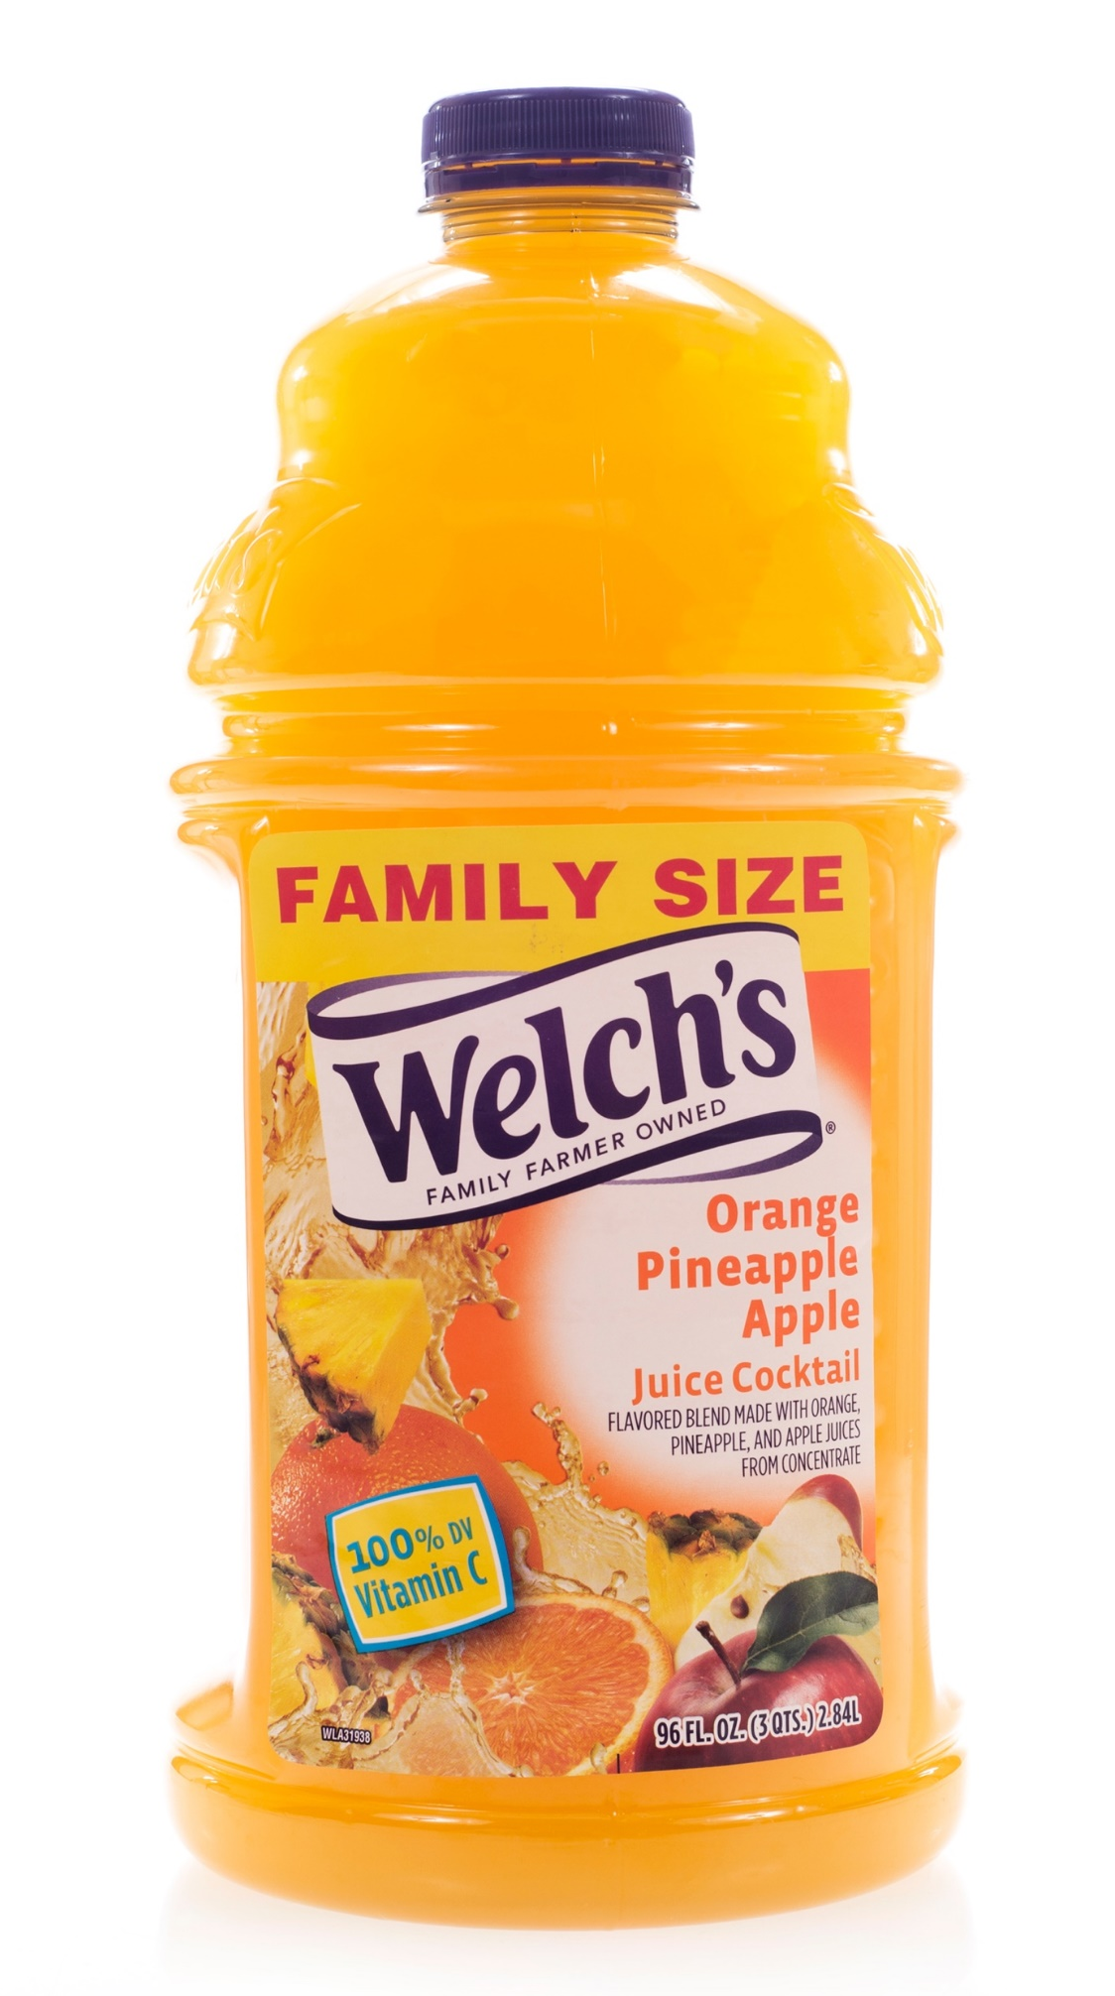


Slide 3

What type of product is this?
Do you think there is a difference between ‘juice’ and ‘juice cocktail’?
What is the difference between a product having 100% juice and having 100% Vitamin C?
Do you think this label is misleading? Why or why not?

Slide 4
Fine Print
: the part of an agreement or document that contains important details and that is sometimes written in small letters
Read the fine print before you sign the contract.
Definition retrieved from http://learnersdictionary.com/definition/fine%20print

Slide 5
Gyms in Santa Ana

Slide 7
*Pay initiation fee plus first and last months’ dues. Initiation fee ranges between $39.99-$89.99, and monthly dues range between $29.99-$99.99 per month, depending on club location and type. Pay $49.99 Annual Fee once during first year of enrollment and annually thereafter. Offer available online or in club. Excludes One-Club, Basic, Add-On and Limited Term Prepaid memberships. One year commitment required for Commitment memberships. Selected club of enrollment must be within 50 miles of purchaser’s residence. Not valid for current members. Dues must be paid by pre-authorized payment. No other discounts with this offer. Facilities and amenities vary per location. Kids’ Club, Personal/Group Training, specialty classes and class reservations are available for an additional fee. Not all clubs open 24 hours every day.
Adapted from membership details at https://www.24hourfitness.com

Slide 8
Analyze
: to study (something) closely and carefully : to learn the nature and relationship of the parts of (something) by a close and careful examination
To analyze a problem
Definition retrieved from http://learnersdictionary.com/definition/analyze

Slide 9
Initiation fee | The act of becoming a member or participant in something
Enrollment | Not included
Dues | The regular payment you make to be a member of an organization
Access | The money paid to join a club or organization for the first time
Thereafter | arrangement when a bank is given permission to automatically take payment from a customer on regular basis.
Valid | Permission to enter or make use of something
Exclude | Acceptable according to law
Pre-authorized payment | After that

Slide 10
Analyzing the facts:
Choose 3 sentences from the reading that you believe are most important. Write the sentence number below and in the space provided, explain why.
Sentence #: _______
Reasoning:_____________________________________________________________________________________________________________________________
___________________________________________________________________
Sentence #: 2
Reasoning: It is important that we know exactly how much we are paying. This sentence shows us that there are many different membership fees and monthly dues. We need to understand why these prices can be so different.

Slide 11
Therefore
Meaning - for that reason; because of that.
John is sick. Therefore, he can’t take the exam.
Therefore shows cause and effect.
Therefore is a conjunctive adverb.

Slide 12
3 Ways to use therefore in a sentence:
Use therefore along with a conjunction such as ‘and’ to connect 2 independent clauses.
  John is sick and therefore can’t take the exam.
Use therefore with a semi colon.
  Martha loves to travel; therefore, she is always looking for discounted travel deals online.
Instead of using semi colon, Therefore can be used to start a new sentence.
  Xu Ping left her wallet at home. Therefore, she can’t pay for the ticket.

