Slide 1
Comparative Shopping!

Slide 2
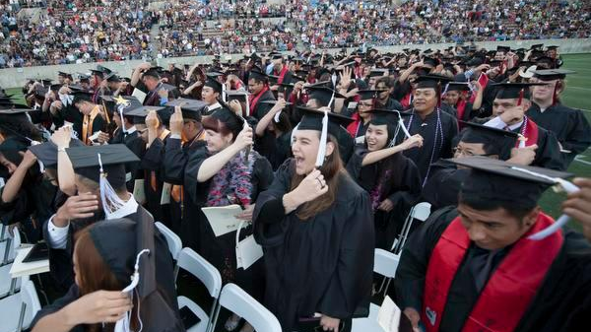
Photo retrieved from https://www.ocregister.com/2014/06/12/santa-ana-college-sends-off-graduates/

Slide 3
Get ready to play…
Guess the Price!

Slide 4
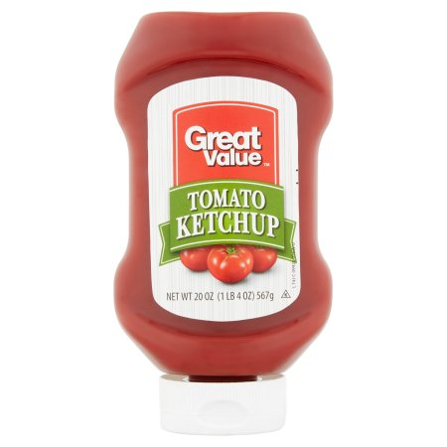
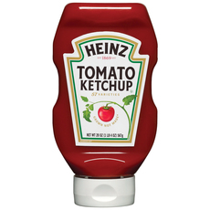
$2.50
$3.49

Slide 5
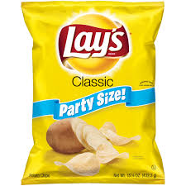
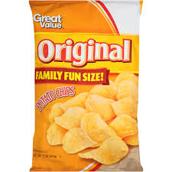
$3.99
$2.50

Slide 6
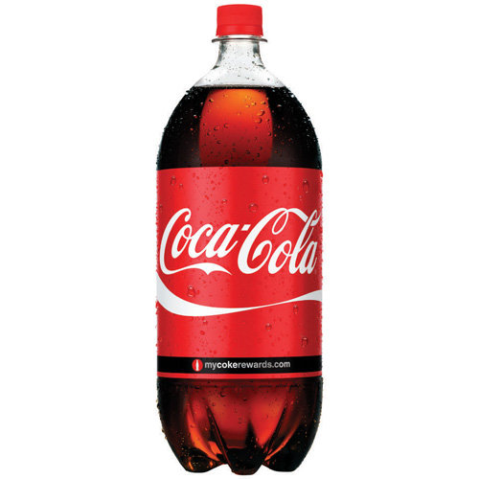
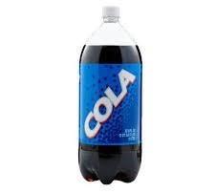
$1.99
$.99

Slide 7
Budget:
An amount of money available for spending that is based on a plan.
“We have a $50.00 budget for groceries every week.”

Slide 8
Comparison Shop:
To compare items while shopping in order to see which one is the best or has the lowest price.
“If you want to save money, it is important to comparison shop before you make a purchase.”

Slide 9
Comparative Adjectives

Slide 10
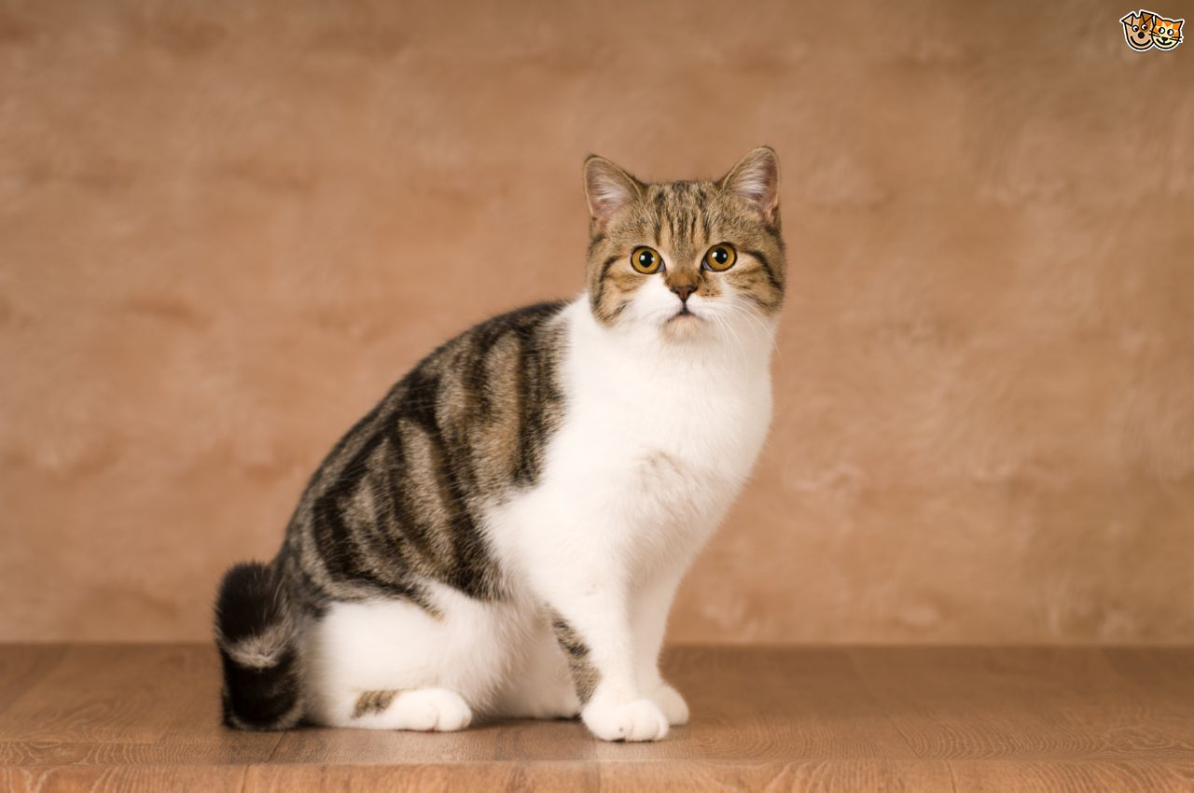
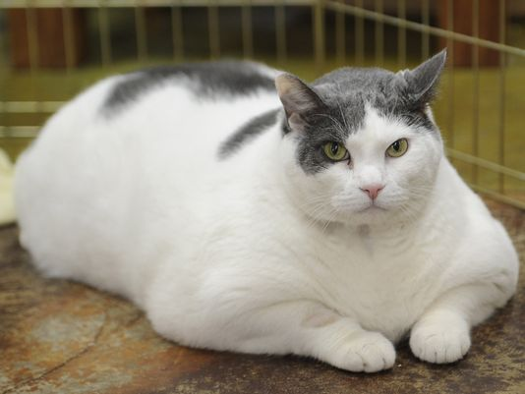
Molly
Bob
Molly is smaller than Bob.

Slide 11
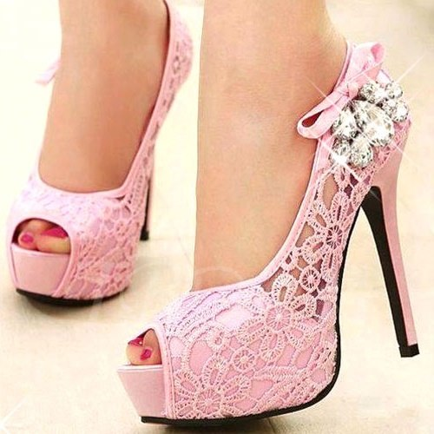
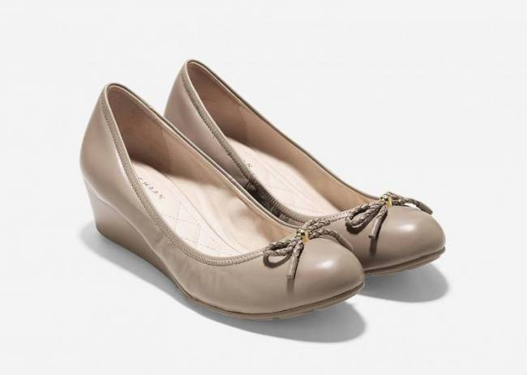
Pink heels
Tan heels
The tan heels are more comfortable than the pink heels.

Slide 12
Comparative Adjective Rules:
Use ‘er’ with one syllable words and two syllable words that end in ‘y’.
  Big Saver is cheaper than Northgate. (Cheap becomes cheaper.)
  Apples are healthier than potato chips. (Healthy becomes healthier.)
Use ‘more’ with two syllable words that don’t end in ‘y’ and three or more syllable words.
  French fries are more delicious than Brussel sprouts.
  Health is more important than money.

Slide 13
Special Notes:
Good and bad are irregular adjectives and don’t follow the rules.
  Good becomes ‘better’. I am better than you at dominoes.
  Bad becomes ‘worse’. Mai is worse than Alex at dancing.
NEVER, EVER put ‘er’ and ‘more’ together!
  She is more taller than Martin. NO!!!!
  She is taller than Martin. YES!
  Bertha is more better at soccer than Albert. NO!!!!
  Bertha is better at soccer than Albert. YES!

Slide 14

more better

Slide 15
Comparative Pictures of CEC to come!

