Slide 1

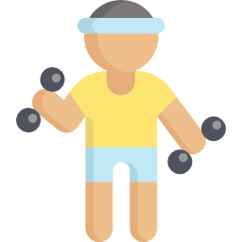

Exercise for All
Beginning High – Health and Safety

Slide 2
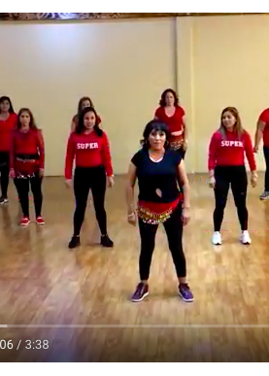
Zumba Video
Zumba Video

Slide 3
  Do you need to spend money to be fit?

Slide 4
Sample Answer
We think you need to spend money to stay fit.
First, you need money to buy exercise clothes.
Second, ___________________.
Third, _________________.

Slide 5
Scan:
To look at something carefully usually in order to find someone or something
"He scanned the room to find his daughter."

Slide 6
Questions for specific information:
What percentage of Americans engage in exercise every day?
Where do most Americans exercise?
Who prefers to do activities like Yoga and aerobics?

Slide 7
Americans and Exercise
Eighteen (18) percent of Americans age 15 and older engage in exercise on a typical day. Walking is the most popular form of athletic activity followed by Weightlifting and running. Women are more likely to participate in aerobics and yoga. Men or likely to participate in basketball and golf. Most Americans exercise outside and not at a gym or in their homes.

Slide 8



Infographic definition
Information
Graphic
= Infographic

Slide 9
Definition of Inforgraphic
Infographics present information quickly and clearly. In recent years infographics has become very popular. Businesses and organizations often use them on social media apps like Facebook, Twitter and Pinterest.

Slide 10
6 Free Ways to Exercise Infographic
6 Ways to Exercise

Slide 11
Who, What & Where
Who – We use ‘who’ to ask about people.
  Who is the Zumba instructor?
What – We use ‘what’ to ask about objects,
ideas or actions.
  What will you wear to class?
Where – We use ‘where’ to ask about location.
  Where is the Zumba class?

Slide 12
When & Why
When – We use ‘when’ for time.
  When does the Zumba class begin?
Why – We use why for ‘reason’.
  Why did Reyna stop coming to Zumba class?

Slide 13
How to create a ‘wh’ questions:
‘wh’ word
+
‘verb
+
subject
Where is Elena?
‘wh’ word
+
Aux.
+
Subject
+
Verb
(+ object)
Where did Elena buy those sneakers?

Slide 14
Wh word sentence structure
'wh word’+ Aux + subject + verb + (object)
What do you do to stay fit?
What’s wrong with these sentences?
Where he work at nights?
Why you late for class?
What gym do she go to?
When will you running start?
Where does he work at nights?
Why are you late for class?
What gym does she go?
When will you start running?

Slide 15
Recreation:
Something a person does for fun or entertainment.
“People use parks for recreation.”

Slide 16
References:
Slide 6:
Adapted from bls.gov
Slide 7:
Informaton Image retrieved from I want my mail
Graphic Image retrieved from UNH.edu

