Slide 1

Online Review Sites for Orange County Services
Community – Beginning High

Slide 2
ANSWER THE QUESTIONS
  What kind of food do you like?
  Do you prefer food from a restaurant or food from home?
  How often do you eat out?
  Do you enjoy eating out?
  New Vocabulary: Eat Out
  To eat out means to eat at a restaurant and not at home.

Slide 3
Unscramble the sentence:
Every out family my Friday night eats.
My family eats out every Friday night.
Or
Every Friday night, my family eats out.

Slide 4
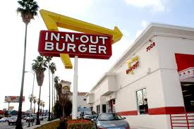
In ‘n’ Out Burger

Slide 5
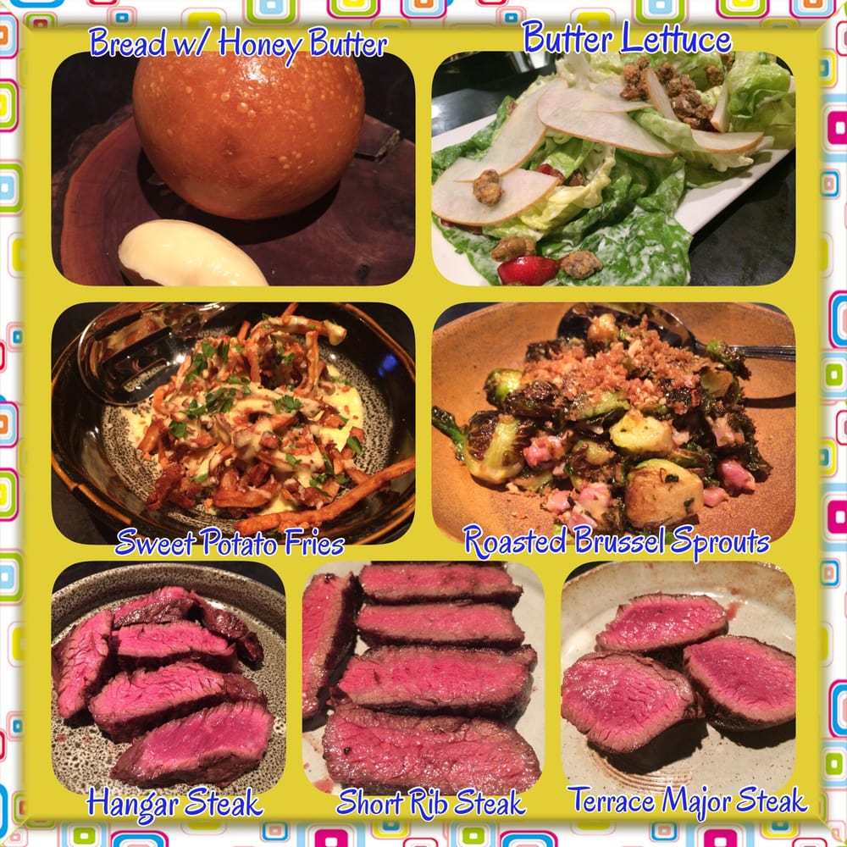
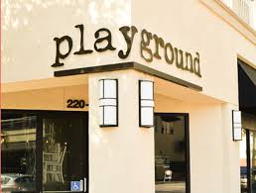
Playground

Slide 6
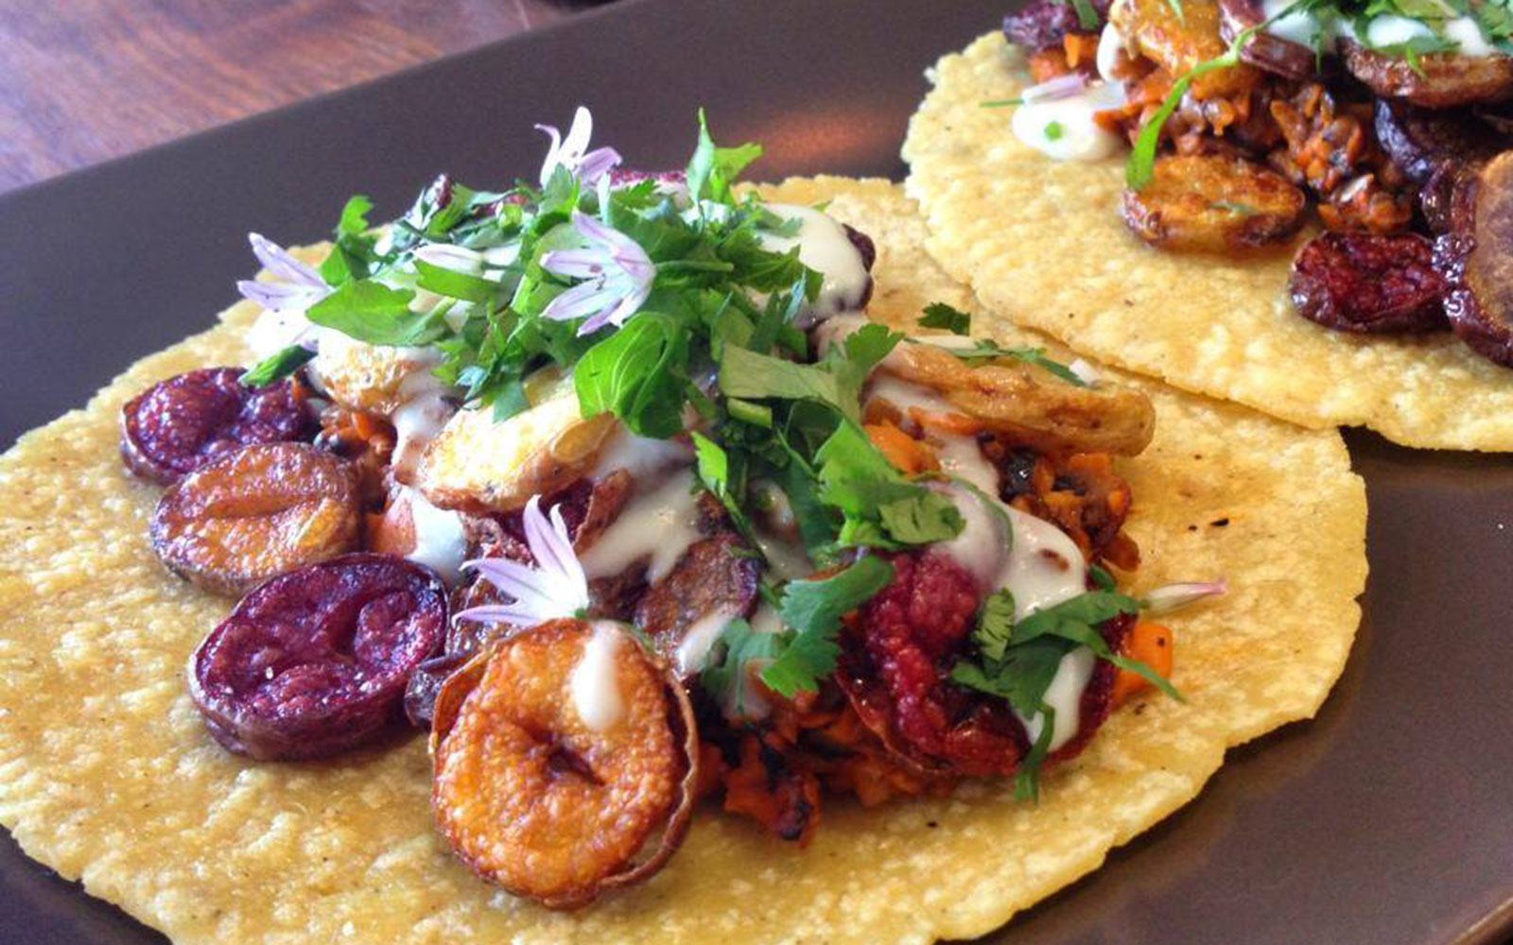
Taco Maria

Slide 7
Questions for discussion
  Do you have a favorite restaurant?
  Do you like to try out new restaurants?
  How do you decide on which restaurant to try out?
  New Vocabulary: Try out
  To try something new for the first time.

Slide 8
Unscramble the sentence (2):
Restaurant try on out want Main Street Vietnamese the I to new.
I want to try out the new Vietnamese restaurant on Main Street.

Slide 9
Idioms are words that take a special meaning different from their original meaning.
“Word of mouth”- to learn about something from another person.
The news spread by word of mouth.

Slide 10
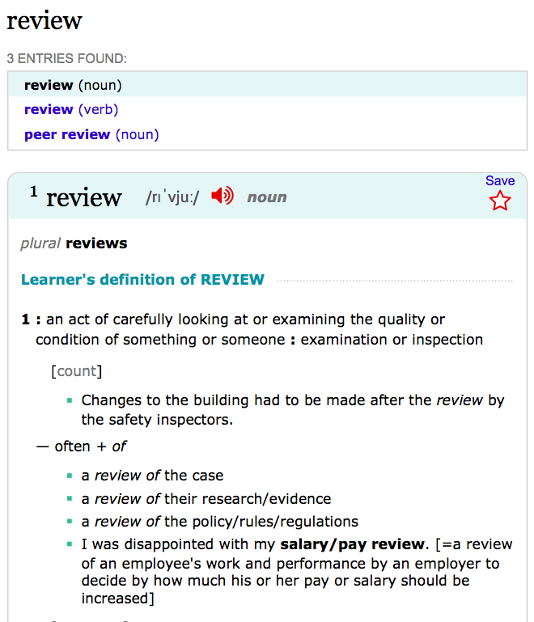
Using an Online
Dictionary

Slide 11
Using Yelp
  Take your smartphones.
  Go to Yelp
  Search for the restaurant ‘Playground’. (It is located in Santa Ana.)
  How many stars does the restaurant have?
  How much does this restaurant cost?
  Does this seem like a good restaurant to visit?
  Discuss answers with your group.

Slide 12
Playground Review:
“Everything about our experience at Playground was great. They had something for everyone, including many vegetarian options. We sat a table by the window. We noticed right away that they had an extensive wine list and a good selection of cocktails. My husband drank a strawberry daiquiri and it made perfectly.
We ordered veggie steam buns as an appetizer. They were really good. The bread was nice and soft, and not overly chewy. We also got a couple of pasta dishes and they were all tasty. They cooked the noodles perfectly and the sauces were yummy without being too heavy. Overall, we had a fantastic experience.
- Sunny S

Slide 13
Use Simple Past Statements to express an action in the past.
Everything about our experience at Playground was great.
  ‘Was’ is the past tense of ‘is’.
To write a sentence in the past tense, you must change the verb to its past tense form. We do this two ways.
  For regular verbs, Add ‘ed’ to the verb – They ‘cooked’ the noodles perfectly.
    ‘Cooked’ is the past tense of ‘cook’.
  For irregular verbs, change the verb to its past tense form. - We ‘got’ a couple of pasta dishes.
    ‘Got’ is the past tense of ‘get’.

