Slide 1
Exercise at a Park
Great Parks for Exercising in Orange County
Beginning Low – Health & Safety

Slide 2
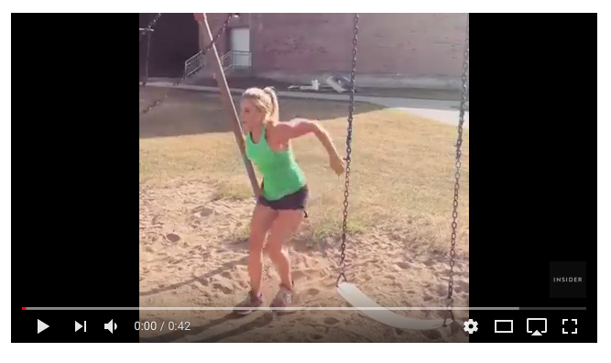
Exercise at Park Video
Park Burpees!

Slide 3
What do people do in the video?
erciesex
exercise

Slide 4
Question:
How can you exercise at the park?

Slide 5
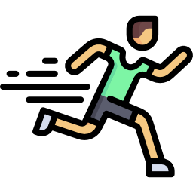
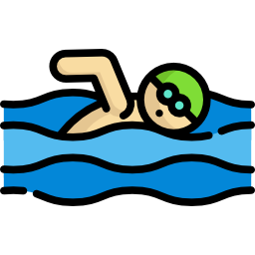
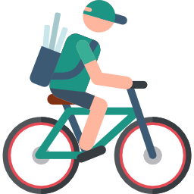

Vocabulary
You can run.
You can swim.
You can ride a bike.
You can hike.

Slide 6
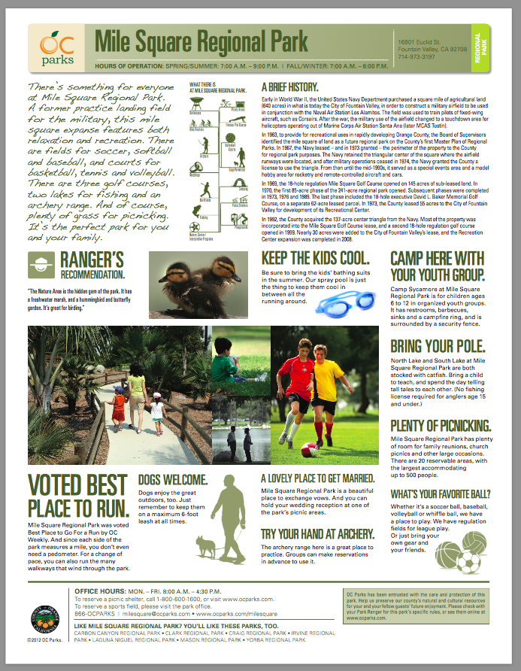
Miles Square Regional Park
Miles Square
Regional Park

Slide 7
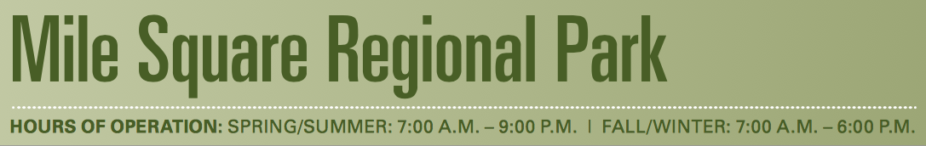

Finding Specific Information

Slide 8
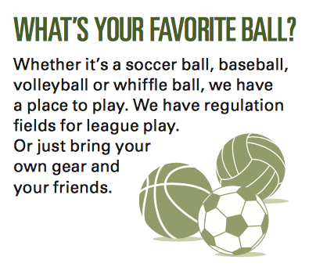
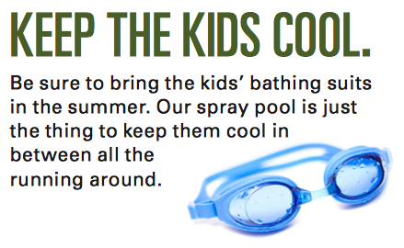
Finding specific information 1

Slide 9
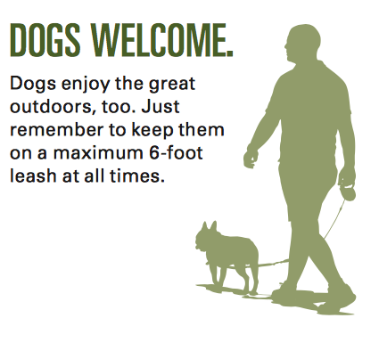

Finding Specific Information 2

Slide 10
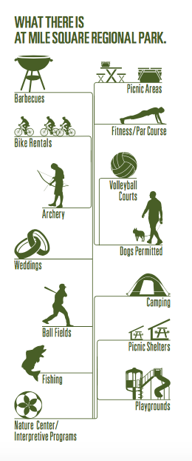
Activity Icons

Slide 11
Can and Can’t
I can swim.
You can swim.
Berta can swim.
Subject + can + base verb.
I can’t swim.
You can’t swim.
Berta can’t swim.
Subject + can’t + base verb.

Slide 12
Questions
  Think of a park you like.
  Write down 3 exercises you can do there.
  Say your sentences to your partner.
  Listen to your partner say their sentences to you.

Slide 13
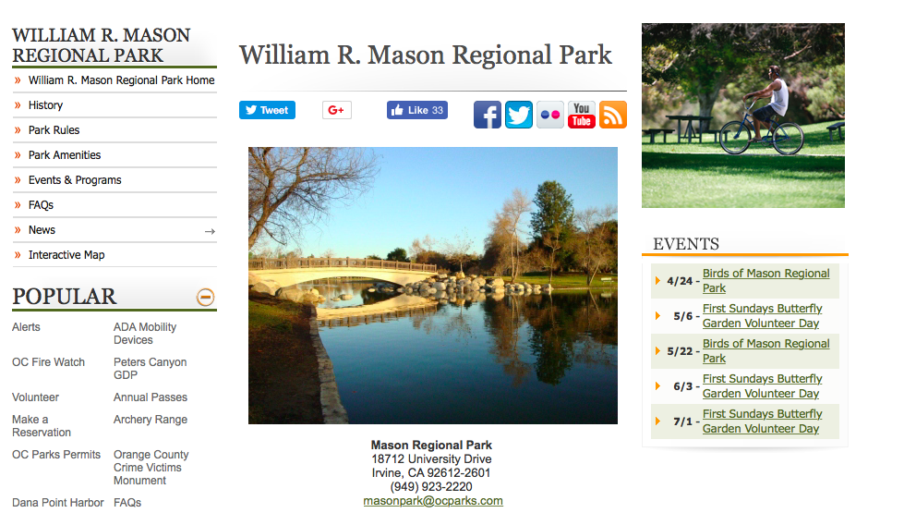
William Mason Park

Slide 14
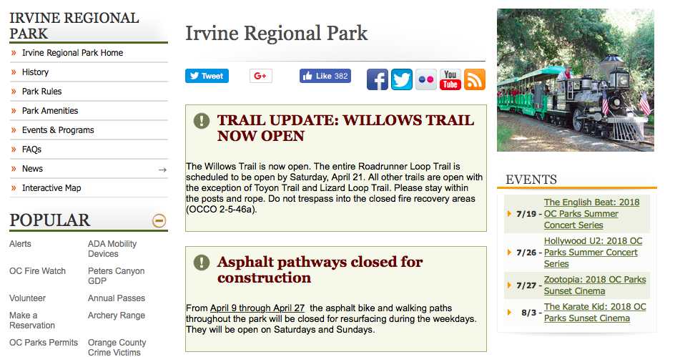
Irvine Regional Park

Slide 15
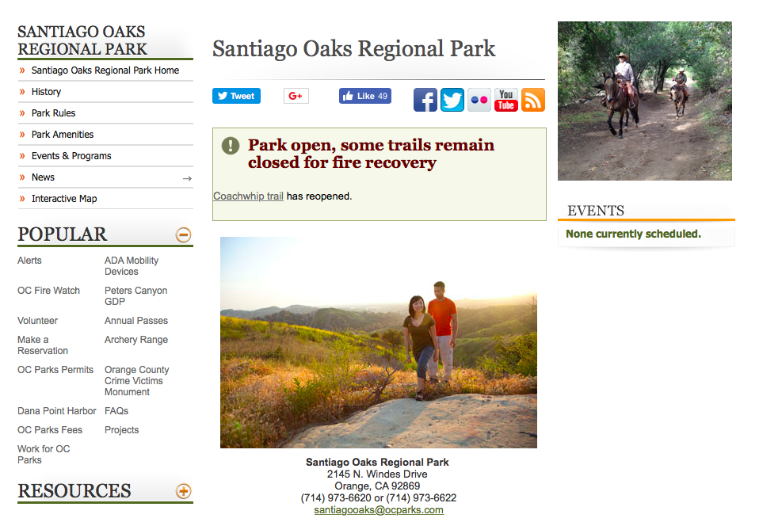
Santiago Oaks Regional Park

Slide 16
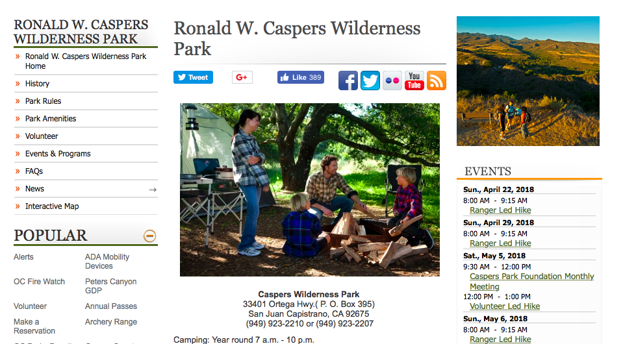
Caspers Regional Park

Slide 17
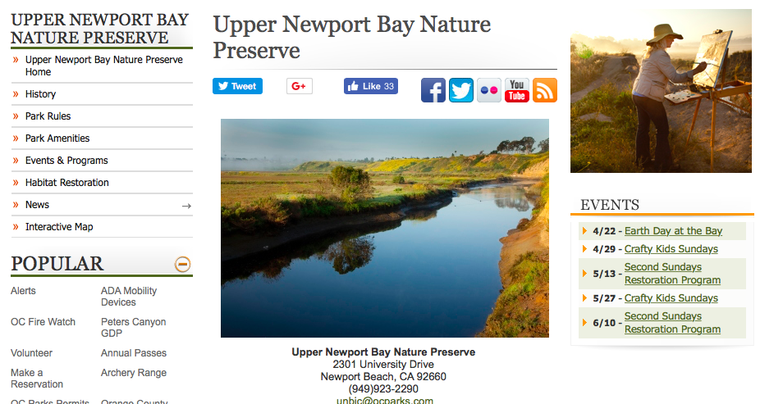
Newport Bay Nature Preserve

