Slide 1
Community
Transportation in Orange County
Beginning Low

Slide 2

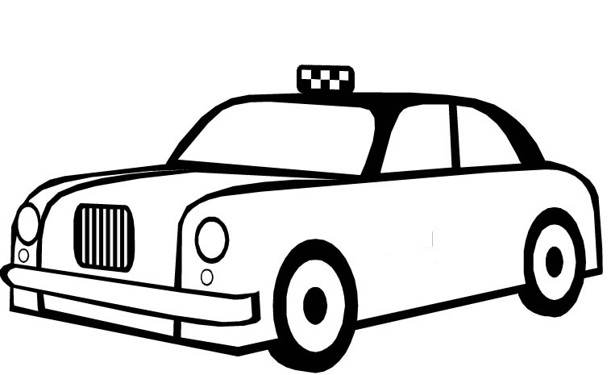

What do you see? What is this?
Bus
Car
Taxi

Slide 3


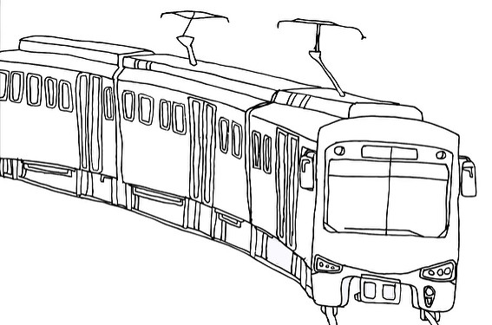

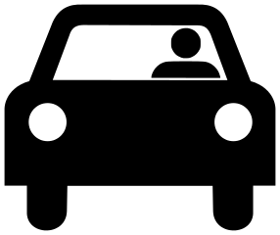
What is this?
Train
Bicycle
Uber/Lyft

Slide 4

Walk
1) I walk to work.
2) I walk to go shopping.
3) I walk to exercise.
Do you walk to work?

Slide 5

Drive a Car
I drive a car to work.
I drive a car to go shopping.
I drive a car to visit friends.
Do you drive a car to work?

Slide 6

Ride a Bicycle
I ride a bicycle to school.
I ride a bicycle in the park.
I ride a bicycle to exercise.
Do you ride a bicycle to school?

Slide 7
Take a Bus
I take a bus to work.
I take a bus to school.
I take a bus to fun places.
Do you take a bus to work?

Slide 8
Take a Taxi/ Take Uber/Lyft
Expensive Inexpensive
Taxi stop or Call Uber/Lyft app
Pay in person Pay on the app

Slide 9
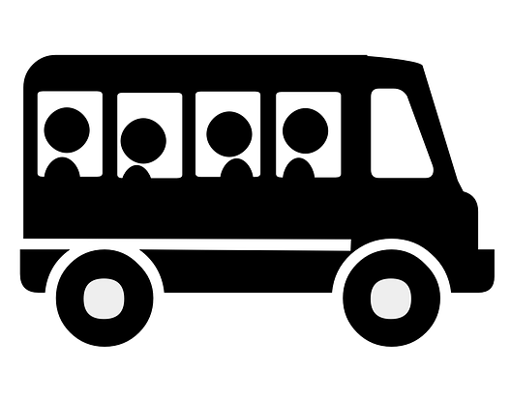
Use a Vanpool
I use a vanpool.
I save money.
I save time.

Slide 10
Take a Train/ Metrolink
I buy a ticket to take the train.
I take a train to work.
I take a train to school.
Do you like Metrolink?

