Slide 1
What is it?

Slide 2
Do you like to attend performances for entertainment in your free time?

Slide 3
Do you like to attend dance or musical performances?

Slide 4
Do you like ballet?

Slide 5
Do you like jazz music performances?

Slide 6
Do you like to attend museums?

Slide 7
Do you like classical music concerts or festivals?

Slide 8
Do you enjoy visiting art galleries?

Slide 9
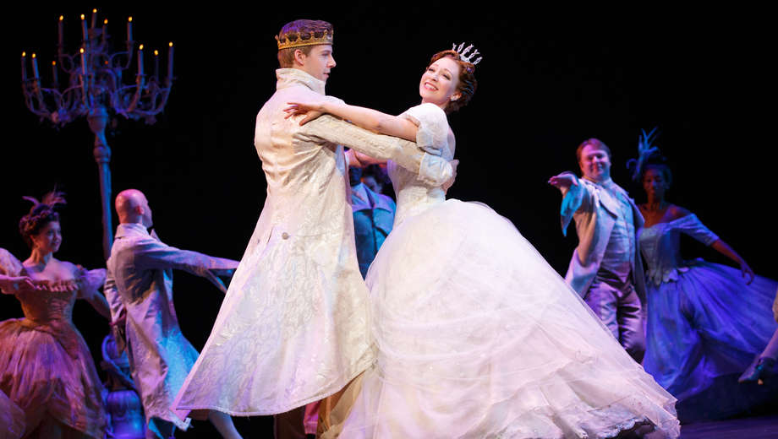
CULTURAL EVENTS IN ORANGE COUNTY CINDERELLA AT THE SERGESTROM CENTER (https://youtu.be/KxLb4px3Q5U)

Slide 10
Cultural events
Have you seen this performance before?
What type of performance is it?
Do you enjoy this type of performances?
Where can you see these types of performances ?
Do you recognize the venue?
Have you ever been to Segerstrom Center for the Arts?

