Slide 1
Where to get legal help
Different types of law professions.

Slide 2
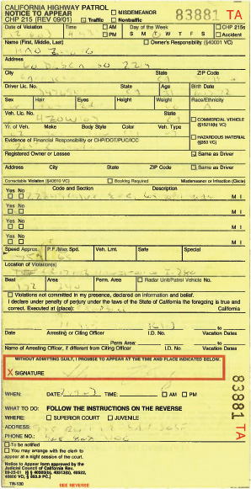
Traffic Ticket!
You got a traffic ticket and need help.
Where can you get help?

Slide 3
Who can help you?
Usually, you don’t need an attorney for a traffic ticket, but if you get arrested during a traffic stop, you may need to go to court with your lawyer.
How do you know who is the right person?

Slide 4
Attorney
In the United States attorneys or lawyers are people who have gone to law school and have law degrees.
There are many types of lawyers and attorneys that can help with different cases, such as, immigration attorney, tax attorney, criminal attorney, etc.

Slide 5
How can I find an attorney?
The first thing you need to know is if he is certified and in good standing.
To check for this, you can look them up in The State Bar of California website.
We found our attorney, now let’s write a letter and ask for help from our new attorney.

Slide 6
Other Professions in Law
There are many other professions in law, but they are different than attorneys, such as:
  Notary Public - Public Defender
  Legal aid worker - Mediator
  Law clerk - Prosecutor
  Legal secretary - Court clerk
  Legal assistant - Paralegal
  Court reporter - Court administrator
  Court Interpreter - Legal videographer

