Slide 1

Kids Smiling

Slide 2
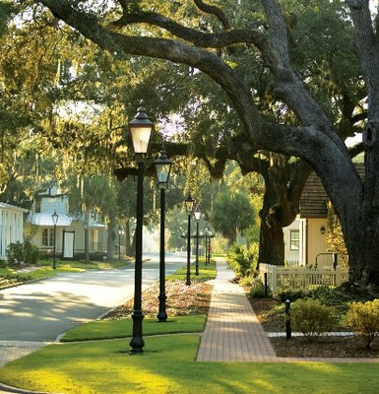
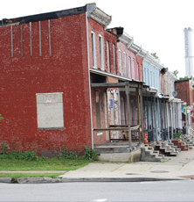
Compare the photos
1.
2.

Slide 3
Context:
Meaning One:
the words that are used with a certain word or phrase and that help to explain its meaning.
Meaning Two:
the situation in which something happens : the group of conditions that exist where and when something happens

Slide 4
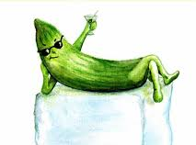

Cool as a Cucumber

Slide 5
Tale of Two Cities – Sample Answer
Where you live is about more than your address. It is about opportunities.” (1:04 seconds)
Meaning:
  “Your home is more than just a place where you and your family stay. Your home is your community. And different communities have different opportunities.”
  Context clues from the video that helped you understand the meaning:
- The video show that Deb has healthy food options.
- It shows the healthy air that Deb can breathe
- It shows that there are parks where Deb lives.
- Where Maria lives, things look different.
- It shows broken beer bottles.
- It shows trucks and pollution.
- Everything looks dark depressing.

Slide 6
Building Healthy Communities
Building Healthy Communities (BHC) is a 10 year, $1 billion comprehensive community initiative launched by The California Endowment in 2010 to advance statewide policy, change the narrative, and transform 14 of California’s communities devastated by health inequities into places where all people and neighborhoods thrive.
Click the here to see the 14 cities!

Slide 7
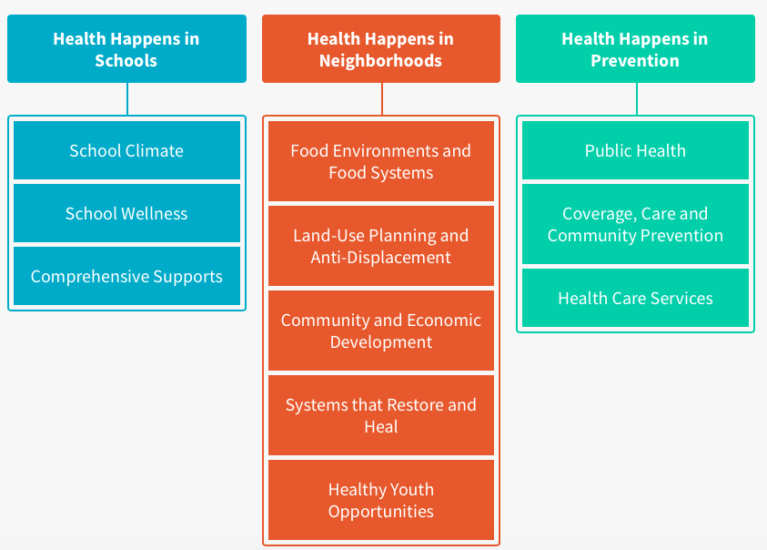
Santa Ana Focus Areas
Santa Ana Focus Areas

Slide 8
References:
Picture 1 retrieved from LA Parent (http://www.laparent.com/events/cultural-diversity-days/)
Picture 2 retrieved at CMCF
(http://cmcf.org.my/6-things-to-consider-before-moving-to-a-new-city-for-that-job/)
Picture 3 retrieved at HUD User (https://www.huduser.gov/portal/periodicals/em/winter11/highlight2.html)
Picture 4 retrieved atBank Lawyers Blog (http://www.banklawyersblog.com/.a/6a00d8341c652b53ef0128760b4e13970c-popup)
Picture 5 retrieved at Red Sox Life (http://www.redsoxlife.com/2013/06/cool-as-cucumber.html)
Image on Slide 6 retrieved at Calendow (http://www.calendow.org/building-healthy-communities/)
Slideshow Author: Jennifer Hoeger, 2018

