Slide 1
Emergency Alerts in Orange County
*
Completing
Online Forms
Health & Safety – Intermediate Low

Slide 2
Scrambled Words
lainfCorai
California

Slide 3


Brainstorm definition
brain
+
storm

Slide 4
Brainstorming Rules
Write down anything that comes to your mind associated with the word or picture you see.
Don’t worry about spelling or writing your answers in full sentences.
Go wherever your brain takes you.
There are no wrong answers.

Slide 5
Research Time!
  Work with your partners to answer the following questions about Alert OC:
    What is Alert OC?
    What does Alert OC notify users about?
    Where do users receive messages from Alert OC?
You have ten minutes to complete the activity.

Slide 6
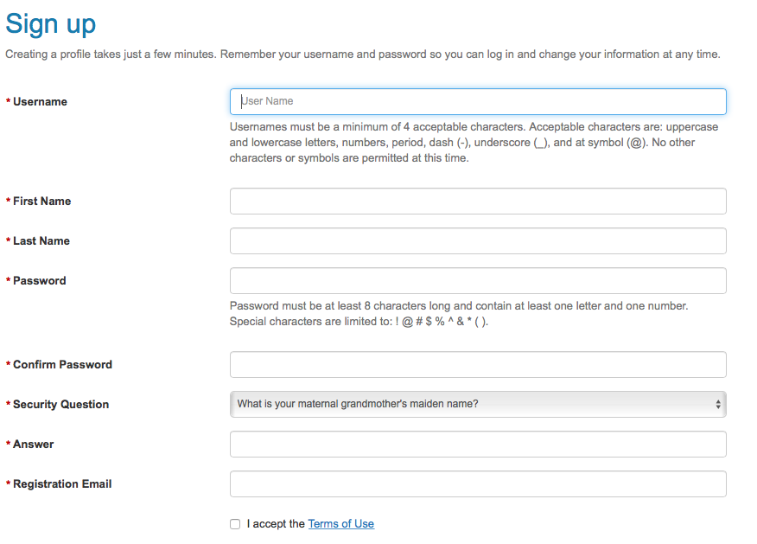
Screen shot of sign up page

Slide 7
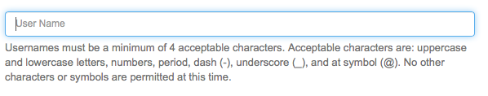


Special Instructions for Usernames
Usernames must be a minimum of 4 acceptable characters. Acceptable characters are: uppercase and lowercase letters, numbers, period, dash (-), underscore (_), and at symbol (@). No other characters or symbols are permitted at this time.
LR
Linda!
Linda_Rose$
LRose
LRoseSAC17
Linda_Rose
*Bonus Question – Do you know who Dr. Linda Rose is?

Slide 8
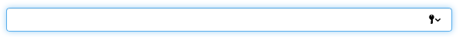
Special Instructions for Passwords
Password must be at least 8 characters long and contain at least one letter and one number. Special characters are limited to: ! @ # $ % ^&* ( ).
apr2604
Apr262004?
6109526813
apr262004
Apr262004!
6109526813A

Slide 9
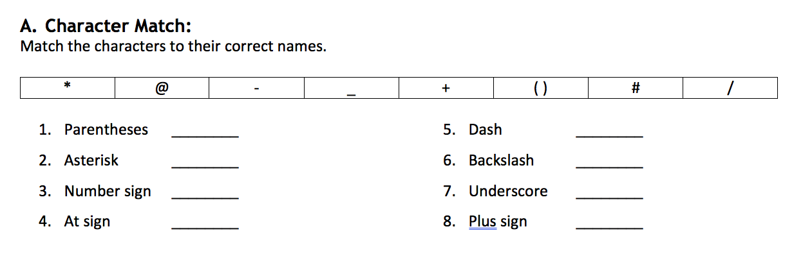
Worksheet screenshot

Slide 10
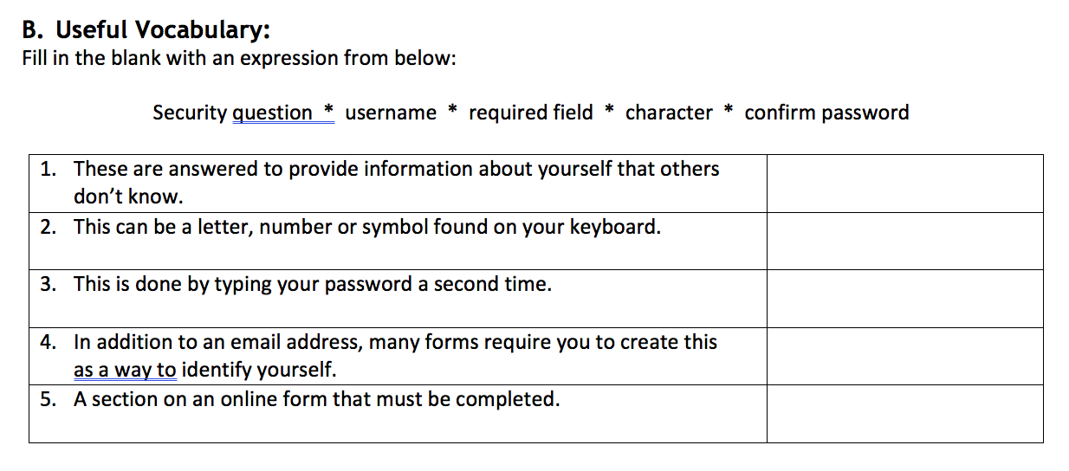
Worksheet Screenshot 2

Slide 11
Sample Security Questions
What is your maternal grandmother’s maiden name?
What is the city or town where your mother and father met?
What is the name of your favorite childhood friend?
What is the city or town where you met your spouse/significant other?
Where was your first job?
What school did you attend in sixth grade?
What was your childhood nickname?
What street did you live on in third grade?
What was the name of your favorite pet or stuffed animal?
What was the last name of your favorite teacher?
What is the city or town of your birth?

