Slide 1
Do You Know These Words?

Slide 2

Add-on
An extra part that can be added to something.
I can use a mouse as an add-on to my computer.

Slide 3
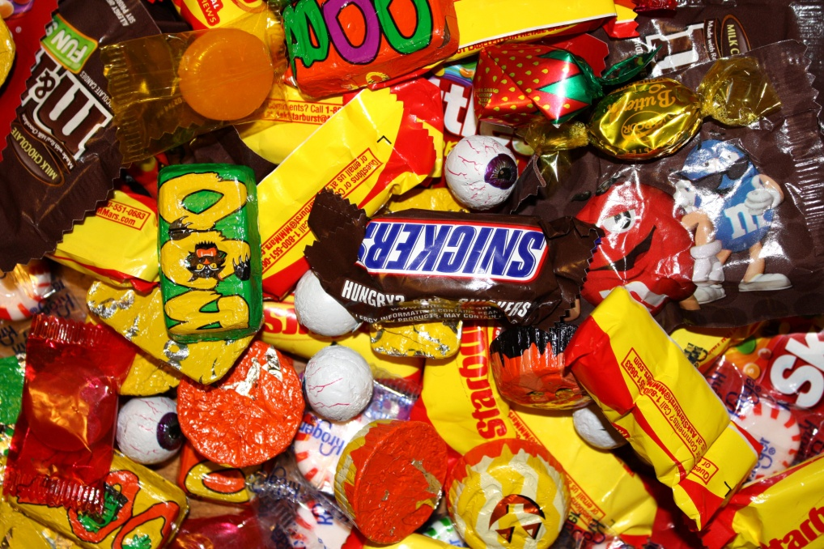
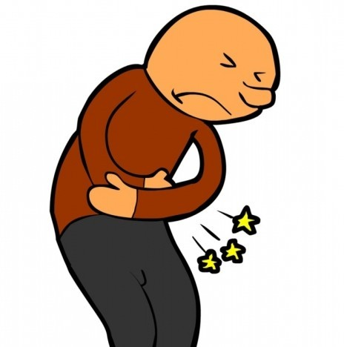
Consequences
The result of your actions.
The consequence of eating too much candy is a stomachache!

Slide 4
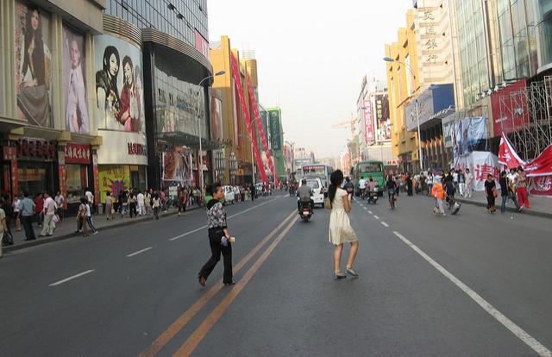
Jaywalking
Crossing the street where cars usually do not stop.
Although dangerous, jaywalking is very common in big cities.

Slide 5
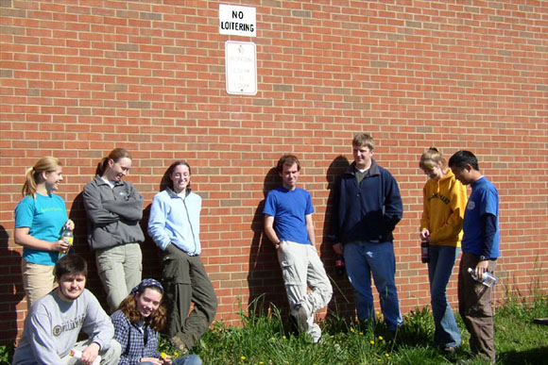
Loitering
To stand or stay in an area for no reason.
Students often loiter in the parking lot after classes are over.

Slide 6
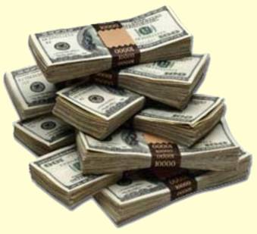
Monetary
Money
The monetary value of that vase is $15.

Slide 7
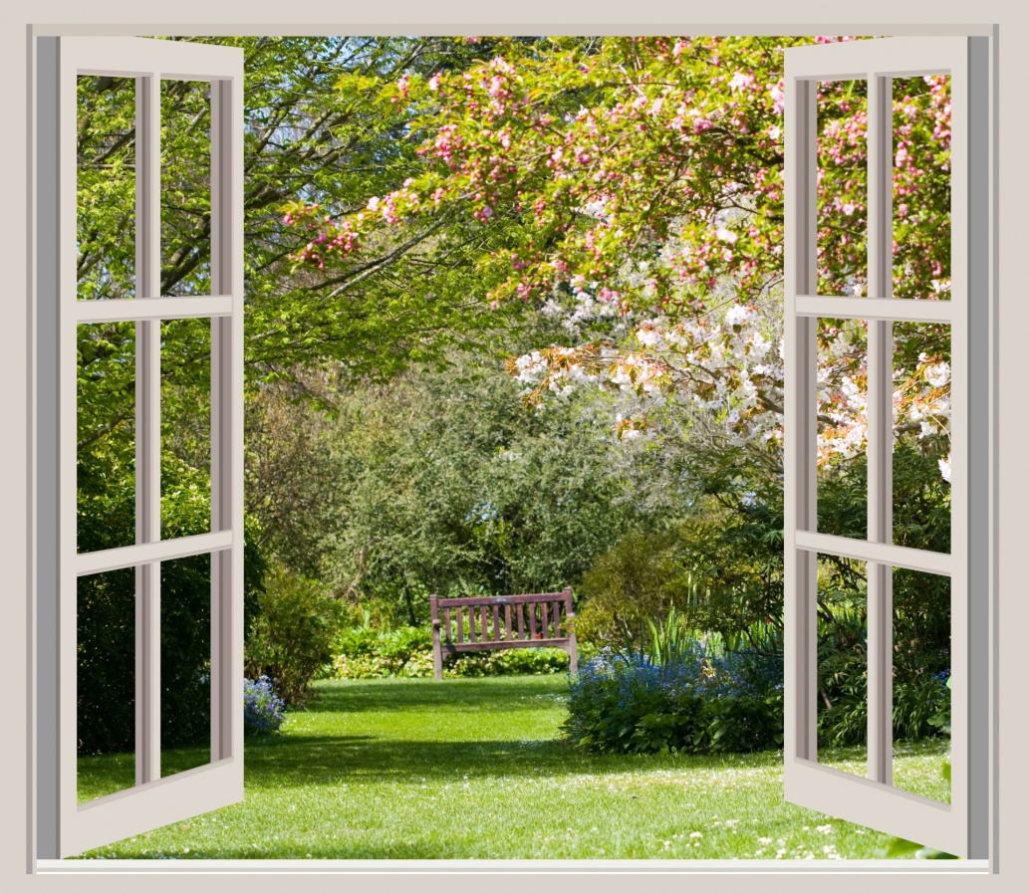
Proportional
Correct size or amount.
The window was too big for that room. It was not proportional to the size of the room.

Slide 8
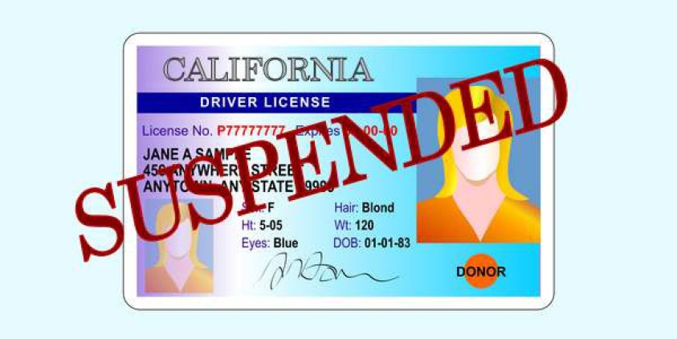
Suspend
To officially stop something for a short time.
His driver’s license was suspended because he didn’t pay his ticket.

Slide 9
Resources:
All pictures courtesy of Microsoft clipart
Suspended license: Click for resource

