Slide 1
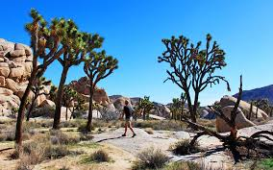
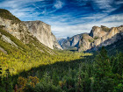
Best National and State Parks in
CALIFORNIA

Slide 2
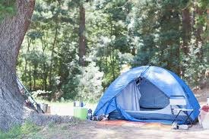
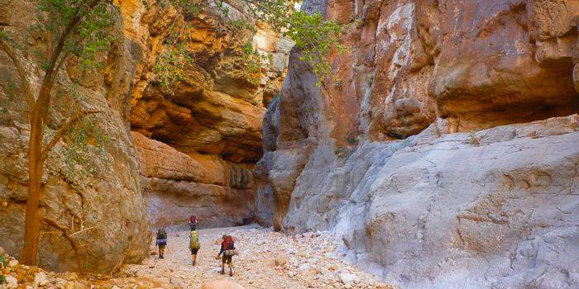
What outdoor activities do you like to do?

Slide 3
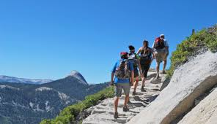
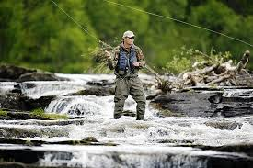
Do you enjoy hiking, fishing and swimming?

Slide 4
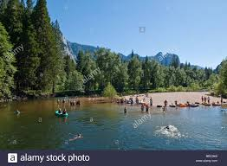
Do you like to camp?

Slide 5
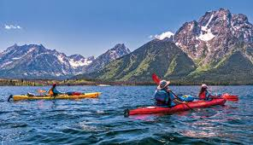
Do you like kayaking?

Slide 6
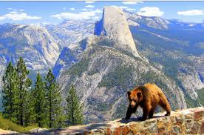
Do you like to watch wildlife?

Slide 7
12 Best National Parks in California
Do these places look familiar to you?
Have you been to any of these national parks ?
What national and state parks do you know?
What nature spots do you prefer to visit?
If you decide to go to one of these national parks, what would you do there?

Slide 8
NATIONAL PARKS IN CALIFORNIA
Death Valley National Park
Desert

Slide 9
JOSHUA NATIONAL PARK (140 MILES EAST OF LOS ANGELES)

Slide 10
SEQUOIA AND KINGS CANYON NATIONAL PARK

Slide 11
PINNACLES NATIONAL PARK
(CENTRAL CALIFORNIA)

Slide 12
POINT REYES NATIONAL SEASHORE (NOTHERN
CALIFORNIA)

Slide 13
LASSEN VOLCANIC NATIONAL PARK

