Slide 1
Healthy Foods
Literacy – Health & Safety

Slide 2
Santa Ana
Supermarkets

Slide 3
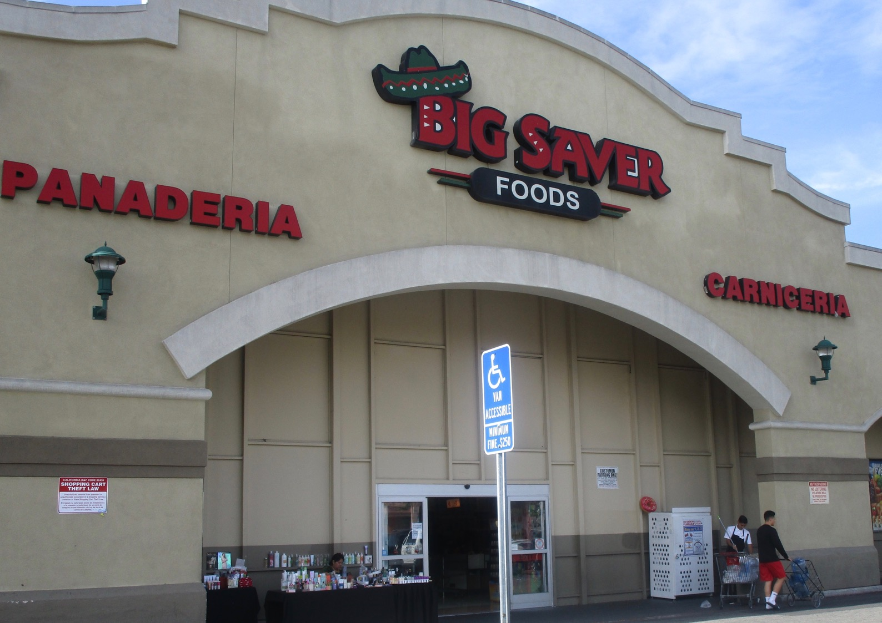
Big Saver Supermarket

Slide 4
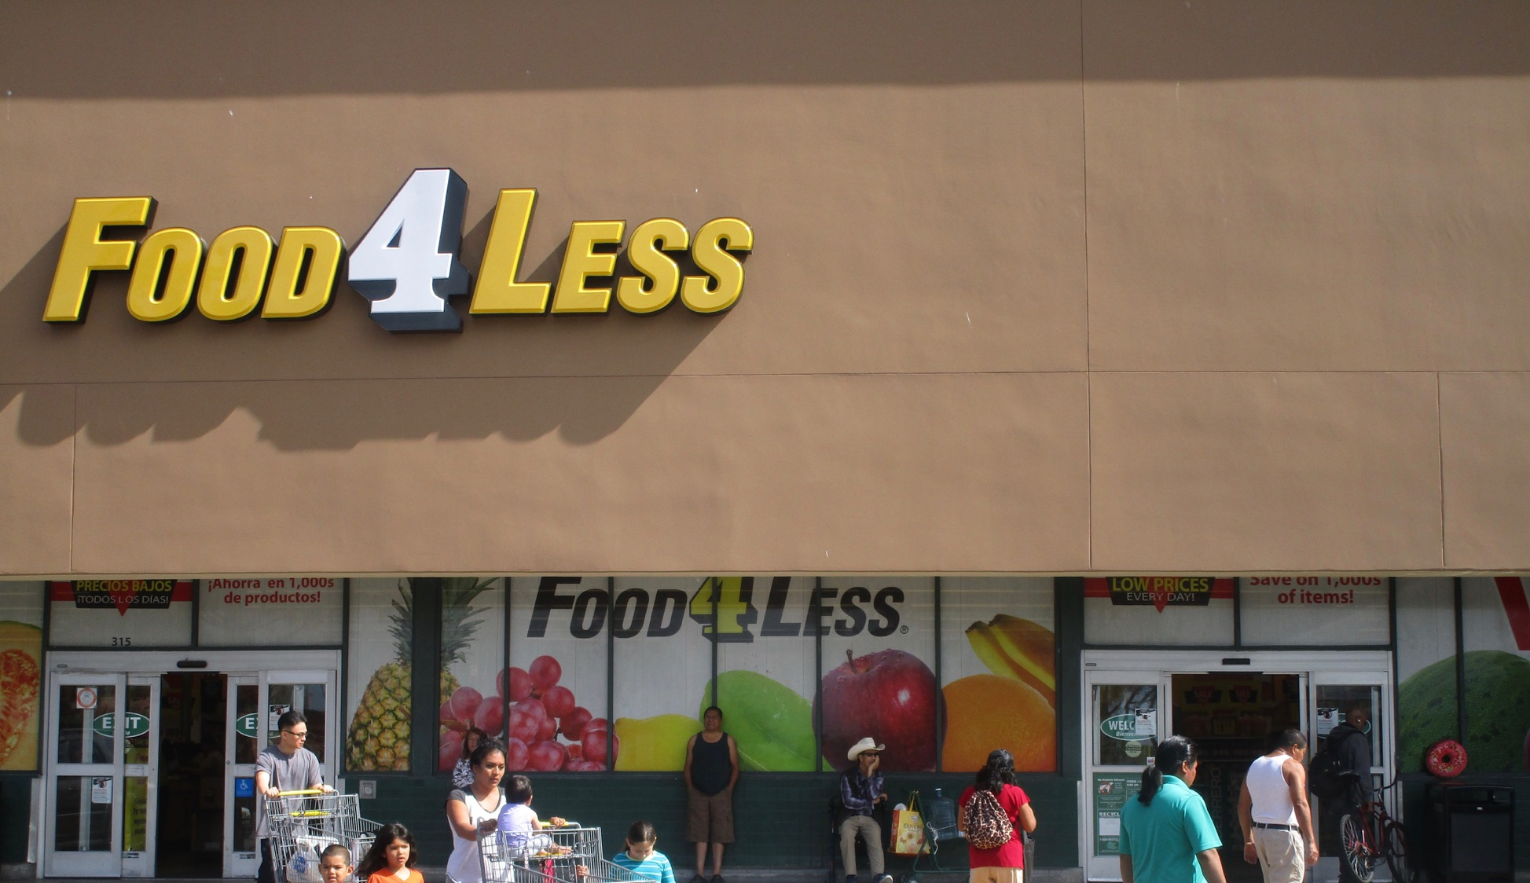
Food For less Supermarket

Slide 5
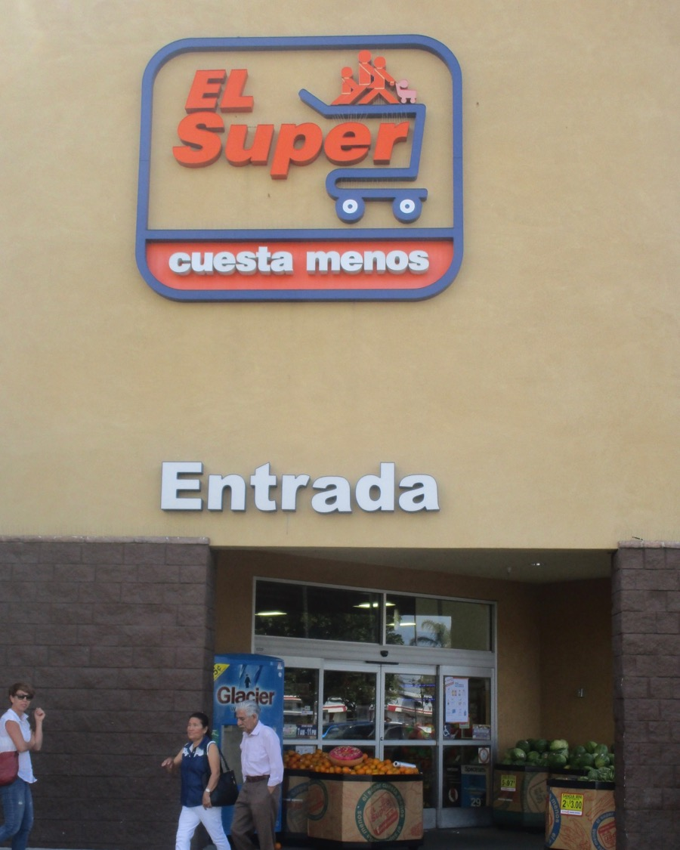
El Super Supermarket

Slide 6
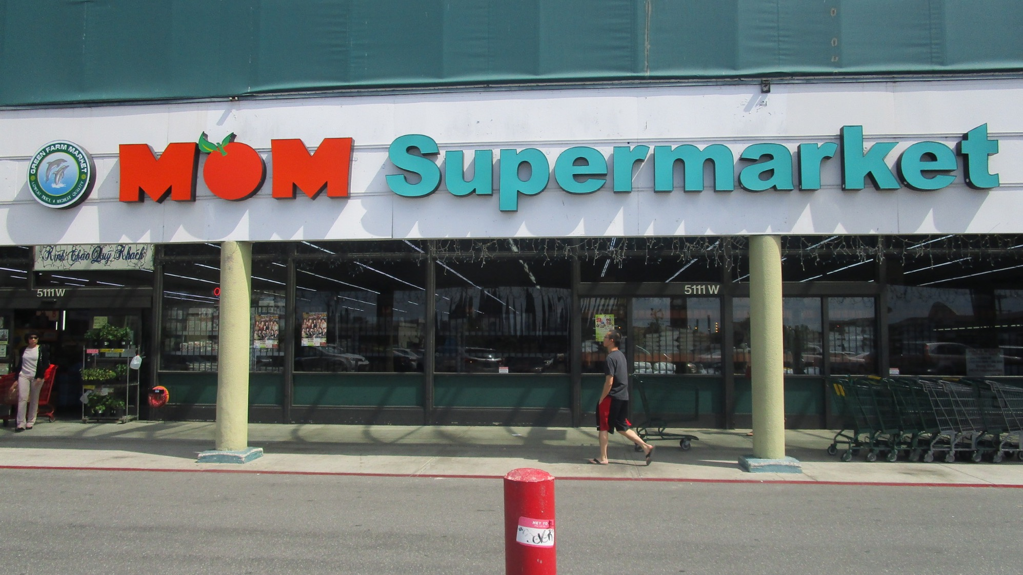
Mom’s Supermarket

Slide 7
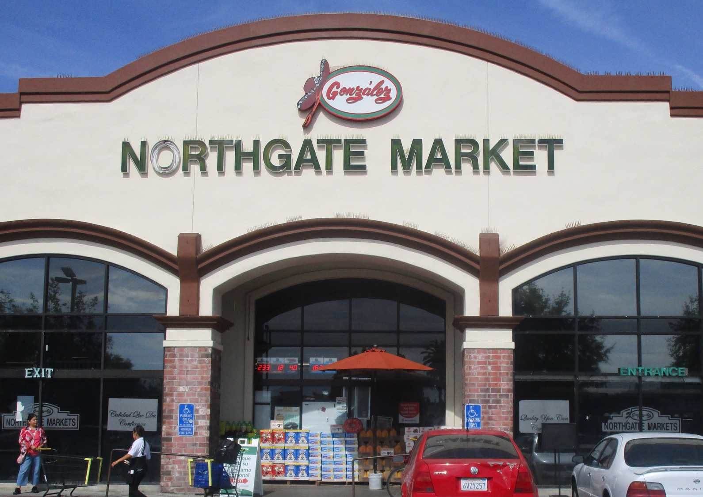
Northgate Supermarket

Slide 8
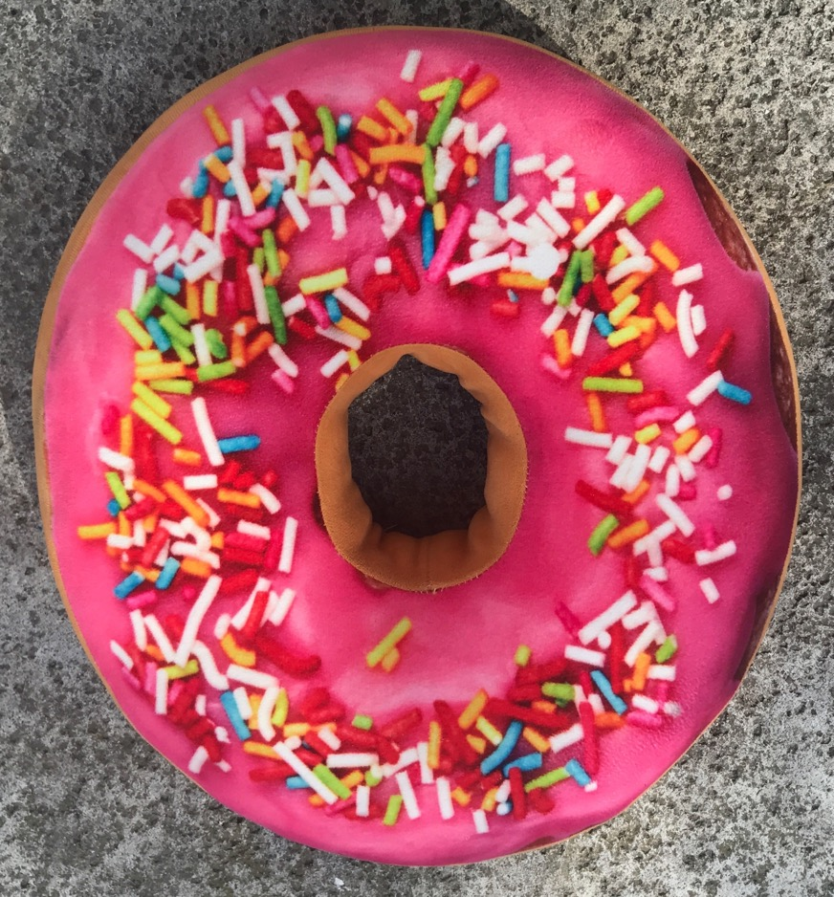
Where is the donut?

Slide 9
Foods at the supermarket

Slide 10
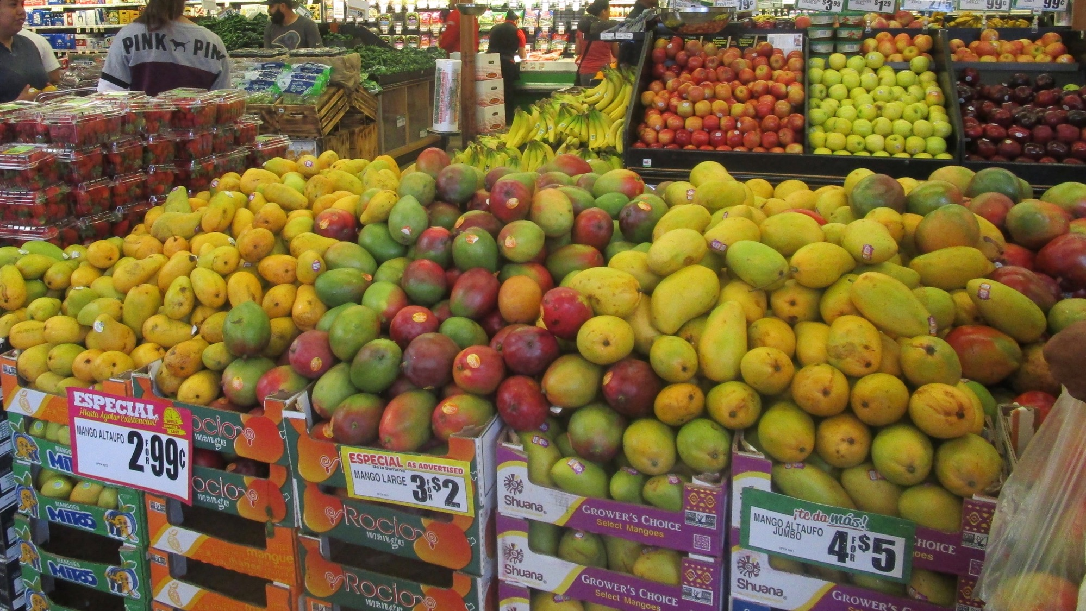
Fruit

Slide 11
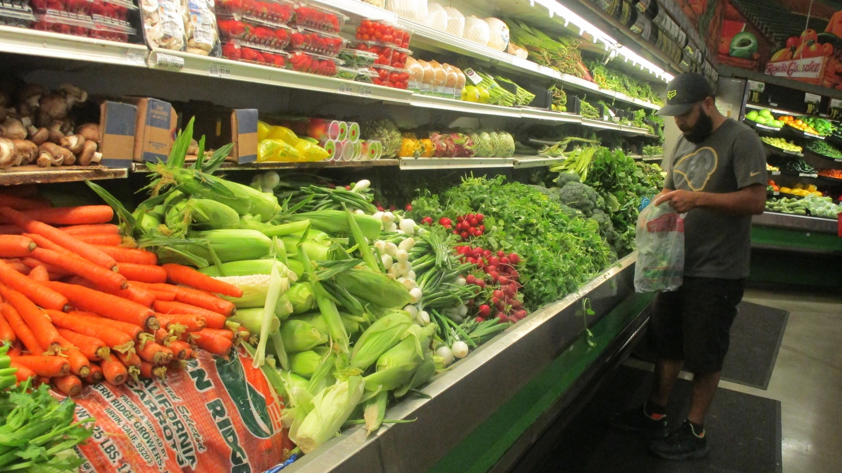
Vegetables

Slide 12
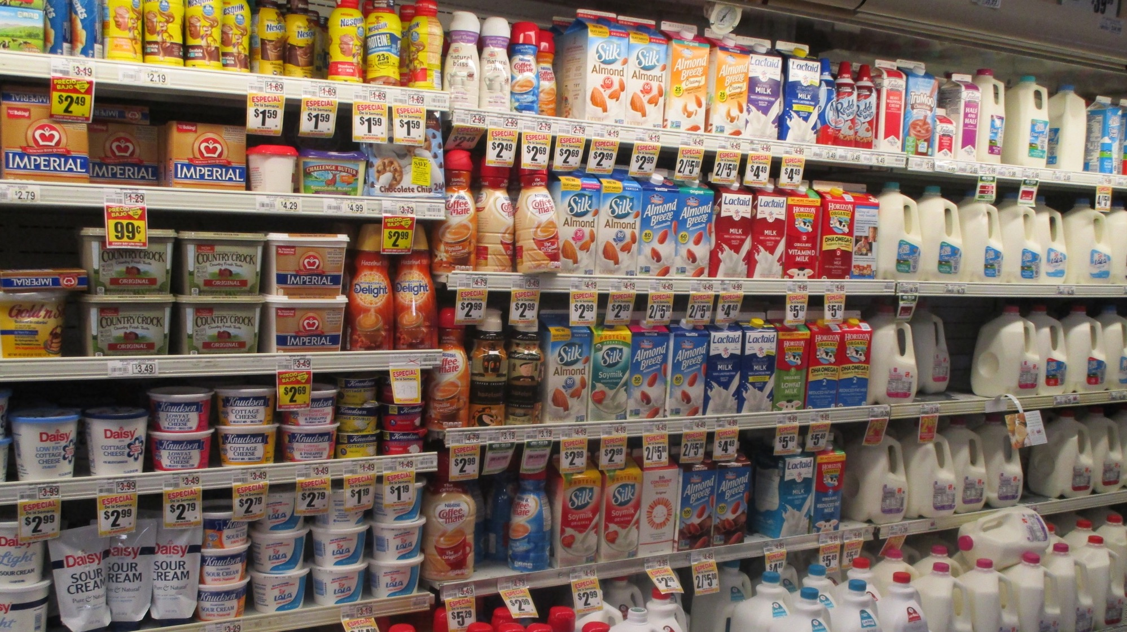
dairy

Slide 13
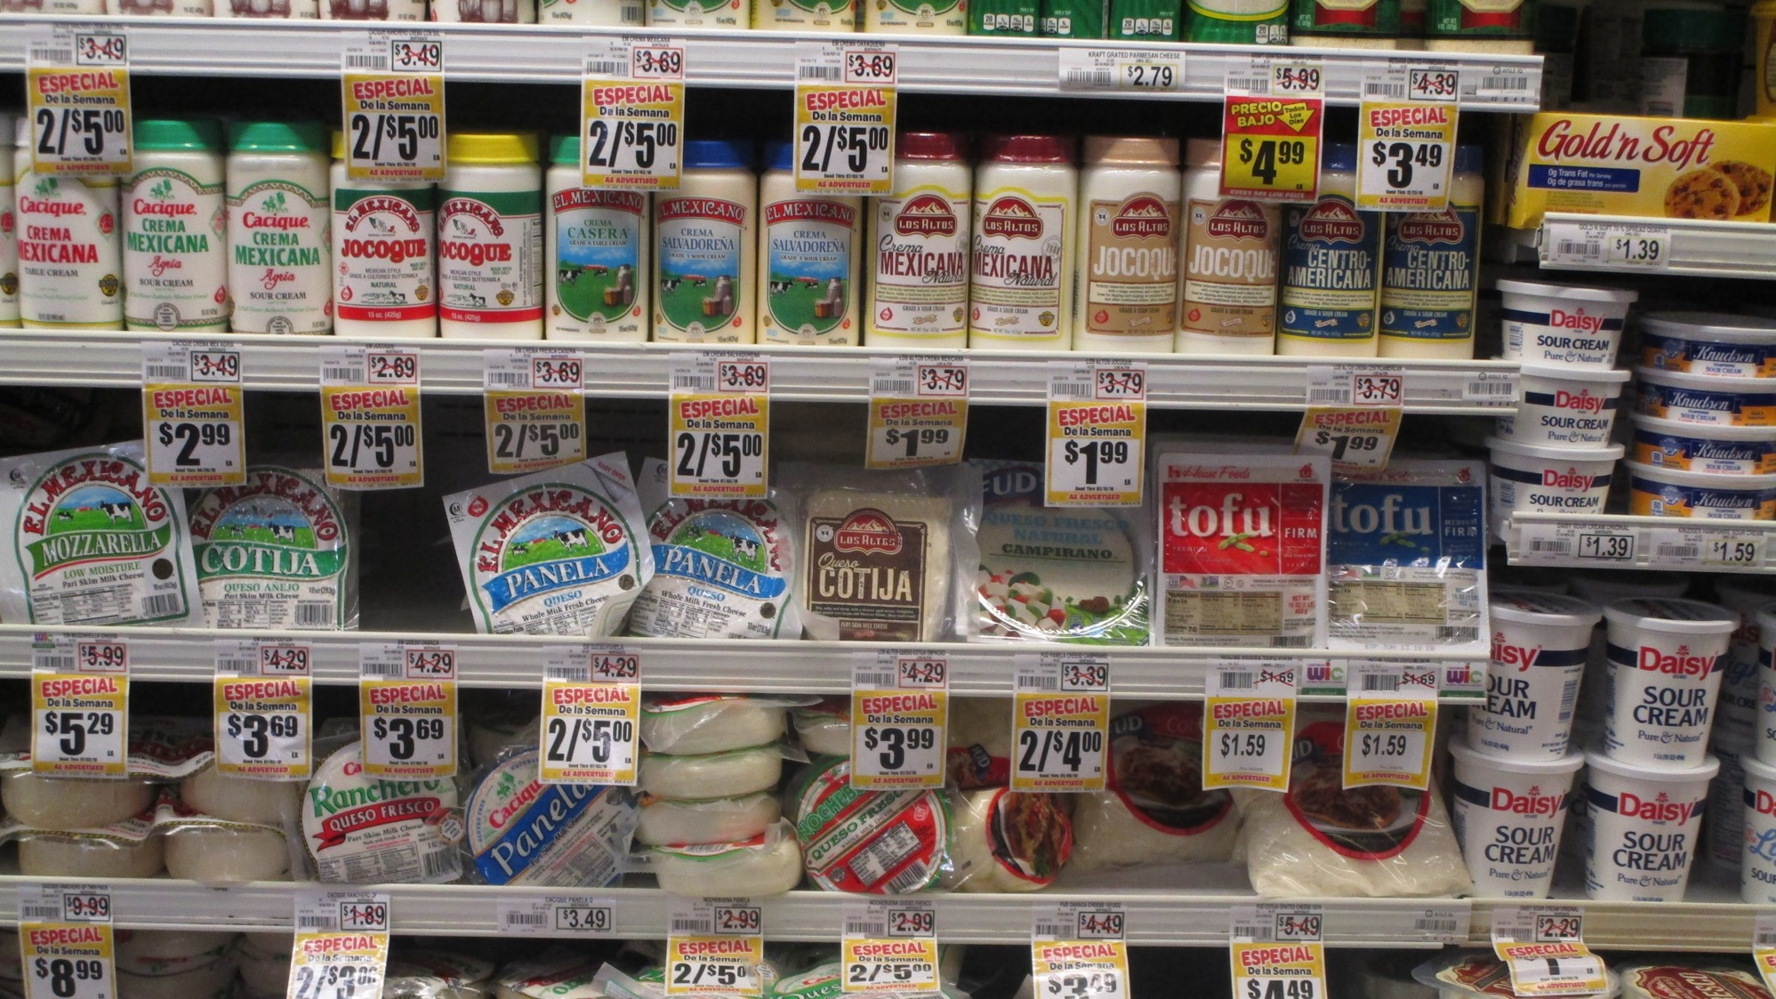
Cheese and sour cream

Slide 14
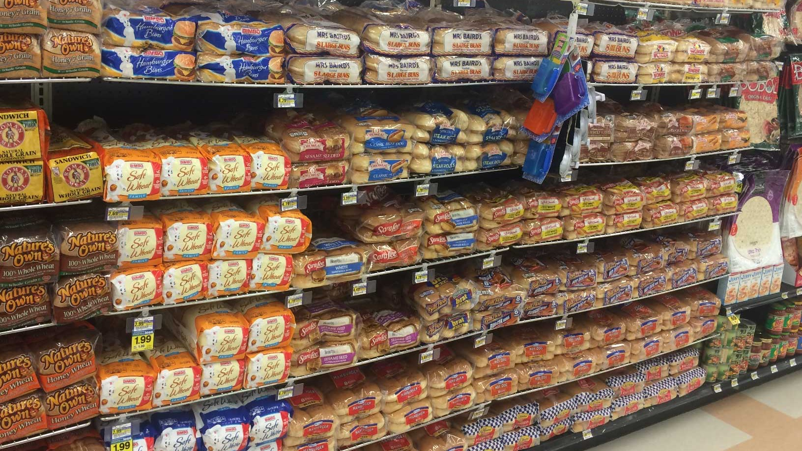
Bread

Slide 15
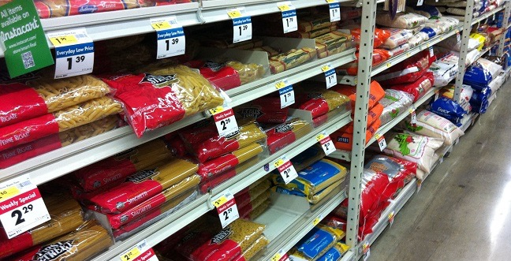
Pasta

Slide 16
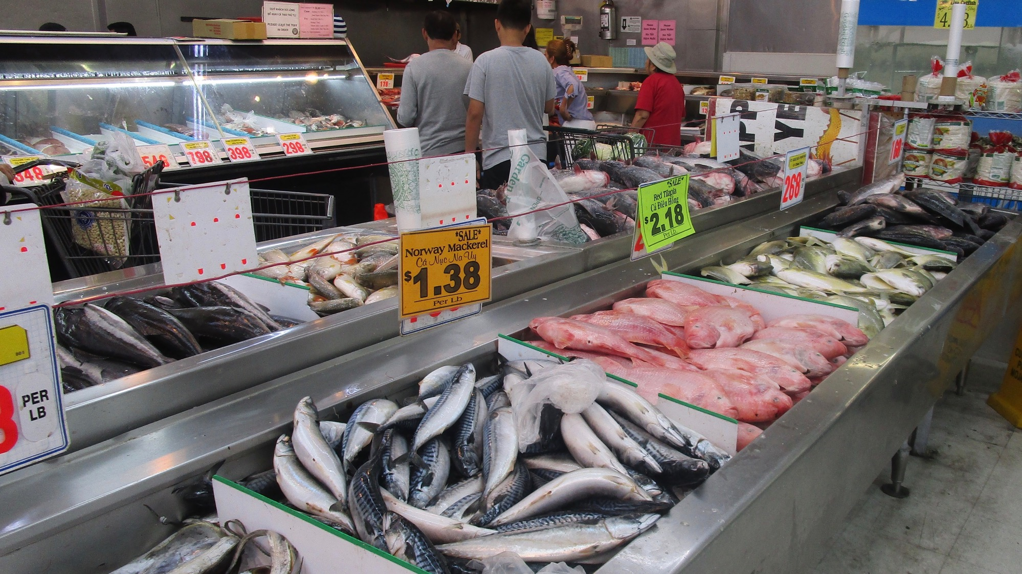
Fish Department

Slide 17
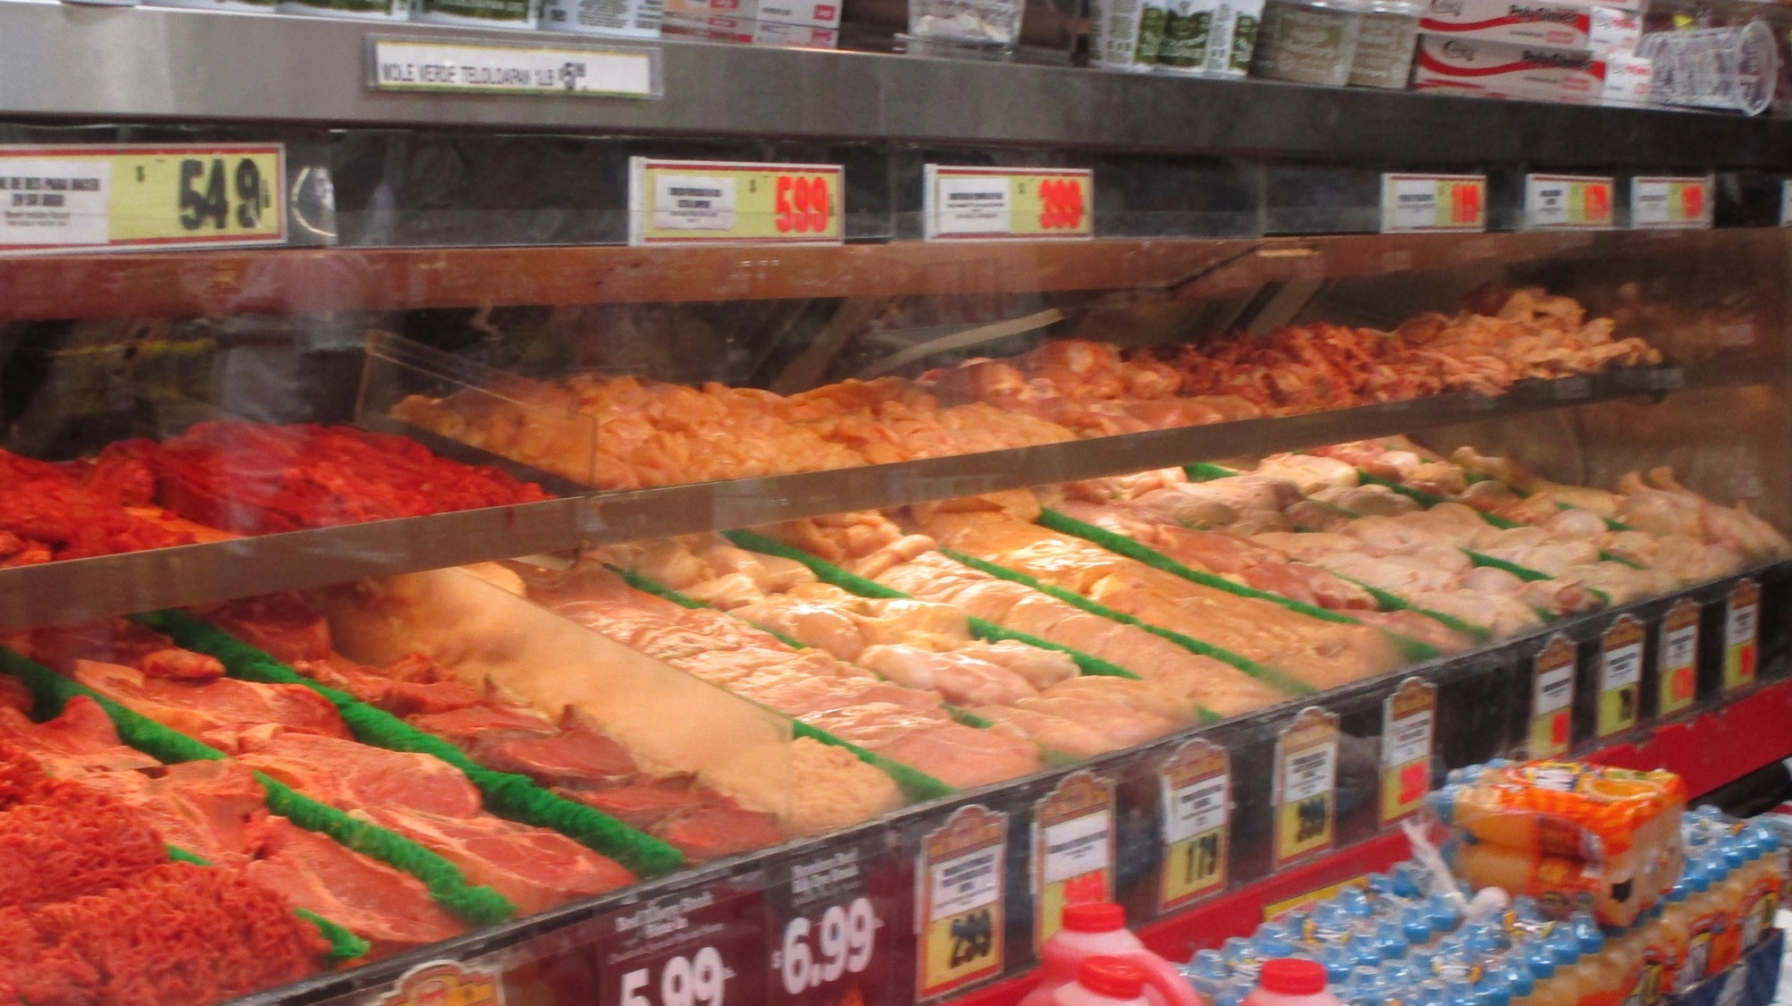
Meat Department

Slide 18
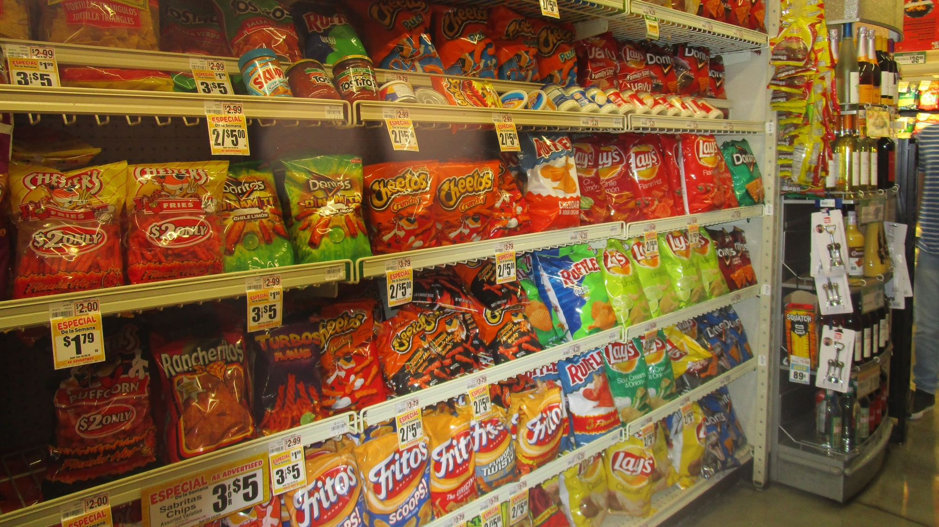
Junk Food

Slide 19
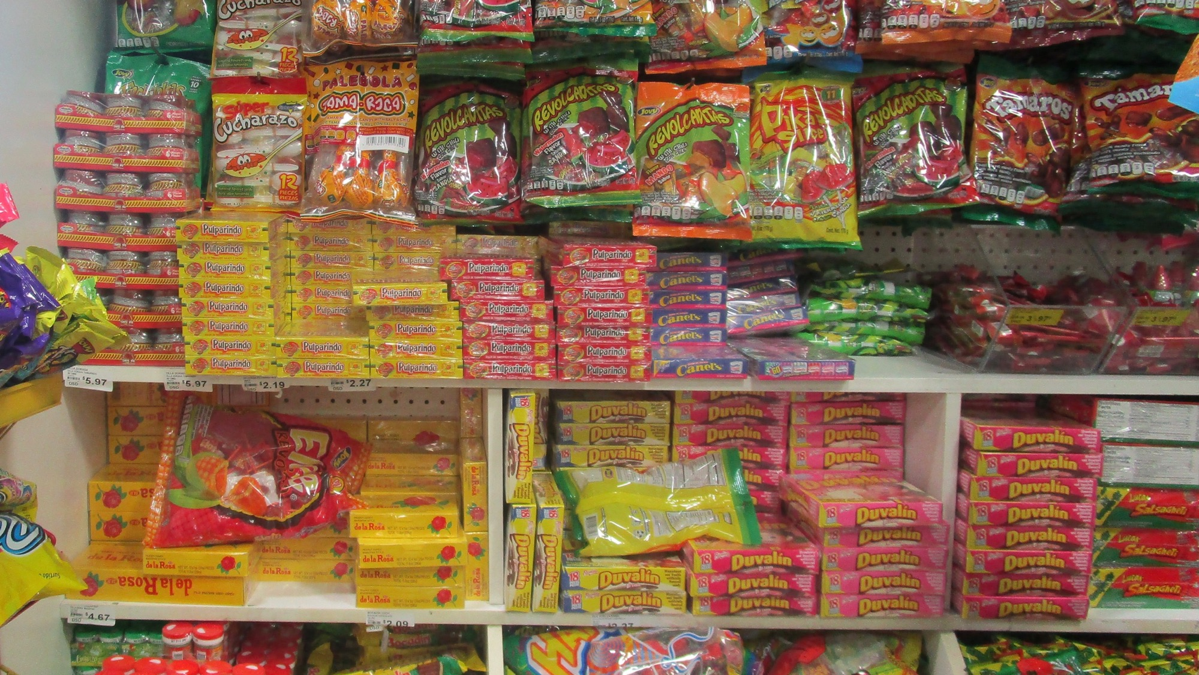
Candy

Slide 20
Food Groups

Slide 21
Food Groups Overview

Slide 22
Dairy Food Group

Slide 23
Vegetable Food Group

Slide 24
Fruit Food Group

Slide 25
Grains

Slide 26
Proteins

Slide 27
Junk Food Food Group☺

Slide 28
Healthy or Unhealthy?

Slide 29
Mangoes

Slide 30

Healthy
healthy

Slide 31
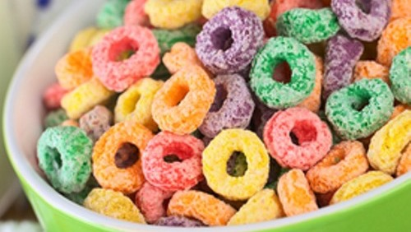
Sugar Cereal

Slide 32
Unhealthy
unhealthy

