Slide 1
Job Titles and Images
Employment Literacy
Song Hong

Slide 2

http://ecedtoday.wikidot.com/start

Slide 3

https://openclipart.org/detail/219622/shiny-bbq-tools

Slide 4
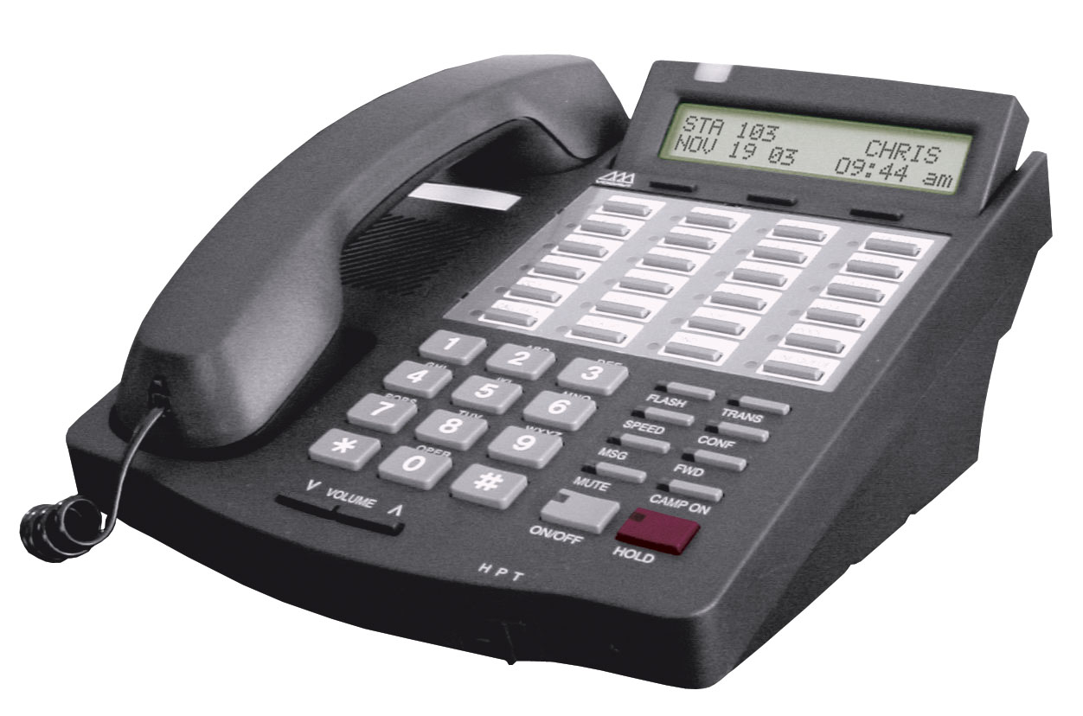
http://utcbangalore.blogspot.com/2013/06/utc-phone-numbers-and-intercom.html

Slide 5

http://www.bubblybear.co.uk/services/

Slide 6

http://healthinformatics.wikispaces.com/Logical+Observation+Identifiers+Names+and+Codes+-+LOINC

Slide 7

https://openclipart.org/detail/168575/safety-helmet

Slide 8

http://computercartschedule.wikispaces.com/

Slide 9
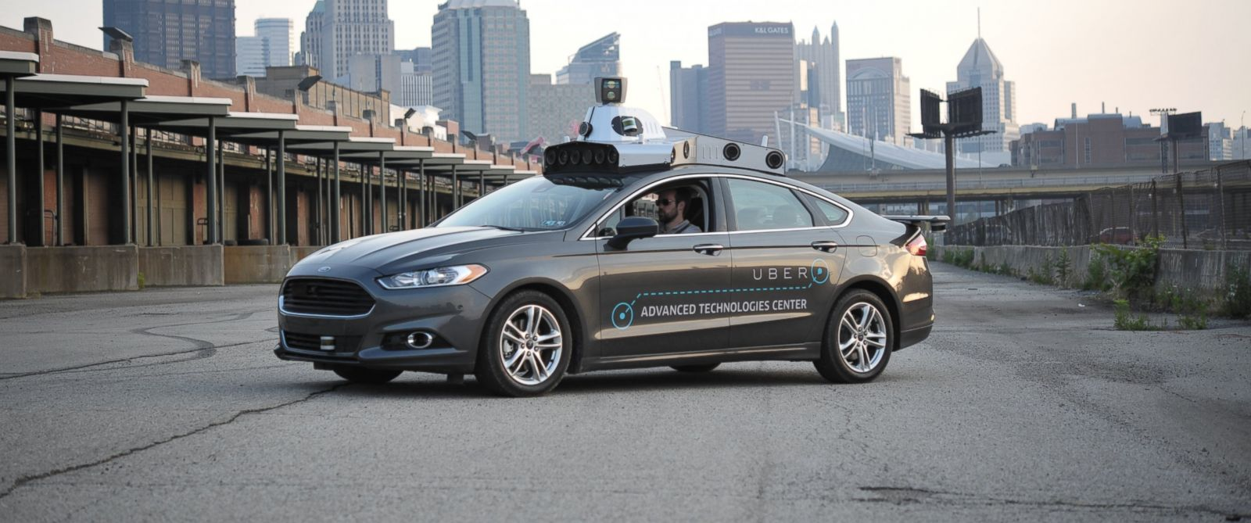
https://futurism.com/welcome-to-the-future-of-driving-are-you-ready/

