Slide 1
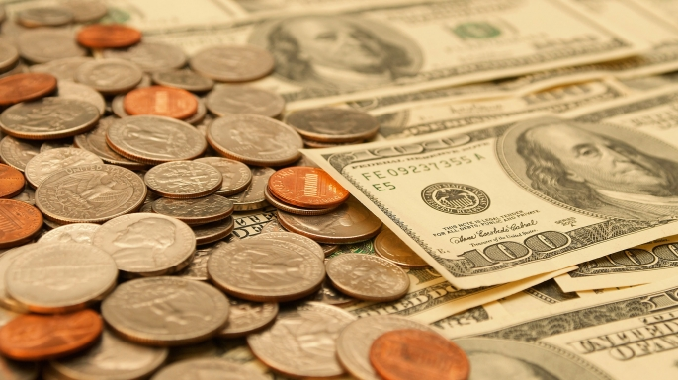
Money

Slide 2
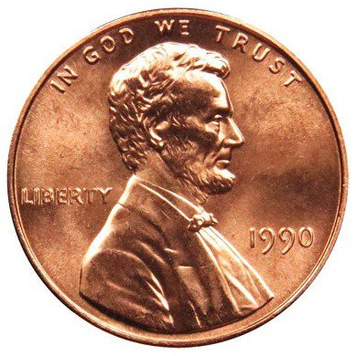
Penny
$.01

Slide 3
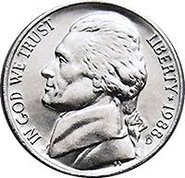
Nickel
$.05

Slide 4
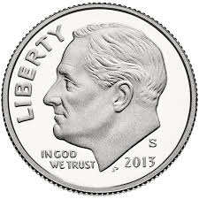
Dime
$.10

Slide 5
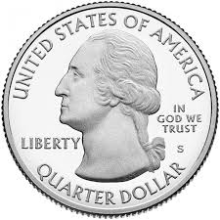
Quarter
$.25

Slide 6
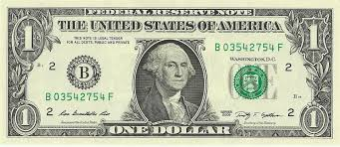
Dollar
$1.00

Slide 7
How many pennies do you have?
How many nickels do you have?
How many dimes do you have?
How many quarters do you have?

Slide 8
How many pennies do you have?
I have _____ pennies.
How many nickels do you have?
I have ______ nickels.

Slide 9
How many dimes do you have?
I have _____ dimes.
How many quarters do you have?
I have ______ quarters.

