Slide 1
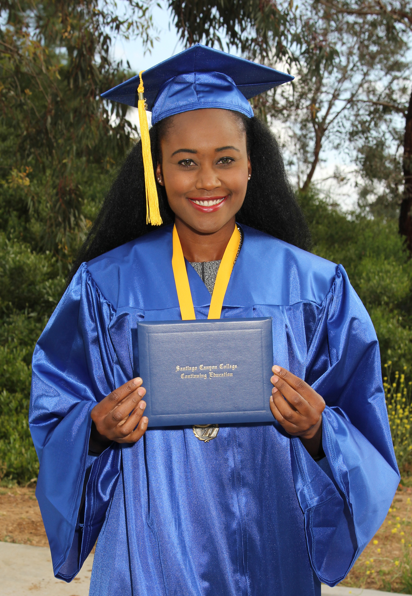
SCC – CONTINUING EDUCATION
New Student Orientation
SANTIAGO CANYON COLLEGE • DIVISION OF CONTINUING EDUCATION • SCCFORME.COM

Slide 2

AGENDA
Continuing Education Options
  English as a Second Language
  High School Diploma/GED/HiSet
  Career Education
  Adults with Disabilities
  Active Adults
Student Educational Plan
Learning Options and Modalities
The Registration Process
Transition to College/STARS
Supports to Help You Succeed
SANTIAGO CANYON COLLEGE • DIVISION OF CONTINUING EDUCATION • SCCFORME.COM

Slide 3
CONTINUING EDUCATION OPTIONS
The Division of Continuing Education is part of Santiago Canyon College. We are located in Orange, California and offer classes throughout our community.
All classes are 100% tuition-free to adults living in California. Career counseling, academic guidance, and educational planning are free to enrolled students. Our academic programs include:
English as a Second Language | High School Diploma | High School Equivalency
Career Education | Active Adults Program | Adults with Disabilities
SANTIAGO CANYON COLLEGE • DIVISION OF CONTINUING EDUCATION • SCCFORME.COM

Slide 4
ADULT HIGH SCHOOL DIPLOMA INFORMATION
REQUIREMENTS:
Completion of 160 credits
Completion of 3 proficiencies in Reading, Math, & Composition
Complete 20 credits of residency at Continuing Education
  Credits from other high schools are accepted.
  High school credits from any foreign countries accepted.
EDUCATION PLAN:
A counselor will develop an education plan to guide you in completing your graduation requirements.
Students should bring official transcripts and a counselor will review options to receive credits to graduate.
SANTIAGO CANYON COLLEGE • DIVISION OF CONTINUING EDUCATION • SCCFORME.COM

Slide 5

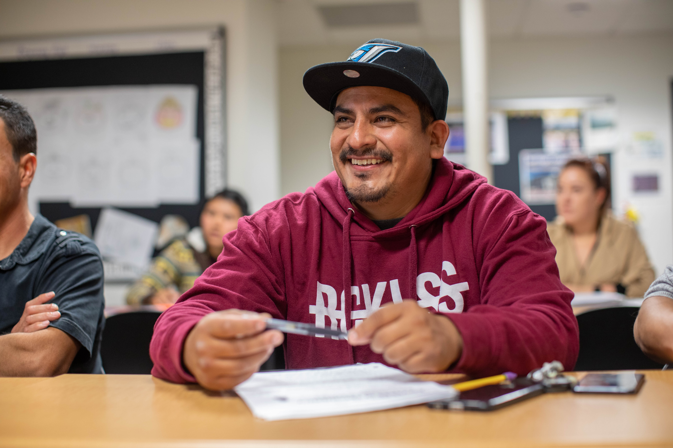
SCC- CONTINUING EDUCATION – LEARNING OPTIONS
You can study online, in-person or a combination of both!
SANTIAGO CANYON COLLEGE • DIVISION OF CONTINUING EDUCATION • SCCFORME.COM

Slide 6
SCC-CONTINUING EDUCATION – LEARN ONLINE
Students access class using CANVAS, an online learning system.
Classes are 9, 14, and 16 weeks long and all coursework must be completed during this time. Classes start through out the semester.
A computer or tablet is needed for class.
Because there is no set time for class, you can study anytime that works for your schedule.
In a traditional class, you go to a classroom to learn. With online learning, you use Canvas. Canvas is where you access your lessons, complete assignment and communicate with your teacher & classmates. Video on how to log into Canvas.
Never used Canvas before? We will help you get started!
SANTIAGO CANYON COLLEGE • DIVISION OF CONTINUING EDUCATION • SCCFORME.COM

Slide 7
HIGH SCHOOL DIPLOMA – LEARN IN PERSON
Study at your own pace at one of our two high school labs in Orange, CA
Coursework can be completed any time during the semester
Teachers onsite to provide one-on-one support
Locations:
Santiago Canyon College, 8045 E Chapman Ave, Orange, CA 92869
College & Workforce Preparation Center , 1572 N Main St, Orange, CA 92867
Our labs are open 6 days a week with morning and evening hours available!
SANTIAGO CANYON COLLEGE • DIVISION OF CONTINUING EDUCATION • SCCFORME.COM

Slide 8
STEPS TO GET REGISTERED
Complete the new student orientation
Schedule an appointment with a counselor to register in AHSD program
A counseling appointment is not required but highly recommended to register for other programs.
Register for classes using your Self-Service account.
To meet with a counselor online or in-person visit: sccollege.edu/cecounseling
SANTIAGO CANYON COLLEGE • DIVISION OF CONTINUING EDUCATION • SCCFORME.COM

Slide 9
MANAGE YOUR CLASSES WITH SELF SERVICE
Self Service is a student information system. Here you can:
Manage your schedule
Access your educational plan
Register for and drop classes
Tutorial to use Self-service:
To access self service, visit: sccollege.edu/selfservice
Login with your school email address and password
(To retrieve your username or update your password, visit: rsccd.edu/resetpassword)
SANTIAGO CANYON COLLEGE • DIVISION OF CONTINUING EDUCATION • SCCFORME.COM

Slide 10
TRANSITION TO COLLEGE (STARS)
Counselors are available to assist Continuing Education students with their transition to Santiago Canyon College by providing information for the following:
• Counselors will assist you:
  Complete a college application (CCCApply)
  Will provide an orientation to all credit student services
  Will develop a first semester education plan
  Connect you to a college credit counselor
  Provide a backpack with materials to get started in college
SANTIAGO CANYON COLLEGE • DIVISION OF CONTINUING EDUCATION • SCCFORME.COM

Slide 11
SUPPORTS YOU NEED TO SUCCEED
Welcome Center Support
Disabled Student Programs & Services
Counseling Department resources booklet
To access self service, visit: sccollege.edu/selfservice
Login with your school email address and password
(To retrieve your username or update your password, visit: rsccd.edu/resetpassword)
SANTIAGO CANYON COLLEGE • DIVISION OF CONTINUING EDUCATION • SCCFORME.COM

Slide 12
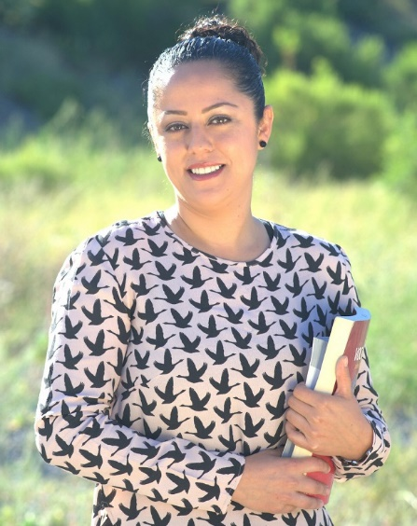
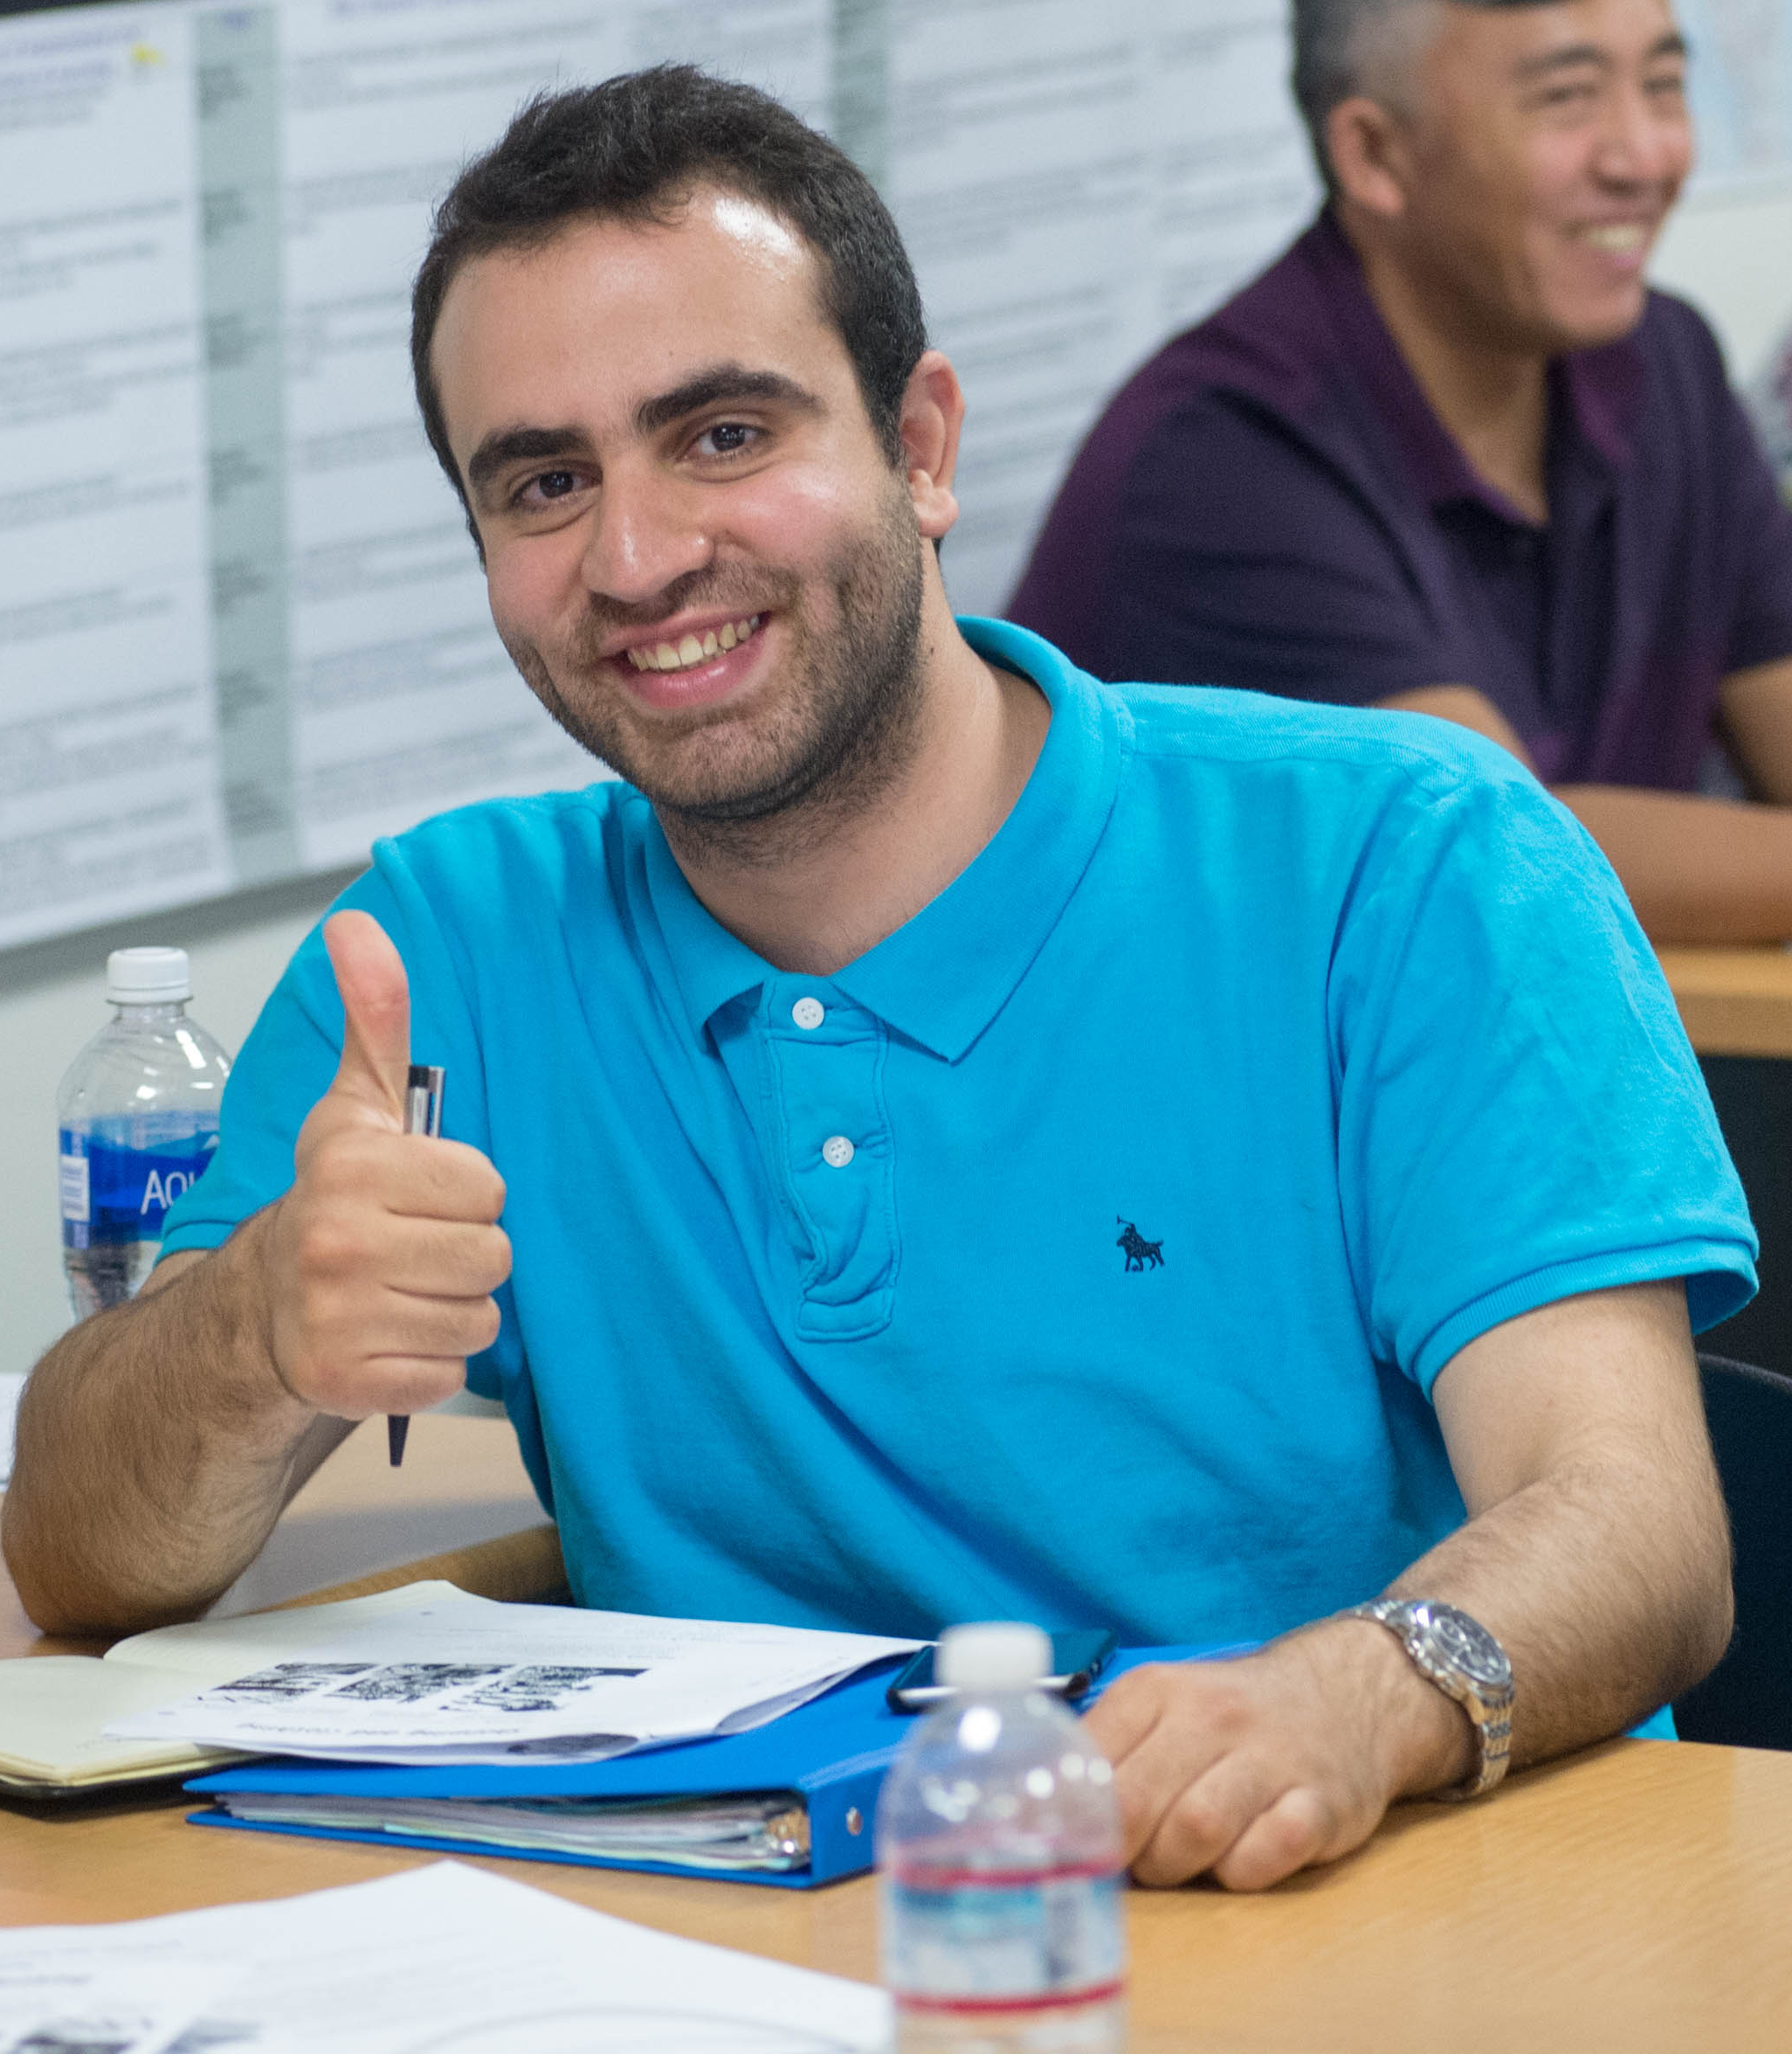
Student Welcome Centers
Services Provided:
​ Technology support (CANVAS, Self-Service, MS 365, & student’s email)
General information about programs & services
Registration support
Laptop Loaner Program assistance
Cares funding support
Scholarships
College Application Assistance
In-person, by email or by phone assistance:
Location: CHAP- 203 or SCC-U81
Website: sccollege.edu/cewelcome
Email: gpp85994@rsccd.edu
Phone number: 714-628-5994

