Slide 1
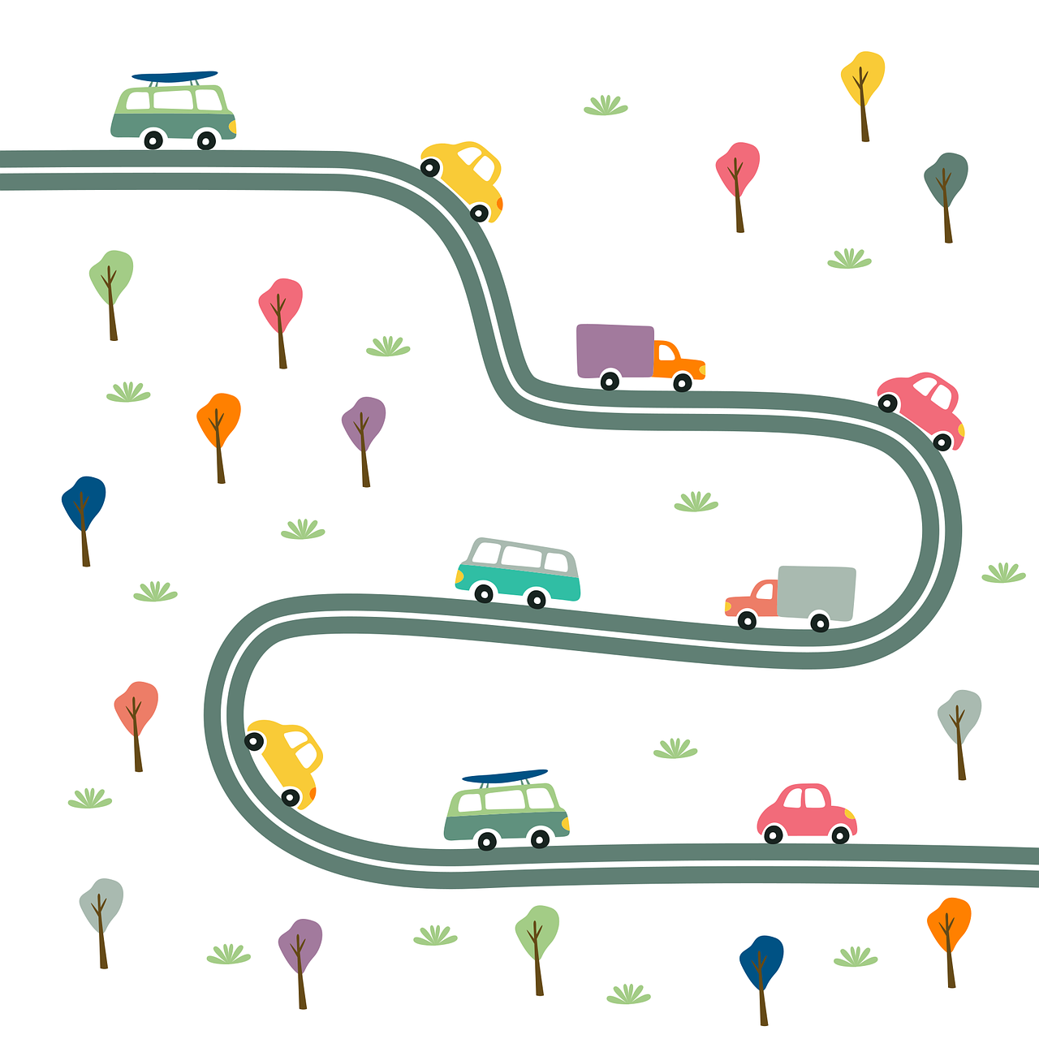
EL Civics
12.9 DMV
Remote Assessment
Advanced low/HIGH

Slide 2
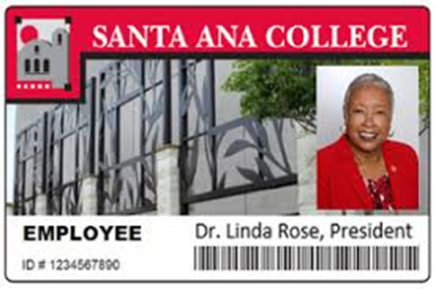

Student:
Please show your ID and tell the assessor your student ID number

Slide 3
Student Agreement:
I agree:
a. to be the only person in the room during the test
b. NOT to get help from others
c. NOT to use notes, dictionaries, or other devices to find answers
d. to use my phone or computer camera to scan the room whenever the assessor asks me to.
If you agree, please say Yes.
Spanish Vietnamese
Korean Arabic

Slide 4
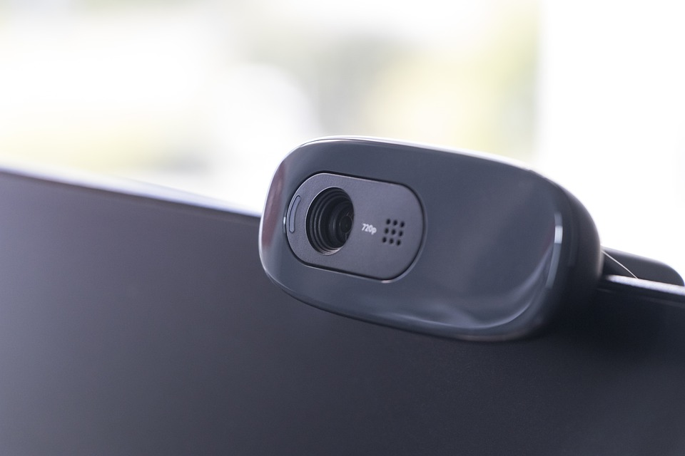
Use your phone camera or computer webcam to scan the room now.

Slide 5
Task 4, Oral: Respond to a Traffic Citation
You will answer 5 questions about a traffic citation.
The first one is for practice.

Slide 6
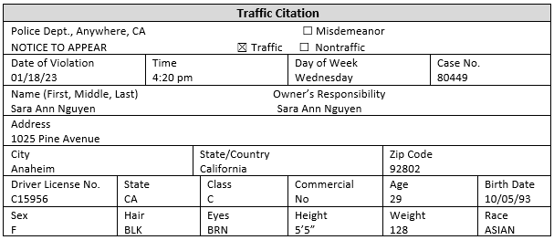
Practice: What’s the driver’s birth date?

Slide 7
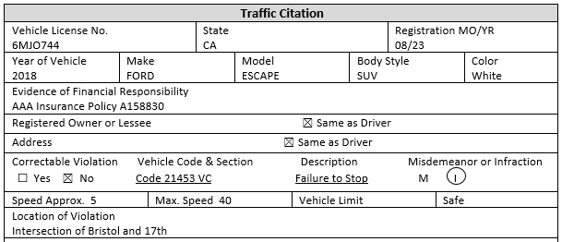
1. What’s the make and model of the car?

Slide 8

2. What’s the date and time of the violation?

Slide 9
3. What is the vehicle license number?

Slide 10
4. What is the description of the violation?

Slide 11
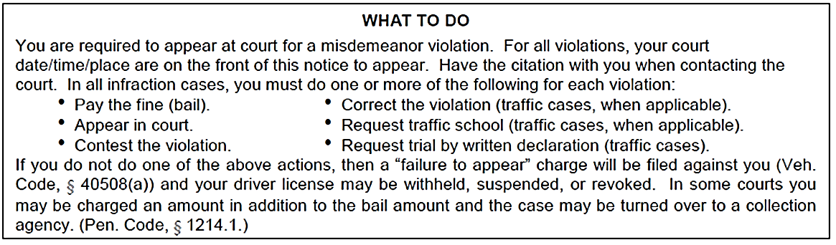
5. What are 2 possible actions you can take if you get a citation?

Slide 12
Task 5, Written: Persuade a Person to Follow Driving Safety Laws
You will write an email persuading a friend or family member to follow driving safety laws.

Slide 13
Let’s get ready:
Take out a blank sheet of lined paper
Use a dark pen
(black or blue)
Write your name and student ID at the top

Slide 14
Copy this on your paper
From:
To:
Subject:

Slide 15
Task 5: Use the scenario below to write an email persuading your friend to change her driving habit.
Your friend Susana often eats or drinks while driving. She says she has a busy life, and it’s easier to eat and drink in the car.
Your email: student99@gmail.com
Susana’s email: susanaruiz@yahoo.com
Be sure to include:
what the problem is
3 reasons/laws to persuade her to change
the 2 email addresses, a subject, a greeting, a closing, and contact information

Slide 16


Hold your paper up to your
camera for the assessor to
take a picture.
Or take a picture of your paper
with your phone
and send it to the assessor.

Slide 17
Use your phone camera or computer webcam to scan the room again.

Slide 18

You are finished!
Thank you!
Please do not talk about the test with anyone.

Slide 19
Student Agreement
Estoy de acuerdo:
a. no usar la ayuda de otras personas
b. ser la única persona en la sala de evaluación
c. no usar las notas u otros dispositivos para
encontrar respuestas
d. desplazar mi teléfono o dispositivo por la habitación en cualquier momento solicitado por el asesor
Si acepta, por favor diga Yes.

Slide 20
Sự thỏa thuận của sinh viên
Tôi đồng ý trong khi làm bài thi:
a. Tôi không nhờ sự trợ giúp của người khác
b. Tôi là người duy nhất trong phòng
c. Tôi không sử dụng sổ ghi chú hoặc các thiết bị khác để tìm câu trả lời
d. Tôi sẽ dùng điện thoại hoặc máy vi tính quét khắp phòng nếu giám khảo yêu cầu
Nếu bạn đồng ý, xin vui lòng nói 'đồng ý'

Slide 21
학생 동의서
저는 아래의 사항들을 동의 합니다:
a. 시험 보는 동안, 방안에 혼자 있을것을 동의합니다
b. 다른 사람으로부터 도움을 받지 않을 것을 동의 합니다
c. 시험문제 답을 찾기위해 메모, 사전, 또는 다른 기기를 사용하지 않을 것을 동의 합니다
d. 시험 평가자의 지시대로 전화기나 컴퓨터 카메라를 사용하여 방을 스캔할것을 동의합니다
동의하시면, "네" 라고 말하십시오

Slide 22
اتفاقية الطالب​
أوافق: ​
أن أكون الشخص الوحيد في الغرفة أثناء أداء الاختبار​
عدم الحصول على مساعدة من الآخرين​
عدم استخدام المذكرات أو القواميس أو الأجهزة الأخرى للحصول على الإجابات​
استخدام هاتفي الشخصي أو كاميرا الكمبيوتر لمسح الغرفة ضوئيا كلما طلب مني الممتحن ذلك.​
إذا كنت توافق، يرجى قول نعم.

