Slide 1


EL Civics 26.3
Health: Free &
Low-Cost Care
Beginning High
Remote Assessment

Slide 2




Student:
Please show your ID and tell the assessor your student ID number

Slide 3
Student Agreement
I agree:
a. to be the only person in the room during the test
b. NOT to get help from others
c. NOT to use notes, dictionaries, or other devices to find answers
d. to use my phone or computer camera to scan the room whenever the assessor asks me to.
If you agree, please say Yes. Spanish Korean
Vietnamese

Slide 4
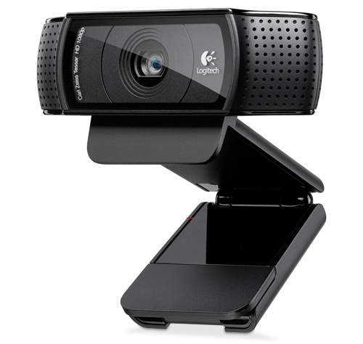
Use your phone camera or computer webcam to scan the room now.

Slide 5
Task One
Find information on low-cost health care.

Slide 6
Directions:
You will read a flyer and give the information.
The first one is for practice.

Slide 7
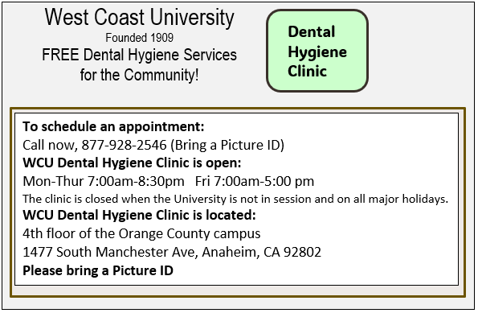
Practice
Phone number?

Slide 8
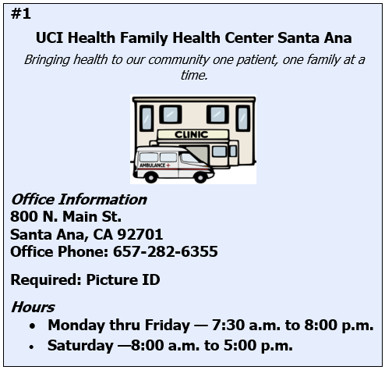
Tell the assessor the information:
1a. Name?
1b. Address?
1c. Phone number?
1d. Hours?
1e. Documentation needed?

Slide 9

Tell the assessor the information:
2a. Name?
2b. Address?
2c. Phone number?
2d. Hours?
2e. Documentation needed?

Slide 10
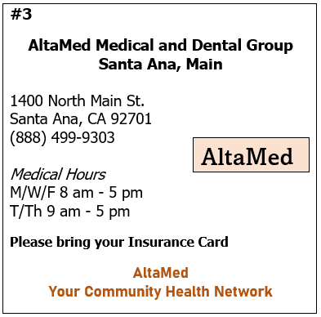
Tell the assessor the information:
3a. Name?
3b. Address?
3c. Phone number?
3d. Hours?
3e. Documentation needed?

Slide 11
Use your phone camera or computer webcam to scan the room again.

Slide 12
Task Two
Complete an application form for low-cost health services/insurance.

Slide 13
Directions:
You will fill in the information on a health insurance application.

Slide 14


Let’s get ready to write!
Take out a blank sheet of lined paper
Use a dark pen
(black or blue)
Write your name and student ID at the top

Slide 15
Number your paper 1-16:
1.
2.
3.
4.
5.
6.
7.
8.
9.
10.
11.
12.
13.
14.
15.
16.

Slide 16
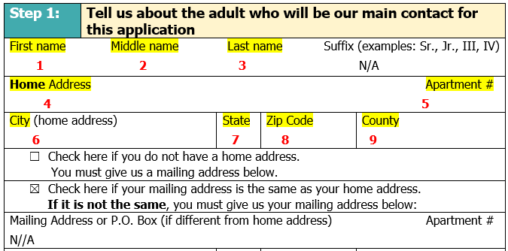
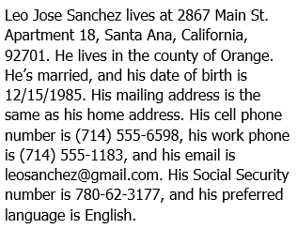
Write the answers for 1-9.

Slide 17
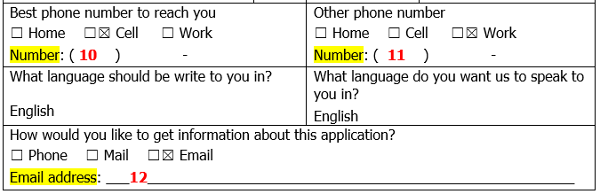
Write the answers for 10-12.

Slide 18
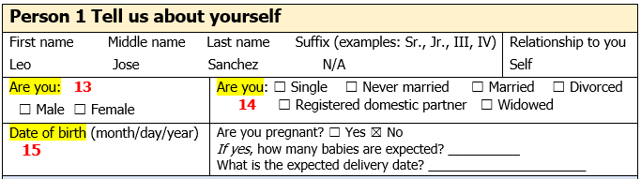
Write the answers for 13-15.

Slide 19
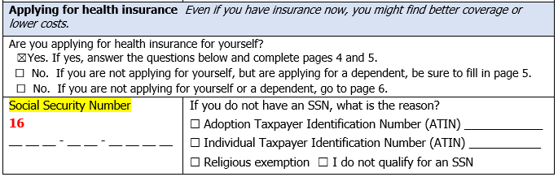
Write the answer for 16.

Slide 20


Hold up your answer sheet to your camera. The assessor will take a picture of your answers.
Or take a picture of your paper with your phone and send it to the assessor.

Slide 21
Use your phone camera or computer webcam to scan the room again.

Slide 22

Thank you!
Please do not talk about the test with anyone!

Slide 23
Student Agreement
Estoy de acuerdo:
a. no usar la ayuda de otras personas
b. ser la única persona en la sala de evaluación
c. no usar las notas u otros dispositivos para
encontrar respuestas
d. desplazar mi teléfono o dispositivo por la habitación
en cualquier momento solicitado por el asesor
Si acepta, por favor diga Yes.

Slide 24
Sự thỏa thuận của sinh viên
Tôi đồng ý trong khi làm bài thi:
a. Tôi không nhờ sự trợ giúp của người khác
b. Tôi là người duy nhất trong phòng
c. Tôi không sử dụng sổ ghi chú hoặc các thiết bị khác để tìm câu trả lời
d. Tôi sẽ dùng điện thoại hoặc máy vi tính quét khắp phòng nếu giám khảo yêu cầu
Nếu bạn đồng ý, xin vui lòng nói 'đồng ý'

Slide 25
학생 동의서
저는 아래의 사항들을 동의 합니다:
a. 시험 보는 동안, 방안에 혼자 있을것을 동의합니다
b. 다른 사람으로부터 도움을 받지 않을 것을 동의 합니다
c. 시험문제 답을 찾기위해 메모, 사전, 또는 다른 기기를 사용하지 않을 것을 동의 합니다
d. 시험 평가자의 지시대로 전화기나 컴퓨터 카메라를 사용하여 방을 스캔할것을 동의합니다
동의하시면, "네" 라고 말하십시오

