Slide 1

EL Civics Remote Assessment
COAAP 4.9 Housing Rentals
Beginning Low

Slide 2


Please show your ID and tell the assessor your student ID number

Slide 3
Student Agreement
I agree: a. to be the only person in the room during the test b. NOT to get help from others c. NOT to use notes, dictionaries, or other devices to find answers d. to use my phone or computer camera to scan the room whenever the assessor asks me to.
If you agree, please say Yes.
Spanish Vietnamese Korean Arabic

Slide 4

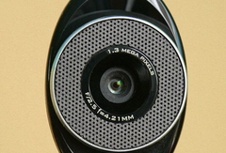
Please use your phone camera or computer webcam to scan the room now.

Slide 5
Task 1 Assessment: Written
Complete a Rental Application Form

Slide 6
Let’s get ready:
Take out a blank sheet of lined paper
Use a dark pen
(black or blue)
Write your name and student ID at the top
Or you can ask the assessor for the fillable application

Slide 7
Part 1. Copy the numbers on your paper:
1.
2.
3.
4.
5.
6.
7.
8.
9.
10.
11.

Slide 8
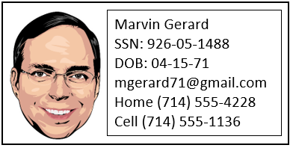
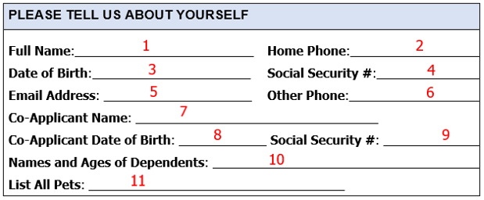
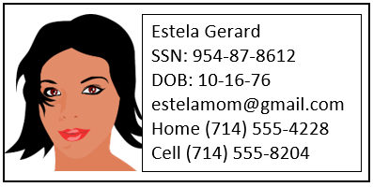
Read the information. Fill in the correct information for numbers 1-11.
Scenario:
Marvin Gerard (applicant) and his wife Estela (co-applicant)
want to rent an apartment. They have 2 children: Luis, age 12,
and Maya, age 10. They have 1 cat.

Slide 9
Part 2. Copy the numbers on your paper:
12.
13.
14.
15.
16.

Slide 10
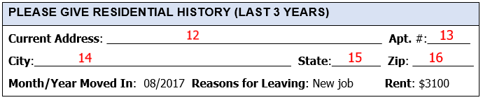
Read the information. Fill in the correct information for numbers 12-16.
Scenario:
Their current address is 906 Prospect St. #7A, Orange, CA 92867.
Their rent is $3100 a month.

Slide 11


Hold your paper up to the camera. The assessor will take a picture.
Or take a picture of your paper with your phone and send it to the assessor.
*If you used the fillable application, save it and send it to the assessor.

Slide 12
Task 2 Assessment: Written
Write a Note to the Landlord

Slide 13
Let’s get ready:
Take out a blank sheet of lined paper
Use a dark pen
(black or blue)
Write your name and student ID at the top

Slide 14
Copy the numbers on your paper:
1.
2.
3.
4.
5.
6.

Slide 15
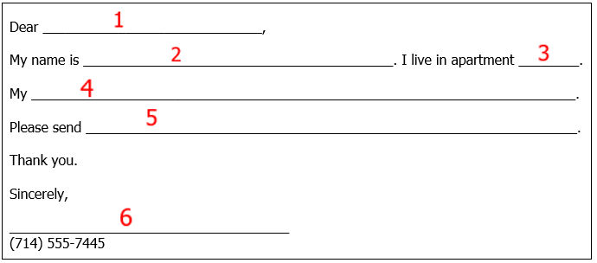
Read the problem, then write the information for numbers 1-6.
Rick Cortez in apartment 15 has a problem. His shower is leaking.
His landlord is Mr. Sutters.

Slide 16
Hold your paper up to the camera. The assessor will take a picture.
Or take a picture of your paper with your phone and send it to the assessor.

Slide 17

You are finished!
Please do not talk about the test with anyone.

Slide 18
Student Agreement
Estoy de acuerdo: a. no usar la ayuda de otras personas b. ser la única persona en la sala de evaluación c. no usar las notas u otros dispositivos para encontrar respuestas d. desplazar mi teléfono o dispositivo por la habitación en cualquier momento solicitado por el asesor
Si acepta, por favor diga Yes.

Slide 19


Slide 20
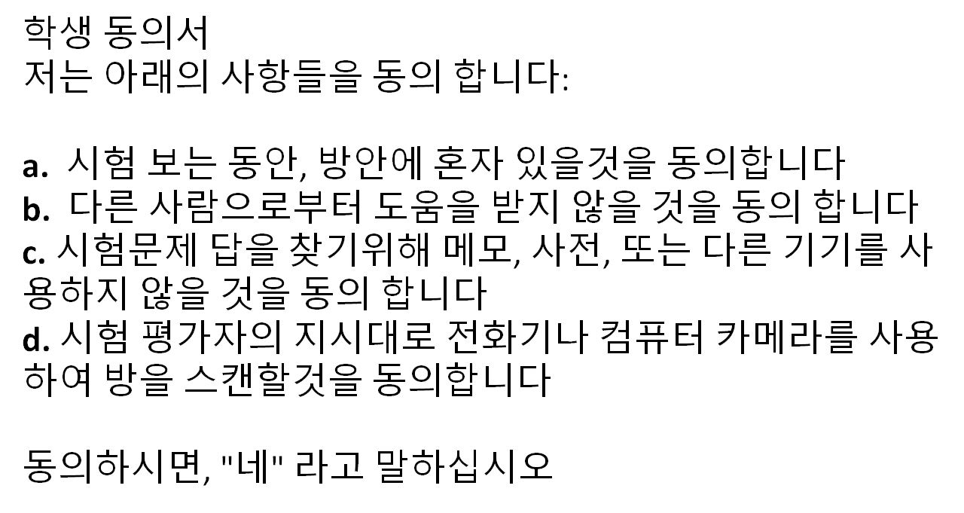

Slide 21


