Slide 1

EL Civics Remote Assessment
COAAP 4.9 Housing Rentals
Intermediate High

Slide 2


Please show your ID and tell the assessor your student ID number

Slide 3
Student Agreement
I agree: a. to be the only person in the room during the test b. NOT to get help from others c. NOT to use notes, dictionaries, or other devices to find answers d. to use my phone or computer camera to scan the room whenever the assessor asks me to.
If you agree, please say Yes.
Spanish Vietnamese Korean Arabic

Slide 4

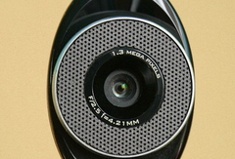
Please use your phone camera or computer webcam to scan the room now.

Slide 5
Task 1 Assessment: Written
Complete a Rental Application Form

Slide 6
Let’s get ready:
Take out a blank sheet of lined paper
Use a dark pen
(black or blue)
Write your name and student ID at the top
You can also ask the assessor for a fillable form. You would need to download it, fill it out, then save and send it.

Slide 7
Part 1. Copy the numbers on your paper:
1.
2.
3.
4.
5.
6.
7.
8.
9.
10.
11.

Slide 8
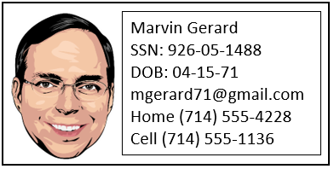
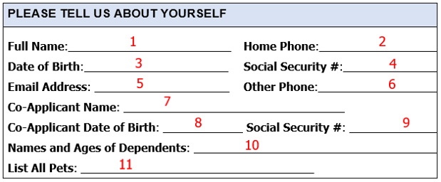
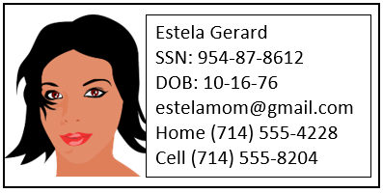
Read the information. Fill in the correct information for numbers 1-11.
Scenario:
Marvin Gerard (applicant) and his wife Estela (co-applicant)
want to rent an apartment. They have 2 children: Luis, age 12,
and Maya, age 10. They have 1 cat.

Slide 9
Part 2. Copy the numbers on your paper:
12.
13.
14.
15.
16.
17.
18.
19.

Slide 10
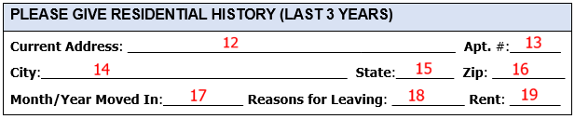
Read the information. Fill in the correct information for numbers 12-19.
Scenario:
They have lived at their current address since August of 2017, which is 906 Prospect St., #7A, Orange, CA 92867. They are moving to be closer to family, and their current rent is $3100.

Slide 11
Part 3. Copy the numbers on your paper:
20.
21.
22.
23.
24.
25.
26.
27.
28.
29.

Slide 12
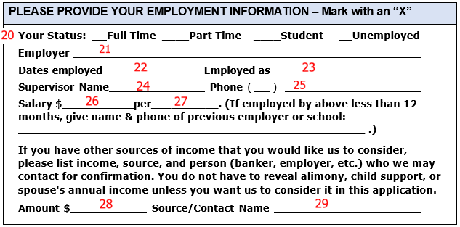
Read the information. Fill in the correct information for numbers 20-29.
Scenario:
Marvin Gerard has been a full-time driver for UPS since 2018. His salary
is $4150 a month. His supervisor is Ahmed Roboz, who can be contacted at (310)
555-8224. Estela is a manager at Target. She earns $3,900 a month. Marvin has his
checking account at Bank of the West, with an account number of 9044-5875.

Slide 13
Part 4. Copy the numbers on your paper:
30.
31.
32.
33.

Slide 14
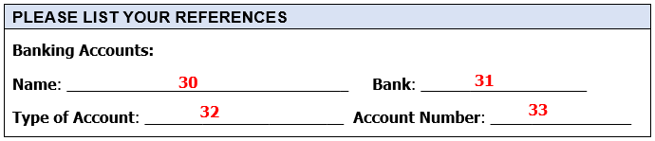
Read the information. Fill in the correct information for numbers 30-33.
Scenario:
Marvin Gerard is a full-time driver for UPS. His salary is $4150 a month. His supervisor is Ahmed Roboz, who can be contacted at (310) 555-8224. Estela is a manager at Target. She earns $3,900 a month. Marvin has his checking account at Bank of the West, with an account number of 9044-5875.

Slide 15


Hold your paper up to the camera.
The assessor will take a picture.
Or take a picture of your paper with your phone and send it to the assessor.
If you did the fillable form, save it with your name and ID, and send it to the email the assessor gives you.

Slide 16
Task 3 Assessment: Written
Write an Email to the Landlord

Slide 17
Let’s get ready:
Take out a blank sheet of lined paper
Use a dark pen
(black or blue)
Write your name and student ID at the top
You can also ask the assessor for a fillable form. You would need to download it, fill it out, then save and send it.

Slide 18
Copy this on your paper:
TO: tomsutters@gmail.com
FROM: cortez90860@gmail.com
SUBJECT:

Slide 19
Read the problem, then write an email to the landlord.
You are Rick Cortez.
Rick Cortez’s shower is leaking (4 days). He needs it fixed this
week. His landlord is Mr. Sutters. He lives in apartment 15,
and his phone number is (949) 555-0622.
TO: tomsutters@gmail.com
FROM: cortez90860@gmail.com
SUBJECT:

Slide 20
Hold your paper up to the camera.
The assessor will take a picture.
Or take a picture of your paper with your phone and send it to the assessor.
If you did the fillable form, save it with your name and ID, and send it to the email the assessor gives you.

Slide 21
Please use your phone camera or computer webcam to scan the room again.

Slide 22

You are finished!
Please do not talk about the test with anyone.

Slide 23
Student Agreement
Estoy de acuerdo: a. no usar la ayuda de otras personas b. ser la única persona en la sala de evaluación c. no usar las notas u otros dispositivos para encontrar respuestas d. desplazar mi teléfono o dispositivo por la habitación en cualquier momento solicitado por el asesor
Si acepta, por favor diga Yes.

Slide 24


Slide 25
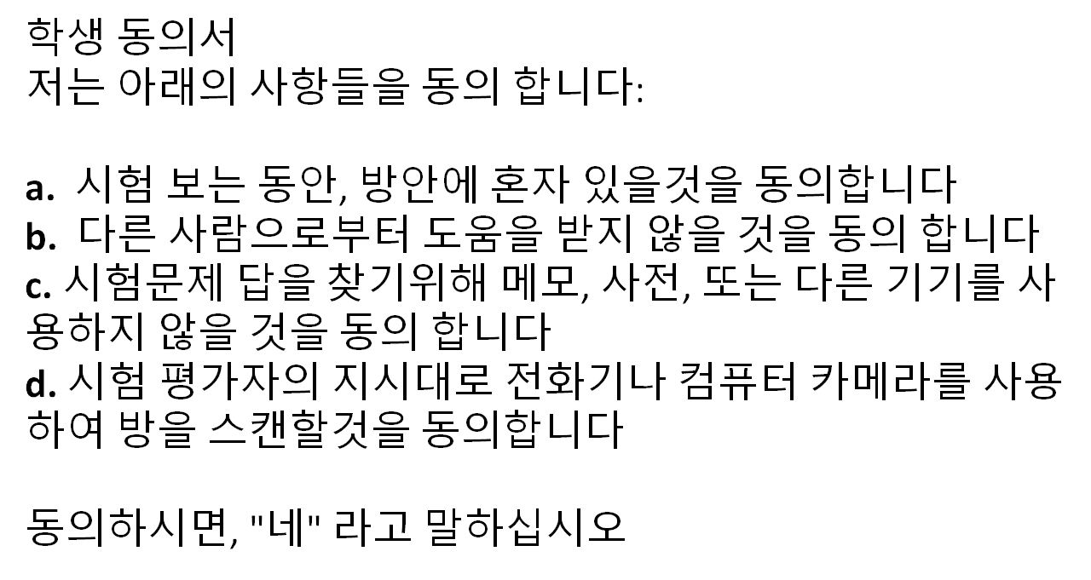

Slide 26


