Slide 1



Purchase Agreement Training
Andrew Lim
Director, Contracts Management Services

Slide 2

Agenda
Objective and Purpose
Current State of District Purchasing Contracts
What is being updated and why
Updated Documents
Resources
Final Thoughts
Questions

Slide 3
Objective and Purpose
Objective of the Training:
Learning to use the updated documents for purchasing goods and services.
Purpose of the Purchase Agreement:
Minimizing legal risk to the District while decreasing end user burden.

Slide 4

Current State
Professional Services Agreement with burden on end user to determine its application.
No agreement for the purchase of goods/services or IT goods and services
Supplier agreements often utilized
Case by case review for purchase of IT goods/services/software

Slide 5
Current State
Rancho Santiago Community College District routed more than $78M 2022-2023. Without appropriate terms and conditions, there is potential for significant liability and risk.
The PSA was supposed to only be for professional services due to IRS regulations, California Public Code, etc. Using PSAs for nonprofessional services puts undue burden on Suppliers, aka “Why do I (the Supplier) have to sign this?”
Supplier agreements often utilized, which means the District starts off the back foot for any contract negotiations and potential missing clauses to minimize our liability.
Case by case review for purchase of IT goods/services/software is a manual process which delays contracts by weeks if not months.

Slide 6
What is being updated?
NEW: Purchase Agreement and Statement of Work (SOW)
REPLACES THE PROFESSIONAL SERVICES AGREEMENT
NEW: General Purchase Terms and Conditions
NEW: Data Protection Exhibit
NEW: Service Level Exhibit

Slide 7
Why the change?
Consistency and efficiency
Minimize risk to the District and Colleges
Eases burden on end user

Slide 8
What is NOT being updated?
Purchase Requisition Process is unchanged
Signature process is unchanged
Contracts Review Process is unchanged
Public work contracts are unchanged (including Field Service Agreements)
Speaker/Performer agreements are unchanged
Educational Affiliation Agreements and Instructional Service Agreements templates are unchanged
Independent contractor verification is unchanged
The TOOL is being updated, but the PROCESS remains the same

Slide 9

Contracts Management Services Intranet
Contract Guide
Resources

Slide 10
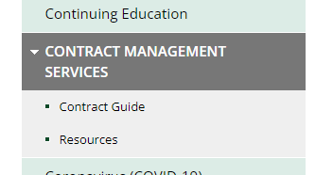
Moved from
Risk
Management
intranet

Slide 11
Purchase Agreement and SOW

Slide 12
Purchase Agreement and SOW
Used for purchases requiring a contract
Pre-drafted Statement of Work with fillable fields
Use checklist as needed to assist with information gathering. Download on Intranet
Replaces the Professional Services Agreement but flexible to be used for non-professional services
Term: Supplier to be used vs. Contractor
Not to be used for public works, field service agreements, or performer agreements.

Slide 13
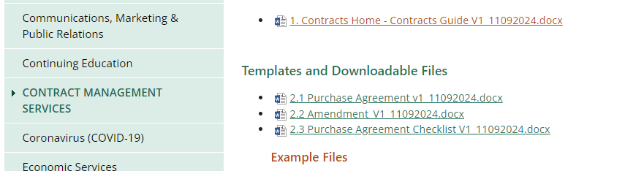
Location

Slide 14
Location

Slide 15

General Purchase Terms and Conditions
Incorporated by reference
Does not need to be added to purchase order in its entirety
Viewable online by Supplier
Will be used for bids, referenced in purchase orders, etc.

Slide 16
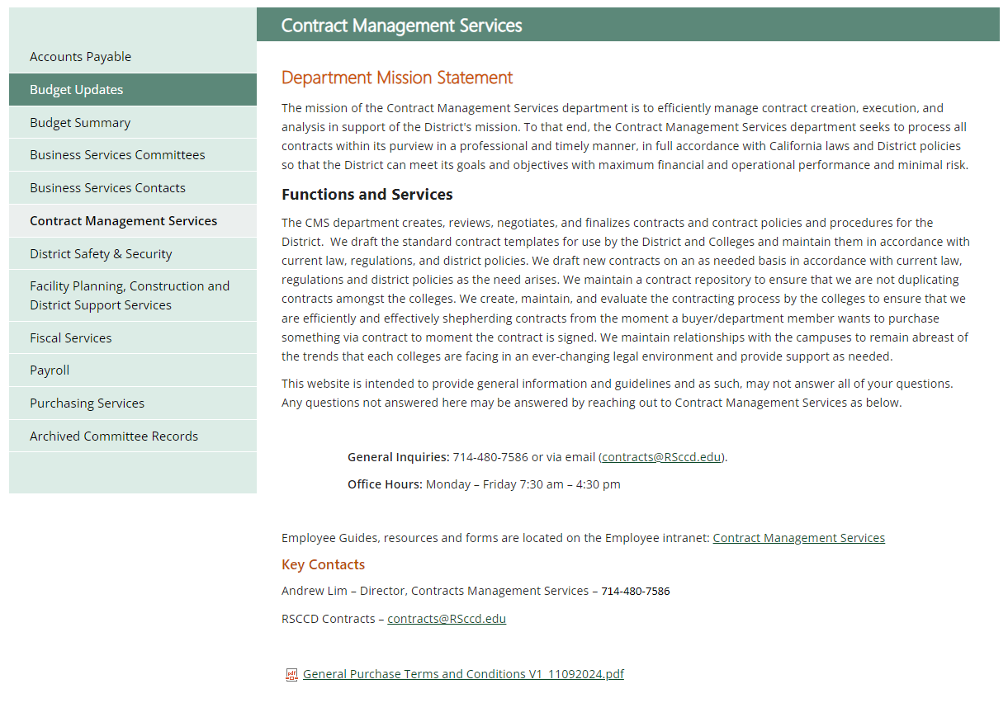
Location

Slide 17
Location

Slide 18
Data Protection Appendix
Used when purchasing goods and/or services that touch or affect District Restricted Data
Does not require departments to fill out form
Usage is determined by Contracts & ITS.

Slide 19
Service Level Agreement Exhibit
Used for IT goods and services that have service level components
Does not require Departments to fill out the form
Usage to be determined by Contracts & ITS

Slide 20
Amendment
Updated to match the Purchase Agreement
Utilized to update changes to Purchase Agreements

Slide 29
Contracts Management Services Intranet
Contract Guide
Resources

Slide 31
Implementation
10 Nov. 2023
New Purchase Agreement and Statement of Work is available on the intranet NOVEMBER 10, 2023.
1 Dec. 2023
Purchase Agreement and Statement of Work to be fully utilized January 16, 2024.
1 Dec. 2023
Current agreements in work can still be used but transition is expected to occur no later than January 16, 2024.

Slide 32
Final Thoughts
Follow your college’s standard operating procedure for contract execution. Signatory authority is specifically delegated for specific processes and thresholds.
These are internal documents. The Supplier should only see the finished product. DO NOT GIVE TO THE SUPPLIER TO COMPLETE.
While this template helps ease the contract review process, please remember that YOU are responsible to administer your contract. Please ensure you are familiar with the agreement in its entirety.

Slide 33
Questions
Need assistance?
Contact Contracts@RSCCD.edu

