Slide 1

Purchasing Services Workshop
September 24-25, 2025
Office hours ​Monday - Friday: 7:30 a.m. -​​ 4:30 ​p.m.​​​

Slide 2

Agenda
Introduction
Process of submitting requisitions for goods and services
PR template and change orders
When is insurance required?
Difference between a purchase agreement and a field service agreement; when/why?
Obtaining management approval on PR’s
Review of AR6150 Designation of Authorized Signatures
When to process requisitions for contracts
Away We Go Travel AR7400
PR Documents Checklist
Update on VPAT Repository
Q&A

Slide 3

Considerations when submitting a PR
Identify and confirm the goods and/or services needed.
Identify suitable vendor(s).
Engage in competitive bidding processes when required.
Determine the funding and correct account to use.
Collect all necessary supporting documents and submit/email to buyer at the time the PR is created
Obtain approval for the purchase request.

Slide 4
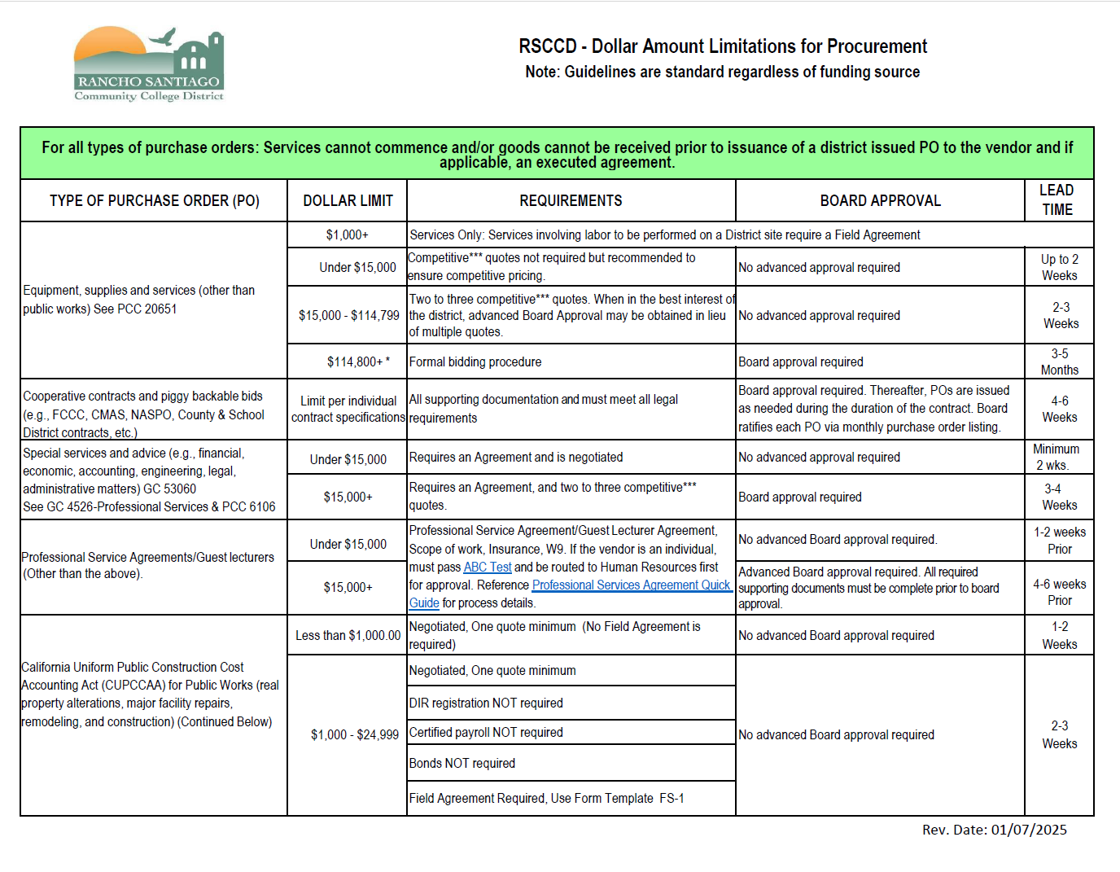
Dollar Amount Limitations for Procurement
Click here

Slide 5
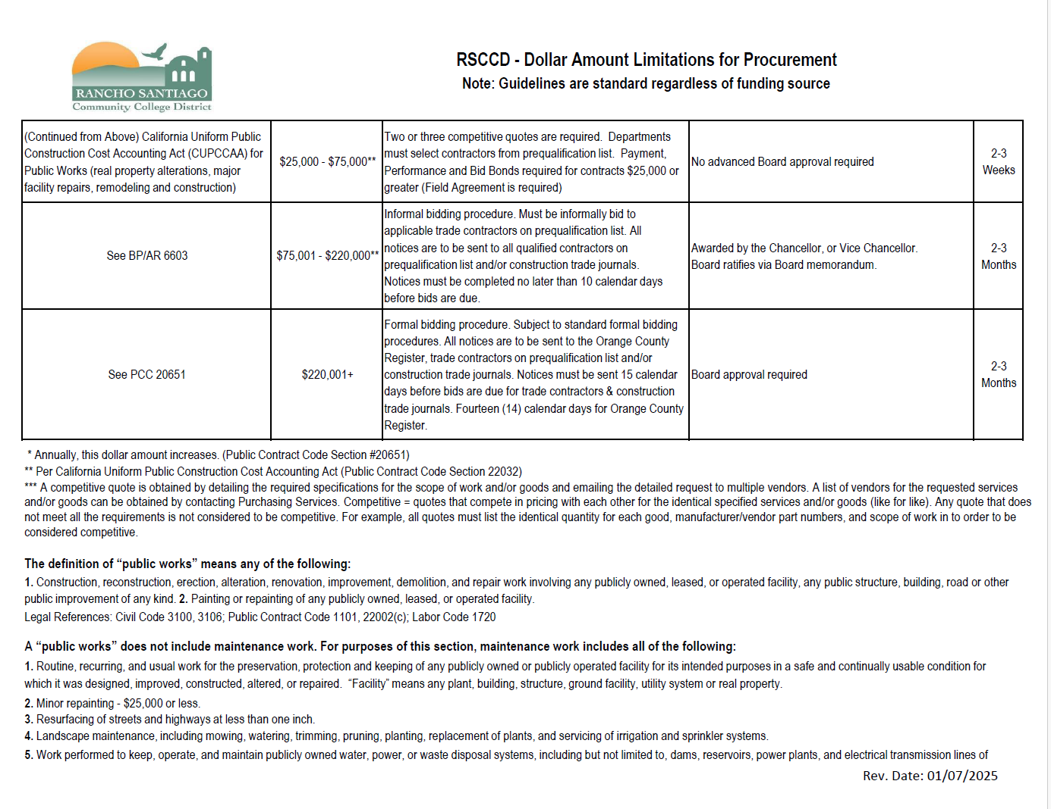
Dollar Amount Limitations for Procurement
Click here

Slide 6
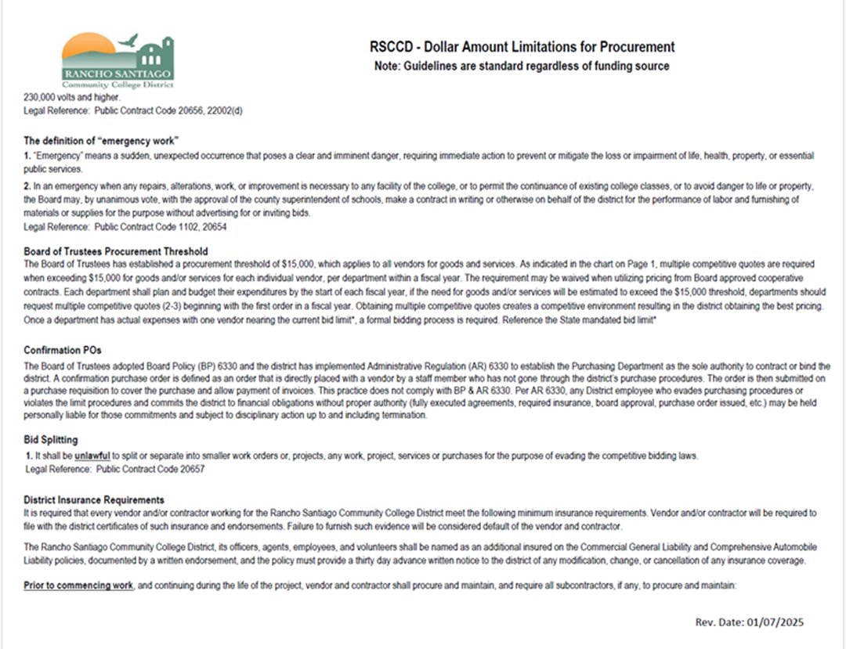
Dollar Amount Limitations for Procurement
Click here

Slide 7
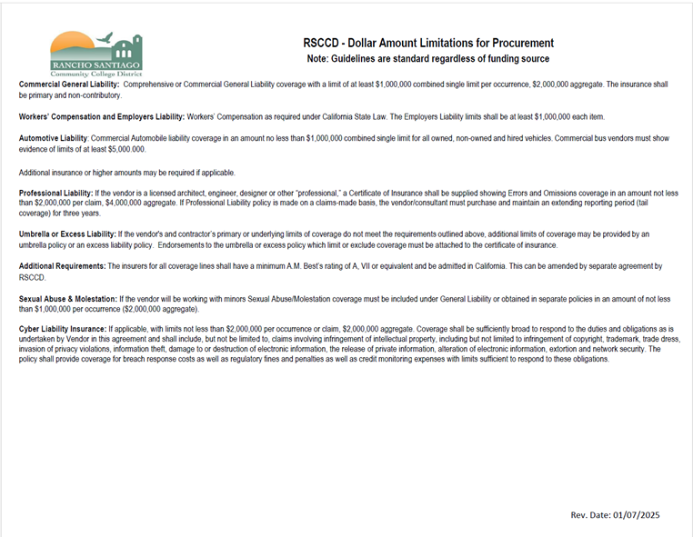
Dollar Amount Limitations for Procurement
Click here

Slide 8
Department identifies a need
Department obtains quote (s),
If not approved, reassess the need
Information Technology related purchases are discussed with ITS department for approval
If approved
Facilities modification related purchases are discussed with Vice President, Administrative Services for approval to begin the FMR process
Follow proper processes for obtaining multiple quotes, Purchase Agreements, Solicitation of Quotes and Field Agreements for Services, and obtaining Board Approvals, when applicable.
Department prepares Purchase Request (PR)
Department Manager reviews and approves PR
Department send PR & backup documents to Purchasing Services

Slide 9
Purchasing Services reviews PR, backup documentation, and funding source
Purchasing Services converts the PR into a Purchase Order (PO)
Director of Purchasing Services reviews the PO
If complete
If incomplete or in need of corrections, Purchasing Services discusses with the Department.
Department makes corrections and resubmits.
If approved
Purchasing Services distributes PO

Slide 10
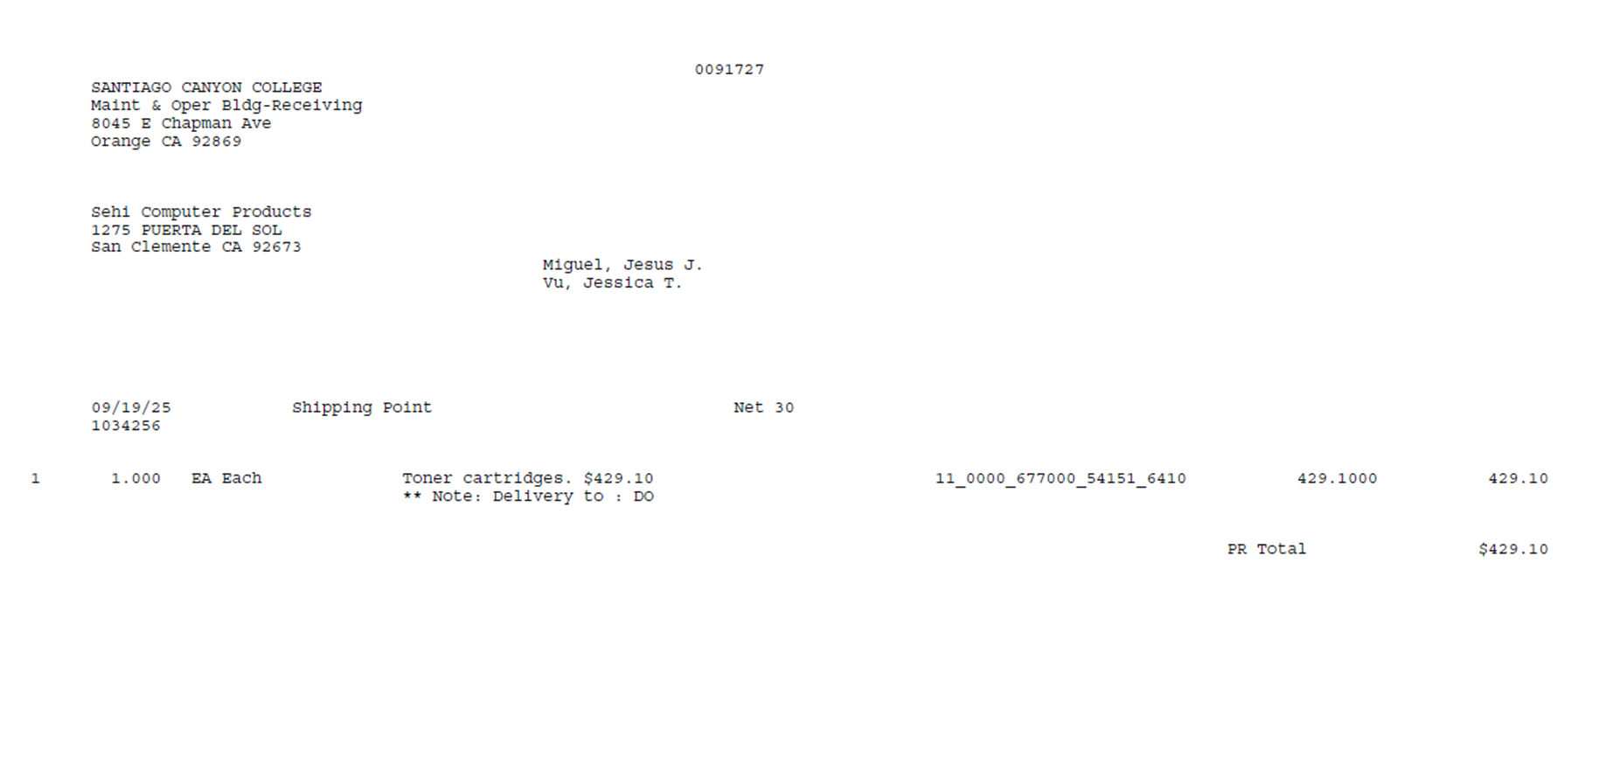
Does this Purchase Requisition contain all the necessary documentation to proceed?

Slide 11
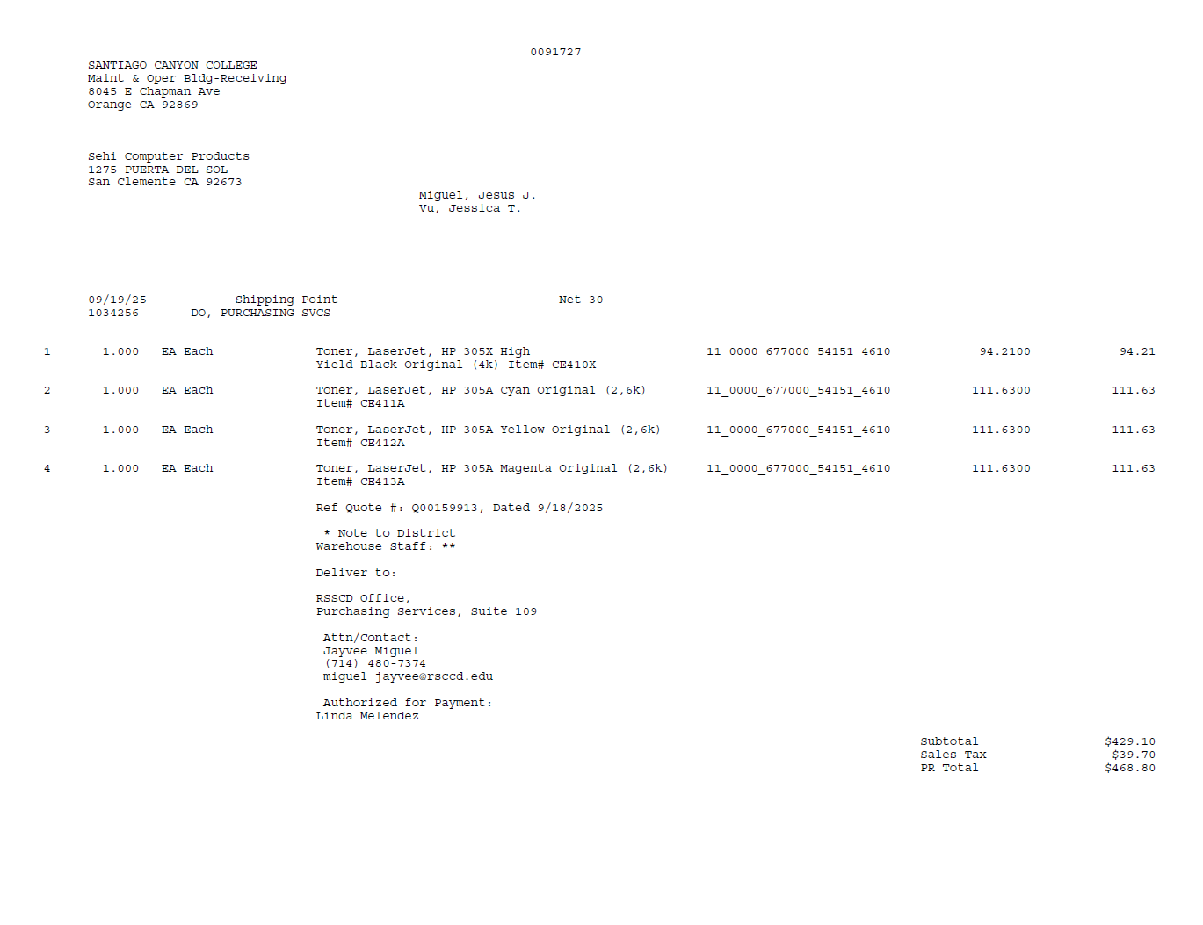
Correct Object code
Indicated requesting Department
Goods itemized and applied sales tax
Indicated quote reference#
Indicated delivery instruction, specific location and contact
Indicated payment approver

Slide 12
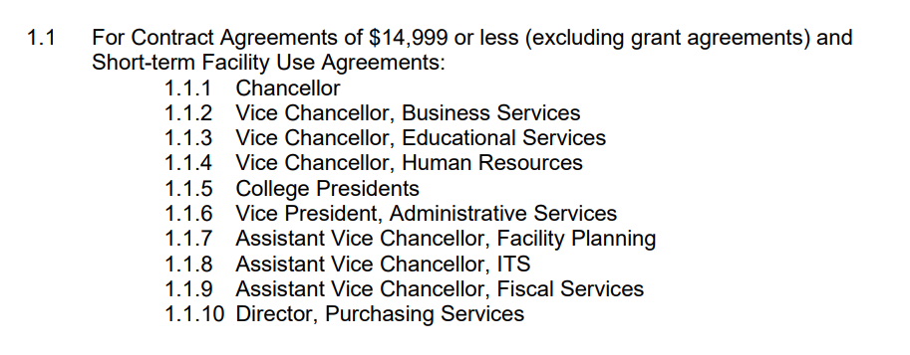
Getting your contract signed
Per Administrative Regulation 6150, contracts may only be signed by the following individuals:

Slide 13
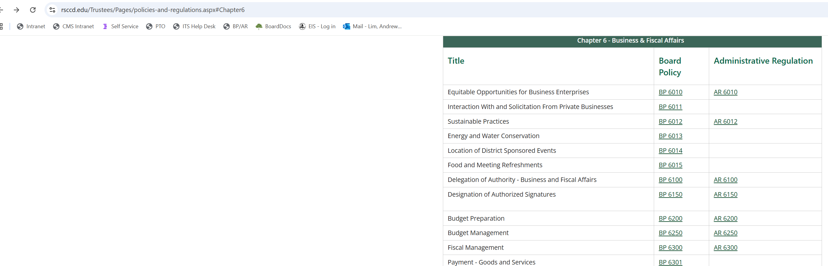
Getting your contract signed

Slide 14

So what can I sign?
Purchase Agreements?
Quotes?
Proposals?
Click through for software?

Slide 15
Getting your contract signed
For the colleges, if your contract is < $14,999.00, and does not affect students, your contract can be signed by:
1. Vice President Administrative Services
2. President
If your contract is > $14,999.00 or affects students, your contract must be approved by the Board of Trustees first, and then signed by
1. Vice Chancellor Business Services Iris I. Ingram
2. Chancellor Marvin Martinez

Slide 16
Getting your contract signed
For the colleges, please follow your applicable contract process to get your contract executed by your
Vice President Administrative Services or President.
To get your contract signed by Vice Chancellor Ingram, please provide the following in a single PDF
document via Adobe Signature email:
Consent calendar showing approval by the Board of Trustees
Docket cover page
Contract
YOU MUST CC THE ASSISTANT TO VICE CHANCELLOR BUSINESS SERVICES IRIS I. INGRAM

Slide 17
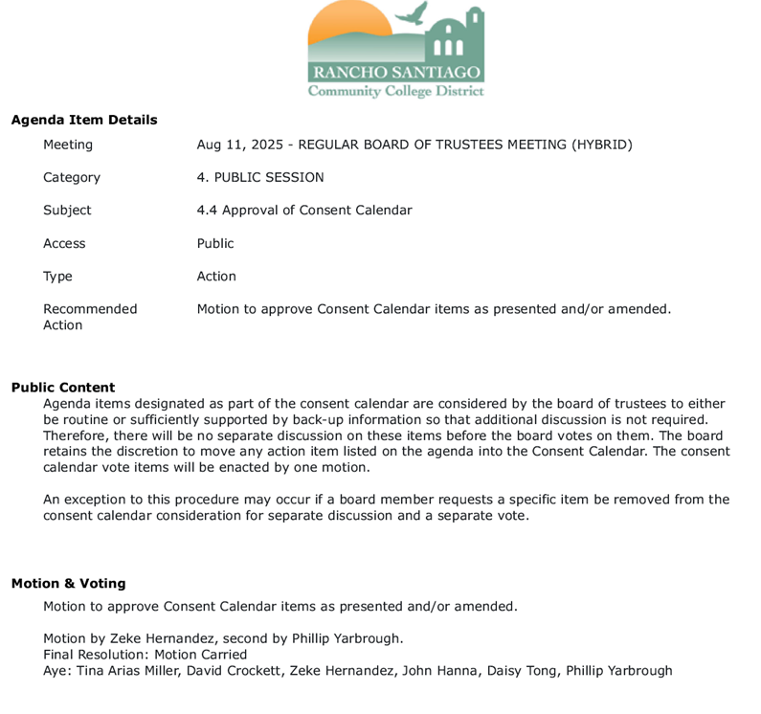
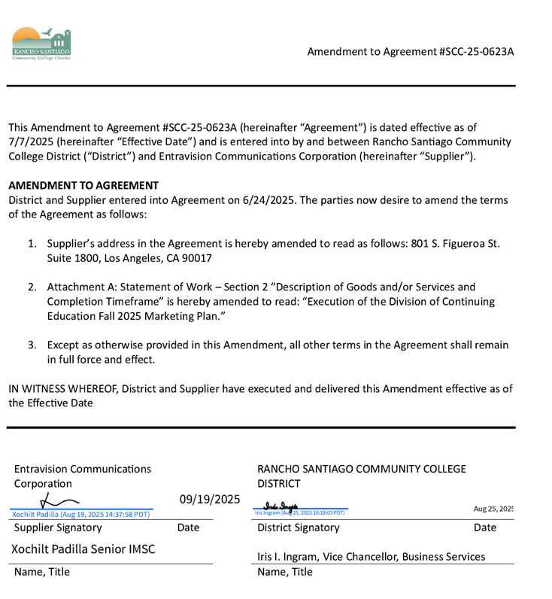
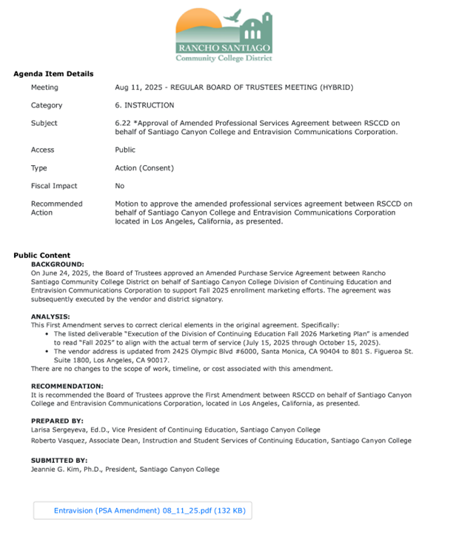
Getting your contract signed

Slide 18
Getting your contract signed

Slide 19
Getting your contract signed

Slide 20
Getting your contract signed

Slide 21
When to Process Requisitions for Contracts
• All supporting documents are to be completed: signatures obtained, insurance documents collected, final proposal or quotes, etc., prior to submitting a purchase requisition
• Purchase requisitions must be completed prior to the start of services. For example, a service with a term of July 1, 2026, through June 30, 2027, must be submitted to Purchasing Services by no later than mid-June 2026 for purchase order processing
• This process also applies to facilities and equipment leases

Slide 22
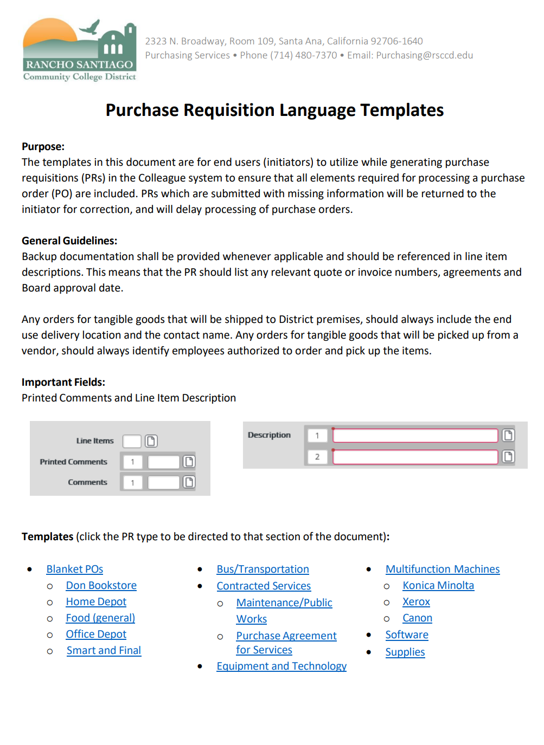
Purchasing Requisition Language Templates
Purpose: to effectively guide the end user, ensure all elements of the PR are included, and to avoid delays
PR should list any relevant quote or invoice numbers, and agreements
Description – following the Purchasing Services Resource page, determine which template is best suited for your PR type
Printed comments – displays vital information such as cooperative contract and board approval (if applicable), or terms of lease agreement
Comments – displays location/department e.g. DO, PURCHASING SERVICES
When generating a blanket purchase requisition, verbiage must be in ALL CAPS in its entirety

Slide 23
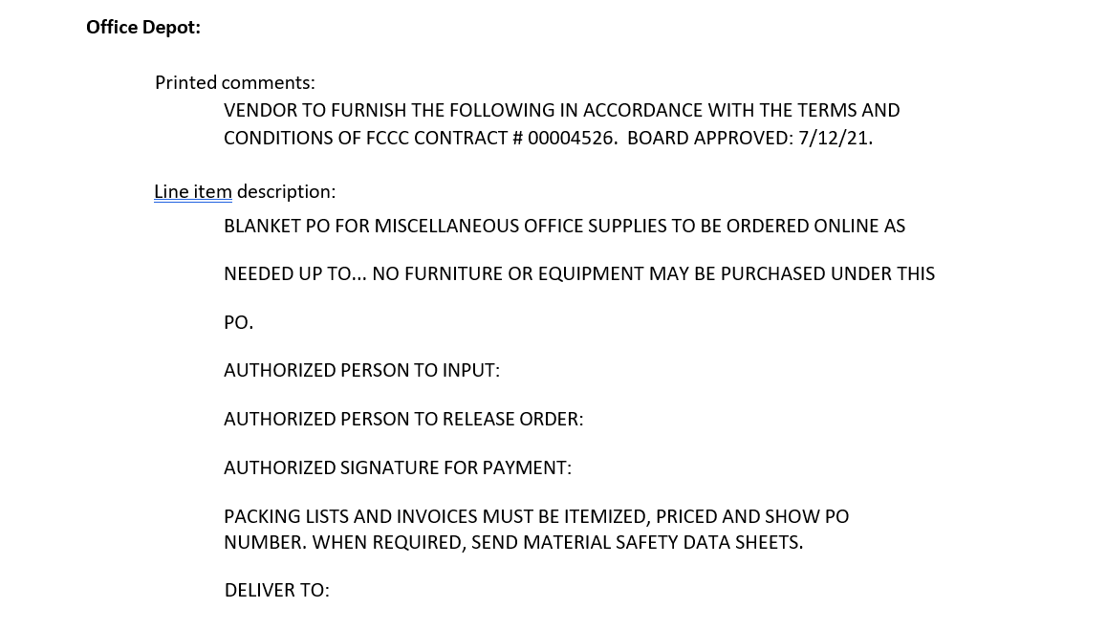
Purchasing Requisition Language Templates
Purpose: to effectively guide the end user, ensure all elements of the PR are included, and to avoid delays
PR should list any relevant quote or invoice numbers, and agreements
Description – following the Purchasing Services Resource page, determine which template is best suited for your PR type
Printed comments – displays vital information such as cooperative contract and board approval (if applicable), or terms of lease agreement
Comments – displays location/department e.g. DO, PURCHASING SERVICES
When generating a blanket purchase requisition, verbiage must be in ALL CAPS in its entirety

Slide 24
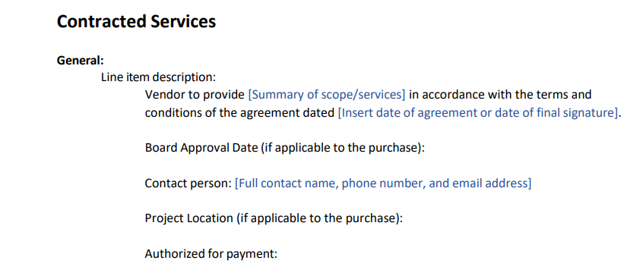
Purchasing Requisition Language Templates
Purpose: to effectively guide the end user, ensure all elements of the PR are included, and to avoid delays
PR should list any relevant quote or invoice numbers, and agreements
Description – following the Purchasing Services Resource page, determine which template is best suited for your PR type
Printed comments – displays vital information such as cooperative contract and board approval (if applicable), or terms of lease agreement
Comments – displays location/department e.g. DO, PURCHASING SERVICES
When generating a blanket purchase requisition, verbiage must be in ALL CAPS in its entirety

Slide 25
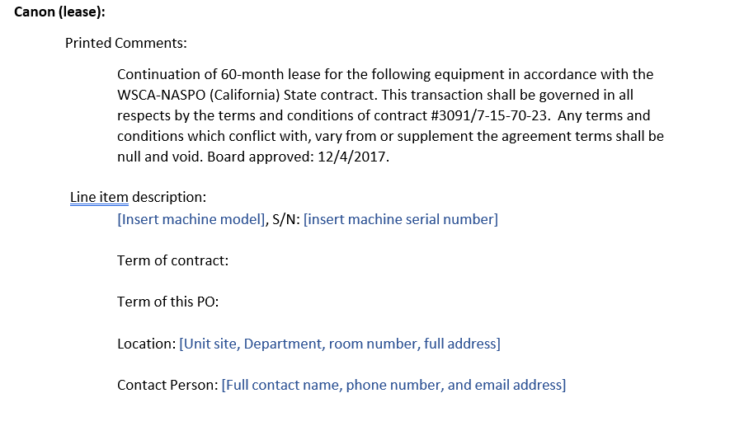
Purchasing Requisition Language Templates
Purpose: to effectively guide the end user, ensure all elements of the PR are included, and to avoid delays
PR should list any relevant quote or invoice numbers, and agreements
Description – following the Purchasing Services Resource page, determine which template is best suited for your PR type
Printed comments – displays vital information such as cooperative contract and board approval (if applicable), or terms of lease agreement
Comments – displays location/department e.g. DO, PURCHASING SERVICES
When generating a blanket purchase requisition, verbiage must be in ALL CAPS in its entirety

Slide 26
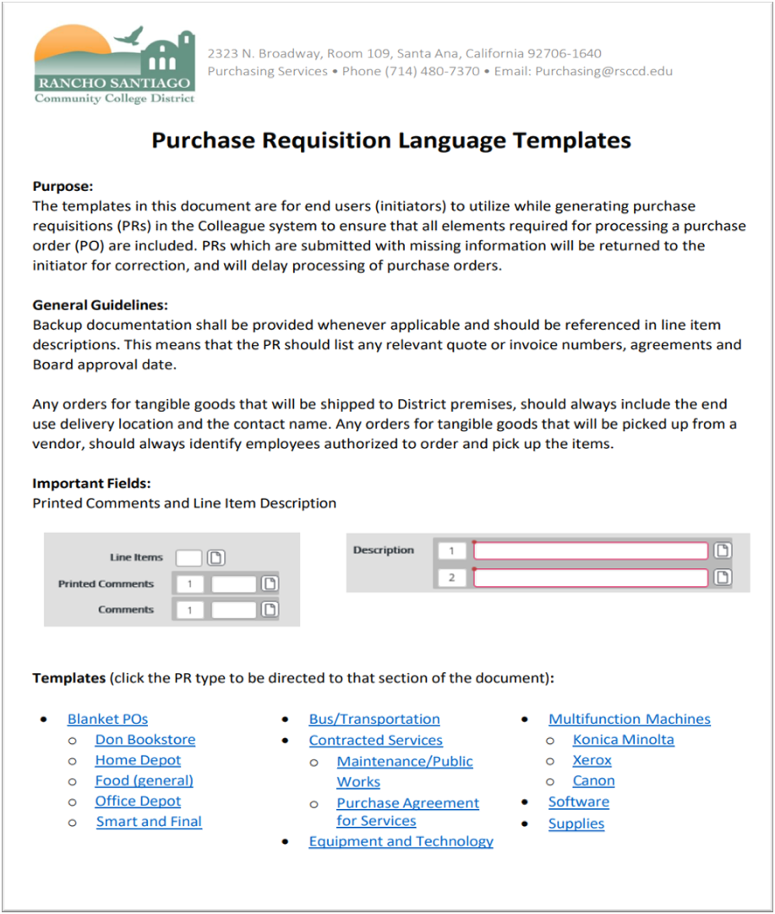
Purchasing Requisition Language Templates
All supplies and equipment must be delivered to the District Warehouse or Direct Delivery to offices (address to be presented in the description)
Where do I find this resource?
Employee Intranet homepage > Purchasing Services > ​​​​Purchase Requisitions, Purchase Orders and Colleague > PR Language Templates
Or click here.

Slide 27
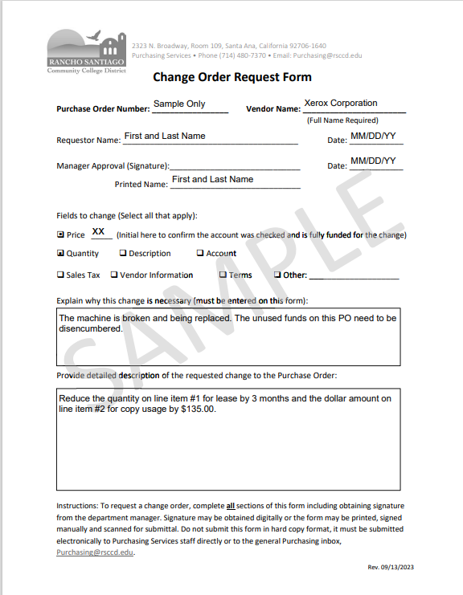
CHANGE ORDERS
Keep description simple yet necessary
With an increase of 20% or more, a second PO must be issued
Requires management approval
Submit electronically to your direct buyer
ChangeOrderRequestForm.pdf

Slide 28
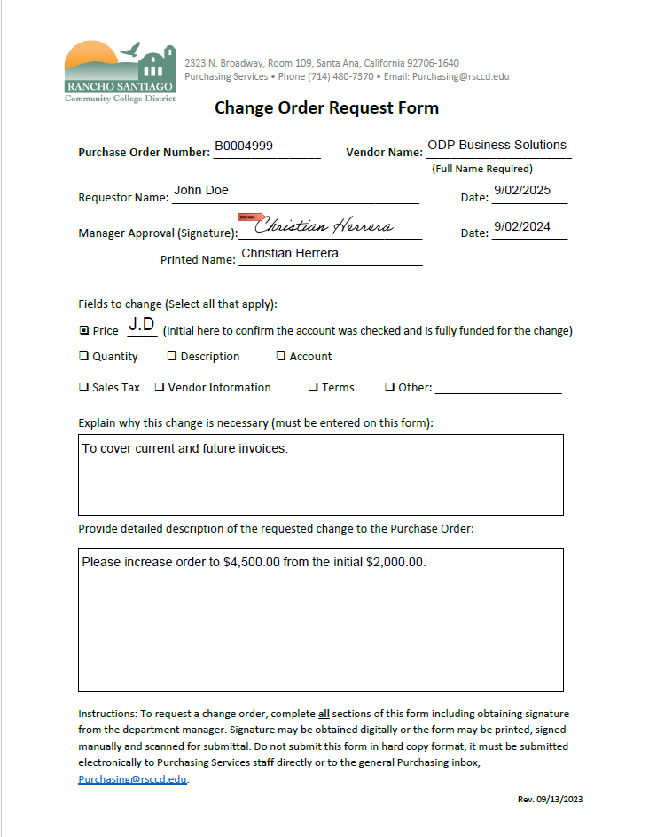
Is this change order request form filled out properly?

Slide 29

Invalid – Manager signature is required
Invalid – Fiscal years do not match
Increase is above the 20% tolerance; A new order is required for the additional amount

Slide 30
Insurance
Link: Insurance Requirements
All contractors, vendors, or service providers coming on to District premises are required to have insurance
Departments request Certificate of Insurance (COI) and for the District to be endorsed as an additional insured
Prior to beginning of work and/or start of contract
Supporting document with Purchase Requisition (PR)
Cover whole term of service or contract
Request new insurance
Breach of contract – stop work

Slide 31
Minimum Insurance Standards
General Liability Coverage
Each Occurrence: $1,000,000
General Aggregate: $2,000,000
Products/Completed Operations Aggregate $1,000,000
OCCUR is checked
Automobile Liability
Owned, Scheduled, Non-Owned, or Hired Automobiles with a combined single limit: $1,000,000
Worker’s Compensation
$1,000,000 per accident for bodily injury or disease
PER STATUTE is checked
Certificate Holder
Name and Address: Rancho Santiago Community College District

Slide 32
Other Insurance Requirements
Additional Liability Coverages
Cyber Liability, Errors and Omissions, Professional Liability, Sexual Abuse/Molestation Coverage (required if any minors are present), Umbrella or Excess Liability
Additional insured endorsement forms
Policy number
Policy naming: The Rancho Santiago Community College District, its officers, employees, volunteers, representatives and agents of each of them as additional insureds
Contact Risk Management, Don Maus
Waivers or exemptions
Additional Liability Coverages (Example: IT purchases, professional services, etc.)
Except: Professional liability and worker’s compensation

Slide 33
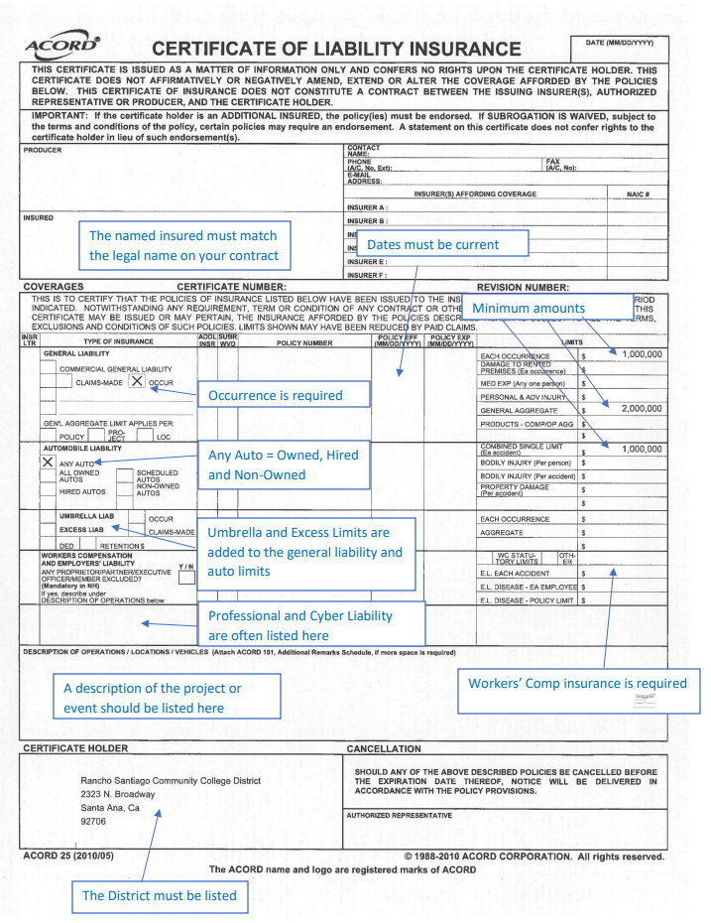
COI Sample
Requirements

Slide 34
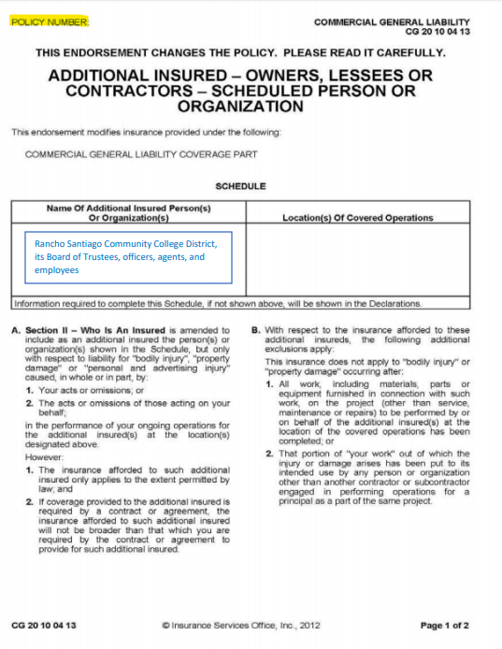
COI Sample
Requirements

Slide 35
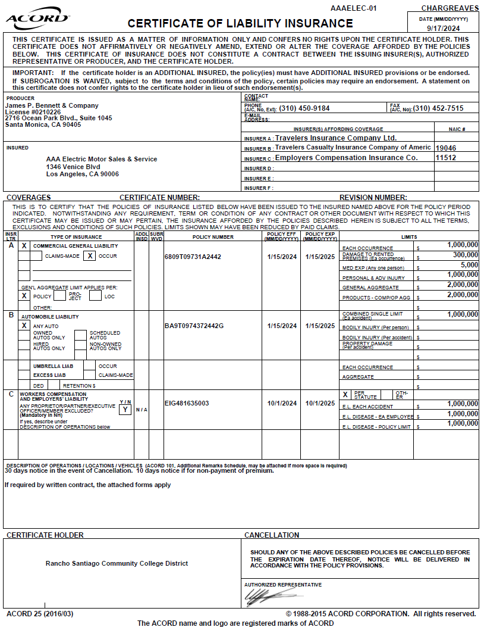
Is this form acceptable?

Slide 36
Expired Coverage
District name AND address

Slide 37
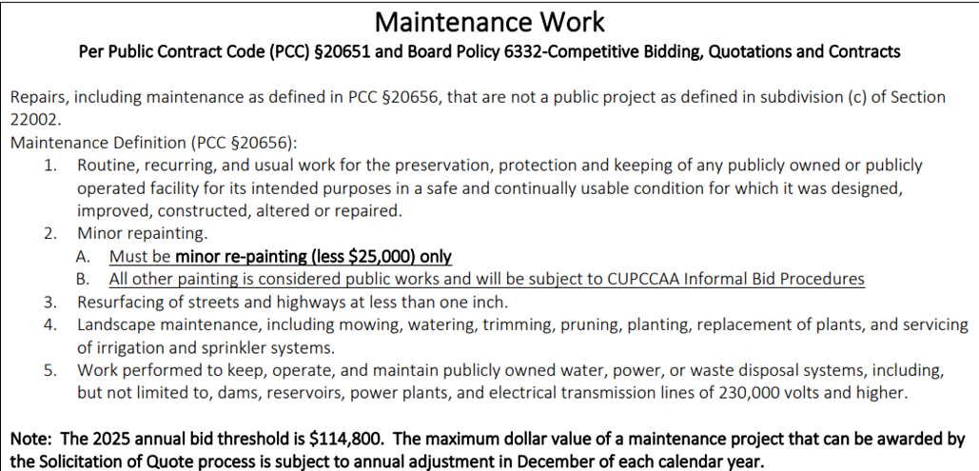
When to use an FAS:
Maintenance Services

Slide 38
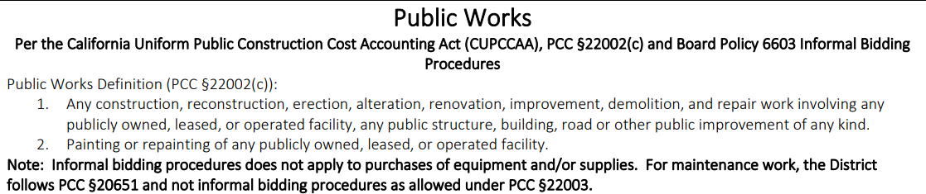
When to use an FAS: Public Work
If it’s not for maintenance or public works, you will need a purchase agreement

Slide 39
Do I need an FAS?
Scope of work:
“I need to fix a water dispenser. I also want someone from the company to come every other month to clean it. They said the initial estimate for the repair is $499. They have a maintenance service package for $100 a month. Do I need an FAS?”

Slide 40
Do I need an FAS?
Scope of work:
“I need to fix a water dispenser. I also want someone from the company to come every other month to clean it. They said the initial estimate for the repair is $499. They have a maintenance service package for $100 a month. Do I need an FAS?”
Questions to ask
1. Repair: what is involved?
2. Maintenance: what is involved?
3. Dollar amount: $499 + $1,200 = $1,699
If the repair and maintenance require touching, affecting, or adjusting public works, then an FAS is required.

Slide 41
Do I need a Purchase Agreement?
The purchase agreement is to be used for applicable purchases. Circumstances in which the purchase agreement does not need to be used are as follows:
  Services for public works;
  Maintenance services;
  The purchase of goods where the use of competitive quotes are sufficient (including food without any services);
  An active agreement exists that covers the term of the services;
  A cooperative contract covers the scope of the services.
All other circumstances require a purchase agreement.

Slide 42
Do I need a Purchase Agreement
Statement of Work:
Software: $1,000.00
Implementation, including server and kiosk installation: $2,199
Kiosks: 3 each at $1,800

Slide 43
Do I need a Purchase Agreement
Statement of Work:
Software: $1,000.00
Implementation, including server and kiosk installation: $2,199
Kiosks: 3 each at $1,800
Questions to ask:
1. Does installation affect public works? If so, then an FAS is required and no PA is required
Otherwise, a purchase agreement is needed.

Slide 44
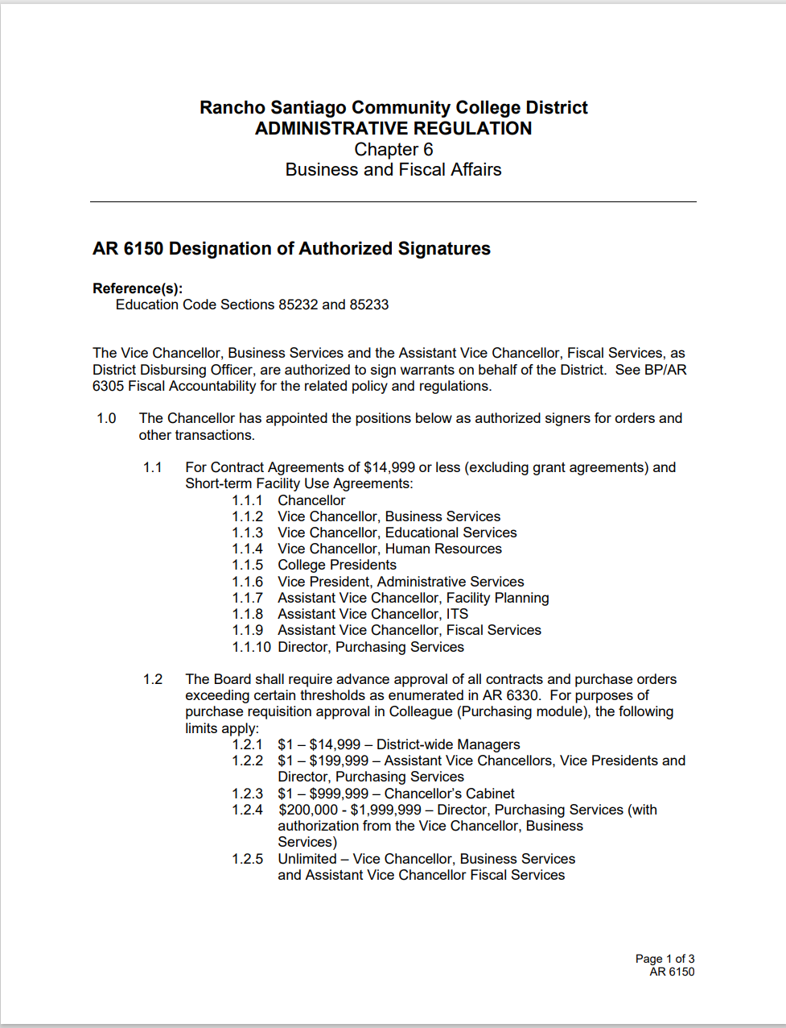
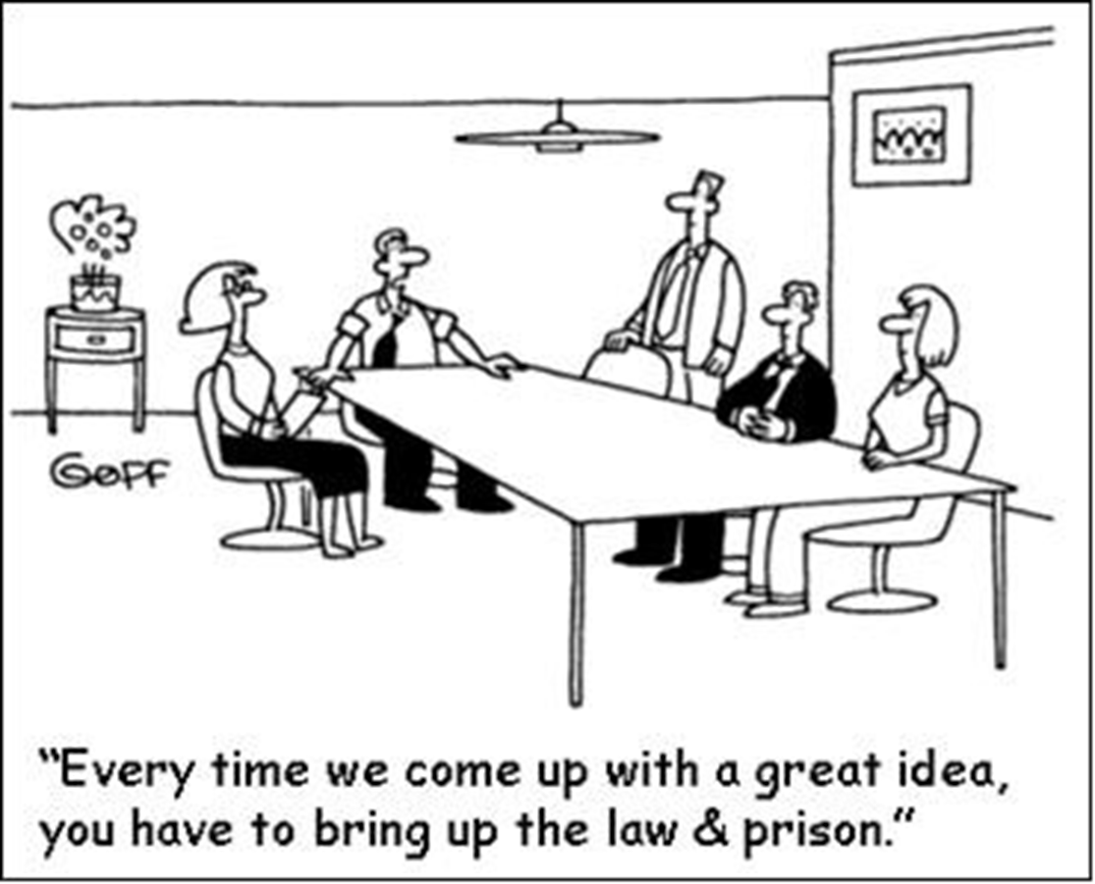
AR6150

Slide 45
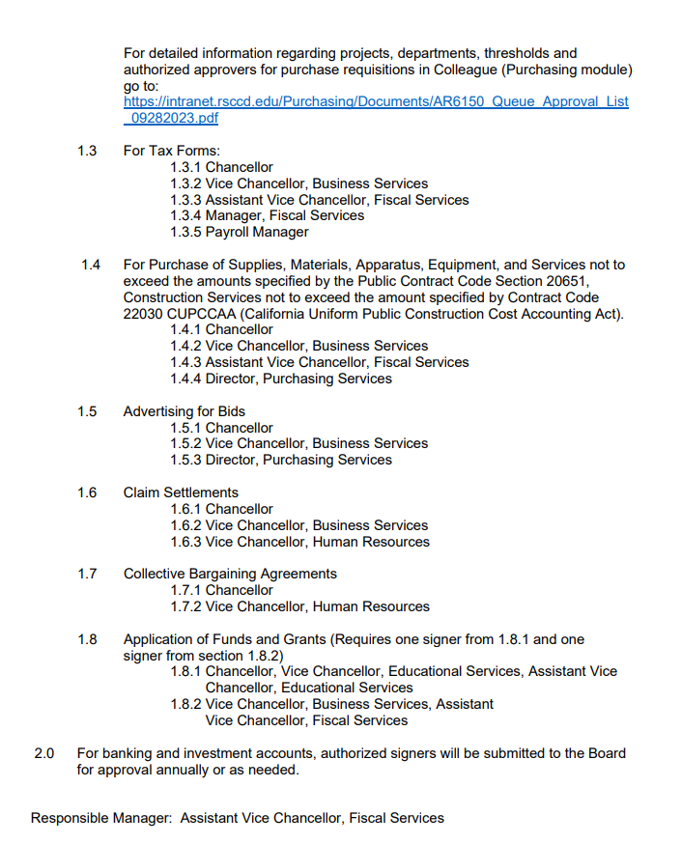
AR6150

Slide 46

Away We Go Travel
Resource page
Follow steps 1 - 4

Slide 47
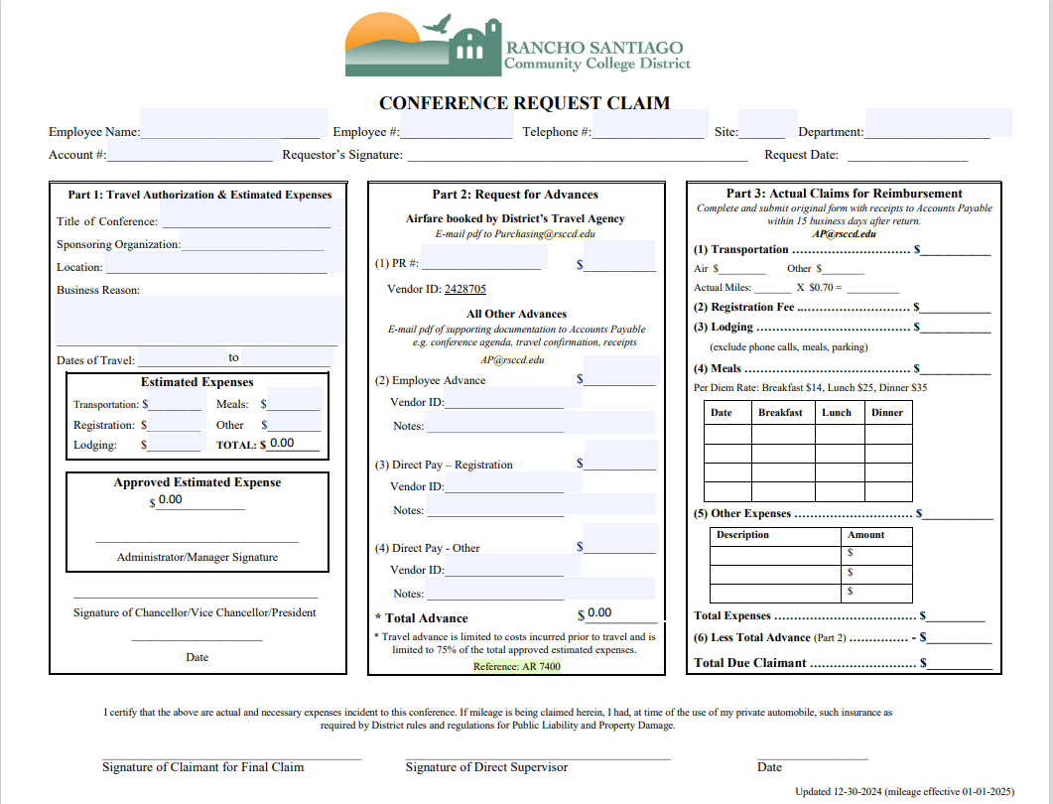
Away We Go Travel
Step 1: Complete
Conference Request Claim Form
Step 2 –Contact AWGT
For employees who are travelling, log into www.awaywegotravel.comwebsite.
For groups of 10 or more travelers, contact AWGT at: (562) 690-3339 to set up a group profile

Slide 48
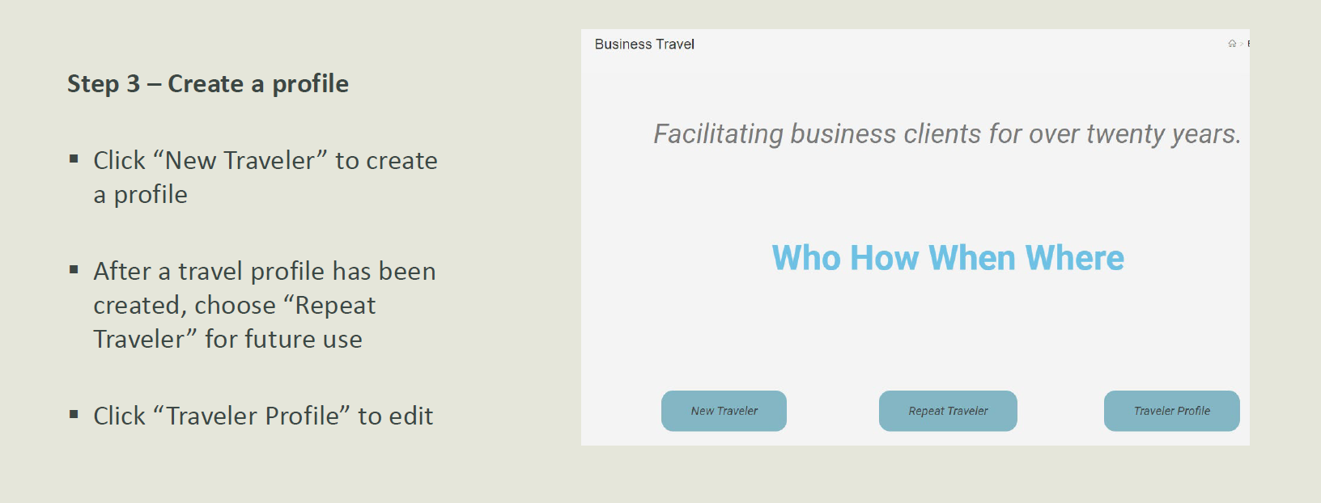

Slide 49
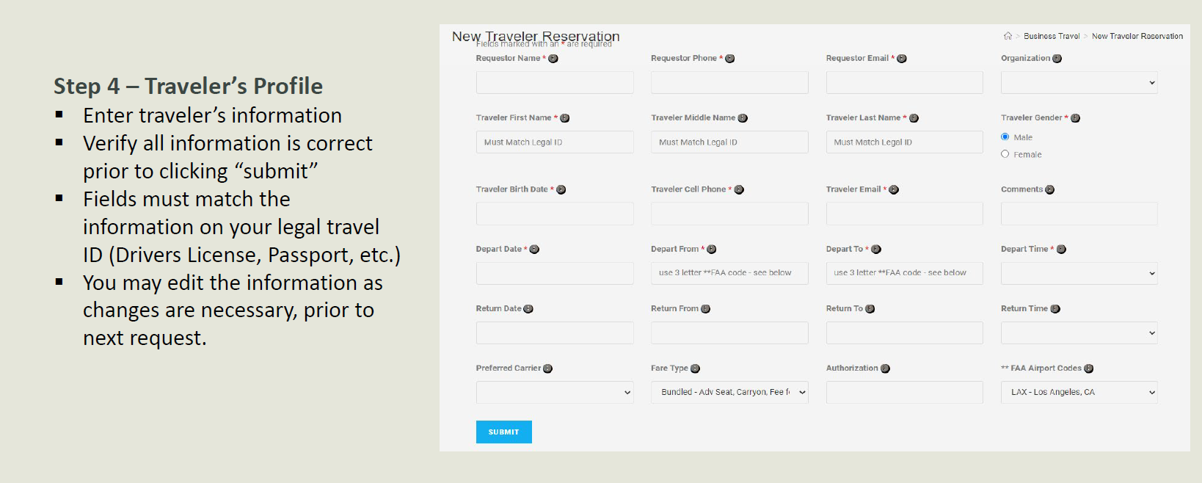

Slide 50
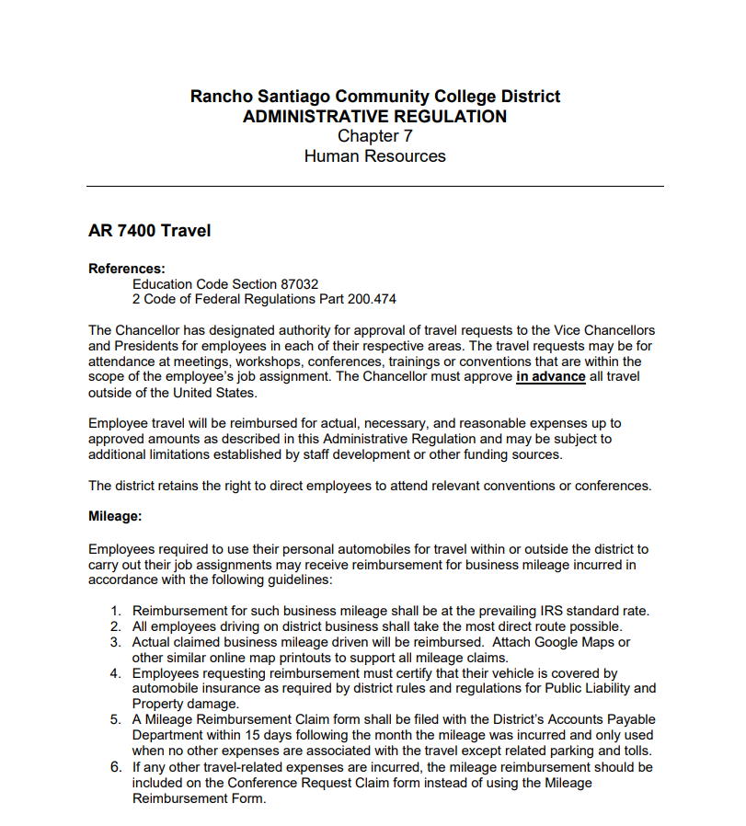
Away We Go Travel
AR 7400

Slide 51
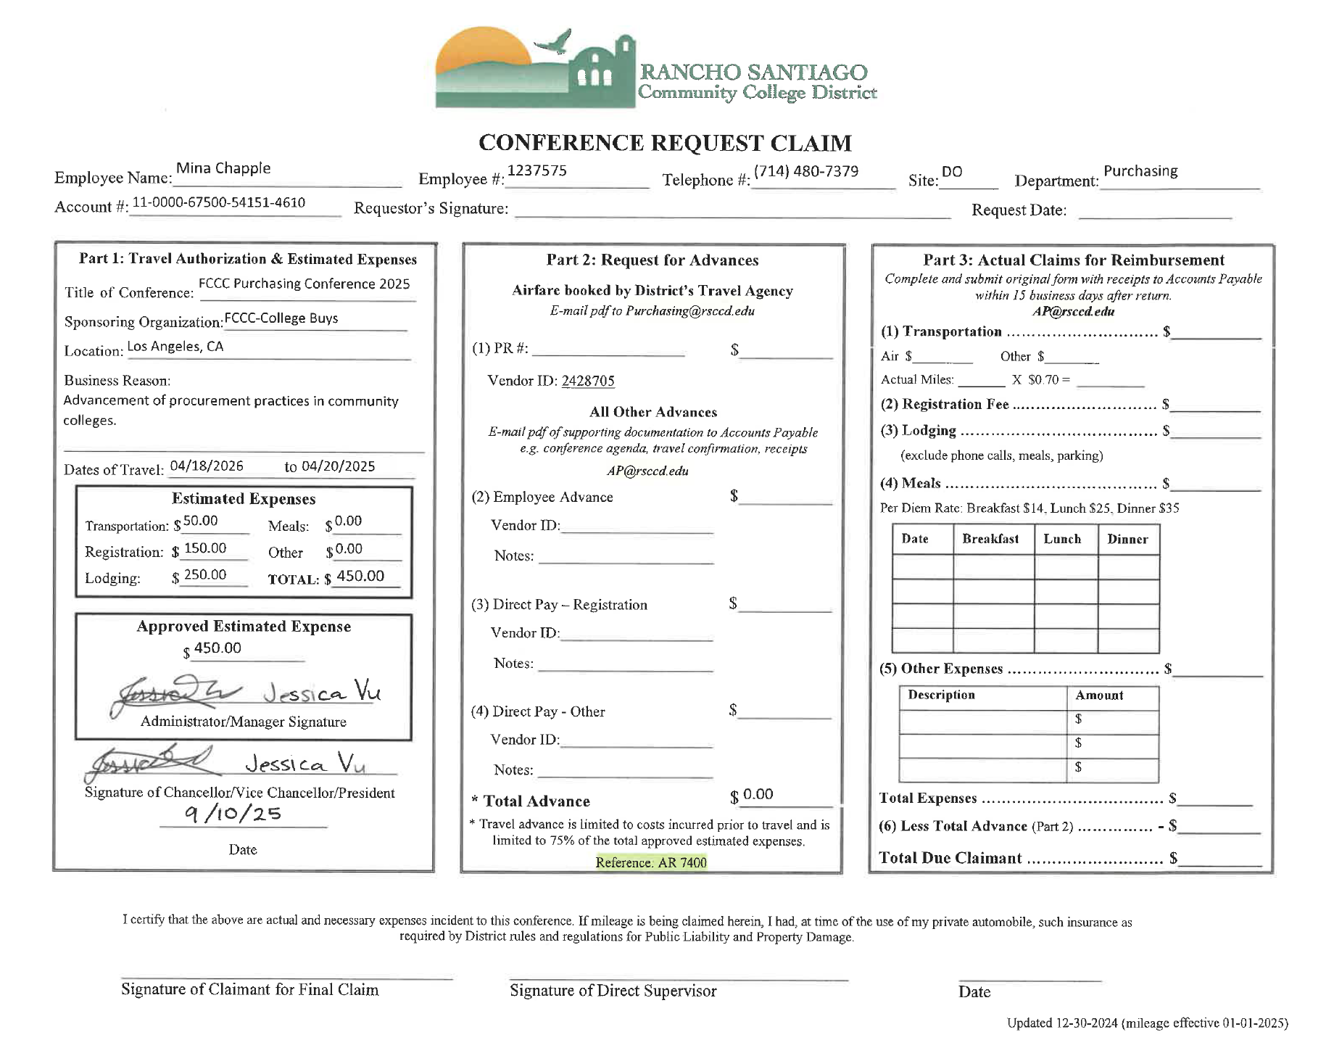
Is this acceptable?

Slide 52
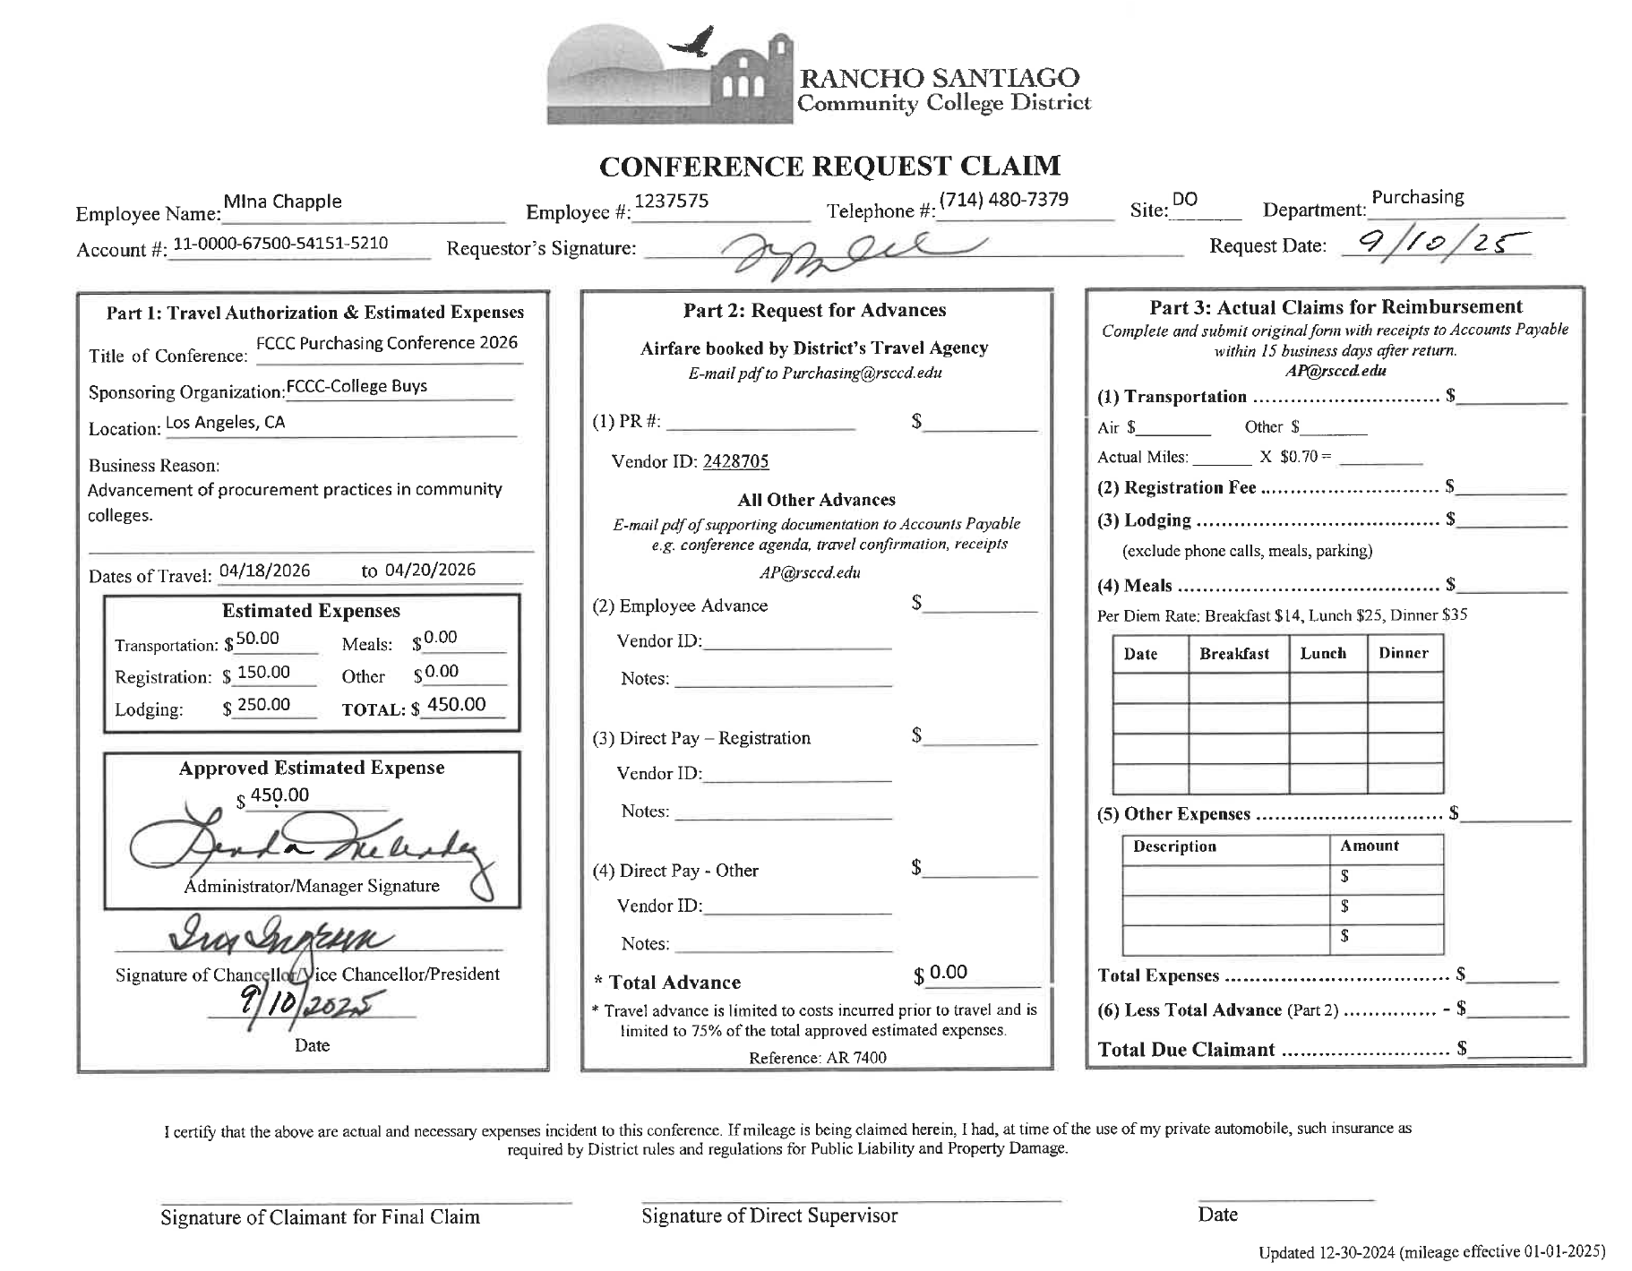
Requester signature is required
Improper object code being used (4610)
Request date is required
Incorrect dates
Administrator/Manager and Cabinet signatures are required under these fields

Slide 53
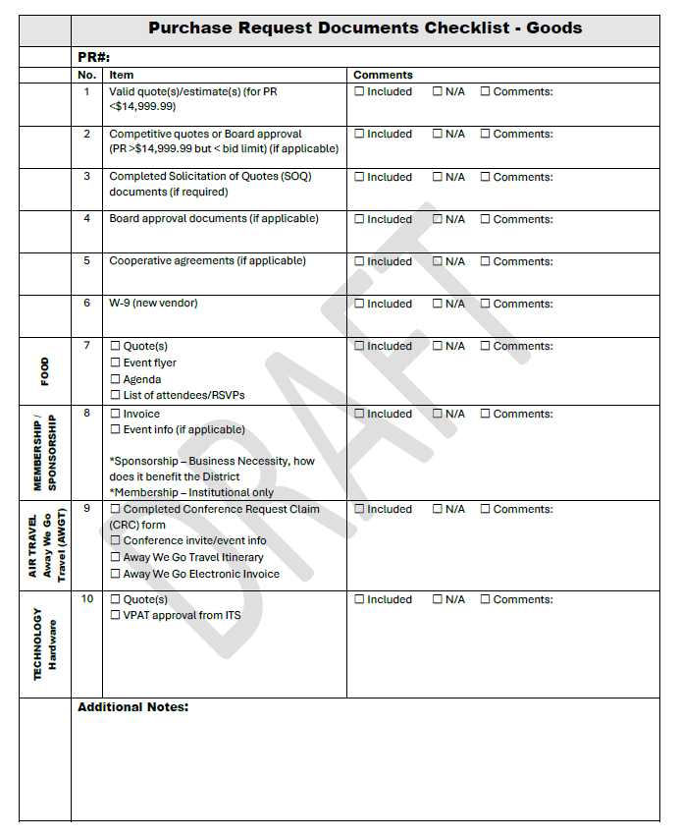
Purchasing Request Documents Checklist

Slide 54
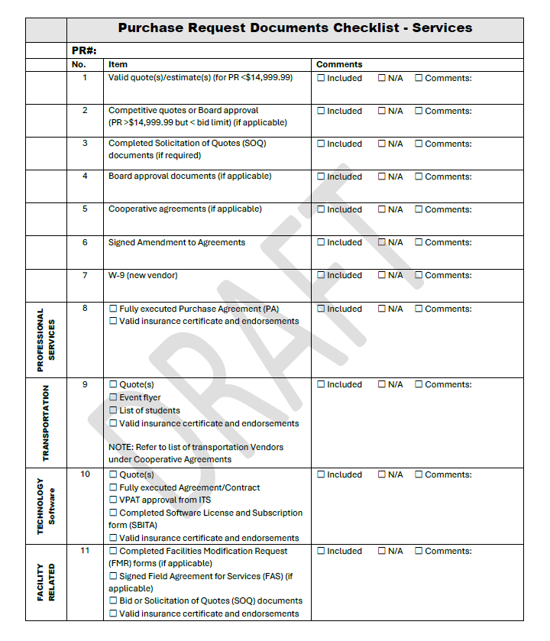
Purchasing Request Documents Checklist

Slide 55
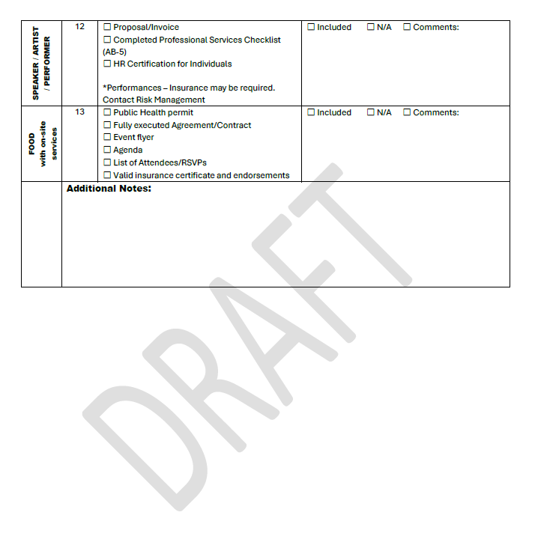
Purchasing Request Documents Checklist

Slide 56
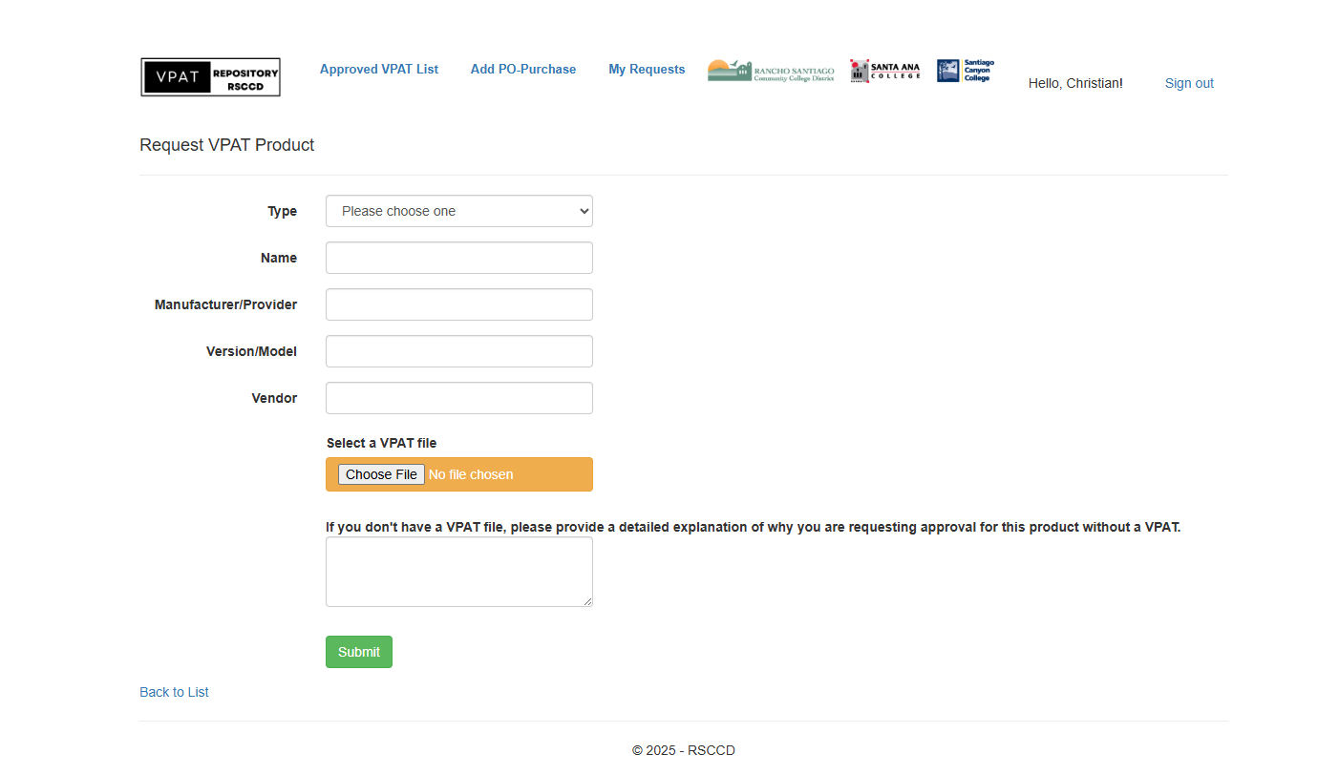
VPAT REPOSITORY

Slide 57
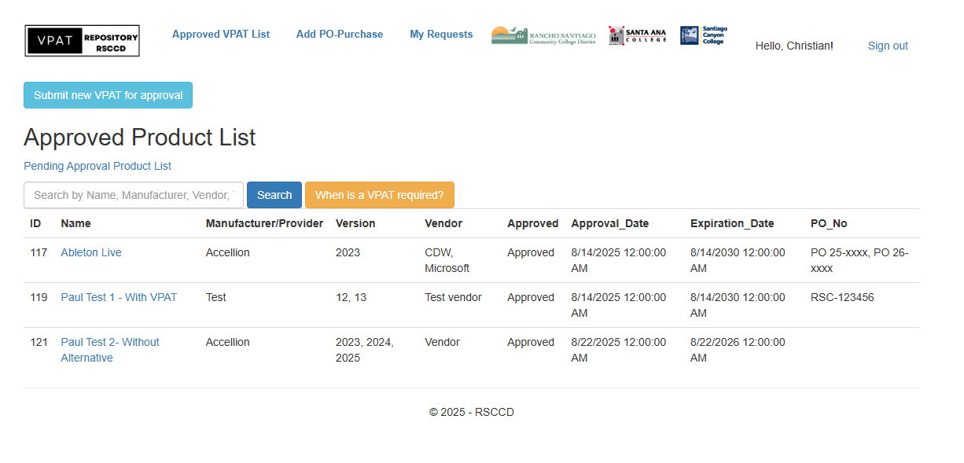

Slide 58
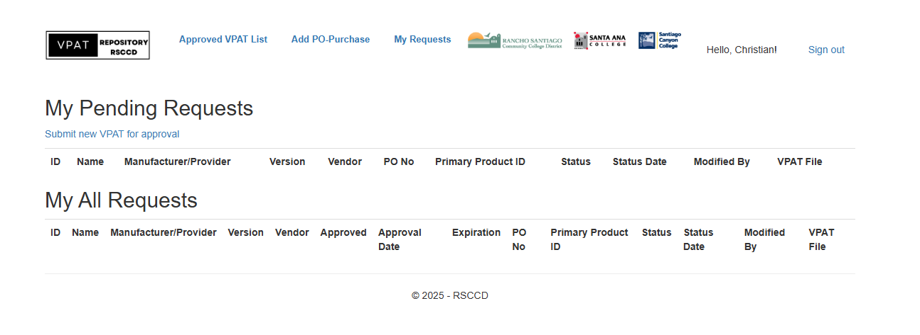

Slide 59

Questions?

