Slide 1
Purchasing & Fiscal services Training
December 07, 2021

Slide 2
AGENDA
FISCAL SERVICES
BUDGETS
  GL0010 Budget Report
  Frequent used object codes
  Budget transfers process and lead times
  Fiscal deadlines memo
  Travel, AR7400
PAYMENTS
  Prepayments
  Holding invoices
  Requests for checks
  Payment timelines
PURCHASING SERVICES
  RESOURCES
    Deadline memo
    Approval & signature resources
    Instructional supply memo
    Purchasing Services Handbook
    REQM Quick Guide
    Dollar Amount Limitations for Procurement
    PR Language Templates
AUDIT
  REQUIRED COMPLIANCE

Slide 3
BUDGET

Slide 4
Gl0010 Budget recap report
GL0010:
  Shows summary of budget to actuals by GL account for your department or project.
  Shows availability of funds.
  Can be used to check availability of funds before entering a purchase requisition in Colleague.
  Can be used to determine if budget transfers are needed and which GL accounts can be used.

Slide 5

Gl0010 Budget recap report
Accessing GL0010 Report via the Online Repository Report
  Information Technology Services homepage > Under “Links” > “Report Repository Login”
  Use Colleague username and password to login. Select “Production” environment.
  Find and click on “GL0010 Budget Recapitulation”.
Notes:
TIP: You can add this link to your bookmarks so it’s easily accessible.
TIP: If you need access to a specific report and don’t have access, please send a request for access to helpdesk@rsccd.edu.

Slide 6
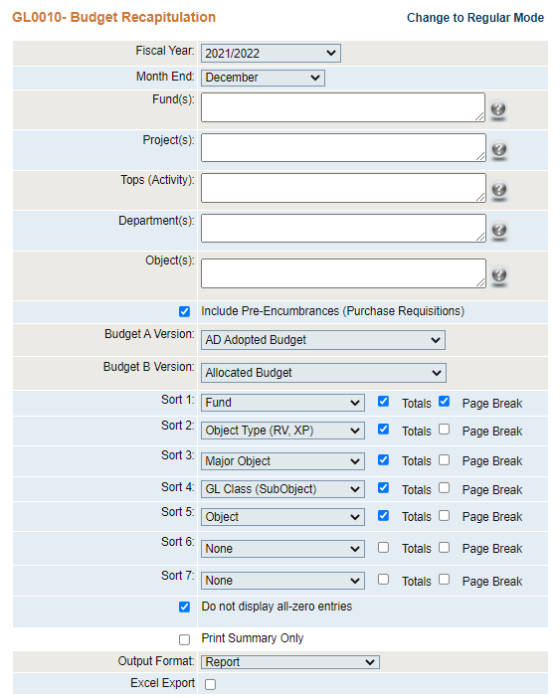
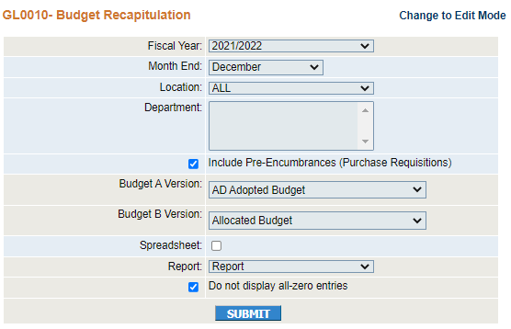
EDIT MODE
REGULAR MODE
Notes:
The report menu is available in 2 modes (Edit and Regular Mode).
Click “Change to Regular Mode”. Regular mode is the easiest way to run a complete GL report for your department. Edit Mode can be used to run the report with additional parameters.

Slide 7
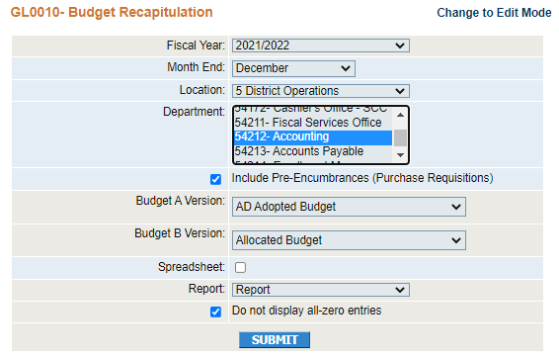
Gl0010 Budget recap report
REGULAR MODE
Can only be run fiscal year-to-date and cannot cross fiscal years.
Select Location and Department from dropdown.
Report will show availability of funds and will include purchase requisitions if box is checked.
Budget A Version and Budget B Version fields are populated by default.
Report will exclude accounts with zero balance if box is checked.
Output formats: Report, Word, PDF, and Excel.
Notes:
You will need to select/enter the report parameters to run the desired report.
The report can only be run by fiscal year and cannot cross fiscal years. A fiscal year is July 1 through June 30 of the next year. Fiscal Year 2021/2022 would refer to the fiscal year beginning July 1, 2021.
In the report menu, the “Fiscal Year” field defaults to current fiscal year but you can select a prior fiscal year from the dropdown. “Month End” defaults to the current month but you can select a different month from the dropdown.
“Include Pre-Encumbrances (Purchase Requisitions)” is checked by default. We recommend leaving this checked so your report shows you an accurate picture of available funds.
Budget A Version and Budget B Version fields populate by default. The Adopted Budget is the budget that was Board approved in August/September. The Allocated Budget is the current budget including budget changes that have subsequently posted. We recommend using the default options so your report shows current budget information.
“Do not display all-zero entries” is checked by default. Uncheck this box if you’d like your report to include accounts that have a zero balance.
Select the Output Format for your report from the dropdown. You can select Report, PDF, or Word. You can also check “Excel Export” if you’d like the report in Excel.
Regular Mode offers more ways to enter report parameters and more way to sort and subtotal data.

Slide 8
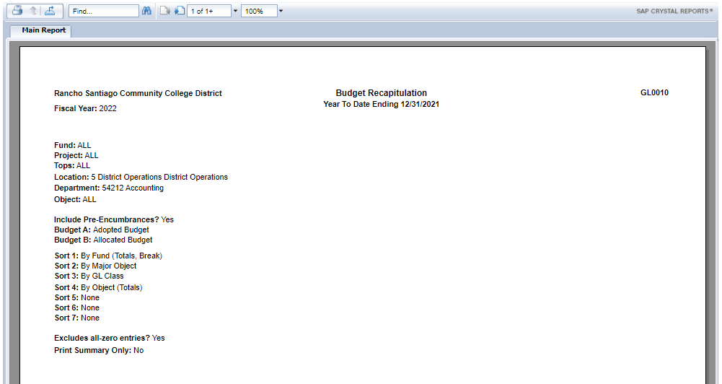
Notes:
For this demo, we selected “report” as the output format.
The first page of the report will show the report parameters that were selected and the period covered.
In the top menu bar, click on the “next page” icon to navigate to the next page.

Slide 9
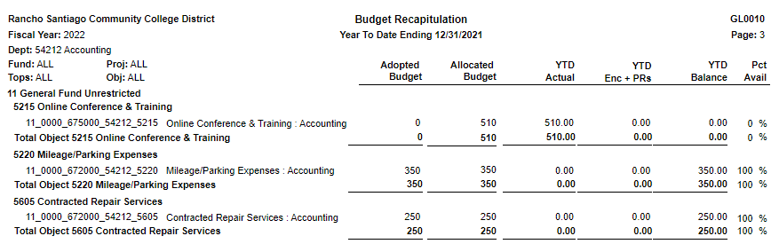
A B C A - B - C
“YTD Actuals” represents actual expenses. It includes any transfers of expenditure (TOEs) that have posted.
“YTD Enc + PRs” represents encumbrances and purchasing requisitions.
“YTD Balance” shows the amount of budget available to spend in the account. It is the allocated budget, less actual expenditures, less encumbrances and requisitions.
Notes:
This report will show your department’s GL accounts on the very left and subtotals are in bold. You’ll see the report shows a short description of the object code. Object codes are how we classify financial transactions and are based on the State’s Budget and Accounting Manual.
“Adopted Budget” is the budget that was Board approved in August/September.
“Allocated Budget” is the current budget including budget changes posted subsequent to the Adopted Budget.
“YTD Actuals” represents actual expenses. It includes any transfers of expenditure (TOEs) that have posted.
“YTD Enc + PRs” represents encumbrances and purchasing requisitions.
“YTD Balance” shows the amount of budget available to spend in the account. It is the allocated budget, less actual expenditures, less encumbrances and requisitions.
TIP: If a GL account has a negative “YTD Balance”, this indicates that the account is overspent. A budget change should be submitted to transfer budget to this account.
Again, this report shows summary-level detail of the budget, actuals, encumbrances, and available balance by GL account.
TIP: You can use ACBL to drill into account detail for a single account at a time. You can use a GL0210 report to drill into account detail for multiple accounts at a time.

Slide 10
Frequently used object codes
New Resource! Expanded Descriptions of Frequently Used Object Codes
Proper and consistent classification of financial transactions
Where do I find this resource?
  Business Services Department homepage > Fiscal Services (left pane) > Fiscal Services Resources (left pane) > Fiscal Services Forms, Manuals & Other Processes > Under General Ledger > “Frequently Used Object Codes – Expanded Descriptions”.
  https://rsccd.edu/Departments/Fiscal-Services/Documents/FISCAL_FAQs/Frequently%20Used%20Object%20Codes%20-%20Expanded%20Descriptions%20-%20FINAL.v2%20VERDANA%2011-09-21.pdf
Notes:
The next item on the agenda is Frequently Used Object Codes.
At the request of some of our end users, we created a new resource to assist end users in selecting the proper object code and to help us districtwide to account for financial activity consistently.
I previously made reference to the State’s Budget and Accounting Manual. That manual is the guidance that all CA community colleges are required to follow when accounting for financial transactions (including purchases, salaries, other expenditures, revenues, assets and liabilities). The proper and consistent classification of financial transactions is really important for audit and financial reporting purposes. We may or may not realize it but many of us play a really important role in helping to ensure financial transactions are properly accounted for (whether we’re entering purchase requisitions or reviewing them, or entering status change forms or reviewing these items). When you’re selecting the proper GL account, it reduces the risk of having a deficiency noted in the districtwide audit report.

Slide 11
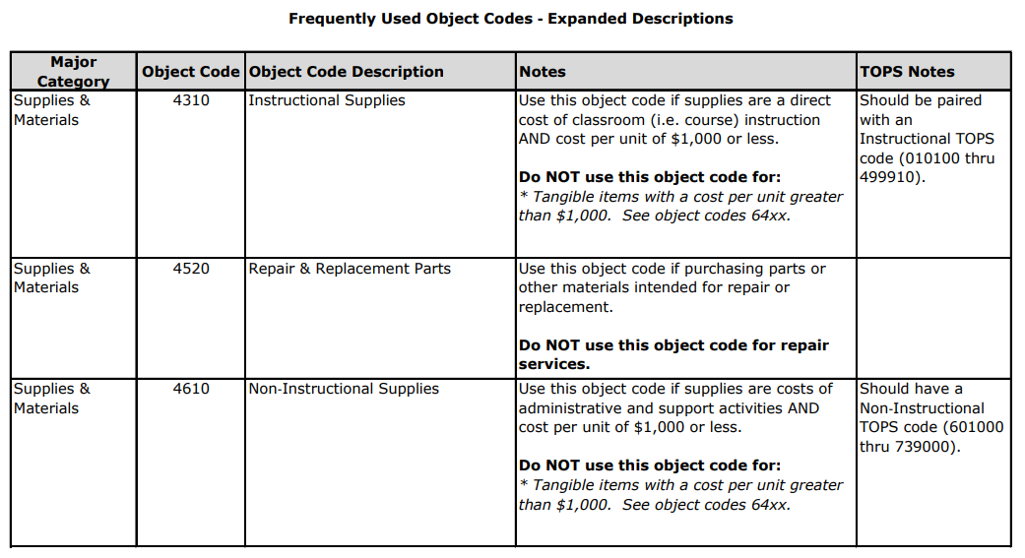

Slide 12
Budget transfers process
Electronic budget changes (e-BCFs) submitted through Web Advisor.
Link to instructions. https://rsccd.edu/Departments/Fiscal-Services/Documents/BC_Instructions.pdf
The e-form checks that accounts are active and for availability of funds.
Approval routing rules were determined by the College.
  Originator > Approver 1 > VP/Approver 2 (if required) > Admin Services Budget Check (if required) > Admin Services VP (if required) > Resource Development (if required) > Budget Analyst (if required) > Fiscal Approver.
If e-BCF is approved by everyone in the approval queue same day, the e-BCF can post the next morning.
Perceptive sends daily automated reminders to approvers. Approvers should check queue at least twice daily.
Please note there are periods when the budget is frozen and we cannot process budget changes during that time. This could impact ability to submit purchase requisitions.
Notes:
How quickly e-BCF posts depends on how quickly approvers in the queue review and sign-off.
The more often each approver check their queues, the faster the BCFs will be processed.

Slide 13
Budget & accounting deadlines
Fiscal Year-End Calendar is distributed end of January or early February through District Announcements.
Includes critical deadlines for every department’s budget changes, invoices and reimbursements, accruals, transfers of expenditure, timecards.
Deadlines are driven by the budget calendar and the Orange County Department of Education (OCDE).
  Required to maintain accounting balances in Colleague and with OCDE.
OCDE requires our district to close our books by July 31st.
Busiest time of the year for Fiscal Services are the months of June through mid-September.
Summer vacations? Please keep Fiscal Year-End deadlines in mind! Missed budget changes, TOEs, invoices can impact your next fiscal year budget.
Notes:
Work has to be completed by the fiscal year-end deadlines (i.e. calendar) regardless of planned vacation. Please plan accordingly.

Slide 14
TRAVEL AR 7400
Reminders!
Purchase requisitions should no longer be submitted for travel including conference registration. The only EXCEPTION is if using the District’s travel agency.
Meals are reimbursed based on per diem. $12 for breakfast, $22 for lunch, and $30 for dinner.
Please make sure to submit conference and mileage claims within 15 business days.
Please refer to instructions for completing the Conference Request Claim Form. https://rsccd.edu/Departments/Fiscal-Services/Documents/FISCAL_FORMS/Travel_Instructions.pdf
The presentation shared at Management Council can be found here. https://rsccd.edu/Departments/Fiscal-Services/Documents/AR%207400%20Overview.pdf

Slide 15
pAYMENTS

Slide 16
Prepayments faqS
Prepaid Conferences, Services & Licenses
Reminder Email sent through District Announcements on December 6, 2021
What are prepayments?
Prepayments are payments made by the District to vendors for conferences, services, or licenses that occur or that have a service term beyond the current fiscal year.
Prepayments include payments made by the District in the current fiscal year for:
Registration fees or airfare for a conference that occurs in a future fiscal year.
Services or licenses (e.g. software licenses, subscriptions, advertisements) that have a service term that ends in a future fiscal year.

Slide 17
Prepayments faqS
Are prepayments permissible?
Prepayments for conference registration fees and airfare are permissible. As part of sound fiscal management, other prepayments should only be requested when the vendor requires advance payment, or when prepayment would result in a significant cost savings for the District. Please keep in mind that prepayments result in forgone interest income for the District.
How do prepayments affect my budget?
For accounting purposes, the expense related to a prepayment is recorded when or as the benefit is received.
Prepaid conference registration fees or airfare are charged to the fiscal year budget in which the conference occurs. The vendor will be paid in full in the current fiscal year but if the conference occurs next fiscal year then 100% of the expense will be charged to your next fiscal year’s budget.
Prepaid services, which have a service term beyond the current fiscal year, are charged to your budget over the service term. Thus, prepaid services will impact your budget in a future fiscal year(s). The portion of the prepayment charged to your budget in each fiscal year is based on the number of service days in each fiscal year divided by the total number of days in the service term.
The Accounting Department manually tracks each prepayment and calculates prepaid expense for the current fiscal year. Prepaid entries are posted periodically to shift expense to the proper fiscal year(s).

Slide 18
Prepayments faqS
Can I spend down my current fiscal year budget by prepaying for conferences, services, or licenses that occur in a future fiscal year?
Not necessarily. The District is required to comply with generally accepted accounting principles. For that reason, only the portion of the prepayment that provides benefit in the current year will be charged to your current fiscal year budget. The remaining portion will be charged to your budget in future fiscal year(s) as the benefit is received.
How do I submit invoices for prepaid services or licenses?
Whenever possible, invoice terms on purchase orders and agreements should coincide with the District’s fiscal year (July 1 to June 30). For example, if the service term is 05/01/2022 to 04/30/2023, please request two invoices from the vendor one for FY 21/22 (for period 05/01/22 to 06/30/22) and another for FY 22/23 (for period 07/01/22 to 04/30/23). Many vendors are willing to accommodate these invoice terms as long as payment is not delayed. Invoices signed by the appropriate Administrator should be submitted to Accounts Payable as soon as received.

Slide 19
Prepayments faqS
What recommendations do you have for managing my budget?
We advise departments to please request that vendors provide invoices that coincide with the District’s fiscal year (July 1 to June 30). This will help you to know how much expense related to the prepayment will be charged to your budget in the current fiscal year and the next fiscal year(s). Many vendors are willing to accommodate these invoice terms.
Can I prepay conferences, services, or licenses using grant funds (Fund 12 or 33)?
No, unless the grant award explicitly allows prepayments or documented pre-approval from the grant sponsor is obtained.

Slide 20
Holding invoices
Expenses must be recorded in the proper fiscal year.
  Payment of invoices
  AP Accrual – an accounting entry to record the expense and liability incurred based on a tentative invoice or an estimate.
  Failure to record expense in the proper period results in misstated financials.
  External auditors perform tests to catch invoices paid in the wrong fiscal year.
  Significant and or material errors could result in a deficiency noted in the district’s audit report.
The Accounts Payable Team reviews all open POs at year-end to identify AP Accruals.
Not enough budget to pay an invoice?
Takeaways:
  Importance of submitting invoices by the deadline with signed signatures.
  Importance of submitting purchase requisitions immediately after your agreement is board-approved.

Slide 21
Request for check
Form used for employees to request reimbursement.
Intended for small-dollar supply purchases for immediate need and not to circumvent purchase order process.
Normal expenses should not be going through the check request process.
Request for check limit raised from $250 to $500. See AR 6330.
Should obtain supervisor’s approval prior to purchase.
All check requests are reviewed and approved by Fiscal Services for reimbursement.
Should not be used for purchases of equipment, software or services.
Reduce employee’s liability and reduce the District’s risk of misused of funds.

Slide 22
Payment Timelines
Payment Process
  We process payments for all County Funds (11, 12, 13, 41, 43, 61, 62, 63, 74 & 89).
  AP invoices are reviewed on Mondays & Wednesdays. Batches could include 60-250 invoices.
  Review includes checking for accuracy, proper accounting coding, compliance with BPs & ARs, and sufficient back-up.
  Checks are printed on Tuesdays & Thursdays.
  Checks go to Internal Audit for review, then to AVC of Fiscal Services for sign-off.
  For example, invoices processed on Friday are reviewed on Monday, printed on Tuesday and mailed out or available for pick-up on Thursday.
OCDE cuts us off from issuing checks the last 2 days of the month. In June, the County’s deadline is earlier.
Reminder: Please submit signed invoices in a timely manner to avoid delays.

Slide 23
AUDIT

Slide 24
Audit
Complex and highly regulated government organization and subject to public records request
Levels of oversight and compliance over our financial transactions and operational processes
  Federal
  State
  Local
  Grant agency requirements
  Annual Audit - accounting rules and standards

Slide 25
Audit
Foundational Understanding
  Laws – legislature and Governor
  Ed Code – regulations to codify education laws
  Public Contract Code – regulations to codify
    public purchasing processes
  Board Policies – guidance from Board of Trustees
  Administrative Regulation – implement board policies
Admin. Regulation
Board Policies
Laws / Codes

Slide 26
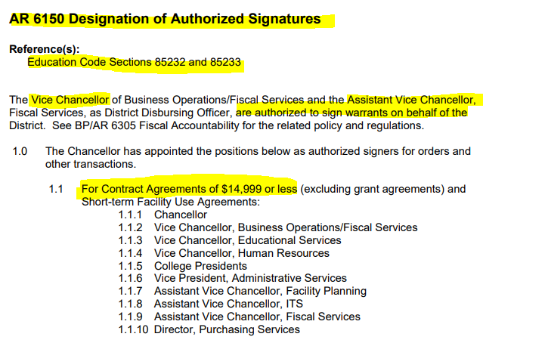
Audit
AR 6150 Designation of Authorized Signatures [RSCCD / Trustees / Administrative Regulations] – Rev 8/24/20

Slide 27
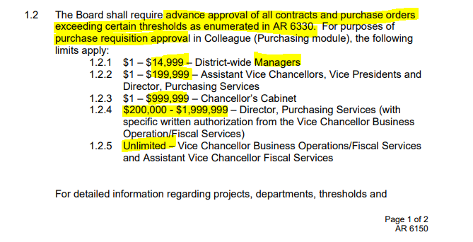
Audit
AR 6150 Designation of Authorized Signatures

Slide 28
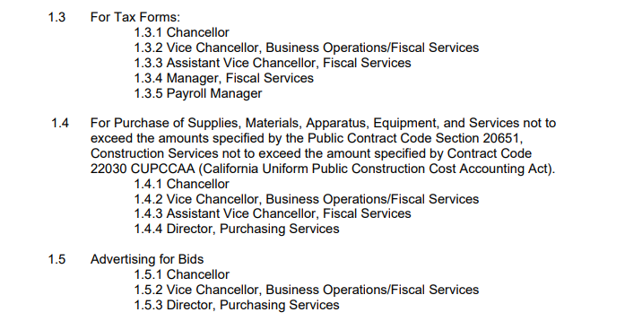
Audit
AR 6150 Designation of Authorized Signatures

Slide 29
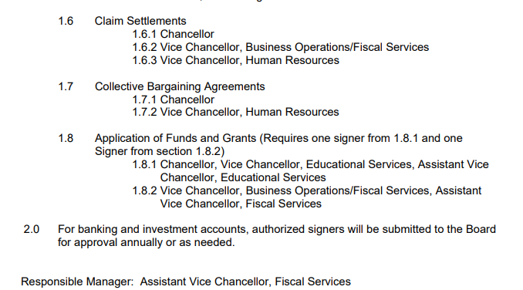
Audit
AR 6150 Designation of Authorized Signatures

Slide 30
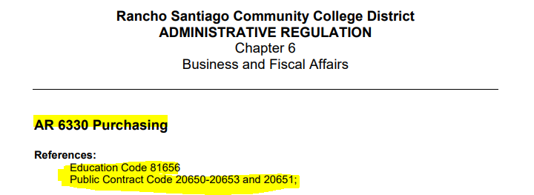
Audit
AR 6330 Purchasing – 5 page document [RSCCD / Trustees / Administrative Regulations]
Complete Rewrite: August 30, 2021

Slide 31
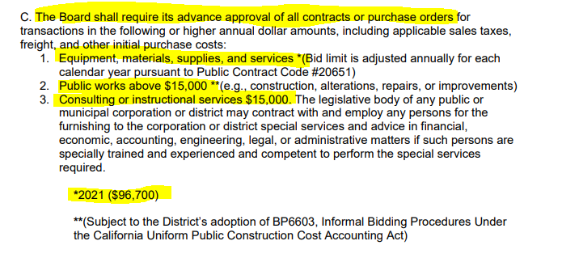
Audit
AR 6330 Purchasing

Slide 32
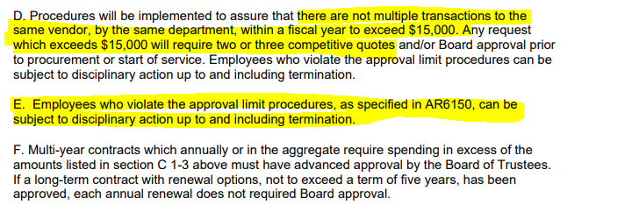
Audit
AR 6330 Purchasing

Slide 33
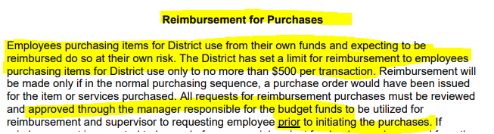
Audit
AR 6330 Purchasing

Slide 34
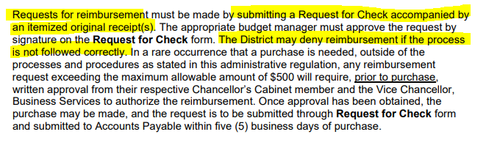
Audit
AR 6330 Purchasing

Slide 35
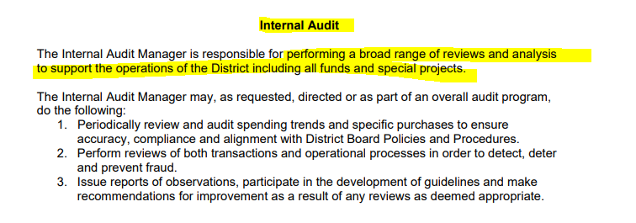
Audit
AR 6330 Purchasing

Slide 36
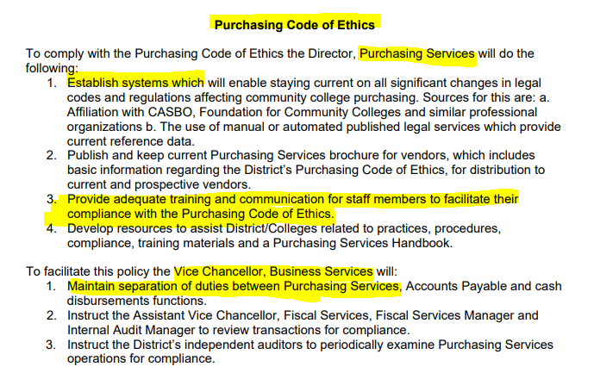
Audit
AR 6330 Purchasing

Slide 37
Audit
Annual Districtwide Audit
  3 audit opinions
    Federal compliance
    State compliance
    Financial Statements are materially correct
  Distribution of audit report & impact

Slide 38
Standard audit requests
Sampling expenditures made during the fiscal year to test for accuracy, proper accounting coding, allowability of expense, and sufficient back-up.
Sampling expenditures made after the fiscal year to test whether expenses were recorded in the proper fiscal year.
Sampling purchase orders for compliance with state and federal requirements regarding solicitation of quotes, bid process, etc.
Sampling purchase orders to ensure internal controls in place to check for debarred or suspended vendors.
Sampling payroll cost including timesheets and status change forms.
Sampling effort certificates for federal programs.
Financial Aid Program
No documentation = Did Not Happen

Slide 39
Audit
2020-2021 Year-End Audit Results
  Team work throughout campuses, district, foundations

