Slide 1
2020 Employee Benefits
Marketing Analysis
Rancho Santiago Community College District
August 17th, 2020

Slide 2
Agenda
Medical
Dental
    PPO
    HMO
Vision
Group Life & Voluntary Life
2020 Employee
Benefits Marketing

Slide 3
Medical

Slide 4
Pool | Response
ASCIP – Incumbent | Renewal received
California Schools JPA (CSEBA) | Declined
California’s Valued Trust (CVT) | Quoted
California Schools Voluntary Employees Benefits Association (VEBA) | Declined
Regional Employer/Employee Partnership for Benefits (REEP) | Declined
Self-Insured School of California (SISC) | Declined
Pool Responses

Slide 5
Pools – Reasons for Declination
Pool | Reason
CSEBA | “Both the PPO and HMO experience and overall age of this group are less favorable than the current CSEBA pool and we do not feel that this would be a good risk for us. 1/3 of the group appears to be lifetime retirees, and that doesn't fit into our underwriting guidelines or strategies for growth.”
REEP | “The driving factor is that the average age of subscribers is substantially older than the REEP averages.”
VEBA | “We have evaluated your information and, at this time, we will not be releasing a quote. In order for VEBA to create custom solutions we begin conversations with prospective groups 9 months prior to the effective date.”
SISC | “Based on the information provided in the RFP, with 150 members missing parts of Medicare, we are declining to quote. Based on the information in the RFP, if Medicare were required, we believe rates for SISC plans would be about 6% higher for actives/early retirees and in the ballpark of $600 per Medicare member.”

Slide 6
Carrier | Response
Aetna | Quoted
Anthem | Quoted
Blue Shield | Quoted
Cigna | Declined
Health Net | Quoted
UnitedHealthcare | Quoted
Direct to Carrier Responses

Slide 7
Impact of Unblended Rates
Active
Medicare Eligible Retiree (65 and Older Retirees)
Early Retiree (Under 65 Retirees)
Quote #1: Current Structure
Quote #2: Medicare Eligible Retirees Carved-Out
Quote #3: All Three Groups Separated

Slide 8
Medicare Eligible Retirees
Retiree Population (346)
No Medicare (18)
Part A +B (196)
Part A Only (132)
Medicare (328)
Move current Medicare eligible to coordinated plan to reduce premium costs
Evaluating the impacts to the remaining populations and the cost of potential Part B benefit penalties
OPEB Liability Impacts

Slide 9
Pending Items
Revised Carrier Rates
  On 8/14, Keenan received large claims reports and timelines for data that were requested to finalize the carrier quotes
ASCIP Renewal
  On 8/14, Keenan received the ASCIP renewal. We are currently awaiting the additional quotes which would allow us to compare options ASCIP has for managing Medicare eligible retirees.

Slide 10
Timeline for Medical Marketing
8/21/2020
Received Final Rates
Week of 8/24/2020
Sent Medical Marketing Update via Email
8/31/2020
Committee Meeting to Discuss Medical Quotes
9/14/2020
Board Meeting for Final Adoption of Committee Recommendations
10/1/2020
Deadline for Notice to ASCIP for Termination of Coverages

Slide 11
Dental

Slide 12
Carrier / Pool | Response
ASCIP – Incumbent (Delta Dental) | Renewal received
Ameritas | Quoted
CICCS Trust – Keenan (Delta Dental) | Quoted
Dental Coalition (Delta Dental) | Quoted
Guardian | Quoted (uncompetitive)
MetLife | Quoted
OCFBJPA (Delta Dental) | Quoted
UnitedHealthcare | Quoted
Dental PPO
Carrier and Pool Responses

Slide 13
Dental PPO Rate Compare

Slide 14
Dental PPO Benefit Compare

Slide 15
Dental PPO Value Add Programs
CICCS Trust
  Roll-Over Benefit: Up to 100% of unused annual maximum for one year
  D&P Waiver
Orange County Fringe Benefits JPA
  Implant Rider of $1,500
  D&P Waiver

Slide 16
Dental PPO Network Disruption
Network Factor | Match
Top 25 Providers | 11 of 25 are Premier Providers which are considered out of network
Dental PPO Providers | 12 of 14 Top 25 Providers
Dental Premier Providers | 7 of 11 are in MetLife network which would receive cost share of 70% vs. 50%

Slide 17
Carrier / Pool | Response
ASCIP – Incumbent (Delta Dental) | Renewal received
Liberty | Quoted
Guardian | Quoted
MetLife | Quoted
UnitedHealthcare | Quoted
Dental HMO
Carrier and Pool Responses

Slide 18
Dental HMO Rate Compare

Slide 19
Dental HMO Benefit Compare

Slide 20
Dental HMO Network Disruption
Network Factor | Match
Top 25 Providers | 22 of 25 are within MetLife network

Slide 21
Vision

Slide 22
Carrier | Response
ASCIP – Incumbent (VSP) | Renewal received
CICCS (VSP) | Quoted
EyeMed | Quoted
OCFBJPA (VSP) | Quoted
MetLife | Quoted
VSP (Direct) | Quoted
VSP (Self-Insured Keenan) | Quoted
Vision
Carrier and Pool Responses

Slide 23
Vision Rate Compare

Slide 24
Vision Benefit Compare

Slide 25
Vision Value Add Programs
CICCS Trust
  Hearing Aid Benefit – Epic Hearing
    Hearing Exam Benefit of $70 every 5 years
    $1000 Hearing Aid benefit per ear every 5 years

Slide 26
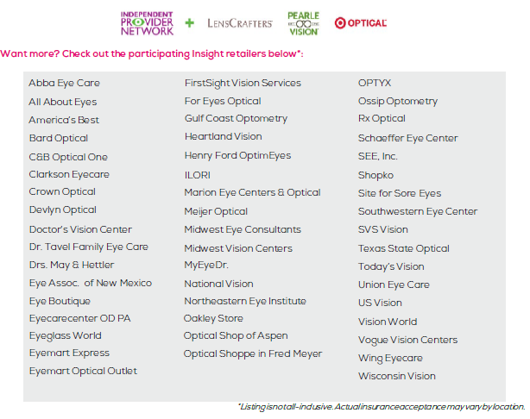
Vision Network Disruption

Slide 27
Group Life & Voluntary Life

Slide 28
Carrier | Response
Colonial Life | Quoted (uncompetitive)
Guardian | Quoted (uncompetitive)
MetLife (Incumbent) | Renewal received
Reliance Standard | Quoted
The Hartford | Quoted
UnitedHealthcare | Quoted
UNUM | Quoted
Voya | Quoted
Pool and Carrier Responses

Slide 29
Group Life Rate Compare

Slide 30
Group Life Benefit Compare

Slide 31
Group Voluntary Life Rate Compare

Slide 32
Group Voluntary Life Benefit Compare

Slide 33
Your Dedicated Keenan Service Team
Name: | Jeffrey Mizokawa, Assistant Vice President
Phone: | (949) 940-1760 Ext. 5140
Cell: | (808) 375-6143
Email: | jmizokawa@keenan.com
Responsibilities: | Responsible for overall account management, including renewals, contract negotiations, questions and review.
Name: | Kim Gleeson
Phone: | (949) 940-1760 Ext. 5175
Cell: | (714) 616-0456
Email: | kgleeson@Keenan.com
Responsibilities: | Negotiates renewals/contract changes Coordinates implementation of new/existing plan and benefit programs Communicates Keenan Resources Preparation for Benefit Committee Meetings Coordinates open enrollment meetings, health & wellness fairs

Slide 34








About Keenan
9
Offices in California
Voted one of the Best
Places to Work
750
employees
40% of employees have
worked at Keenan for
10+ years
850+
Schools clients
#12
In the U.S.
Joined AssuredPartners in 2017
– 12th largest broker in U.S.
120+
Public agency clients
48
years
of providing
customized
solutions
100+
Health care organization clients
2020

Slide 35
Thank you for choosing Keenan.
We truly appreciate your business and look forward to working with you and
RSCCD employees for many years to come.
We believe in forming a mutually beneficial partnership and welcome your feedback on how we may serve you better.

