Slide 1
ASCIP Health Benefits
Shabbir Ahmed
Executive Director of Health Benefits
Cheryl Jackson
Benefit Services Consultant
7/11/2024

Slide 2
Discussion Topics
ASCIP Basics
Results & Rate Change History
Value Adds
Q & A

Slide 3
Discussion Topics
ASCIP Basics

Slide 4
ASCIP Basics
Non-Profit
  Premium surplus used to reduce rates, fund new programs or returned to district
  No Internal sales or retention incentives
  No incentive to raise rates or write bad risk
Transparent
  ASCIP shares available claims
Long Term Rate stability
  Renewals blended with total pool experience
  Pool member selectivity

Slide 5
Discussion Topics
Results & Rate Change History

Slide 6
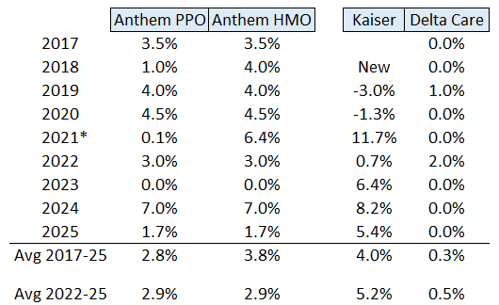
RSCCD Rate Change History
*Moved Medicare enrollees to Companion Care Medicare Supp Plan

Slide 7








Projected Medical Increases 2024-2025 – CA Major Carriers

Slide 8
RSCCD
Health Benefits
Premium Rebate History
Rebate Fiscal Year | Health Benefits Rebate
2018 - 2019 | $403,528
2019 - 2020 | $907,126
2020 - 2021 | $673,313
2021 - 2022 | $1,042,434
2022 - 2023 | $354,951
Total | $3,381,352

Slide 9
Discussion Topics
Value Adds

Slide 10
ASCIP Value Adds
Employee Assistance Program – Anthem
Home Based Physical Therapy* - Hinge Health
Cancer Centers of Excellence*
Mental Health Care Coordination – Care Solace
*Included with PPO plans

Slide 11

Offered in 2024
Nox Health Sleep Treatment Program
Insomnia and Sleep Apnea strongly linked to heart disease, diabetes, obesity, cancer risk, poor immune function and mental health disorders.
Free for adults enrolled on Anthem or Kaiser through ASCIP.
Expected positive return on investment through medical cost savings.

Slide 12
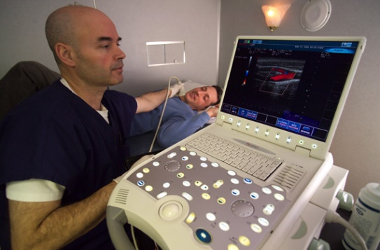
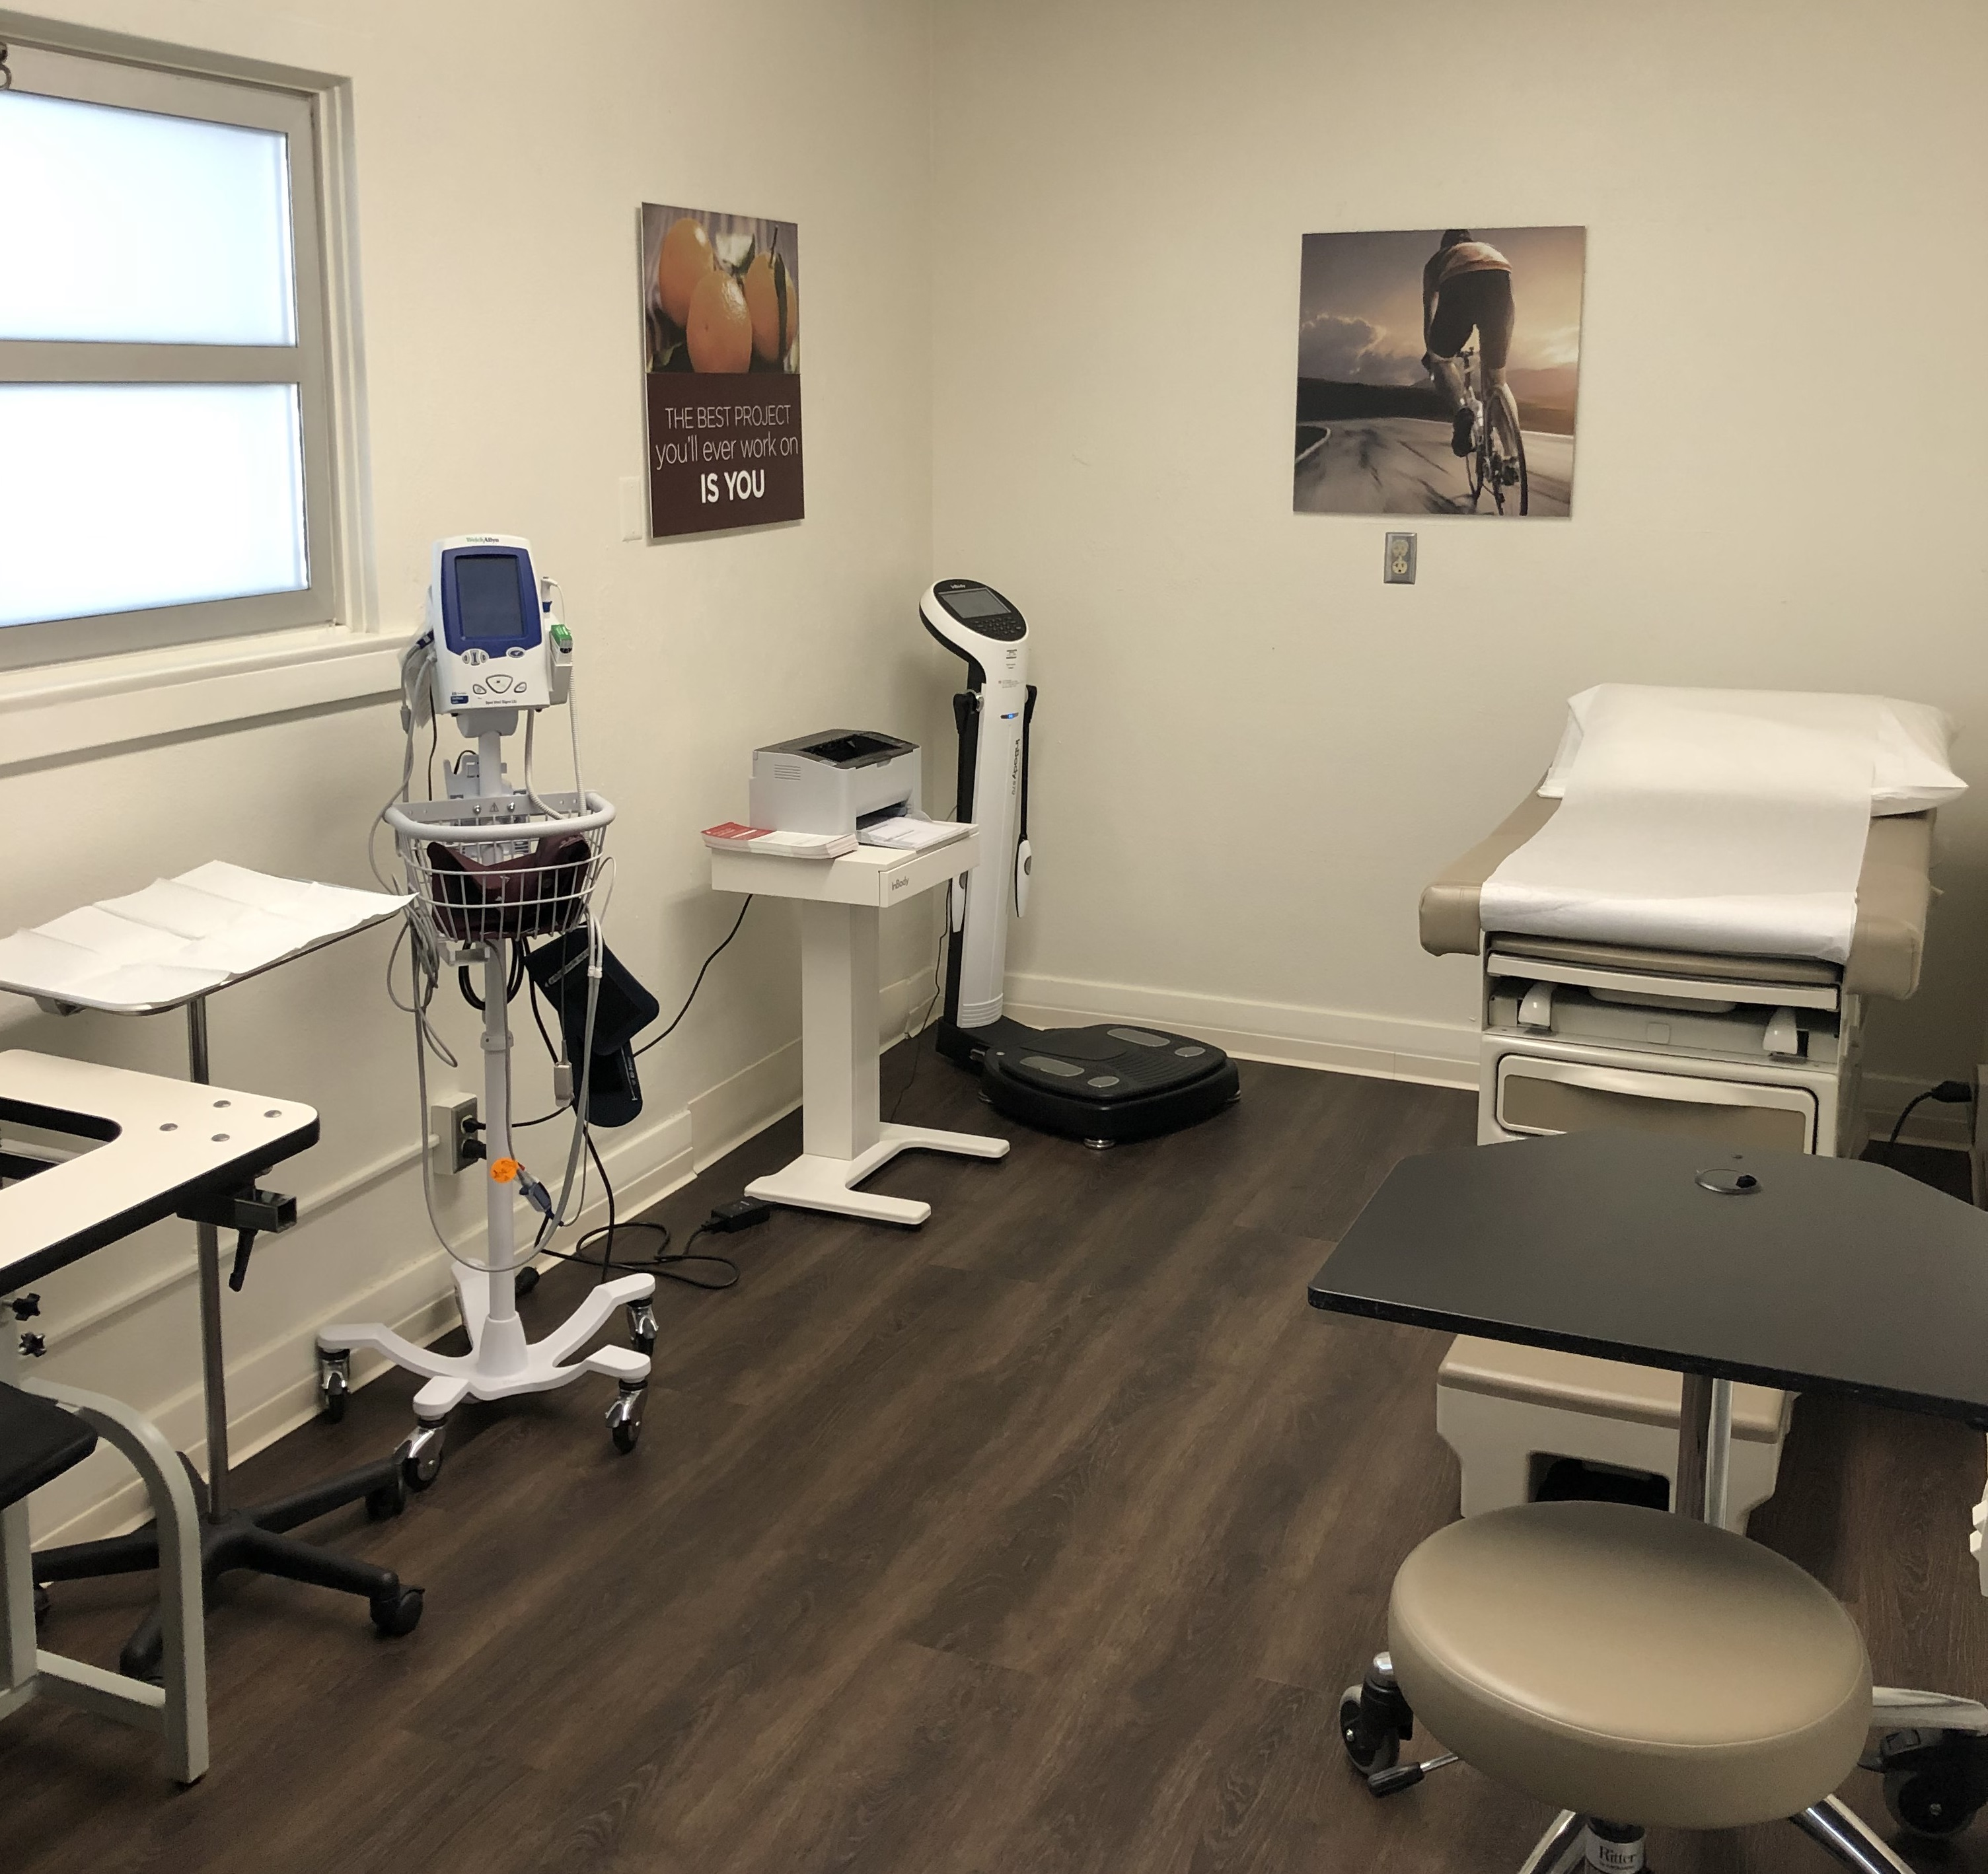
Cost Strategy:
Prevention and Early Detection / Primary Care
 | Traditional | ASCIP
Clinical Outcomes | Wellness & Annual Physicals | Early Detection via Mobile Health Screens with Imaging
Primary Care | Medical Office Patient Load 3,000+ Prescription & Referral | Onsite Clinic Patient Load 700 Care & Coordination

Slide 13
RSCCD Onsite Health Screen Results
Spring 2016
Participants | High Cholesterol / % on Meds | Undiagnosed Diabetics | Abnormal EKG | Abnormal Carotid Ultrasound | Abdominal Aortic Aneurysms
579 | 44% / 22% | 12 | 31 | 5 | 2
No Cost to RSCCD -- Funded with ASCIP Pool Equity

Slide 14
Takeaways
Transparent and Non-Profit
ASCIP shares available claims and returns surplus premiums
No incentive to raise rates or write bad risk
Rate Stability
Long-term view with renewals blended with total pool experience
Pool has performed well over many years

Slide 15

Q & A
ASCIP’s Health Benefits Team
Yvette Avila
Senior Coordinator
avila@ascip.org
(562) 677-2034
Liz Garcia
Senior Benefit Services Consultant
garcia@ascip.org
(562) 677-2047
Cheryl Jackson
Benefit Services Consultant
jackson@ascip.org
(562) 677-2028
Shabbir Ahmed
Executive Director of Health Benefits
sanger@ascip.org
(562) 677-2048
www.ascip.org

