Slide 1
ASCIP Health Benefits
Shabbir Ahmed
Executive Director of Health Benefits
Cheryl Jackson
Benefits Service Consultant
05/29/2026

Slide 2
Discussion Topics
ASCIP Basics
Benefits & Rate Change History
Support & Value Adds
Q & A

Slide 3

Discussion Topics: ASCIP BASICS
ASCIP Basics

Slide 4
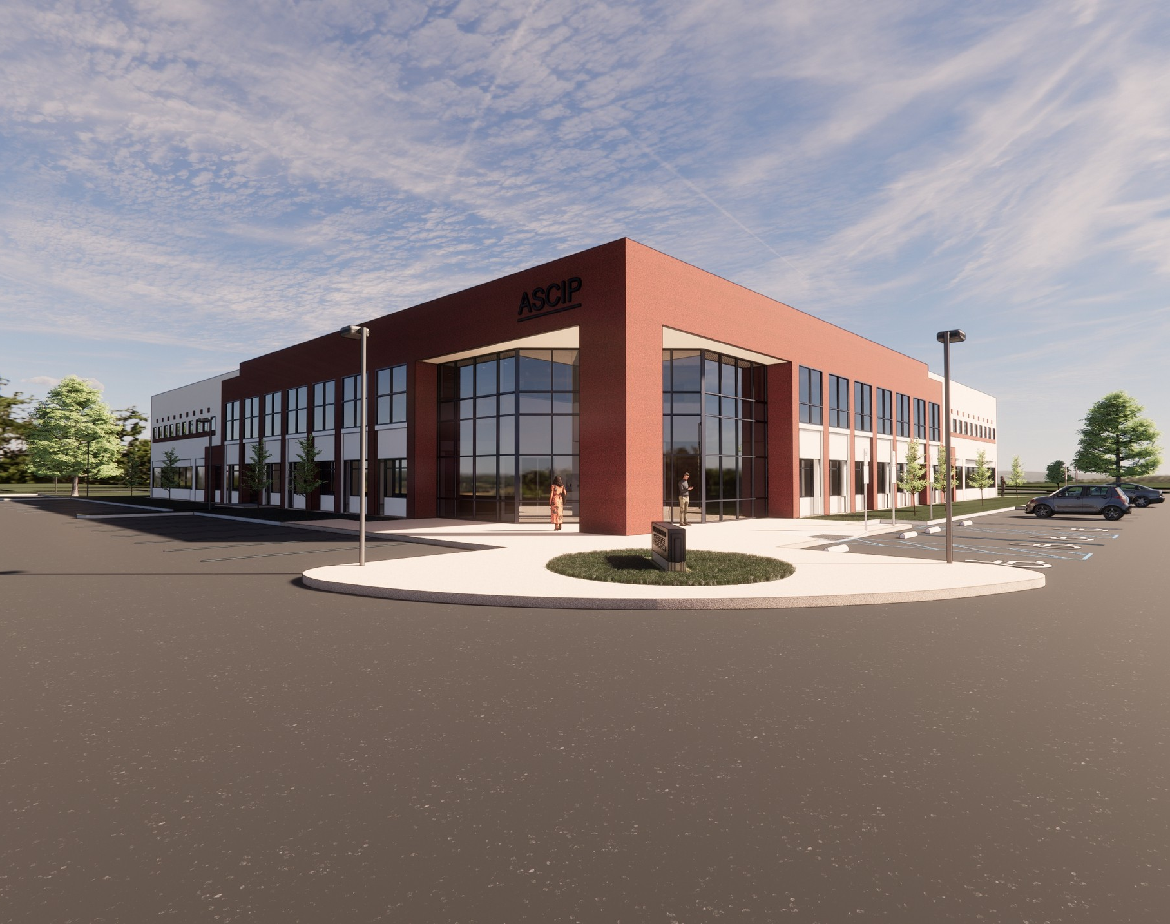
ASCIP Basics
Risk Sharing Joint Powers Authority
  Non-Profit
  No Internal sales or retention incentives
  No incentive to raise rates
Transparent
  ASCIP shares available claims
Long Term Rate stability
  Renewals blended with total pool experience
  Pool member selectivity

Slide 5

Discussion Topics: Health Benefits

Slide 6
Anthem Blue Cross
Blue Cross HMO Premier 10
Anthem PPO 90 / 70
Cal Year Ded: None
Out of Pocket Maximum:
  $1,000 Individual
  $2,000 Family
Copays:
  PCP/SCP: $10
  ER: $100
Rx Copay:
  $5/15/30
Cal Year Ded:
  $250 Individual
  $500 Family
Out of Pocket Maximum:
  Individual: InNet $1,000 / OutNet $3,000
  Family: InNet $2,000 / OutNet $6,000
Copays:
  PCP/SCP: $20
  ER: $50
Rx Copay:
  $5/15/30

Slide 7
Kaiser HMO
Cal Year Ded: None
Out of Pocket Maximum:
  $1,500 Individual
  $3,000 Family
Copays:
  PCP/SCP: $10
  ER: $35
Rx Copay:
  $5/10

Slide 8

Discussion Topics: ASCIP Rate History

Slide 9
ASCIP Renewal Calendar
Self-funded pool projections released
January 1 renewals released
Jan | Feb | Mar | Apr | May | Jun | Jul | Aug | Sep | Oct | Nov | Dec
October 1 renewals released

Slide 10
RSCCD Rate Change History
 | Anthem PPO | Anthem HMO | Kaiser HMO | Delta Care
2017 | 3.5% | 3.5% |  | 0.0%
2018 | 1.0% | 4.0% | New | 0.0%
2019 | 4.0% | 4.0% | -3.0% | 1.0%
2020 | 4.5% | 4.5% | -1.3% | 0.0%
2021* | 0.1% | 6.4% | 11.7% | 0.0%
2022 | 3.0% | 3.0% | 7.0% | 2.0%
2023 | 0.0% | 0.0% | 6.4% | 0.0%
2024 | 7.0% | 7.0% | 8.2% | 0.0%
2025 | 1.7% | 1.7% | 5.4% | 0.0%
2026 | 9.0% | 15.0% | 8.6% | 0.0%
Ave 2017-2026 | 3.4% | 4.9% | 5.4% | 0.3%
Average 2022-2026 | 4.1% | 5.3% | 7.1% | 0.4%
*Moved Medicare enrollees to Companion Care Medicare Supp Plan

Slide 11

ASCIP Value Adds

Slide 12
ASCIP HB Advantage:
Value Adds
Hinge Heath: Home Based Physical Therapy
Health Advocate: Medical Bill Review / Care Coordination
Nox Health: Sleep Disorder Treatment
Life Line Health Screenings

Slide 13

Sleep Charge Administered by NOX
Nox Health Sleep Treatment Program

Slide 14

Health Advocate

Slide 15

Health Advocate Services
Pricing Transparency
Medical Bill Review
Benefits Navigation
Second Opinion Coordination
Provider Finder
Health Advocacy
Rx Shopper

Slide 16

New Wellness Program:
Life Line Screening

Slide 17
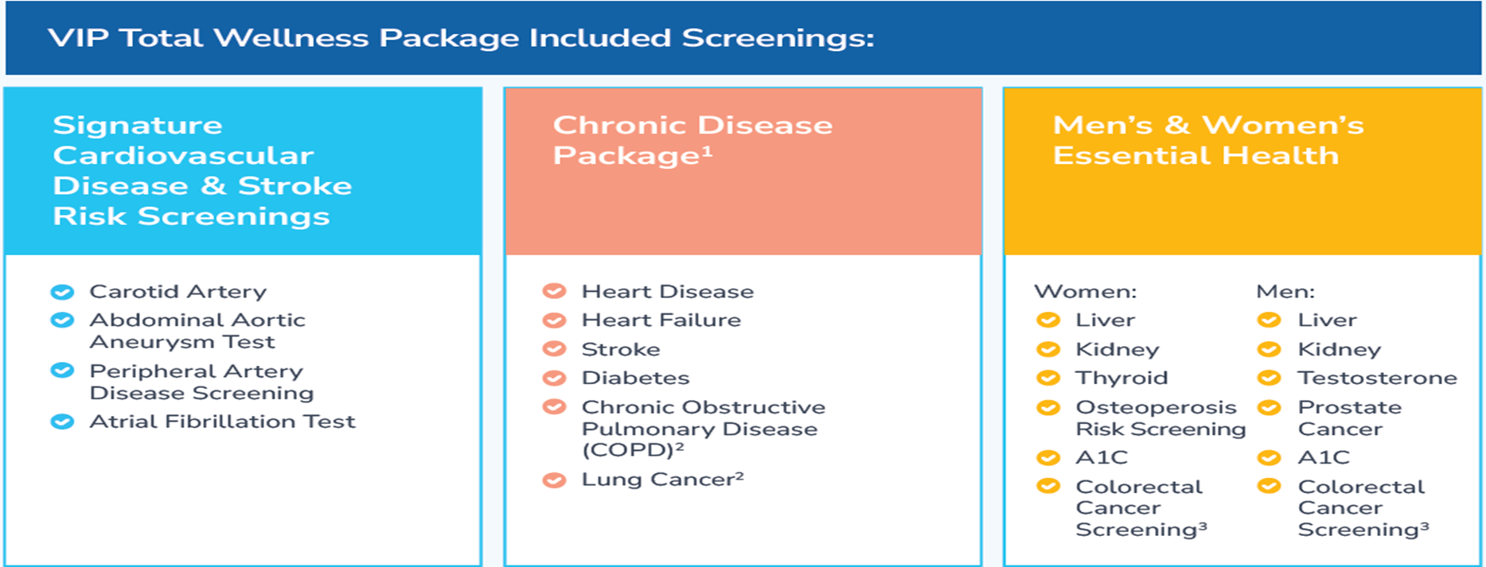
Preventive Care Screenings

Slide 18

ASCIP Support
Open Enrollment Meetings
Health Fairs
Escalated Member Issues
  Customer Service –> District Benefits Staff / Health Advocate –> ASCIP
Administrative Assistance (billing & eligibility)

Slide 19

ASCIP Support
Benefit Information Guides
Regulatory Support
  PCORI fee calculations, Medicare Part D Notices
Claims Reports

Slide 20
ASCIP
Questions?

Slide 21

Questions?
ASCIP’s Health Benefits Team
Yvette Avila
Senior Coordinator
avila@ascip.org
(562) 677-2034
Liz Garcia
Senior Benefit Services Consultant
garcia@ascip.org
(562) 677-2047
Cheryl Jackson
Benefit Services Consultant
jackson@ascip.org
(562) 677-2028
Shabbir Ahmed
Executive Director of Health Benefits
Ahmed@ascip.org
(562) 677-2048
www.ascip.org

