Slide 1
Rancho Santiago CCD
Joint Benefits Committee
2025 Renewal & Marketing Discussion
Date: May 9, 2024
Presenter:
Jeffrey Mizokawa, Vice President – Schools Practice Leader
April Shoeleh, Account Executive
Kim Gleeson, Assistant Vice President

Slide 2
Agenda
2025 Medical Renewal (ASCIP-Anthem)
2025 Medical Marketing Results
JBC Next Steps

Slide 3
2025 renewal

Slide 4
2025 ASCIP Anthem Renewal – HMO & PPO
Anthem HMO | ASCIP |  | ASCIP
 | Anthem |  | Anthem
 | HMO |  | HMO
 | 2024 Current |  | Renewal
EE Only | 109 | $804.55 | $818.23
EE + 1 | 109 | $1,687.98 | $1,716.68
EE + Family | 280 | $2,411.93 | $2,452.93
Monthly Premium | $947,026.17 |  | $963.125.59
Annual Premium | $11,364,314.04 |  | $11,557,507.08
% Change Over Current |  |  | +1.70%
$ Change Over Current |  |  | +$193,193.04
Anthem PPO | ASCIP |  | ASCIP
 | Anthem |  | Anthem
 | PPO |  | PPO
 | 2024 Current |  | 2025 Renewal
EE Only | 161 | $1,235.05 | $1,256.05
EE + 1 | 146 | $2,579.67 | $2,623.52
EE + Family | 69 | $3,705.40 | $3,768.39
Monthly Premium | $831,147.47 |  | $845,276.88
Annual Premium | $9,973,769.64 |  | $10,143,322.56
% Change Over Current |  |  | +1.70%
$ Change Over Current |  |  | +$169,552.92
 | 2024 | 2025
Annual Premium | $21,338,083.68 | $21,700,829.64
% Change Over Current |  | +1.70%
$ Change Over Current |  | +$362,745.96

Slide 5
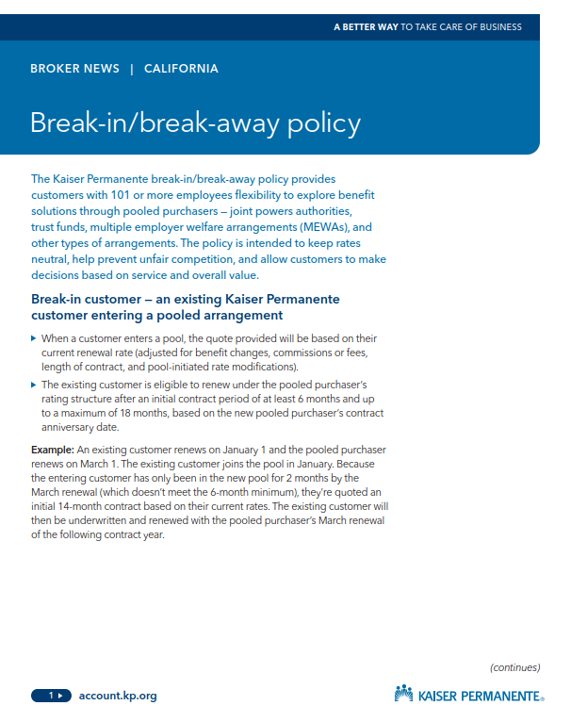
2025 ASCIP Kaiser Renewal - HMO
Timing of Renewal
The fully-insured Kaiser renewal for the ASCIP JPA will be released in July/August 2024.
Kaiser “Break In – Break Out” Policy
Kaiser has a “break in – break out” policy that requires groups moving to or from a pool to retain their renewal for a range of 12 – 18 months to prevent rate hopping.
As a result of this policy, they will not release a quote to a prospective group until they have released the renewal to the incumbent provider.
Impacts
Based on the construct of the RFP, Kaiser is not being evaluated as a carrier for change and thus there is no anticipated impact to existing Kaiser membership.
If Rancho Santiago CCD were to pursue a direct to Kaiser contract the plan would be designed to mirror the existing plan and would be priced at the same cost due to the “break in – break out” policy.

Slide 6
2025 Marketing Results

Slide 7
Market Results
Stand Alone Carriers
Product | Carrier | Quoted | Declined | Comments
Medical/Rx | Aetna | X |  | Quoted, competitive. -1.77% to -4.77% vs. current
Medical/Rx | Anthem | X |  | Quoted, not competitive. +17.89% vs. current
Medical/Rx | Cigna | X |  | Quoted total eligible population only. +10.51% vs. current.
Medical/Rx | Blue Shield |  | X | Decline to Quote- due to large claims and retiree population.
Medical/Rx | Health Net | X |  | Quoted total eligible population only. +16.07% vs. current.
Medical/Rx | Kaiser | n/a | n/a | Per Kaiser Policy – Kaiser will not provide a quote ahead of the release of the renewal for the incumbent provider
JPAs/Trusts
Medical/Rx | ASCIP | X |  | Quoted. Anthem renewal provided at +1.7% vs. current
Medical/Rx | CSEBA |  | X | Decline to Quote, unable to compete with current pricing.
Medical/Rx | CVT | n/a | n/a | Not Eligible due to not being able to meet RFP deadline. Quote would be available on the week of June 3^{rd.}
Medical/Rx | SISC |  | X | Decline to Quote due to membership currently under SISC JPA
Medical/Rx | VEBA | X |  | Quoted. +6.07% vs. current
Medical/Rx | REEP |  | X | Decline to Quote due to demographics and retiree population

Slide 8
Medical Marketing Quote Request
Quote #1
All Benefit Eligible Active Employees and Early Retirees
Quote #2
Quote #2(a) - All Benefit Eligible Active Employees and Early Retirees except CSEA 579
Quote #2(b) - All CSEA 579 Benefit Eligible Active Employees and Early Retirees

Slide 9
Aetna proposal
DISCLAIMER: The information, materials, calculations, totals and analyses contained in and on these pages (and throughout this worksheet and workbook) are general in nature and are subject to change. These materials/calculations and analyses are not meant to replace any professional legal, actuarial, or accounting services. You may wish to consult your actuary, accountant, or attorney for specific advice as to how this information may apply to your situation.
This presentation/proposal and any attachments are the confidential work-product for a specific client of Keenan, an AssuredPartners company. It is covered by the terms and conditions in our Mutual Non-Disclosure Agreement with our client and may not be shared with anyone that is not an employee of the Client and/or the Client’s legal counsel. No other third parties may receive, review of discuss the content of this presentation/proposal or any of the attachments. This is for Client’s sole consideration, discussion and/or implementation.

Slide 10
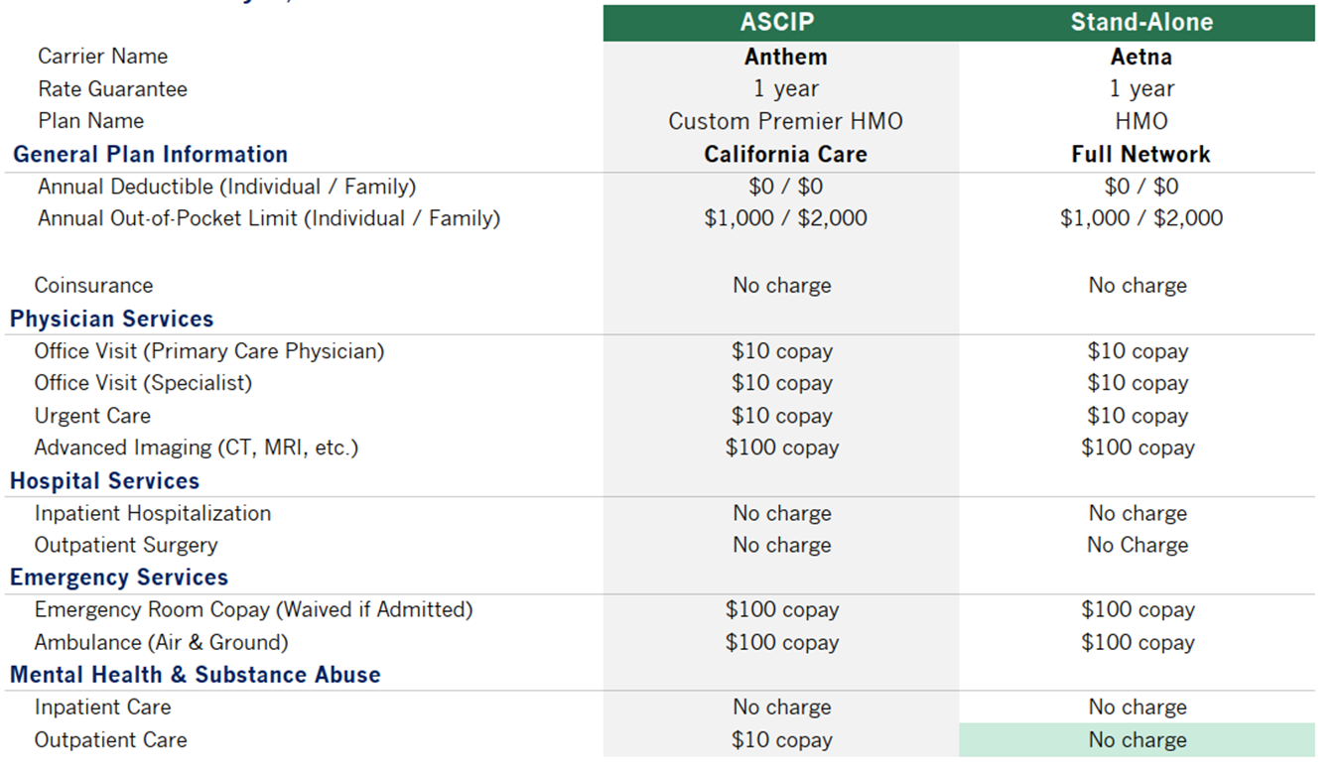
Plan Comparison – HMO

Slide 11
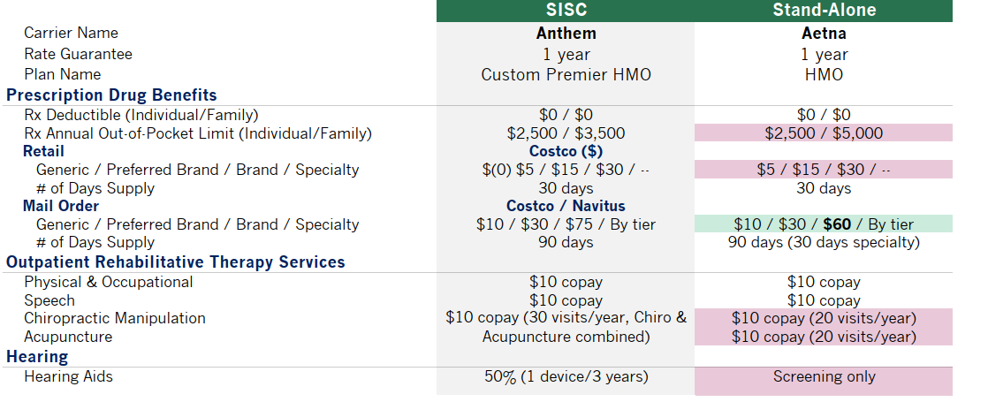
Plan Comparison – HMO (Continued)

Slide 12
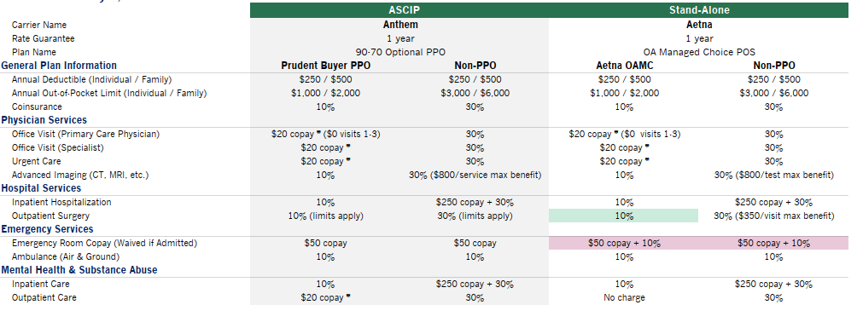
Plan Comparison – PPO

Slide 13
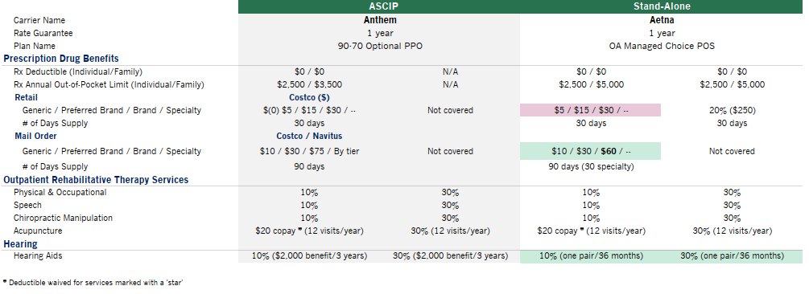
Plan Comparison – PPO (Continued)

Slide 14
Rate Comparison – AETNA HMO & PPO (Actives & Early Retirees)
Option 1
Anthem HMO | ASCIP |  | Direct to Carrier
 | Anthem |  | AETNA
 | HMO |  | HMO
 | 2025 Renewal |  | 2025 Proposed
EE Only | 109 | $818.23 | $766.18
EE + 1 | 109 | $1,716.68 | $1,607.48
EE + Family | 280 | $2,452.93 | $2,296.90
Monthly Premium | $963,125.59 |  | $901,860.94
Annual Premium | $11,557,507.08 |  | $10,822,331.28
% Change Over Current | +1.7% |  | -4.77%
$ Change Over Current | +$193,193.04 |  | -($541,982.76)
Anthem PPO | ASCIP |  | Direct to Carrier
 | Anthem |  | AETNA
 | PPO |  | PPO
 | 2025 Renewal |  | 2025 Proposed
EE Only | 161 | $1,256.05 | $1,176.09
EE + 1 | 146 | $2,623.52 | $2,456.51
EE + Family | 69 | $3,768.39 | $3,528.50
Monthly Premium | $845,276.88 |  | $791,467.45
Annual Premium | $10,143,322.56 |  | $9,497,609.40
% Change Over Current | +1.7% |  | -4.77%
$ Change Over Current | +$169,552.92 |  | -($476,160.24)
Total Estimated Savings from Current | -$1,018,143.00

Slide 15
Rate Comparison – AETNA HMO & PPO Option 2a
Quote #2 (a) - All Benefit Eligible Active Employees and Early Retirees except CSEA 579
Anthem HMO | ASCIP |  | Direct to Carrier
 | Anthem |  | AETNA
 | HMO |  | HMO
 | 2025 Renewal |  | 2025 Proposed – 2a
EE Only | 59 | $818.23 | $761.41
EE + 1 | 43 | $1,716.68 | $1,597.47
EE + Family | 129 | $2,452.93 | $2,282.61
Monthly Premium | $438,520,78 |  | $408,071.09
Annual Premium | $5,262,249.36 |  | $4,896,853.08
% Change Over Current | +1.7% |  | -5.36%
$ Change Over Current |  |  | -($277,433.64)
Anthem PPO | ASCIP |  | Direct to Carrier
 | Anthem |  | AETNA
 | PPO |  | PPO
 | 2025 Renewal |  | 2025 Proposed – 2a
EE Only | 106 | $1,256.05 | $1,168.77
EE + 1 | 95 | $2,623.52 | $2,452.12
EE + Family | 63 | $3,768.393 | $3,503.80
Monthly Premium | $619,784.27 |  | $577,580.42
Annual Premium | $7,437,411.24 |  | $6,930,965.04
% Change Over Current | +1.7% |  | -5.23%
$ Change Over Current |  |  | -($382,124.76)
Total Estimated Savings from Current | -$659,558.40

Slide 16
Rate Comparison – AETNA HMO & PPO Option 2b
Quote #2 (b) - All CSEA 579 Benefit Eligible Active Employees and Early Retirees
Anthem HMO | ASCIP |  | Direct to Carrier
 | Anthem |  | AETNA
 | HMO |  | HMO
 | 2025 Renewal |  | 2025 Proposed – 2b
EE Only | 50 | $818.23 | $851.82
EE + 1 | 66 | $1,716.68 | $1,787.16
EE + Family | 151 | $2,452.93 | $2,553.64
Monthly Premium | $524,604.81 |  | $546,143.20
Annual Premium | $6,295,257.72 |  | $6,553,718.40
% Change Over Current | +1.7% |  | +5.88%
$ Change Over Current | +$105,230.40 |  | +$363,691.08
Anthem PPO | ASCIP |  | Direct to Carrier
 | Anthem |  | AETNA
 | PPO |  | PPO
 | 2025 Renewal |  | 2025 Proposed – 2b
EE Only | 55 | $1,256.05 | $1307.55
EE + 1 | 51 | $2,623.52 | $2743.29
EE + Family | 6 | $3,768.393 | $3919.84
Monthly Premium | $225,492.61 |  | $235,342.08
Annual Premium | $2,705,911.32 |  | $2,824,104.96
% Change Over Current | +1.7% |  | +6.14%
$ Change Over Current | +$45,231.48 |  | +$163,425.12
Total Estimated Increase from Current | +$527,116.20

Slide 17
Rate Comparison – AETNA HMO & PPO (Actives & Early Retirees)
Rate Cap – 9.9% rate cap for first renewal
Anthem HMO | ASCIP |  | Direct to Carrier
 | Anthem |  | AETNA
 | HMO |  | HMO
 | 2025 Renewal |  | 2025 Proposed
EE Only | 109 | $818.23 | $789.17
EE + 1 | 109 | $1,716.68 | $1,655.70
EE + Family | 280 | $2,452.93 | $2,365.81
Monthly Premium | $963,125.59 |  | $928,916.77
Annual Premium | $11,557,507.08 |  | $11,147,001.22
% Change Over Current | +1.7% |  | -1.91%
$ Change Over Current | +$193,193.04 |  | -($217,312.82)
Anthem PPO | ASCIP |  | Direct to Carrier
 | Anthem |  | AETNA
 | PPO |  | PPO
 | 2025 Renewal |  | 2025 Proposed
EE Only | 161 | $1,256.05 | $1,211.37
EE + 1 | 146 | $2,623.52 | $2,530.21
EE + Family | 69 | $3,768.39 | $3,634.36
Monthly Premium | $845,276.88 |  | $815,211.47
Annual Premium | $10,143,322.56 |  | $9,782,537.68
% Change Over Current | +1.7% |  | -1.92%
$ Change Over Current | +$169,552.92 |  | -($191,231.96)
Total Estimated Savings from Current | -$408,544.78

Slide 18
Aetna Proposal Considerations
A comparison of medical groups shows a 96% match on the Full HMO
Includes $30,000 implementation/communications allowance (for Aetna plans) and a $20,000 Wellness allowance – The District can decide how they would like allocate these funds. For example, combine for $50,000 wellness allowance.
Will allow orphan dependents

Slide 19
Veba proposal
DISCLAIMER: The information, materials, calculations, totals and analyses contained in and on these pages (and throughout this worksheet and workbook) are general in nature and are subject to change. These materials/calculations and analyses are not meant to replace any professional legal, actuarial, or accounting services. You may wish to consult your actuary, accountant, or attorney for specific advice as to how this information may apply to your situation.
This presentation/proposal and any attachments are the confidential work-product for a specific client of Keenan, an AssuredPartners company. It is covered by the terms and conditions in our Mutual Non-Disclosure Agreement with our client and may not be shared with anyone that is not an employee of the Client and/or the Client’s legal counsel. No other third parties may receive, review of discuss the content of this presentation/proposal or any of the attachments. This is for Client’s sole consideration, discussion and/or implementation.

Slide 20
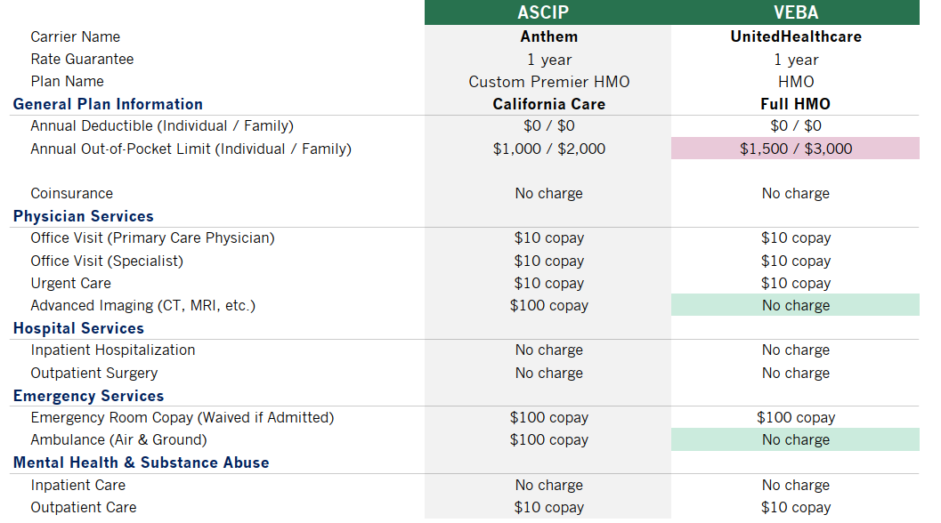
Plan Comparison – HMO

Slide 21
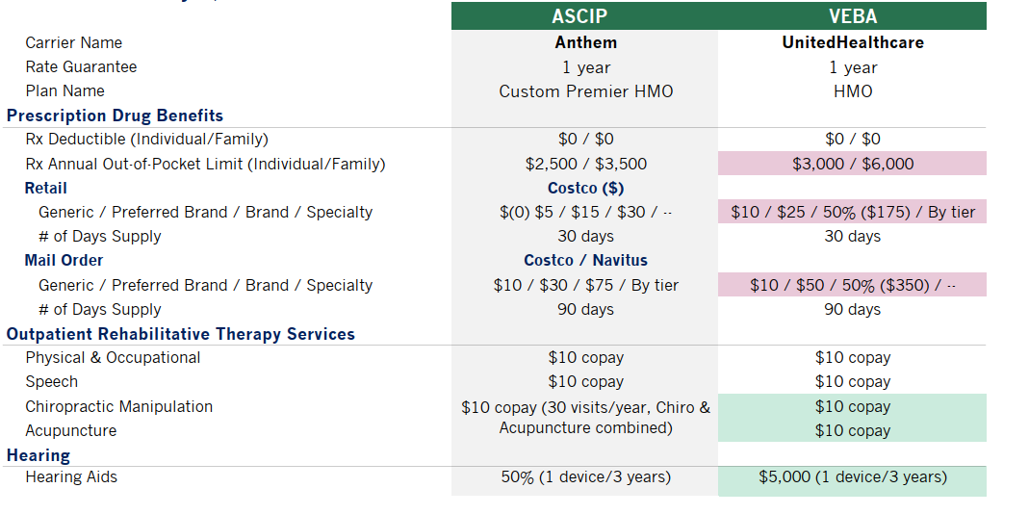
Plan Comparison – HMO (Continued)

Slide 22
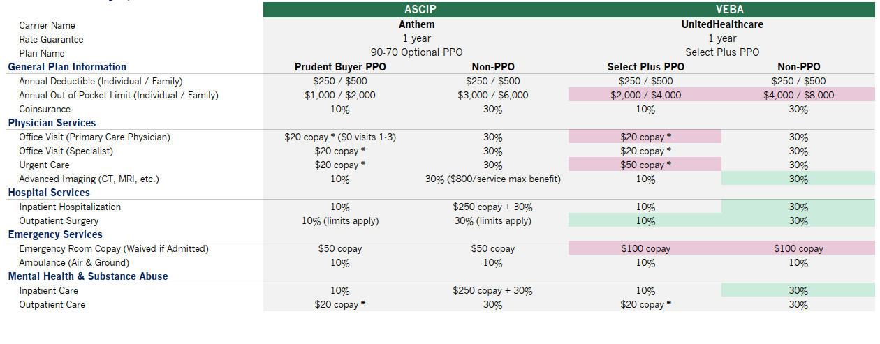
Plan Comparison – PPO

Slide 23
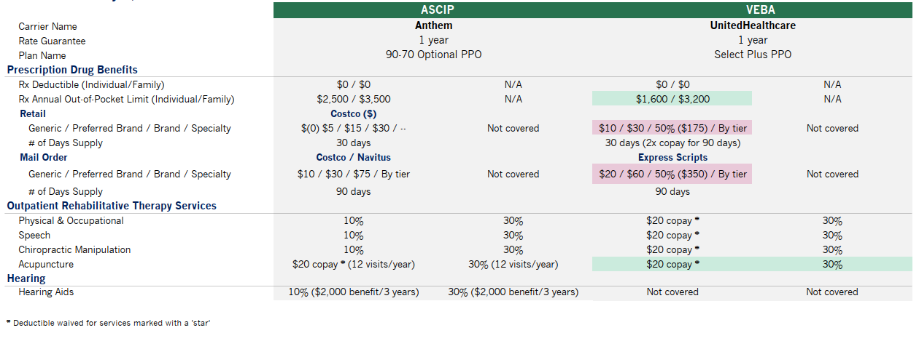
Plan Comparison – PPO (Continued)

Slide 24
Rate Comparison – VEBA HMO & PPO (Actives & Early Retirees)
Option 1
Anthem HMO | ASCIP |  | VEBA
 | Anthem |  | United HealthCare
 | HMO |  | Full HMO Network
 | 2025 Renewal |  | 2025 Proposed
EE Only | 109 | $818.23 | $846.00
EE + 1 | 109 | $1,716.68 | $1,775.00
EE + Family | 280 | $2,452.93 | $2,536.00
Monthly Premium | $963,125.59 |  | $995,769.00
Annual Premium | $11,557,507.08 |  | $11,949.228.00
% Change Over Current | +1.7% |  | +5.15%
$ Change Over Current | +$193,193.04 |  | +584,913.96
Anthem PPO | ASCIP |  | VEBA
 | Anthem |  | United HealthCare
 | PPO |  | PPO
 | 2025 Renewal |  | 2025 Proposed
EE Only | 161 | $1,256.05 | $1,323.00
EE + 1 | 146 | $2,623.52 | $2,763.00
EE + Family | 69 | $3,768.39 | $3,969.00
Monthly Premium | $845,276.88 |  | $890,262.00
Annual Premium | $10,143,322.56 |  | $10,683,144
% Change Over Current | +1.7% |  | +7.11%%
$ Change Over Current | +$169,552.92 |  | +$709,374.36
Total Estimated Increase from Current | +$1,294,288.32

Slide 25
Rate Comparison – VEBA HMO & PPO Option 2a
Quote #2 (a) - All Benefit Eligible Active Employees and Early Retirees except CSEA 579
Anthem HMO | ASCIP |  | VEBA
 | Anthem |  | United HealthCare
 | HMO |  | HMO Full Network
 | 2025 Renewal |  | 2025 Proposed – 2a
EE Only | 59 | $818.23 | $844.00
EE + 1 | 43 | $1,716.68 | $1,771.00
EE + Family | 129 | $2,452.93 | $2,530.00
Monthly Premium | $438,520,78 |  | $452,319.00
Annual Premium | $5,262,249.36 |  | $5,427,828.00
% Change Over Current | +1.7% |  | +4.90%
$ Change Over Current |  |  | +$253,541.28
Anthem PPO | ASCIP |  | VEBA
 | Anthem |  | United HealthCare
 | PPO |  | PPO
 | 2025 Renewal |  | 2025 Proposed – 2a
EE Only | 106 | $1,256.05 | $1,324.00
EE + 1 | 95 | $2,623.52 | $2,765.00
EE + Family | 63 | $3,768.393 | $3,972.00
Monthly Premium | $225,492.61 |  | $653,255.00
Annual Premium | $2,705,911.32 |  | $7,839,060.00
% Change Over Current | +1.7% |  | +7.19%
$ Change Over Current |  |  | +$525,970.20
Total Estimated Increase from Current | +$779,511.48

Slide 26
Rate Comparison – VEBA HMO & PPO Option 2b
Quote #2 (b) - All CSEA 579 Benefit Eligible Active Employees and Early Retirees
Anthem HMO | ASCIP |  | VEBA
 | Anthem |  | United HealthCare
 | HMO |  | HMO Full Network
 | 2025 Renewal |  | 2025 Proposed – 2b
EE Only | 50 | $818.23 | $849.00
EE + 1 | 66 | $1,716.68 | $1,781.00
EE + Family | 151 | $2,452.93 | $2,545.00
Monthly Premium | $524,604.81 |  | $544,291.00
Annual Premium | $6,295,257.72 |  | $6,531,492.00
% Change Over Current | 1.7% |  | 5.52%
$ Change Over Current | +$105,230.40 |  | +$341,464.68
Anthem PPO | ASCIP |  | VEBA
 | Anthem |  | United HealthCare
 | PPO |  | PPO
 | 2025 Renewal |  | 2025 Proposed – 2b
EE Only | 55 | $1,256.05 | $1,326.00
EE + 1 | 51 | $2,623.52 | $2,769.00
EE + Family | 6 | $3,768.393 | $3,978.00
Monthly Premium | $225,492.61 |  | $238,017.00
Annual Premium | $2,705,911.32 |  | $2,856,204.00
% Change Over Current | 1.7% |  | 7.36%
$ Change Over Current | +$45,231.48 |  | +$195,524.16
Total Estimated Increase from Current | +$536,988.84

Slide 27
JBC Next steps & future Meetings

Slide 28
JBC Meeting #2
Item | Detail
Purpose | Presentation of Medical Marketing Results based on Illustrative Quotes
Date | May 9, 2024
Keenan Responsibility | Assess the proposals and develop the comparison tools to provide critical insights related to (i) Benefit Comparison (ii) Network Disruption (iii) Fiscal Implications (potentially illustrative)
JBC Responsibility | The JBC will be asked to vote to narrow down the list of finalists to ideally 2-3 potential markets

Slide 29
JBC Meeting #3
Item | Detail
Purpose | Carrier/Pool Finalist Interviews
Date | May 29, 2024
Keenan Responsibility | Keenan will work with RSCCD HR team to schedule finalist interviews for the 2-3 potential markets selected by the JBC during JBC Meeting #2
JBC Responsibility | The JBC will be asked to vote on which finalist or finalists they would like to recommend moving forward so that union membership will have sufficient time to research disruption and provide union leadership their feedback and conduct a vote. This timeline has been designed to provide a 60 day window for RSCCD employees to evaluate their options during the months of June and July 2024.

Slide 30
JBC Meeting #4
Item | Detail
Purpose | Presentation of Fiscal Impact with Final Rates from Selected Finalists and ASCIP Renewal
Date | Late July 2024
Keenan Responsibility | Work with finalists to obtain final binding quotes and perform a fiscal comparison against the ASCIP Renewal to provide transparency and education on fiscal impacts
JBC Responsibility | No Action will be taken by JBC. This meeting is informational and designed to provide transparency and final confirmation of the fiscal impacts of RFP finalist market options.

Slide 31
JBC Meeting #5
Item | Detail
Purpose | Vote by JBC on Recommendation to the Chancellor
Date | Mid August 2024
Keenan Responsibility | Keenan will work with RSCCD HR Office to facilitate meeting for JBC membership to cast final votes on recommendation to the Chancellor to be presented to RSCCD Board on September 9th, 2024
JBC Responsibility | The JBC will be asked to cast their votes on the JBC recommendation to the Chancellor

Slide 32
Questions?

