Slide 1
Rancho Santiago CCD
Joint Benefits Committee
Date: February 15, 2024
Presenter:
Jeffrey Mizokawa, Vice President – Schools Practice Leader
April Shoeleh, Account Executive
Kim Gleeson, Assistant Vice President

Slide 2
Agenda
District / JBC / Keenan’s Roles
Overview of Marketing Process
Medical Marketing Timeline
Discussion Items

Slide 3

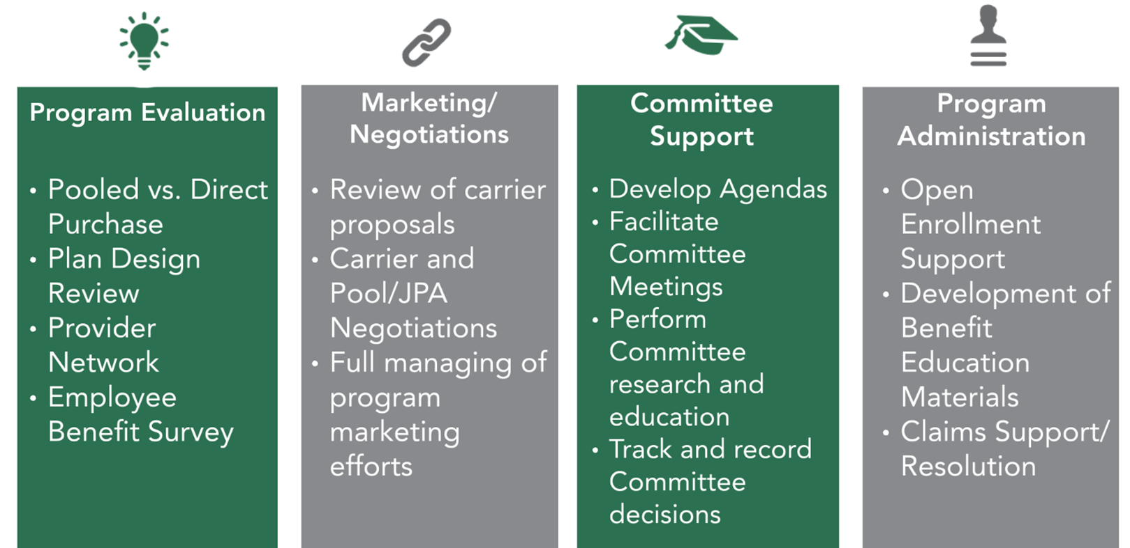
Keenan Core Brokerage & Consulting Services

Slide 4


Keenan’s Role as your Broker
Assist RSCCD in finding the best fit for members and educate committee members on the impacts and potential disruption resulting from changes to benefits
This allows the Insurance Committee to have the information needed to make decisions

Slide 5
Overview of marketing process

Slide 6


The Marketplace: School Pools and Carriers
Pool Markets
VEBA
SISC
REEP
ASCIP
CVT
CSEBA
Carrier Markets
Kaiser Permanente
Anthem Blue Cross
Blue Shield
United Health Care
Aetna
CIGNA

Slide 7



The Marketplace: Pools and Carriers Explained
Direct to Carrier | Pool Structure
Carriers
Carriers
District
Pool: Group of multiple districts or entities

Slide 8
Major Considerations when Marketing
#1: Purchasing Power – The Power of Size
#2: Kaiser Concentration – Break-In/Break-Away Policy
#3: Markets – Pools vs. Direct

Slide 9
Kaiser Break In/Break Out Explained
Break In/Break Out rules defined by Kaiser state a district will leave ASCIP with their ASCIP renewal rate for up 6 to 18 months.
The district will adopt the Plan Designs and Rates of their group on a stand-alone basis or of the pool the district joins; Rates are subject to change after the initial 6 to 18 months and are not guaranteed.
The District will take the ASCIP rate and renewal, however, the plan is underwritten based on the design of the new placement. Thus, there could be either an increase or decrease to the Kaiser rate during the break-in period to reflect the new plan design and accounts for increases or decreases in coverage.

Slide 10
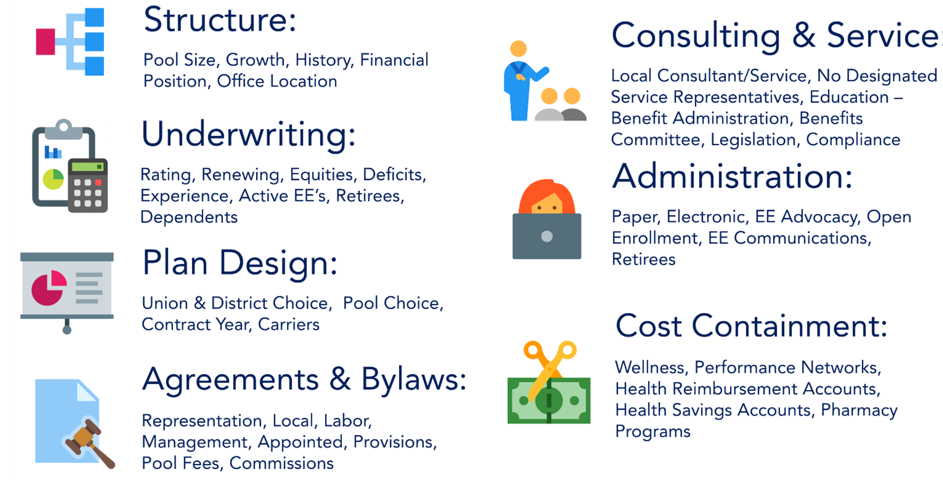
More Considerations When Marketing

Slide 11
The Marketplace: Pools, Trusts & JPAs
Pool | Carriers | Renewal Date | Waivers/ Opt-outs
ASCIP - Alliance of Schools for Cooperative Insurance Programs (JPA) | Kaiser, Anthem, Blue Shield, United Healthcare | 10/1 or 1/1 | Sometimes
CSEBA - California Schools Employee Benefits Association (JPA) | Kaiser, Blue Shield | 10/1 | Yes – Service Fee
CVT - California Valued Trust (Trust) | Kaiser, Blue Shield, Anthem, Aetna | 10/1 | Grandfathered – no new
REEP - Regional Employer/ Employee Partnership for Benefits (JPA) | Kaiser, Anthem | 7/1 | Yes
SISC - Self-Insured Schools of California (JPA) | Kaiser, Blue Shield, Anthem | 10/1 | No – Anchor Bronze Plan
VEBA - Voluntary Employees Beneficiary Association (Trust) | Kaiser, CIGNA, United Healthcare | 10/1 or 1/1 | No
Notes:
https://www.ascip.org/about/governance/
https://www.csjpa.org/governance
https://www.cvtrust.org/about/board
https://sisc.kern.org/
https://www.vebaonline.com/veba-board-members/

Slide 12
The Marketplace: Pool Summary and Governance
Pool | Governance (based on publicly posted information)
ASCIP (JPA) | ASCIP is governed by a 13-member Board of Directors called the Executive Committee. The Executive Committee has representation from the following membership categories: K-12; K-8; Community Colleges; Joint Powers Authorities; and Charter Schools. Members of the Executive Committee are required to be full-time employees of an active ASCIP member agency participating in ASCIP’s Property/Liability program.
CSEBA (JPA) | 13-member Executive Committee by election of their representatives
CVT (Trust) | Decision control by Trust Board made up of equal number of labor and management representatives, not individual Employer members. CVT is governed by a 12-member board of trustees.
REEP (JPA) | Decision control by JPA Board made up of representatives from each member employer (district). Labor has opportunity to sit on the Board of Directors, Insurance Advisory Committee, and Executive Committee.
SISC (JPA) | Decision control by JPA Board made up of representatives from each member employer (district). Employer names the representative(s). If a new group joins SISC JPA they are not guaranteed a seat on the board – only if a position is vacant or becomes vacant.
VEBA (Trust) | Decision control by Trust Board made up of equal number of labor and management representatives, not individual Employer members.
Notes:
https://www.ascip.org/about/governance/
https://www.csjpa.org/governance
https://www.cvtrust.org/about/board
https://sisc.kern.org/
https://www.vebaonline.com/veba-board-members/

Slide 13
Medical Marketing Quote Request
Quote #1
All Benefit Eligible Active Employees and Early Retirees
Quote #2
Quote #2(a) - All Benefit Eligible Active Employees and Early Retirees except CSEA 579
Quote #2(b) - All CSEA 579 Benefit Eligible Active Employees and Early Retirees

Slide 14
Joint Benefits Committee
2025 Medical Marketing Timeline

Slide 15

Medical Marketing Timeline
February 2024
JBC Meeting #1
Finalize RFP Documents
RFP Released
March/April 2024
Work with Carrier/Pools Markets to Finalize Quotes
Early – May 2024
JBC Meeting #2
Mid/Late – May 2024
JBC Meeting #3
Late - April 2024
Proposals Due with Illustrative Rates
Review & Analyze All Proposals (Keenan)
Mid - August 2024
JBC Meeting #5
Early & Late – September 2024
Board Decision – September 9th
Finalize Renewal/Transition
June/July 2024
JBC Meeting #4
Allow membership to research
Finalize Rates for Carriers/Pools

Slide 16
JBC Meeting #1
Item | Detail
Purpose | Planning for 2024 Medical Marketing
Date | February 15th, 2024
Keenan Responsibility | February 2024 – Gather Census/Claims data and perform Finalization and Release of RFP March/April 2024 – Work with Carrier/Pool markets on questions April 26th, 2024 – Final Date for Submission of RFP Responses
JBC Responsibility | No Action will be taken by JBC. This meeting is informational and designed to provide transparency and communication of the 2024 Medical Marketing timeline.
Important Item: As a result of the due date for the RFP being outside of 6 months from the 1/1/2025 effective date we would like the JBC to be prepared that the rates provided in the RFP responses could be “illustrative” and may not be “binding & final”.

Slide 17
JBC Meeting #2
Item | Detail
Purpose | Presentation of Medical Marketing Results based on Illustrative Quotes
Date | Early May 2024
Keenan Responsibility | Assess the proposals and develop the comparison tools to provide critical insights related to (i) Benefit Comparison (ii) Network Disruption (iii) Fiscal Implications (potentially illustrative)
JBC Responsibility | The JBC will be asked to vote to narrow down the list of finalists to ideally 2-3 potential markets

Slide 18
JBC Meeting #3
Item | Detail
Purpose | Carrier/Pool Finalist Interviews
Date | Mid-Late May 2024
Keenan Responsibility | Keenan will work with RSCCD HR team to schedule finalist interviews for the 2-3 potential markets selected by the JBC during JBC Meeting #2
JBC Responsibility | The JBC will be asked to vote on which finalist or finalists they would like to recommend moving forward so that union membership will have sufficient time to research disruption and provide union leadership their feedback and conduct a vote. This timeline has been designed to provide a 60 day window for RSCCD employees to evaluate their options during the months of June and July 2024.

Slide 19
JBC Meeting #4
Item | Detail
Purpose | Presentation of Fiscal Impact with Final Rates from Selected Finalists and ASCIP Renewal
Date | Late July 2024
Keenan Responsibility | Work with finalists to obtain final binding quotes and perform a fiscal comparison against the ASCIP Renewal to provide transparency and education on fiscal impacts
JBC Responsibility | No Action will be taken by JBC. This meeting is informational and designed to provide transparency and final confirmation of the fiscal impacts of RFP finalist market options.

Slide 20
JBC Meeting #5
Item | Detail
Purpose | Vote by JBC on Recommendation to RSCCD Board
Date | Mid August 2024
Keenan Responsibility | Keenan will work with RSCCD HR Office to facilitate meeting for JBC membership to cast final votes on recommendation to be presented to RSCCD Board on September 9th, 2024
JBC Responsibility | The JBC will be asked to cast their votes on the JBC recommendation to the RSCCD Board

Slide 21
Additional Timeline Details
September 9th, 2024
  Board Meeting identified for Board Vote on 2024 Medical Marketing
Mid - September 2024
  Finalize Renewal/Transition
  ASCIP Notice of Withdrawal Deadline (9/30/24)
  Implementation of New Plans
  Preparation for Open Enrollment
October 2024: Open Enrollment
December 2024: Confirm Carriers Have Received EDI File with Enrollment
January 2025: New Plan Year Begins

Slide 22
Questions?

