Slide 1
2020 Employee Benefits
Marketing Overview
Rancho Santiago Community College District
Board of Trustees Presentation
September 14th, 2020

Slide 2
Agenda
Marketing Overview
2020 Marketing Process
Next Steps
2020 Employee
Benefits Marketing

Slide 3
Marketing Overview

Slide 4
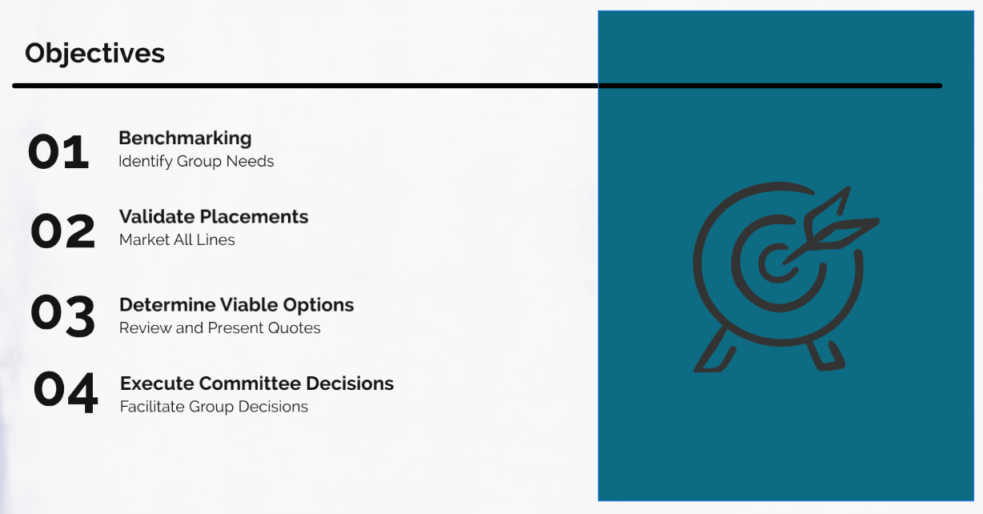
Goals of Marketing

Slide 5
Medical
ASCIP JPA
Dental
ASCIP JPA
Delta Dental PPO
Vision
ASCIP JPA
Group Life
Anthem PPO
Anthem HMO
Kaiser HMO
DeltaCare HMO
VSP
MetLife
Direct to Carrier
Current Program
Placement

Slide 6
2021 Estimated Premiums
Benefit | Carrier | 2021 Estimated Premium
Medical | Anthem HMO | $13,079,960.40
 | Anthem PPO | $14,200,283.28
 | Kaiser HMO | $2,983,302.84
Dental | Delta Dental PPO | $1,355,037.48
 | DeltaCare HMO | $149,544.60
Vision | VSP | $185,425.68
Group Life | MetLife | $208,517.40
Total Annual Premium | N/A | $32,162,071.68

Slide 7
2020 Marketing Process

Slide 8
Pool vs. Direct Placements
Pool
Reduce volatility of renewal
Blended Risk
Direct
Utilization has direct impact
Lower Purchasing Power
Full Customization of Benefits and Networks
No Customization of Benefit Designs or Carriers
100% Control
Significant Purchasing Power

Slide 9
Medical Marketing
Pools (6)
Direct to Carrier (6)
Medical Marketing Entities (12)
VEBA Trust
(Declined to Quote)
SISC JPA
(Declined to Quote)
CVT Trust
(Quoted)
ASCIP JPA
(Incumbent)
REEP JPA
(Declined to Quote)
CSEBA JPA
(Declined to Quote)
Anthem Blue Cross
(Quoted)
Blue Shield of CA
(Quoted)
United Healthcare
(Quoted)
Health Net
(Quoted)
Cigna
(Declined to Quote)
AETNA
(Quoted)

Slide 10
Current Enrollment Statistics
Employee Group | Kaiser | Kaiser Senior Advantage | Anthem PPO | Anthem HMO | Waive | Total
Active | 190 | NA | 557 | 359 | 36 | 1,142
Early Retiree | 5 | NA | 47 | 63 | NA | 115
Medicare Eligible Retiree | NA | 5 | 69 | 278 | NA | 352
Total | 195 | 5 | 673 | 700 | 36 | 1,609

Slide 11
Medicare Eligible Retirees
Retiree Population (347)
No Medicare (18)
Part A +B (197)
Part A Only (132)
Medicare (329)
Reduce premium spend by moving Medicare eligible retirees to coordinated Medicare Advantage and/or Supplement Plans
Reduce Total OPEB Liability

Slide 12
Dental Marketing
Pools (4)
Direct to Carrier (4)
Dental Marketing Entities (8)
Orange County Fringe Benefits JPA
CICCS Trust
Keenan Dental Coalition
ASCIP JPA
Delta Dental
Guardian
MetLife
Ameritas

Slide 13
Vision Marketing
Pools (4)
Direct to Carrier (4)
Vison Marketing Entities (8)
Orange County Fringe Benefits JPA
CICCS Trust
Keenan Vision Coalition
ASCIP JPA
MetLife
VSP
MES
EyeMed

Slide 14
Group Life Marketing
MetLife
Group Life Marketing Entities (7)
The Hartford
Lincoln Financial Group
UNUM
VOYA
Reliance Standard
Colonial Life

Slide 15
JBC Marketing Tools
Tool #1
Rate Comparisons (Fiscal Savings)
Tool #2
Benefit Comparison (Employee Coverage)
Tool #3
Network Comparison (Disruption Risk)

Slide 16
Next Steps

Slide 17
JBC Actions To-Date
8/17/2020
JBC #1
Ancillary Benefits
8/26/2020
JBC #2
Ancillary Benefits Follow-Up
8/31/2020
JBC #3
Medical Benefits
9/3/2020
JBC #4
Medical Benefits Roadmaps
9/14/2020
Board Update on Marketing Project

Slide 18
Next Steps
9/18/2020
JBC #5
Finalize JBC Choices
9/29/2020
Final Board Meeting and Decision
Mid-October 2020
Open Enrollment for 2021 Benefits
1/1/2021
Effective Date of Benefits

Slide 19
2020 – 2021 Calendar Overview
Fall 2020
2021 Policy Year Decisions
Spring 2021
Develop Strategy for Benefits for 2022 Year
Summer 2021
Explore Options for RSCCD 2022 Year
Fall 2021
JBC provide recommendation to Board for 2022 Year

Slide 20
Your Keenan Team

Slide 21
Your Dedicated Keenan Service Team
Name: | Jeffrey Mizokawa, Assistant Vice President
Phone: | (949) 940-1760 Ext. 5140
Cell: | (808) 375-6143
Email: | jmizokawa@keenan.com
Responsibilities: | Responsible for overall account management, including renewals, contract negotiations, questions and review.
Name: | Kim Gleeson
Phone: | (949) 940-1760 Ext. 5175
Cell: | (714) 616-0456
Email: | kgleeson@Keenan.com
Responsibilities: | Negotiates renewals/contract changes Coordinates implementation of new/existing plan and benefit programs Communicates Keenan Resources Preparation for Benefit Committee Meetings Coordinates open enrollment meetings, health & wellness fairs

Slide 22








About Keenan
9
Offices in California
Voted one of the Best
Places to Work
750
employees
40% of employees have
worked at Keenan for
10+ years
850+
Schools clients
#12
In the U.S.
Joined AssuredPartners in 2017
– 12th largest broker in U.S.
120+
Public agency clients
48
years
of providing
customized
solutions
100+
Health care organization clients
2020

Slide 23
Thank you for choosing Keenan.
We truly appreciate your business and look forward to working with you and
RSCCD employees for many years to come.
We believe in forming a mutually beneficial partnership and welcome your feedback on how we may serve you better.

