Slide 1


SISC Health Benefits Information
Rancho Santiago CCD
Presented by:
Lola Nickell, Health Benefits Manager
May 21, 2026

Slide 2
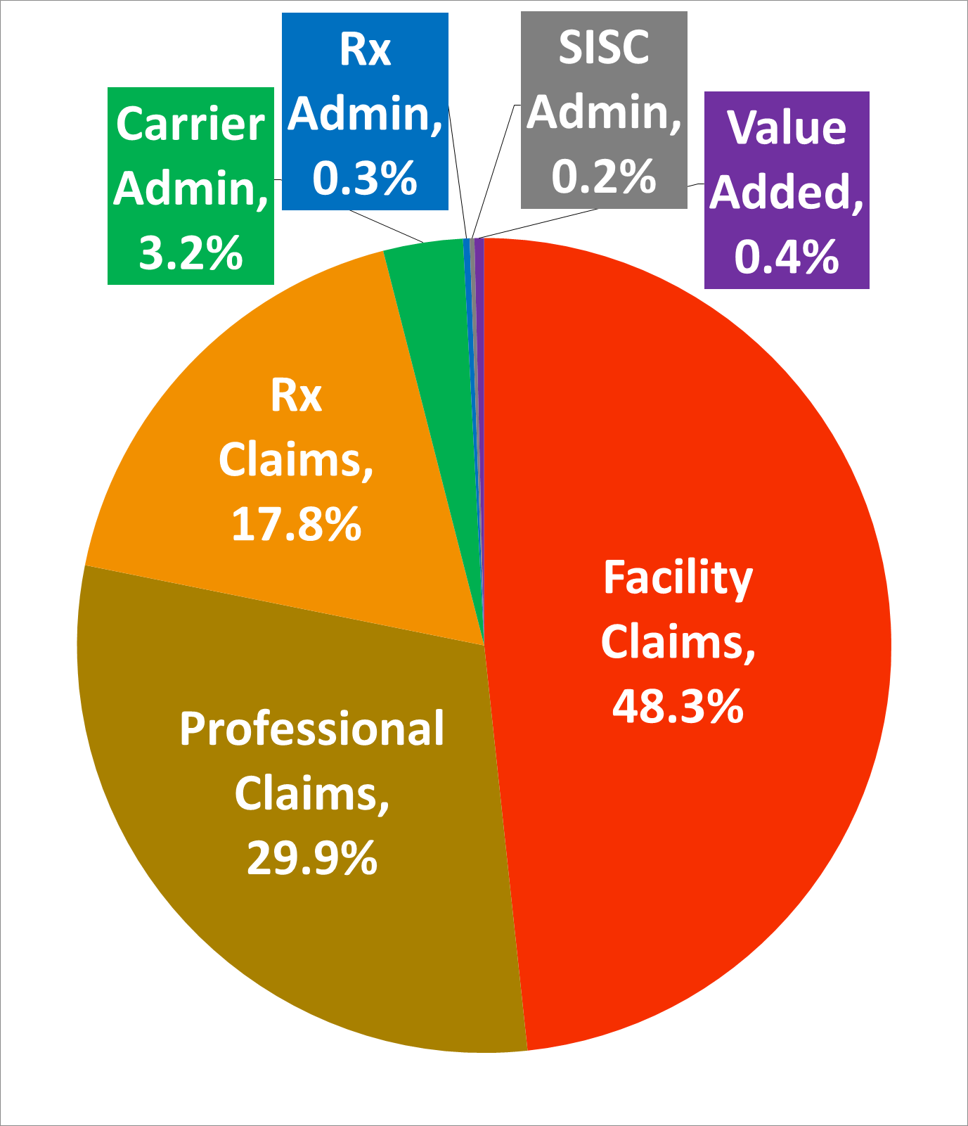
schools helping schools
Almost every dollar we collect goes to pay directly for healthcare services
STRENGTH IN NUMBERS
With the combined power of 475 California school districts, SISC is a strong, stable health system. By pooling risk for over 424K employees and their families, we deliver predictable value to our membership.
As a public entity, SISC doesn’t operate on profit margins. All SISC employees and Board Members are public school employees.
Providing value is our top priority. We are committed to serving the needs of our members.

Slide 3
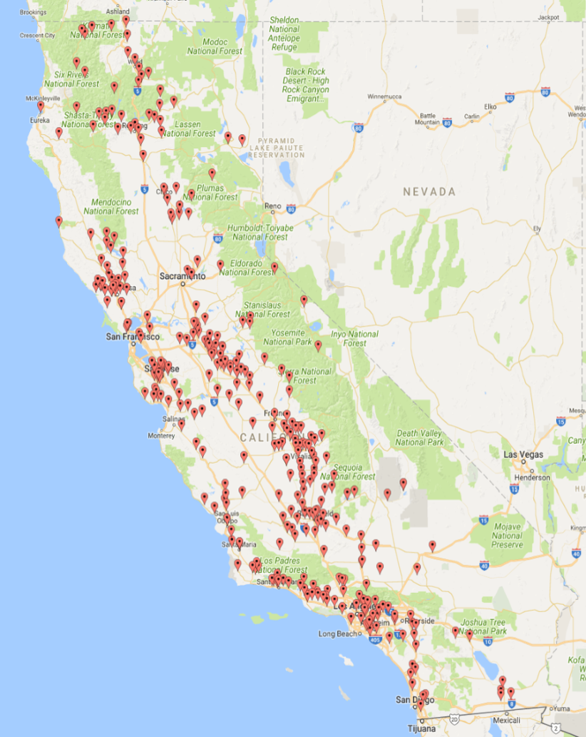

Geographic Diversity Provides Stability
We treat having membership spread out over all of California like a diversified investment.
Renewal rates are based primarily on the experience of the entire statewide pool.
Regional differences in the cost of medical care are taken into consideration, but the size and diversity of our pool allow us to spread the risk and minimize the regional adjustments.
Low costs and stability are major reasons groups join SISC and stay for decades.
Our groups can depend on predictable and fair rate renewals.
Notes:
-

Slide 4
About the region
Public Entity Transparency:
Q: Is the pool a public entity?
Yes, SISC is a public entity. The administration is carried out by a staff of public school employees.
Like public schools, we are subject to the Brown Act. Our board meetings are open to the public.
Timing of Renewals:
Q: When does the pool deliver renewal rates?
SISC delivers renewal rates in March and early April, six months in advance of the effective date.
Regions:
Q: Are renewals based on regions?
Renewal rates are based primarily on the experience of the entire statewide pool with regional differences in the cost of medical care taken into consideration.

Slide 5
Things to consider
Regions:
Q: What region would we be in?
Rancho Santiago Community College District would be in the Orange/LA/San Bernardino/Riverside Region.
Q: What other groups are in this region?
Alvord Unified | Fullerton Jt. Union High | Orange County Dept. of Ed | Santa Clarita CCD
Anaheim Elementary | Glendale Unified | Orange Unified | Santa Monica-Malibu Unified
Arcadia Unified | Huntington Beach City Elem. | Palisades Charter High | Santa Rosa Academy
Azusa Unified | LA County Office of Ed. | Palm Springs Unified | So Orange County CCD
Buena Park | La Habra City | Pasadena Area CCD | Sulphur Springs Union Elem.
Coachella Valley Unified | Lake Elsinore Unified | Pasadena Unified | Temecula Valley Unified
College of the Desert | Lewis Center | Placentia-Yorba Linda | Victor Elementary
Corona-Norco Unified | Menifee Union Elem. | Pomona Unified | Westminster Elementary
Desert Sands Unified | Monrovia Unified | Redondo Beach Unified | Whittier City School
East Whittier City | Moreno Valley Unified | Saddleback Valley Unified | William S. Hart Union High
El Camino Real Charter HS | Mt. San Antonio College | San Bernardino CCD
Fullerton Elementary | Nuview Union | San Gabriel Unified
Notes:
-

Slide 6
CCD Membership in SISC
Q: Which Community College Districts participate in the SISC Health Benefits program?
Santa Cruz County
Cabrillo College - 2006
Shasta/Tehama/Trinity County
Shasta-Tehama- Trinity CCD -2016
Sonoma County
Santa Rosa Junior College - 2008
Stanislaus /Tuolumne County
Yosemite CCD - 2010
Tulare County
College of the Sequoias - 2016
Ventura County
Ventura County CCD - 2024
Alameda County
Ohlone CCD – 2019*
Peralta CCD - 2023
Butte/Glenn County
Butte Glenn CCD - 2017
Fresno County
West Hills CCD – 2004*
Humboldt
College of the Redwoods
- 2019
Kern
Kern CCD - 1983
West Kern CCD - 1987
Lassen
Lassen CCD – 1999*
Los Angeles County
Antelope Valley CCD - 2012
Mt. San Antonio CCD – 2020*
Pasadena Area CCD - 2017
Santa Clarita CCD - 2010
Marin County
College of Marin - 2014
Merced County
Merced CCD – 1989
Monterey County
Hartnell College - 2026
Orange County
South Orange County CCD
- 2003
Placer County
Sierra Jt. CCD - 2012
Riverside County
College of the Desert - 2010
San Bernardino County
San Bernardino CCD - 2020
San Diego County
Miracosta CCD - 2024
Palomar CCD - 2016
San Luis Obispo County
SLO County CCD – 2002
Santa Barbara County
Santa Barbara City College - 1993
Santa Clara County
Gavilan Jt. CCD - 2018
San Jose Evergreen CCD - 2018
*Community College Districts with bargaining unit outside of SISC
Notes:
-

Slide 7
Things to consider
Q: What is the breakdown of the number of members covered by PPO, HMO and Kaiser plans in this region?
Orange/LA/San Bernardino/Riverside Members:
PPO: 35,585
HMO: 37,665
Kaiser: 46,533
Total: 119,783
Size and Stability:
Q: For the region we would be in, what is the renewal history for the past five years for PPO, HMO and Kaiser plans?
PPO HMO KP
2022 - 23: 5.3% 5.7% 7.1%
2023 - 24: 8.1% 8.7% 8.6%
2024 - 25: 4.6% 5.7% 5.4%
2025 - 26: 7.9% 8.3% 8.8%
2026 - 27: 9.0% 9.3% 8.0%
Q: Do all groups in this region receive the same renewal percent change or have some groups sometimes received a different percent change?
All groups within the same region receive the same renewal range regardless of their size or when they joined.
Q: What is the total number of Medical Plan members covered statewide broken down by PPO, HMO and Kaiser?
PPO HMO KP Total
260,985 49,225 113,196 423,406

Slide 8
SISC PlaNS Quoted: 1/1/2027-9/30/2027
Active Employees and Early Retirees
Anthem PPO 90-A $20
Prudent Buyer Network;
Navitus $5G/$20B Rx
3-Tier Rates
Single $1,361
2-Party $2,896
Family $4,036
4-Tier Rates
EE $1,361
EE+SPS $3,014
EE+CH(N) $2,657
EE+FAM $4,191
Anthem HMO Premier 10
Full HMO Network
Navitus $5G/$20B Rx
3-Tier Rates
Single $1,066
2-Party $2,248
Family $3,123
4-Tier Rates
EE $1,066
EE+SPS $2,345
EE+CH(N) $2,050
EE+FAM $3,245
Kaiser Permanente
$0 OV / $5 Rx or
$10 OV / $10 Rx
3-Tier Rates
Single TBD
2-Party TBD
Family TBD
4-Tier Rates
EE TBD
EE+SPS TBD
EE+CH(N) TBD
EE+FAM TBD
SISC KP quote will follow after release of ASCIP renewal.

Slide 9
SISC: Kaiser Permanente Options
Benefit | Kaiser $0 OV / $5 Rx | Kaiser $10 OV / $10 Rx
Annual Deductible | $0 | $0
Out-of-Pocket Maximum | $1,500 Person / $3,000 Family | $1,500 Person/ $3,000 Family
Primary Care Visits | $0 | $10
Specialist Visits | $0 | $10
Mental Health Office Visits | $0 | $10
Telehealth Visits | $0 | $0
Urgent Care | $0 | $10
See benefit summaries and plan booklets for coverage details.

Slide 10
SISC: Kaiser Permanente Options
Benefit | Kaiser $0 OV / $5 Rx | Kaiser $10 OV / $10 Rx
Physical / Occupational / Speech Therapy | $0 | $10
Labs & X-rays | $0 | $0
MRI / CT / PET Imaging | $0 | $0
Outpatient Surgery | $0 | $10
Inpatient Hospital | $0 | $0
Emergency Room | $100 | $100
Ambulance | $50 | $50
Current RSCCD Plan features $0 Ambulance and $35 ER copays
See benefit summaries and plan booklets for coverage details.

Slide 11
SISC: Kaiser Permanente Options
Benefit | Kaiser $0 OV / $5 Rx | Kaiser $10 OV / $10 Rx
Mental Health & Substance Abuse:
Individual Outpatient $0 $10
Group Outpatient $0 $5
Durable Medical Equipment $0 $0
Prosthetics / Orthotics $0 $0
Skilled Nursing Facility $0 $0
Chiropractic / Acupuncture (ASH) $10 $10
Annual limit of 30 visits combined
SISC Kaiser Permanente plans will include coverage for the treatment of infertility as required by California SB 729, effective October 1, 2026.
See benefit summaries and plan booklets for coverage details.

Slide 12
SISC: Kaiser Permanente Options
Covered Prescription Drugs | Kaiser $0 OV / $5 Rx | Kaiser $10 OV / $10 Rx
Most Generics Most Brands Up to a 100-days supply Most Specialty Up to a 30-days supply | $5 $5 $5 | $10 $10 $10
Must use Kaiser Permanente Pharmacy or KP Mail-Order Service.
See benefit summaries and plan booklets for coverage details.

Slide 13
SISC: Anthem Blue Cross HMO Premier 10
Key Benefit | Member Cost
Annual Deductible | $0
Annual Out-of-Pocket Maximum | $1,000 Person / $2,000 Family
Primary Care Visits | $10 copay
Specialist Visits | $10 copay
Mental Health Office Visits | $10 copay
Diagnostic Labs & X-rays | $0
MRI / CT / PET Imaging | $100 copay
Urgent Care | $10 copay
Emergency Room | $100 copay
Inpatient Hospital | $0
Outpatient Surgery | $0
See benefit summaries and plan booklets for coverage details.

Slide 14
SISC: Anthem Blue Cross HMO Premier 10
Service In-Network Member Cost
Chiropractic Care & Acupuncture (ASH) $10 copay
Annual limit of 30 visits combined
Physical, Occupational & Speech Therapy $10 copay
Home Health Care $10 copay
Dialysis $10 copay
Chemo / Radiation Therapy $10 copay
Skilled Nursing Facility $0
Hospice $0
Durable Medical Equipment $0
Prosthetic Devices $0
See benefit summaries and plan booklets for coverage details.

Slide 15
SISC: Anthem Blue Cross HMO Premier 10
Services are generally covered only when coordinated through the member’s PCP and medical group/IPA
Out-of-network services are not covered except for emergency, urgent care, authorized services, or when required by law
Some therapies and specialty services have annual visit limits
SISC HMO plans will include coverage for the treatment of infertility as required by California SB 729, effective October 1, 2026
See benefit summaries and plan booklets for coverage details.

Slide 16
SISC: Anthem Blue Cross PPO 90-A $20
Key Benefit | Member Cost (In-Network)
Annual Deductible | $100 Person / $300 Family
*Annual Out-of-Pocket Maximum | $1,000 Person / $3,000 Family
Primary Care Visits | $0 first 3 visits, then $20 copay
Specialist Visits | $20 copay
Mental Health Office Visits | $20 copay
Urgent Care | $20 copay
Emergency Room | $100 copay + 10% after deductible
Inpatient Hospital | 10% coinsurance after deductible
Diagnostic Testing, Surgery, Imaging | 10% coinsurance after deductible
*Annual Out-of-Pocket Maximum for covered non-emergent, in-network medical services.
The pharmacy benefit has a separate OOPM.
See benefit summaries and plan booklets for coverage details.

Slide 17
SISC: Anthem Blue Cross PPO 90-A $20
Service In-Network Member Cost
Chiropractic Care & Acupuncture (ASH) Deductible, then 10%
No chiro limit; subject to ASH review after 5th visit
Acupuncture – 12 visits per year
Physical, Occupational & Speech Therapy Deductible, then 10%
Home Health Care Deductible, then 10%
Dialysis Deductible, then 10%
Chemo / Radiation Therapy Deductible, then 10%
Skilled Nursing Facility $0
Hospice $0
Durable Medical Equipment $0
Prosthetic Devices $0
SISC PPO Plans are not subject to California SB 729; infertility treatment is not covered.
See benefit summaries and plan booklets for coverage details.

Slide 18
Out of Network Plan Differences
The ASCIP 90-70 Optional PPO provides materially broader Out-of-Network coverage overall, generally member cost share is 30% coinsurance after deductible.
The SISC 90-A $20 Anthem Classic PPO excludes many Out-of-Network services entirely and frequently limits reimbursement to Anthem’s allowed amount. Members using OON providers are subject to potentially significant balance billing.
The ASCIP plan includes a defined Out-of-Network Out-of-Pocket Maximum, while the SISC 90-A plan does not.
Several out of network care categories— including labs, standard imaging, DME, prosthetics, PT/chiropractic, and preventive care — are covered under ASCIP but not covered under the SISC 90-A plan.
Same as current plan:
Specific inpatient surgeries that must be performed at a Blue Distinction Plus Facility
  Hip/Knee joint replacements, spinal surgeries, bariatric surgery (BD/BD+)
Maximize benefits and avoid unexpected billing by accessing non-emergent care in-network

Slide 19
Out of Network Plan Differences
Benefit Category | ASCIP 90-70 Optional PPO | SISC 90-A $20 Anthem PPO
Out-of-Network Out-of-Pocket Maximum | $3,000 person / $6,000 family | No OON Network OOP Max
General Out-of-Network Coverage Approach | Most services covered at 30% after deductible | Many services are not covered OON; others reimburse up to max allowed amount
Primary Care / Specialist / Mental Health Office Visits | 30% coinsurance after deductible | Member pays charges exceeding allowed amount
Preventive Care | 30% coinsurance after deductible | Not covered
Physical Medicine (PT/OT/Chiro) | 30% coinsurance after deductible | Not covered

Slide 20
Out of Network Plan Differences
Benefit Category ASCIP 90-70 Optional PPO SISC 90-A $20 Anthem PPO
Advanced Imaging (MRI/PET/CT) | 30% after deductible plus charges over $800/test limit | Charges above $800/test limit
Urgent Care | 30% after deductible | Charges above allowed amount
Emergency Room / Ambulance | Covered as In-Network | Covered as In-Network
Outpatient Mental Health Facility Services | 30% after deductible | Charges above allowed amount
Hospital Inpatient Facility | $500/admission + 30% after deductible; limit: $1,500/day | Subject to $600/day limit

Slide 21
Out of Network Plan Differences
Benefit Category ASCIP 90-70 Optional PPO SISC 90-A $20 Anthem PPO
Skilled Nursing Facility | Covered; subject to balance billing beyond Anthem allowance | Subject to $600/day limit
Home Health Care | Subject to $150/day limit | Same $150/day limit structure
ASC / Dialysis Centers | Subject to $350/day or visit limit | Same $350/day or visit limit structure
Durable Medical Equipment & Prosthetics | Covered at 30% after deductible | Not covered
Cardiac Rehabilitation | Covered at 30% after deductible | Not covered
Hearing Aids | $2,000 maximum per ear, every 36 months | $700 maximum both ears, every 24 months

Slide 22

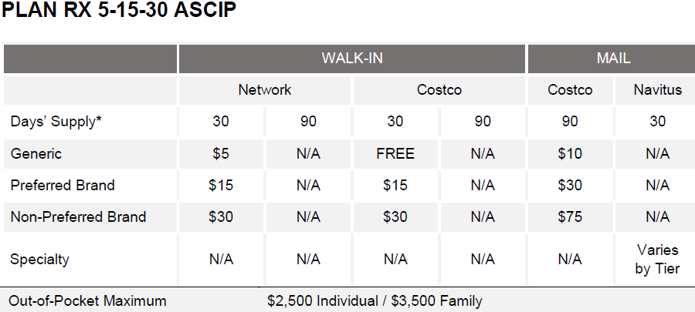
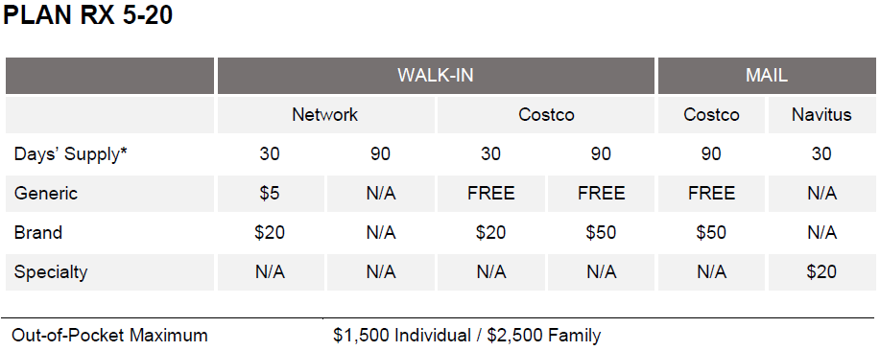
SISC pharmacy Benefits: PPO & HMO
Pharmacy Benefits are provided by Navitus Health Solutions on both plans, using the same formulary.
ASCIP separates Preferred vs. Non-Preferred Brands
SISC combines all brands into a single Brand Tier
  Members using Preferred Brands may pay less under ASCIP.
  Members using Non-Preferred Brands may pay less under SISC.
SISC plan has lower Rx out-of-pocket maximums and richer Costco generic/mail-order generic structure
SISC/Navitus Pharmacy Network includes most independent and all major chain pharmacies except Walgreens.

Slide 23
pharmacy Benefits – additional details
The SISC Navitus pharmacy benefit includes the following provisions to help sustain affordability.
Step Therapy: Members may be required to try safe and cost-effective alternatives before other medications are covered. When filling a prescription that requires step therapy, the pharmacist will be prompted to contact the prescriber to discuss appropriate alternatives.
Prior Authorization: Certain medications will only be approved if specific criteria are met.
Days Supply Limits: Newly prescribed maintenance medications will be filled in a 30-day supply for the first three fills before a 90-day supply can be obtained.
Quantity Limits: Some medications may have factors that necessitate dispensing a smaller quantity.
Brand Names with Generic Equivalents: Once a brand-name drug's patent expires, other companies can sell its generic version. Common examples include Lipitor (generic: atorvastatin) and Synthroid (generic: levothyroxine). Members who choose a brand-name drug when a generic is available must pay the cost difference between the brand and the generic, plus the generic copayment. An exception procedure is available for prescribing physicians if the brand-name drug is deemed medically necessary.

Slide 24
pharmacy Benefits – additional details
Non-Covered Medication Categories: Some medication categories are excluded under the SISC Navitus Pharmacy Benefit, including:
  *Weight loss medications (e.g., Wegovy, Zepbound)
      GLP-1 medications are covered only with a diagnosis of Type II Diabetes
  Medications used for cosmetic purposes (e.g., anti-wrinkle treatments, hair removal)
  Over-the-counter medications (e.g., Prilosec, Nexium, Zyrtec, Flonase, Claritin)
  *See note on slide 25.
Transitioning to the SISC Navitus Prescription Benefit
Most members will not see significant changes to their prescription coverage when moving to SISC.
During the first 90 days of coverage, overrides will allow:
  Covered medications subject to step therapy or prior authorization to be filled once during the first 90 days
Specialty Medications:
Specialty medications are prescription drugs used to treat complex, chronic, or rare conditions. They often require special handling, close monitoring, or specific administration (such as injections or infusions). Members taking a specialty medication should contact Navitus for guidance. Lumicera is the Navitus Specialty pharmacy.

Slide 25
pharmacy Benefits – additional Details
There is NO transition coverage for medications prescribed for weight loss, cosmetic uses, brand-name drugs with generic equivalents, and over-the-counter medications. These categories will NOT be covered under the SISC Navitus pharmacy benefit. The pharmacy will explain that the medication is not covered; members with questions may call Navitus customer service.
HMO members with a BMI over 30 may access Vida’s medical weight loss program, which includes support from a nutritionist, health-coaching, and clinical provider visits. This medical weight loss program also offers the prescribing of weight loss medications, including select GLP-1 therapies for HMO members with a BMI over 40 who meet clinical and program engagement criteria.
As of July 1, 2026, the SISC plan will cover generic Farxiga (dapagliflozin) only. Members currently taking Jardiance will be transitioned to generic Farxiga (dapagliflozin). An exception process may be available through Navitus for medical necessity.
Jardiance and generic Farxiga are both SGLT2 inhibitors that treat the same conditions and work in a similar way.
If you are impacted by a coverage change and have questions, you may contact Navitus for guidance once enrolled.

Slide 26
SISC PlaNS Quoted: 1/1/2027-9/30/2027
Retirees 65+ with Medicare A&B
Anthem PPO 100-A $20 (Medicare COB)
Prudent Buyer Network;
Navitus Part D Rx $0G/$20B
3-Tier Monthly Rates
Single $716
2-Party $1,432
Family $1,869
Anthem Blue Cross CompanionCare Medicare Supplement; Navitus Part D Rx $9G/$35B
3-Tier Monthly Rates
Single $510
2-Party $1,020
Kaiser Permanente Senior Advantage $10 OV / $10 Rx
Medicare A&B assigned to KP
3-Tier Monthly Rates
Single $243
2-Party $486
See benefit summaries and plan booklets for coverage details.

Slide 27
SISC Retirees – important information
Retirees who decline coverage will not be permitted enrollment in the future.
Dependents may not be enrolled without the subscriber (unless Ed. Code 7000 applies)
Under/over combos may remain enrolled on the <65 plan, provided the Medicare eligible person enrolls in Parts A&B on the first date of eligibility; or
The enrollment may be split and the person over 65 may enroll in a SISC Medicare Plan, and the person under 65 may enroll on the <65 plan with the same carrier.
SISC requires retirees to maintain continuous enrollment in Medicare Parts A&B; otherwise, a nonrefundable surcharge will apply to the monthly premium for the <65 retiree plan.
Similarly, Kaiser Permanente members must maintain assignment of Medicare Parts A & B to avoid monthly surcharges to the <65 premium.
Medicare Part | Surcharge
Missing Part A | $700
Missing Part B | $900
Missing Parts A & B | $1,600

Slide 28
SISC ADDED VALUE PROGRAMS
SISC offers “Added Value” Programs in addition to traditional coverage.
These programs make healthcare more accessible and affordable for our members, and help eliminate gaps in care.
The following slides explain the programs available through SISC.

Slide 29
SISC ADDED VALUE PROGRAMS
Employee Assistance Program – (EAP) provides access to free, confidential resources for help with personal concerns – emotional, marital, financial, addiction and recovery, legal, stress and more.
Expert Medical Opinion Benefit for all SISC members – Teladoc provides free access to world-class physicians for the diagnosis of medical conditions and optimal treatment plans.
Health Screening Program for all SISC members – Quest Biometric Screenings PPO members 45+ and over are also eligible for free colorectal screening kits.
Personalized Support for Autoimmune & Inflammatory Conditions for all SISC members – WellTheory offers personalized nutrition and lifestyle coaching from Registered Dietitians and access to specialty lab testing for gut health, hormone balance, and food sensitivities.

Slide 30
SISC ADDED VALUE PROGRAMS
$0 generic drugs at Costco and through Mail Order for PPO & HMO members - Members who use Costco retail pharmacies can have their prescriptions delivered for free through Instacart! (Instacart will deliver within a 60 minute travel radius)
Free remote access to personal health care support for PPO & HMO members – Vida benefits include one-on-one coaching from clinicians and therapists who can help members lose weight, sleep better, manage chronic medical conditions, and cope with stress, anxiety and depression.
24/7 Urgent Care and Mental Health Telehealth for PPO & HMO members – MDLive provides free virtual access to board certified physicians, pediatricians, therapists and psychiatrists.

Slide 31
SISC ADDED VALUE PROGRAMS
Virtual Primary Care for PPO members – With Centivo, members can connect with a primary care provider virtually who can diagnose conditions, prescribe medication, refer to in‐network specialists, and provide mental health support all at no cost.
Maternity Support for PPO members – Maven provides free 24/7 virtual access to one-on-one maternity and postpartum support. Join in the first or second trimester to find out how to get a FREE 6-month diaper subscription!
Digital Joint and Back Pain solution for PPO members – Hinge Health provides free access to virtual physical therapy and digital tools to reduce back and joint pain from the comfort of their own home.
Guided Support for PPO members with Cancer – Lantern Cancer Care provides free access to a personal Oncology Nurse who partners with the member through every step of their cancer journey. The program also facilitates expert medical opinions and, when needed, provides expedited access to national cancer institutes.

Slide 32

eligibility
Who Must Enroll in Coverage?
  Employees working 90%+ FTE must enroll in SISC benefits
  Except grandfathered waivers, all full-time employees must choose benefits or WABE (if offered by district)
Who is Eligible?
  Employees working at least 50% FTE; adjunct faculty who work a minimum of 40% of a full-time faculty job and who receive at least 50% of the FT employee contribution
  Eligible dependents: spouse, registered domestic partner, children (natural, step, adopted (up to age 26), legal guardianship (up to age 18)
  Disabled dependents may continue past 26 if all criteria are met – MUST BE AN IRS TAX DEPENDENT
  SISC allows enrollment of surviving spouse of certificated employee as per Ed Code 7000; this provision may be extended to other employee classifications upon request with a copy of the district’s policy
Who May Decline Coverage?
  Current grandfathered waivers
  Employees working less than 90% FTE
  Those with proof of enrollment in certain other governmental plans such as Medical
These are SISC minimum requirements; member districts may have more stringent participation rules.

Slide 33
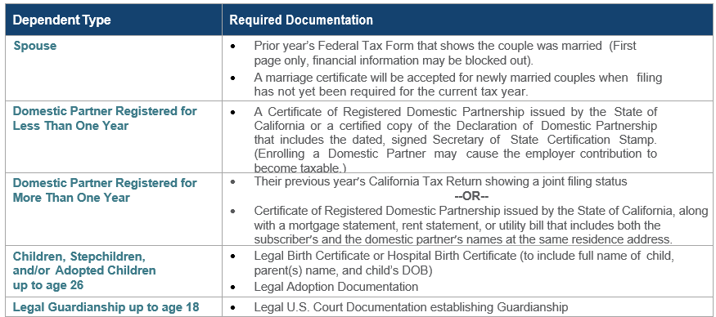
dependent Verification
SISC requires copies of dependent verification documents.

Slide 34
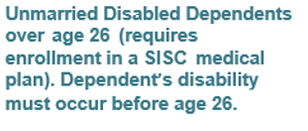
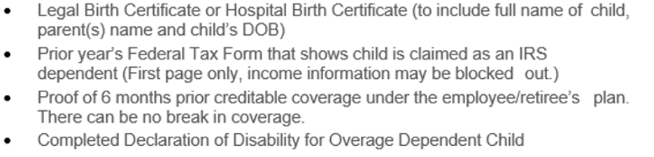
dependent Verification
Disabled Dependents over age 26 must be handled timely and carefully in order to continue coverage!
All items listed below are required
There can be no break in coverage.
Plus Dependent Certification Form for applicable carrier: Blue Shield, Anthem, etc.

Slide 35

SISC Timeline
Kaiser Permanente Break in rule apply
  KP quote will follow release of ASCIP renewal
  KP rates are revenue neutral, net of benefit adjustments
Initial rates effective January 1, 2027
SISC plans renew each October 1st
First renewal: October 1, 2027 – September 30, 2028
  Orange County renewal range will apply
SISC plan accumulations run on a calendar year
Joining documents due at SISC by September 1, 2026
  JPA agreement, Board Resolution, Plan Selection Letter, SISCconnect Registration Form

Slide 36
SISC Timeline
  Enrollment options:
    Upload to SISCconnect portal of completed, signed enrollment forms with dependent verification copies
    EDI file if approved by SISC; dependent verification copies will be upload to SISCconnect portal (Current approved vendors: American Fidelity, Apprize, Benefits Bridge, Plan Source, Selerix, Synergy, Ward)
    Estimated enrollment due dates:
      October 19th: Medicare Retirees
      November 16th Active, Early Retirees (EDI File due date TBD by scheduling discussion)

Slide 37

questions?
Thank you for the opportunity!

