Slide 1

RSCCD
2026-2027 Proposed Adopted Budget
Board of Trustees Meeting
September 14, 2026
Iris Ingram, Vice Chancellor, Business Services

Slide 2
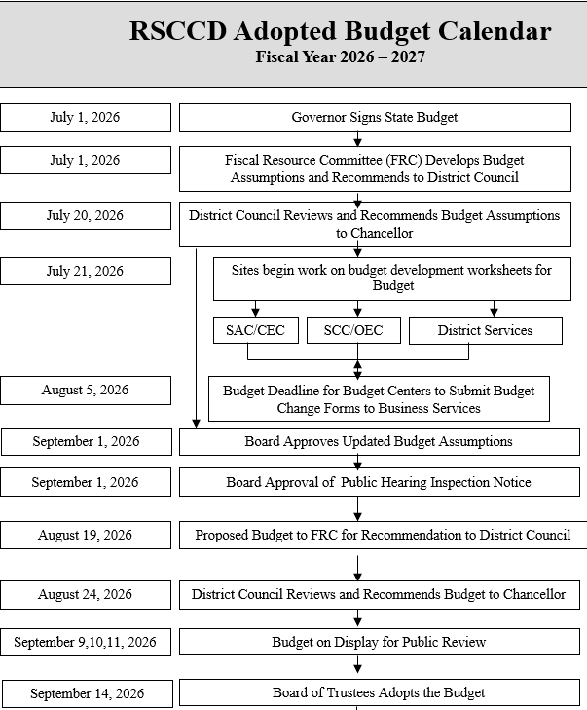

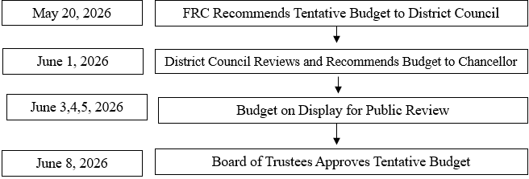
Adopted Budget 2026-27

Slide 3
2026-27 State Budget
2026-27 State Budget Agreement
  Main Budget Bill
    AB 109, as amended by SB 111, signed June 29, 2026
    Appropriated the money
  Trailer Bills
    Statutory and policy changes needed to implement the budget
    Education trailer bill (AB 126)
    Higher education trailer bill (SB 135)
Adopted Budget 2026-27

Slide 4
2026-27 State Budget (continued)
In the Main Budget Bill
  2.87% SCFF COLA (~$292 million ongoing)
  Additional 1.44% discretionary COLA
    ~$159.7 million ongoing
    Intended to help districts absorb the new paid pregnancy disability leave requirements and other operating pressures
  2.5% funded enrollment growth over two years
    ~$153 million ongoing
    1.0% growth funded for 2025-26
    1.5% growth funded for 2026-27
  Permanent Proposition 98 split increase to 11.1%
  Significant one-time funding for student support and facilities.
Adopted Budget 2026-27

Slide 5
2026-27 State Budget (continued)
Major One-Time Investments
Program | Amount
Student Support Block Grant | $147.2 million
Deferred Maintenance & Instructional Equipment | $120.7 million
Dreamer Resource Liaisons | $71.1 million
Common Cloud Data Platform | $36 million
Credit for Prior Learning | $35 million
LGBTQ+ Centers | $30 million
Apprenticeship Backfill | $16 million
Strong Workforce Backfill | $15.8 million
Adopted Budget 2026-27

Slide 6
2026-27 State Budget (continued)
In the Trailer Bills
  "Higher-of-current-year-or-three-year-average" FTES funding methodology
  Statutory implementation of paid pregnancy disability leave funding
  SCFF and apportionment formula revisions
  Calbright statutory changes
  Various implementation and conforming Education Code amendments.
Adopted Budget 2026-27

Slide 7
Macroeconomic
Impacts
State Economy Remains Resilient
California's economy continues to outperform the nation, with California real GDP growing 3.7% in the first quarter of 2026, compared with 2.1% U.S. GDP growth.
Consumer spending remains a key driver of economic activity, supporting state revenues despite broader economic uncertainty.
Inflation Is Moderating but Remains Elevated
Inflation has eased from earlier 2026 highs, with U.S. headline inflation declining from 4.2% in May to 3.5% in June, and further to 3.4% in July. Core inflation also continued to trend downward.
California inflation similarly moderated to 3.4%, which may help reduce some cost pressures on utilities, supplies, and contracted services over time.
While inflation is cooling, pricing levels remain above pre-pandemic norms, continuing to pressure operating budgets and compensation negotiations.
Adopted Budget 2026-27

Slide 8
Macroeconomic
Impacts (continued)
Labor Market Signals Are Mixed
California's unemployment rate improved slightly from 5.3% in May to 5.1% in July, but labor force participation declined and statewide payroll employment contracted in both June and July.
The state lost approximately 2,900 jobs in June and 20,500 jobs in July, led by declines in professional services, financial activities, government, and hospitality sectors.
Slower employment growth could influence enrollment patterns as displaced workers seek retraining and career education opportunities within community colleges.
Housing Activity Continues to Stabilize
Housing permit activity remains stronger than last year, with total housing permits up 17% to 20% year-over-year, largely driven by multifamily development.
Home prices remain elevated despite recent monthly declines, continuing affordability challenges for employees and students.
Adopted Budget 2026-27

Slide 9
Macroeconomic
Impacts (continued)
State Revenue Collections Are Exceeding Forecasts
General Fund revenues finished 2025-26 approximately $828 million above forecast, driven by stronger corporation tax, personal income tax, and sales tax receipts.
Through July, 2026-27 revenues remained $821 million above forecast, primarily due to stronger corporation tax collections and sales tax performance.
Strong revenue performance provides positive near-term indicators for state budget stability, though portions of the gains are tied to one-time timing factors such as Pass-Through Entity Tax payments.
Key Risks to Monitor
Slowing national GDP growth, which declined from 2.1% in Q1 to 1.5% in Q2 2026, may signal moderating economic momentum.
Continued job losses in high-wage sectors such as professional services and finance could eventually affect state income tax collections.
Geopolitical and energy-related risks remain a concern, although fuel-price inflation has begun to moderate
Adopted Budget 2026-27

Slide 10

Rancho Santiago CCD Budget

Slide 11
2026-27 RSCCD Budget
Total General Fund Budget of $551,636,785
Total ALL Funds Budget of $915,994,944
Statutory COLA of 2.87% & Discretionary COLA of 1.44%
Growth of 2.5% with the District’s growth authority of $4,459,846
Balanced budget (5th year) with no structural deficit
Additional on-going revenues of $25.8M flowing through the Budget Allocation Model (BAM)
Adopted Budget 2026-27

Slide 12
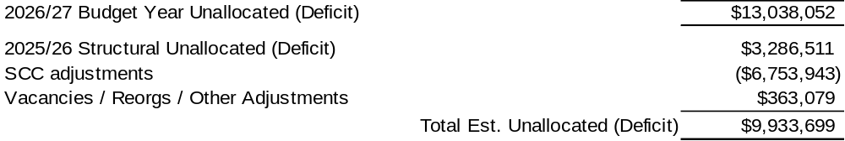
Rancho Santiago Community College District
Unrestricted General Fund Summary
2026/27 Adopted Budget Assumptions
New Revenues |  |  |  | Ongoing Only
Student Centered Funding Formula
Projected COLA of 4.31% |  |  |  | $11,490,331
PY Funded Growth |  |  |  | $7,946,596
Growth Authority 2.28% |  |  |  | $4,459,846
Unrestricted Lottery |  |  |  | $479,054
Mandates Block Grant |  |  |  | $102,944
Non-Resident Tuition |  |  |  | $300,000
Interest Earnings |  |  |  | $0
Apprenticeship - SCC |  |  |  | $488,969
Misc. Income |  |  |  | $519,504
Full-time Faculty Allocation |  |  |  | $0
Total |  |  |  | $25,787,244
New Expenditures |  |  |  | Ongoing Only |  | One-Time
Salary Schedule Increases/Collective Bargaining |  |  |  | $6,716,183
Step/Column |  |  |  | $2,374,770
Health and Welfare/Benefits Est. Increase 11.0% - Active |  |  |  | $1,051,973
Health and Welfare/Benefits - Retirees |  |  |  | $464,504
Health and Welfare - Part-time Faculty (placeholder) |  |  |  | $0
CalSTRS Changes |  |  |  | $0
CalPERS Changes |  |  |  | ($215,233)
Workers' Compensation Insurance (WCI) |  |  |  | $767,657
Full Time Faculty Obligation Hires |  |  |  | $2,176,493
Non-Credit Faculty (Non FON) |  |  |  | $197,863
Hourly Faculty Budgets (Match Budget to Actual Expense) |  |  |  | $0
Cost of Retiree Health Benefit (OPEB Cost) |  |  |  | $0
Capital Outlay/Scheduled Maintenance |  |  |  | $0
Certificates of Participation |  |  |  | ($2,200,000)
Utilities Increase |  |  |  | $115,000
ITS Licensing/Contract Escalation Cost |  |  |  | $252,000
Property, Liability and All Risks Insurance |  |  |  | $800,000
Apprenticeship - SCC |  |  |  | $488,969
Other Additional DSO/Institutional Costs |  |  |  | $524,077
SCC ADA Settlement Costs-final payment |  |  |  | $0 |  | $2,000,000
SRP 2 Expense Reduction (SRP completely paid) |  |  |  | ($765,064)
Total |  |  |  | $12,749,191 |  | $2,000,000
Adopted Budget 2026-27

Slide 13

Adopted Budget 2026-27

Slide 14

Adopted Budget 2026-27

Slide 15

Adopted Budget 2026-27

Slide 16
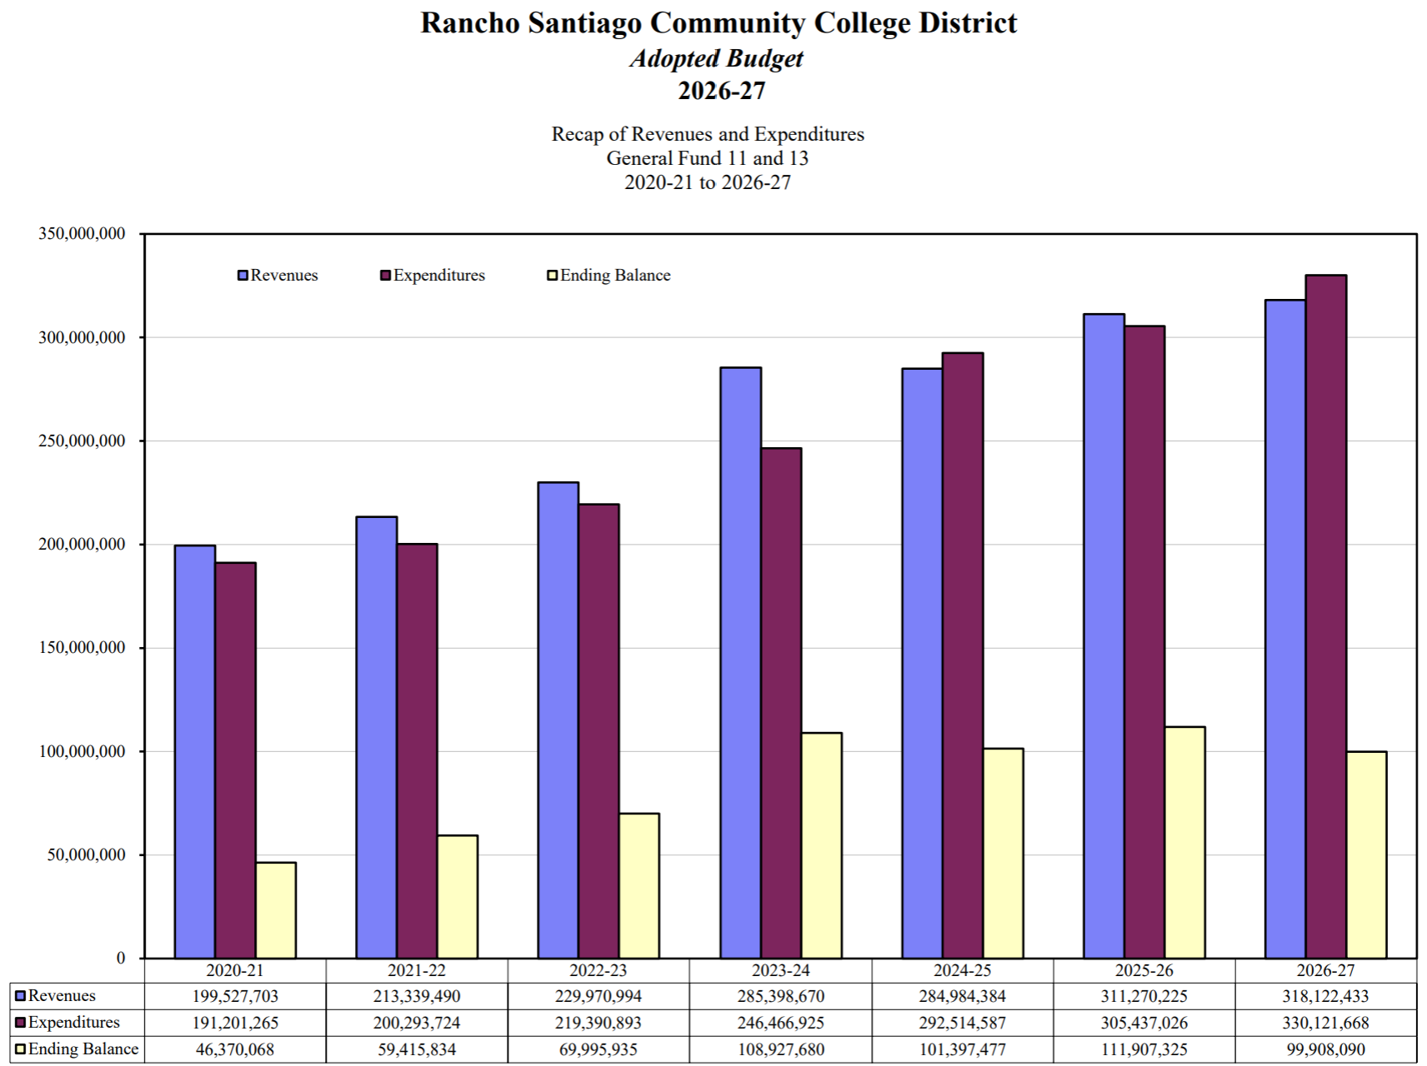
Adopted Budget 2026-27

Slide 17
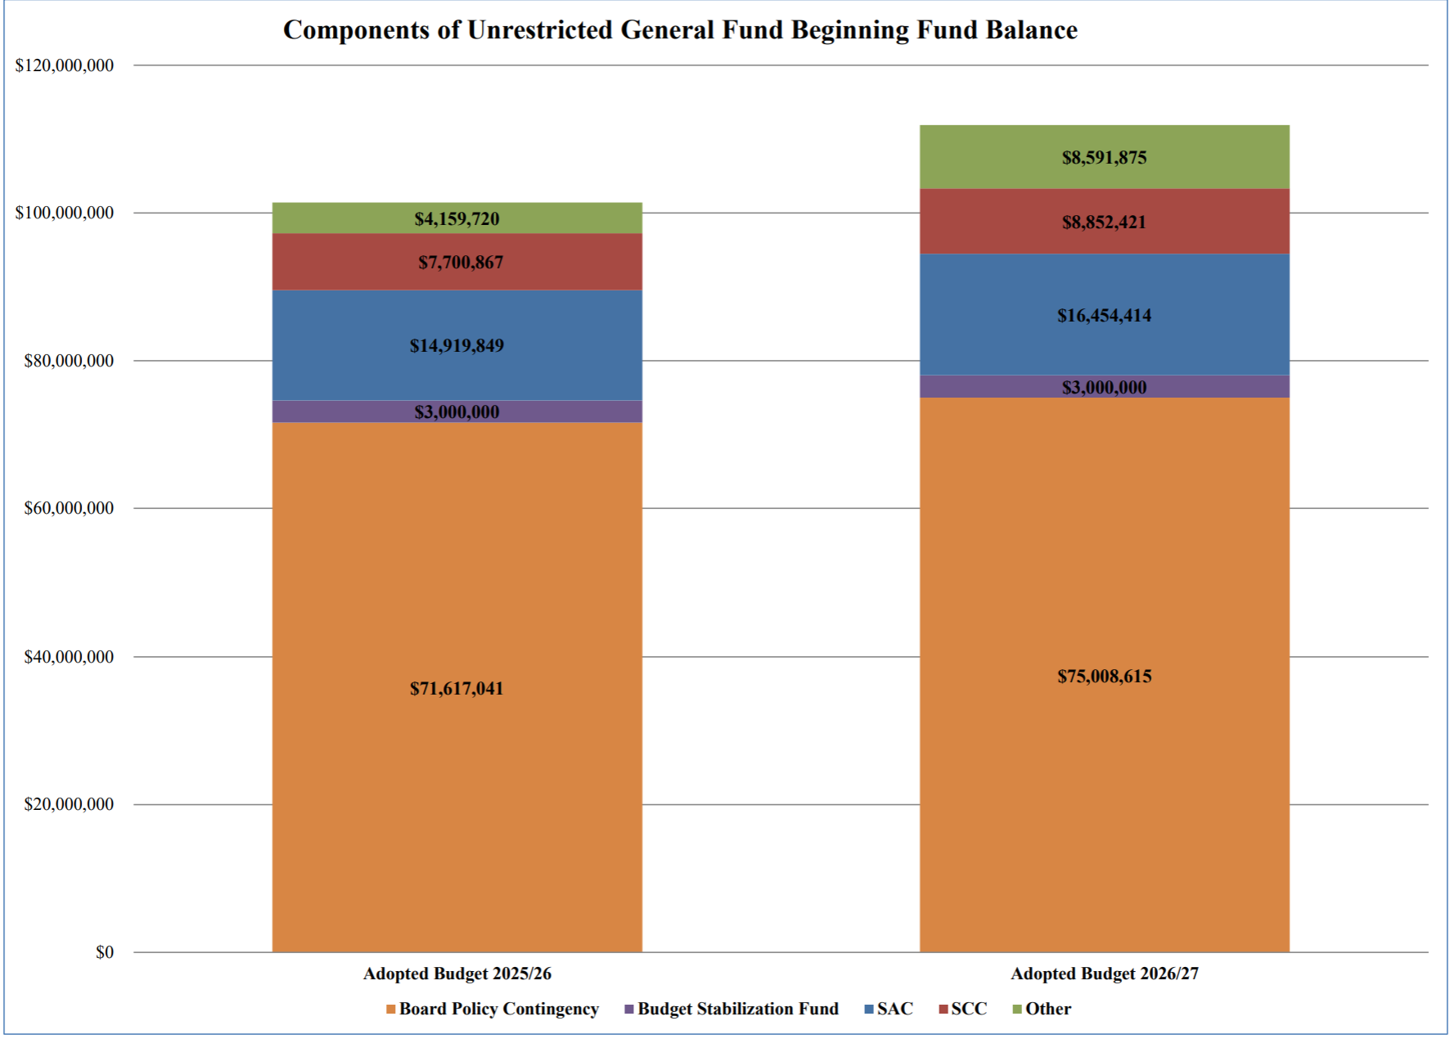
Adopted Budget 2026-27

Slide 18
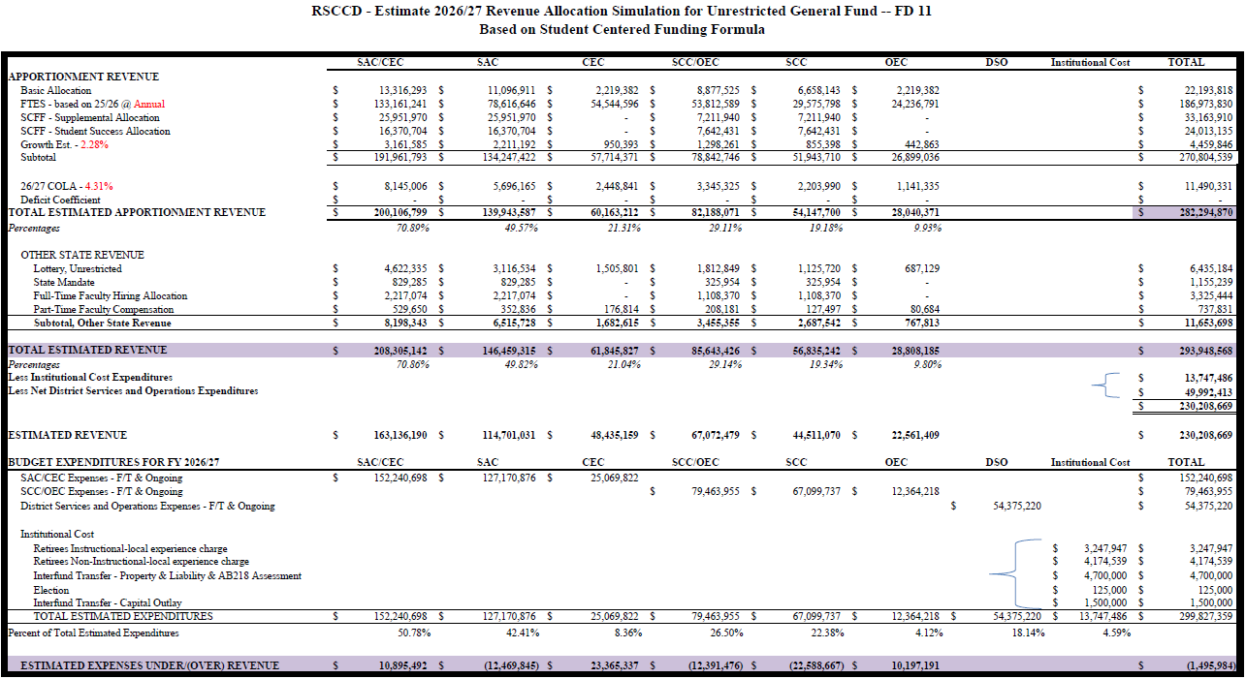
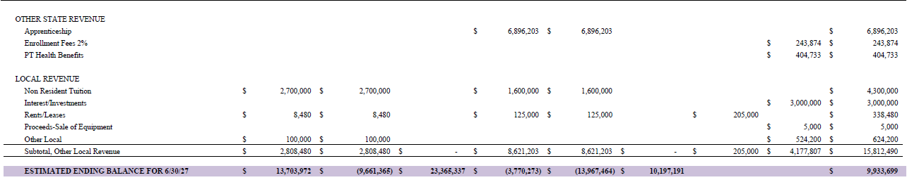
Adopted Budget 2026-27

Slide 19
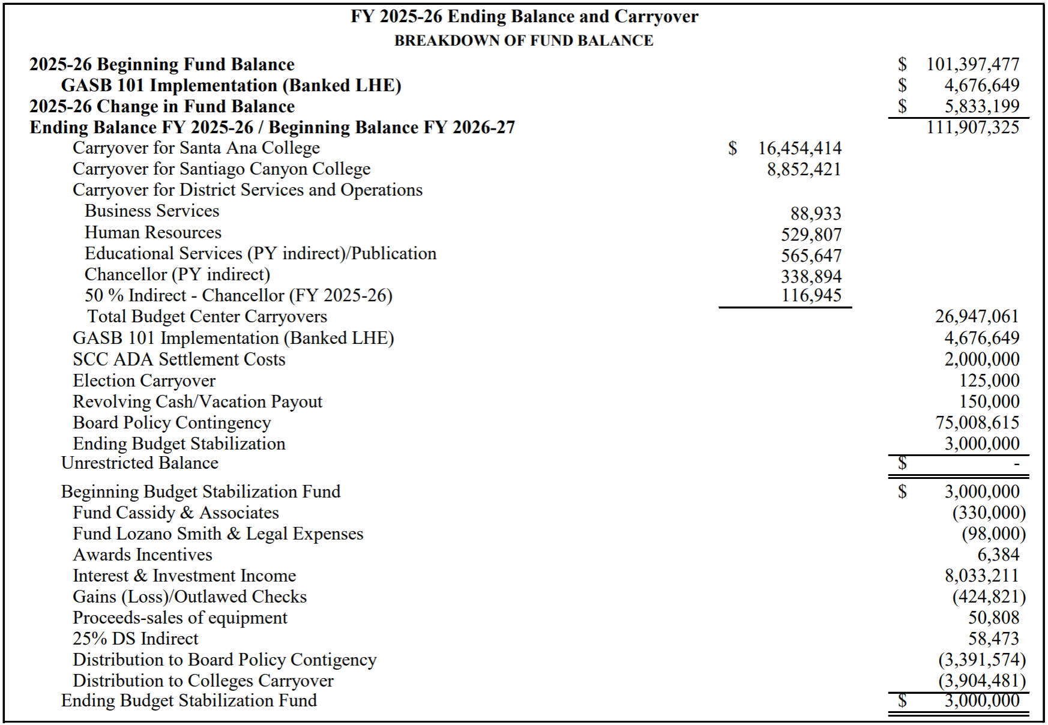
Adopted Budget 2026-27

Slide 20
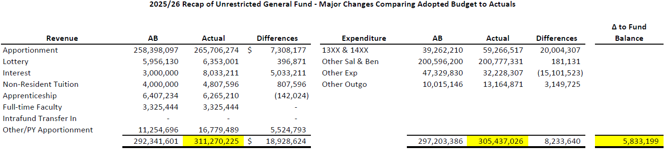
Adopted Budget 2026-27

Slide 21
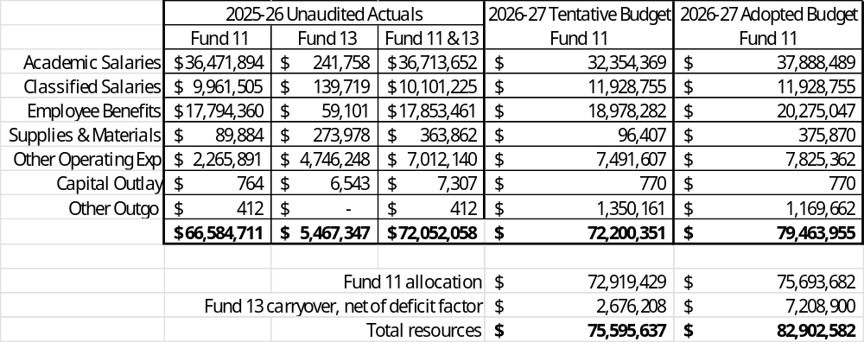
Santiago Canyon College Unrestricted General Fund
Adopted Budget 2026-27

Slide 22

Adopted Budget 2026-27

Slide 23
Appendix
Details of Funds 11 and 13
Details of Reserve levels
Tax Revenue Comparison – Actual vs Forecast
2026-27 SCFF Rates
Budget Planning Factors & Financial Projections
Adopted Budget 2026-27

Slide 24
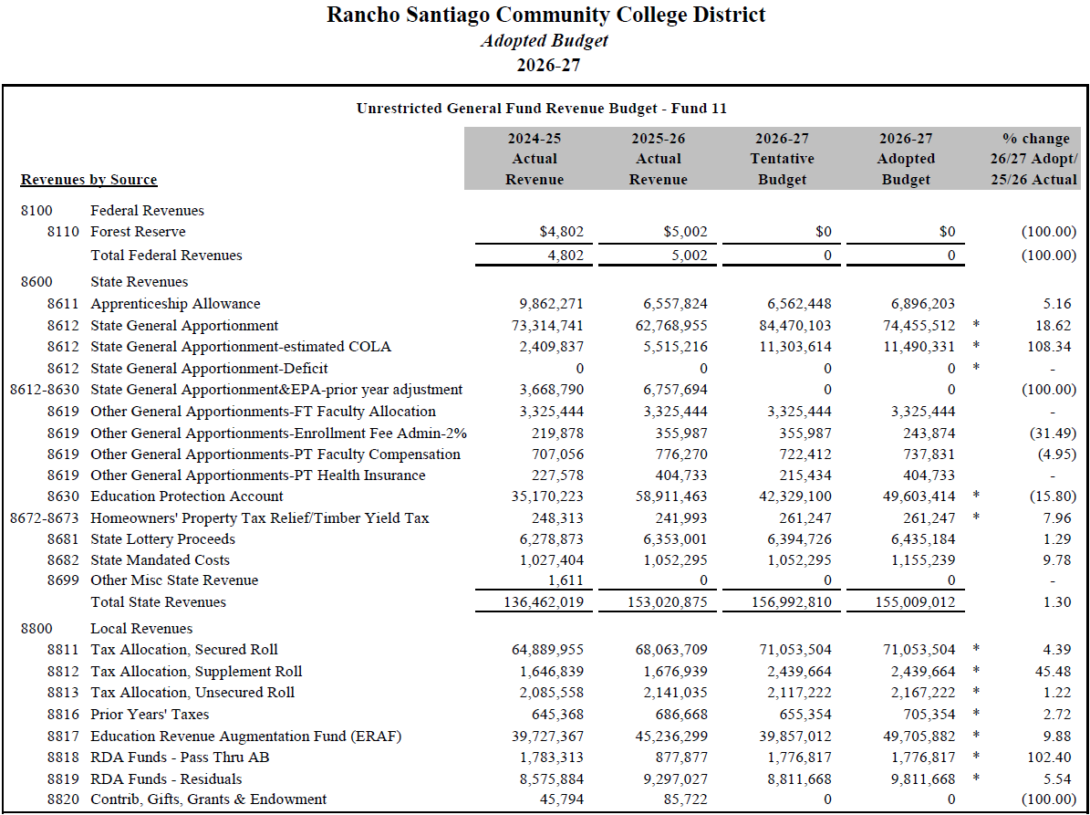
Adopted Budget 2026-27

Slide 25
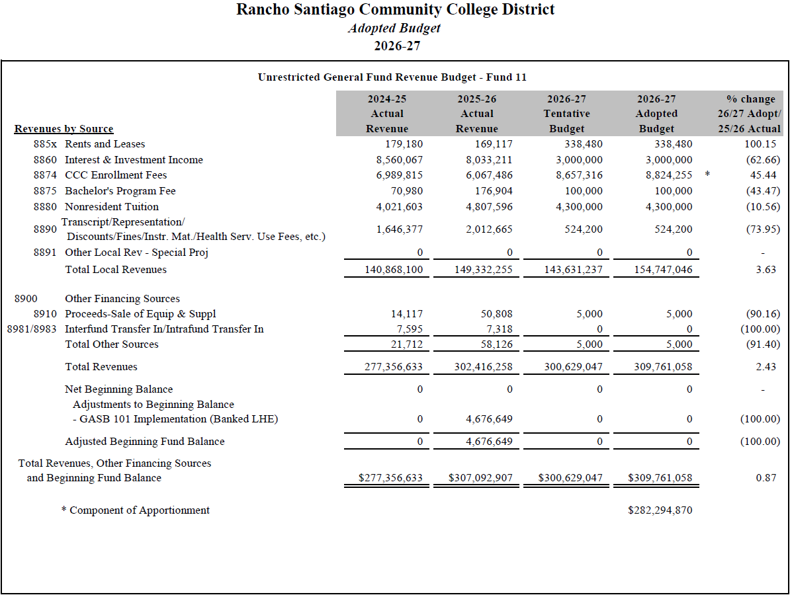
Adopted Budget 2026-27

Slide 26
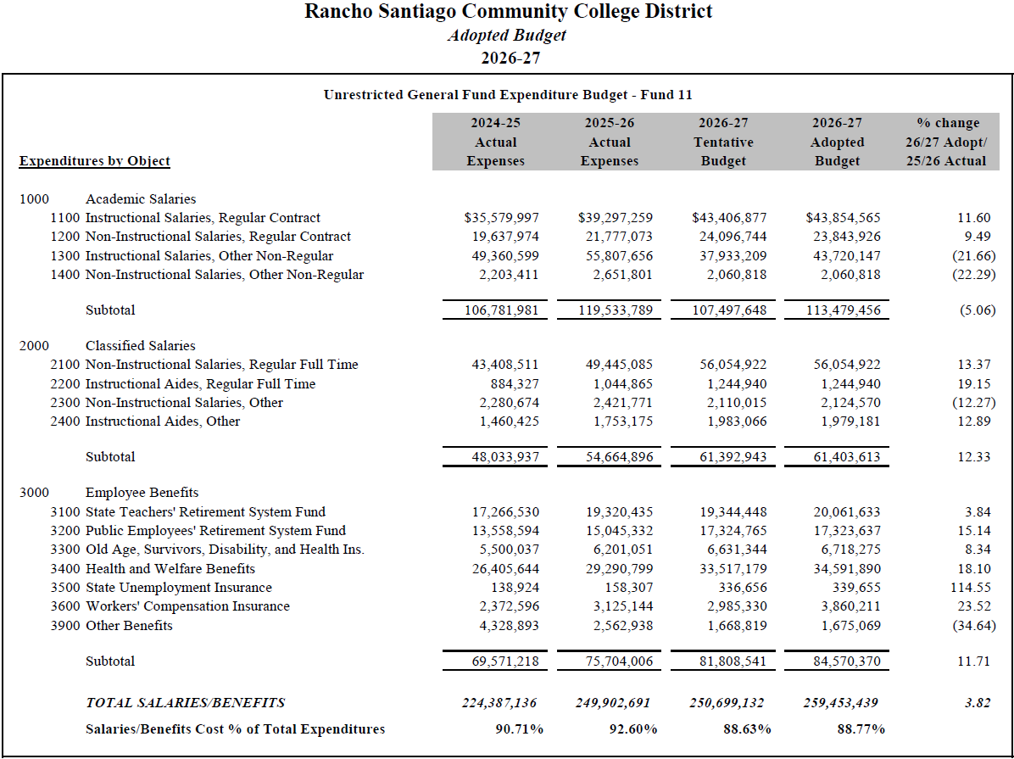
Adopted Budget 2026-27

Slide 27
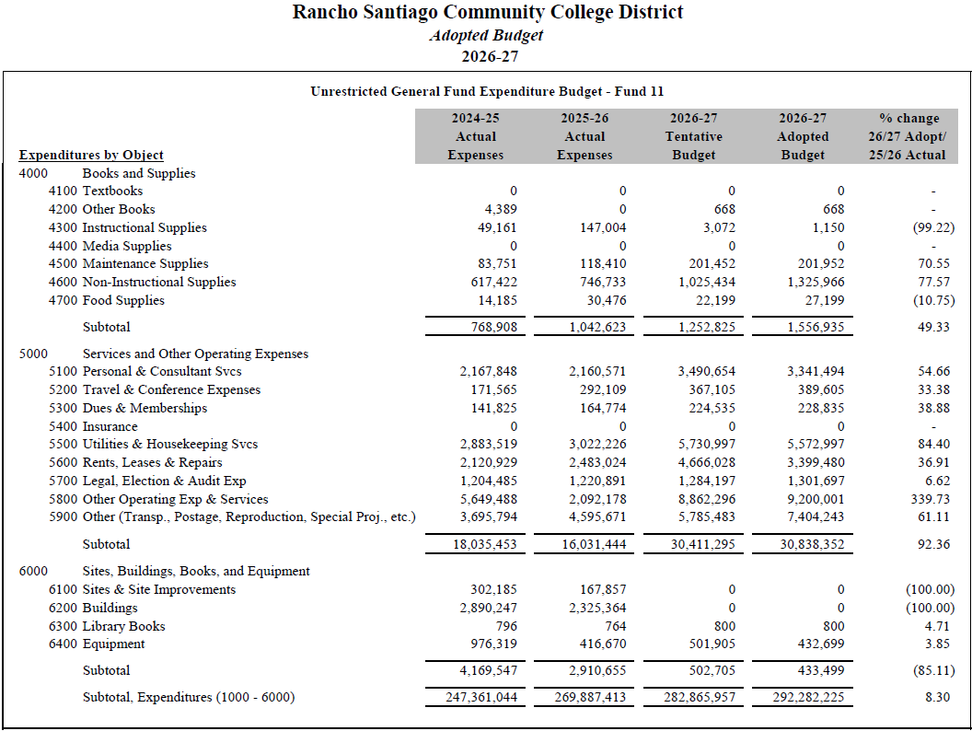
Adopted Budget 2026-27

Slide 28
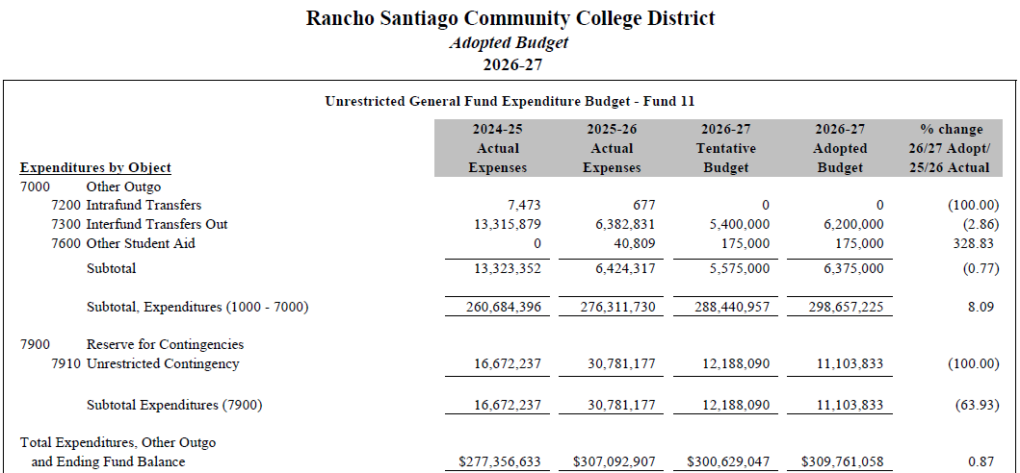
Adopted Budget 2026-27

Slide 29
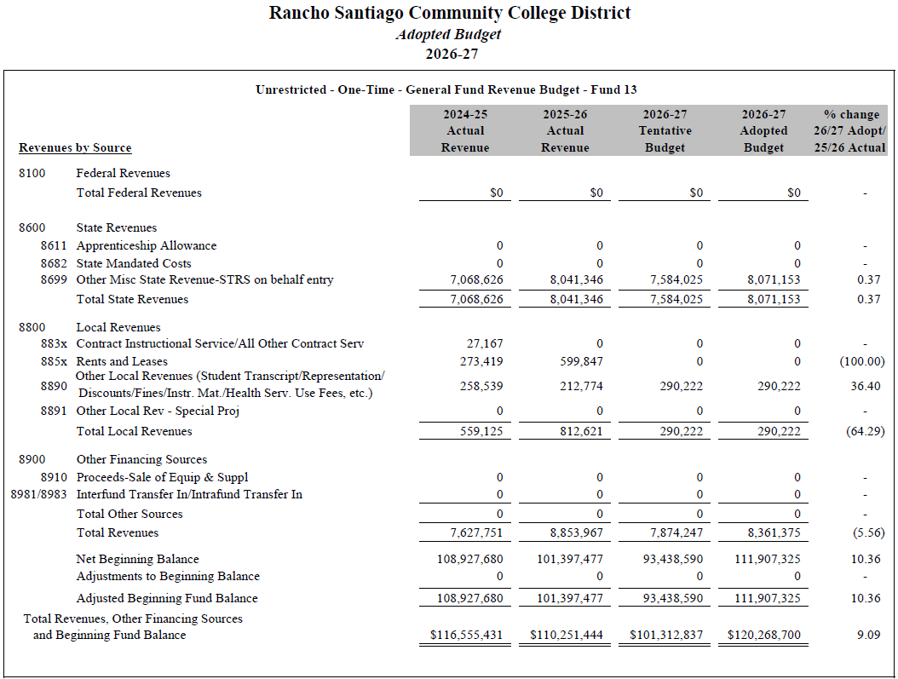
Adopted Budget 2026-27

Slide 30
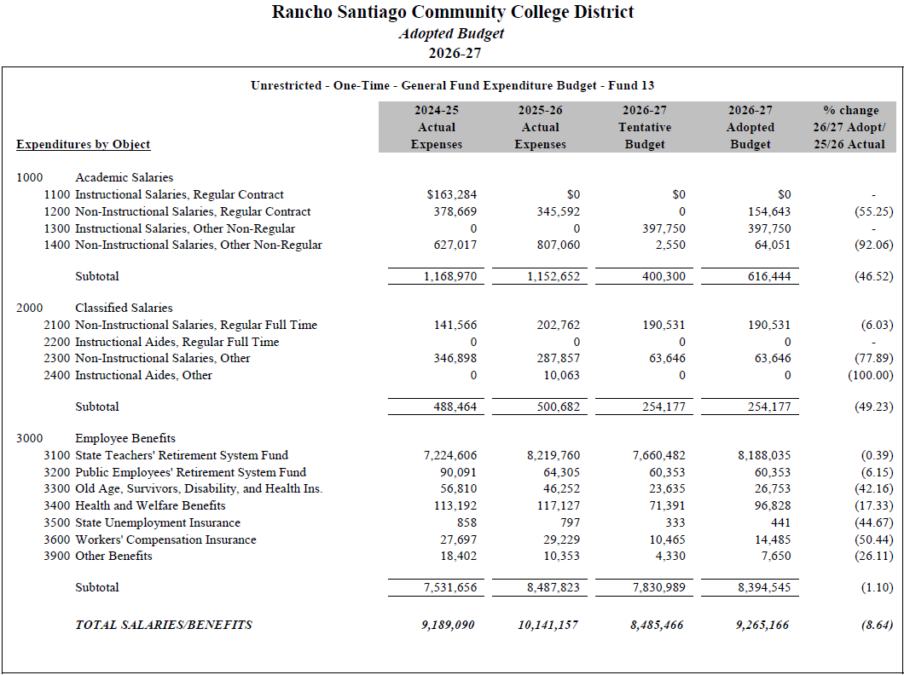
Adopted Budget 2026-27

Slide 31
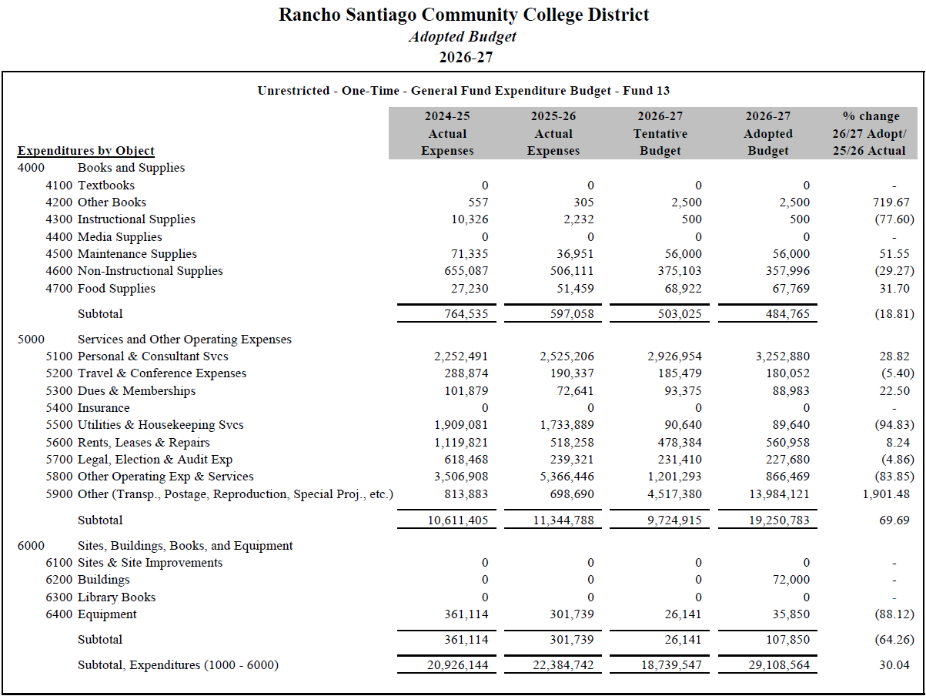
Adopted Budget 2026-27

Slide 32
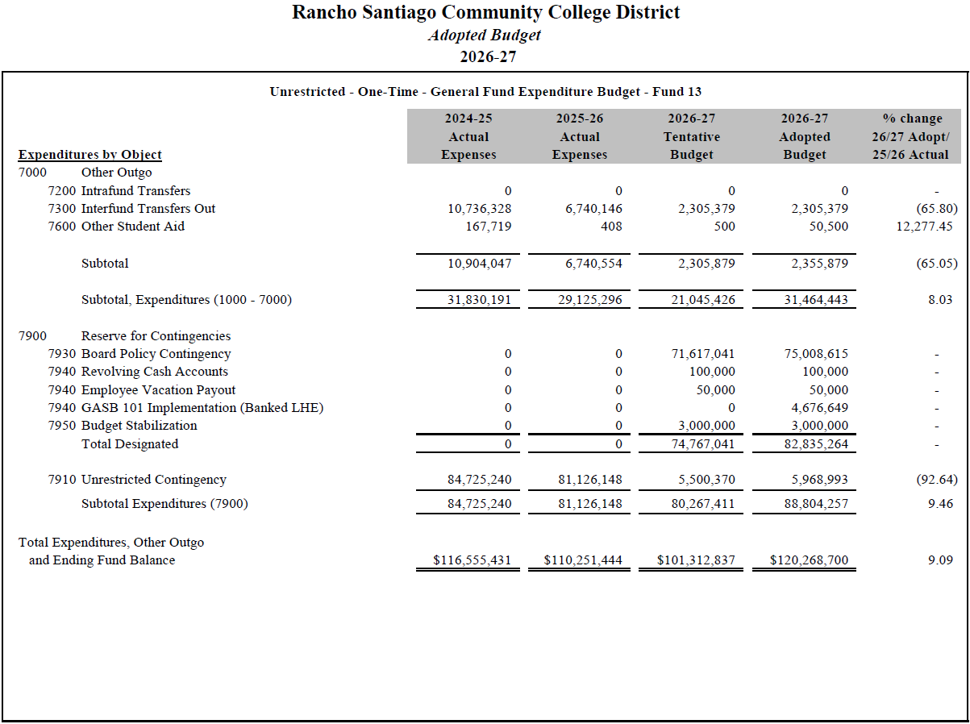
Adopted Budget 2026-27

Slide 33
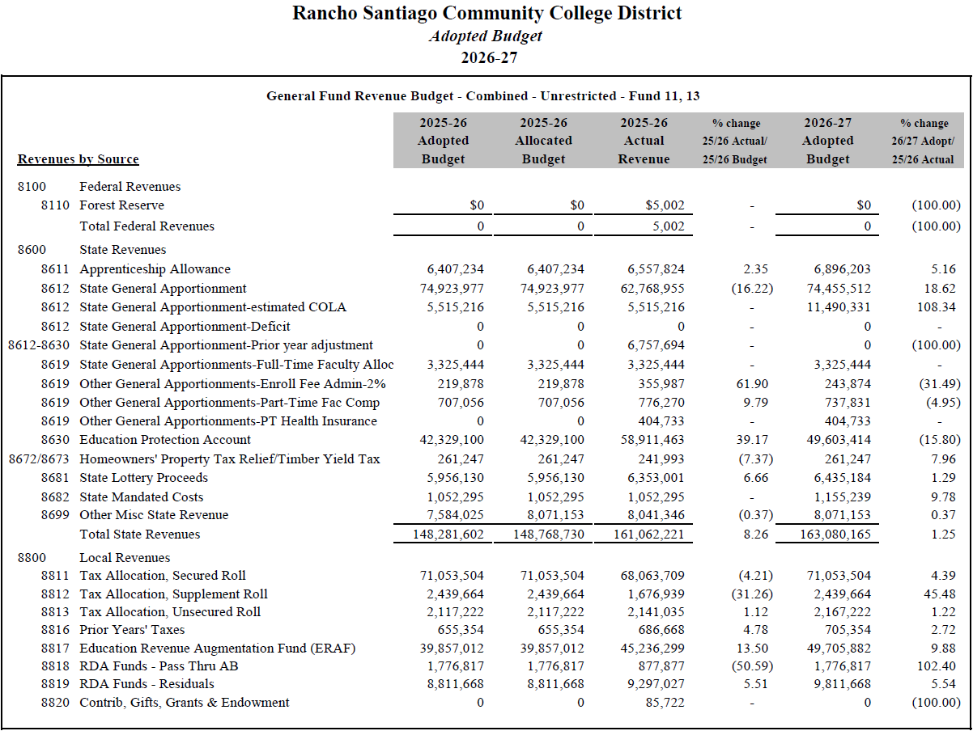
Adopted Budget 2026-27

Slide 34
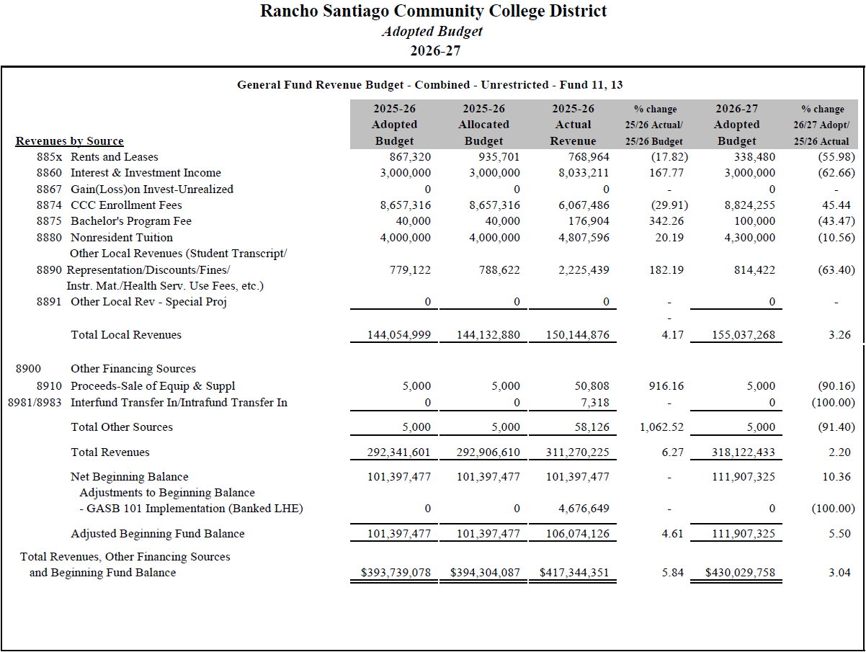
Adopted Budget 2026-27

Slide 35
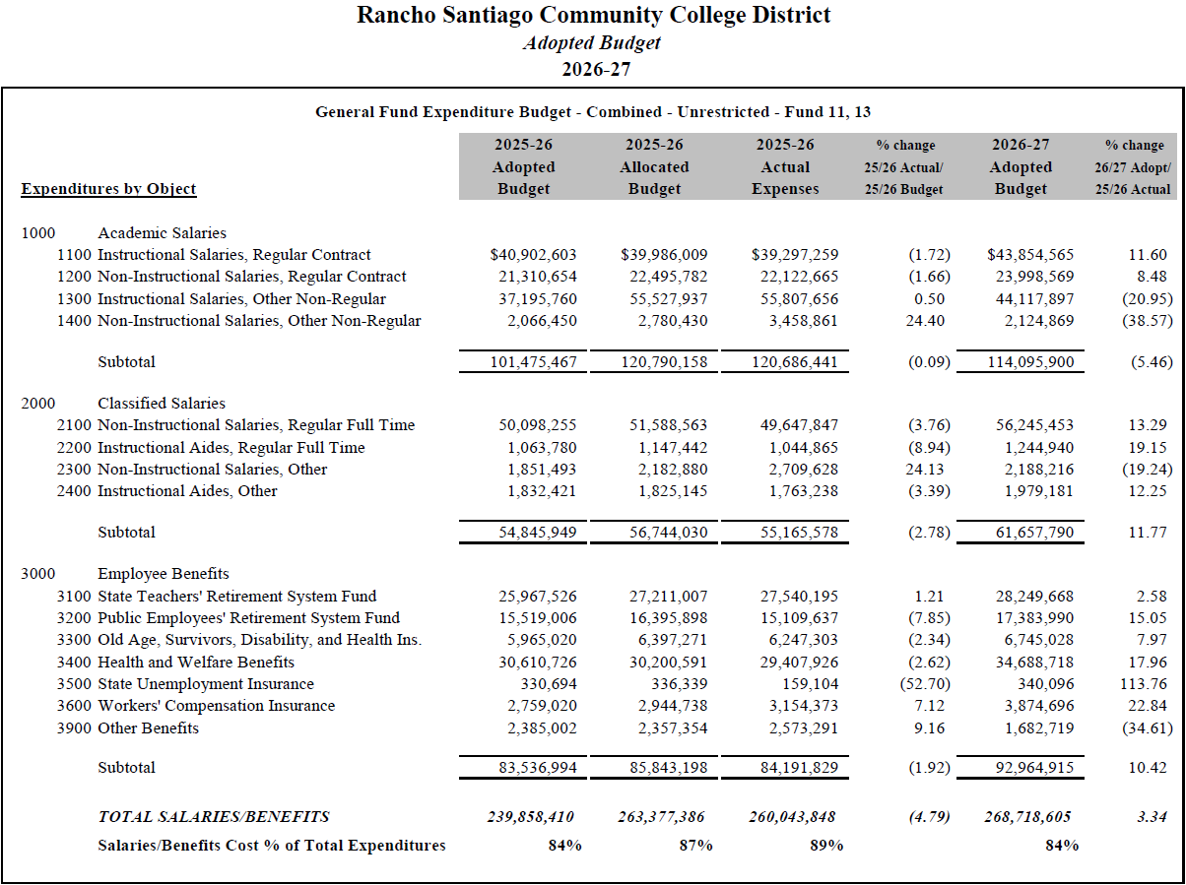
Adopted Budget 2026-27

Slide 36
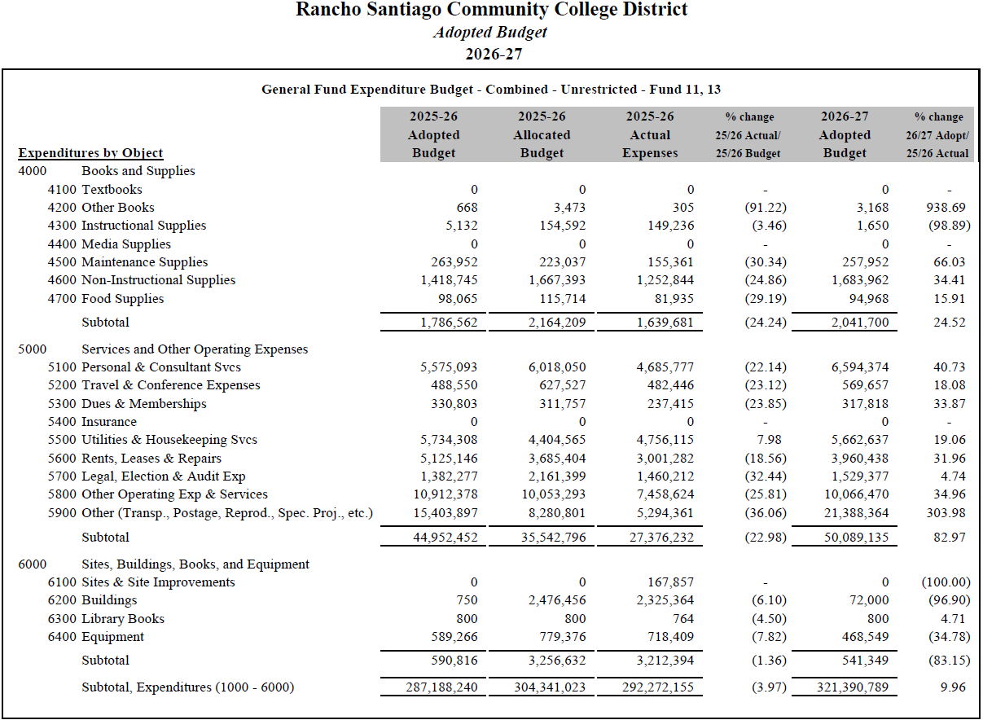
Adopted Budget 2026-27

Slide 37
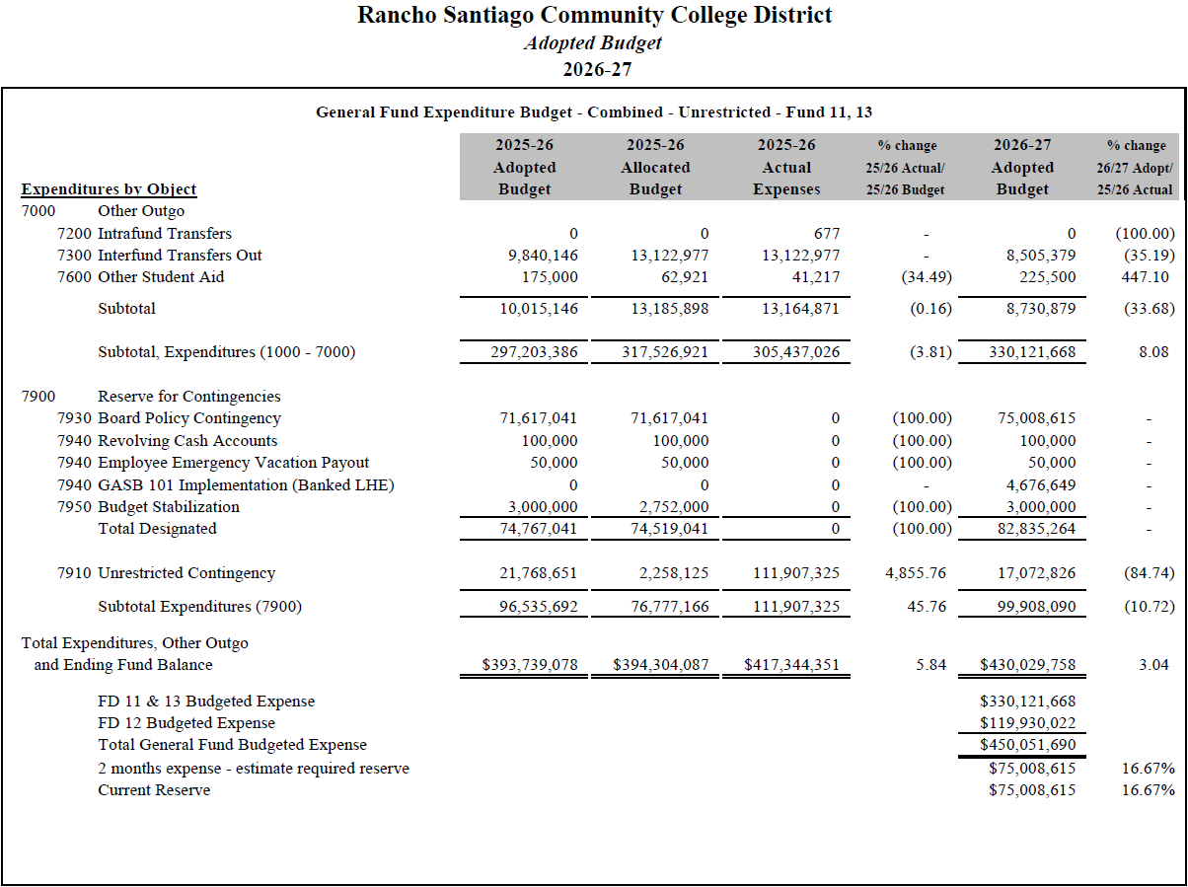
Adopted Budget 2026-27

Slide 38
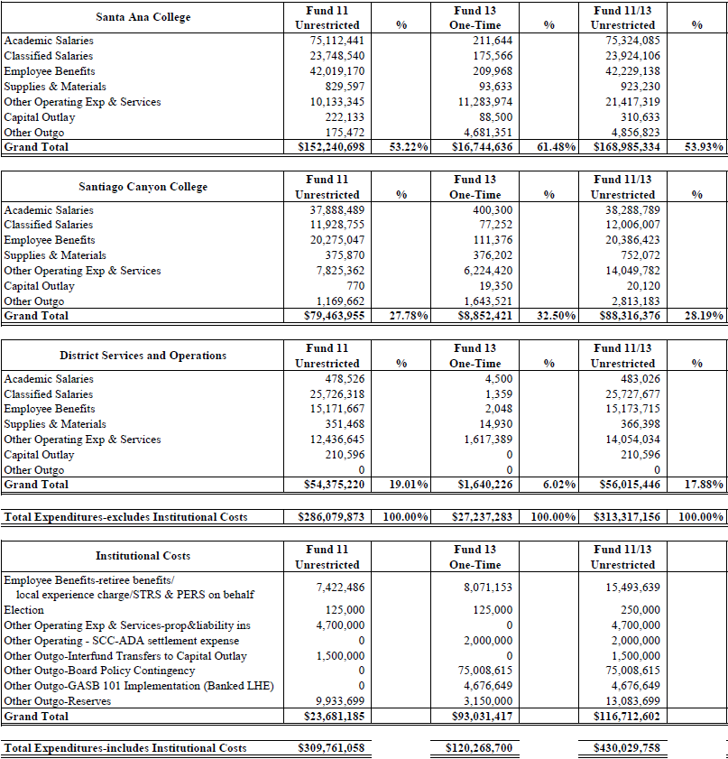

Adopted Budget 2026-27

Slide 39
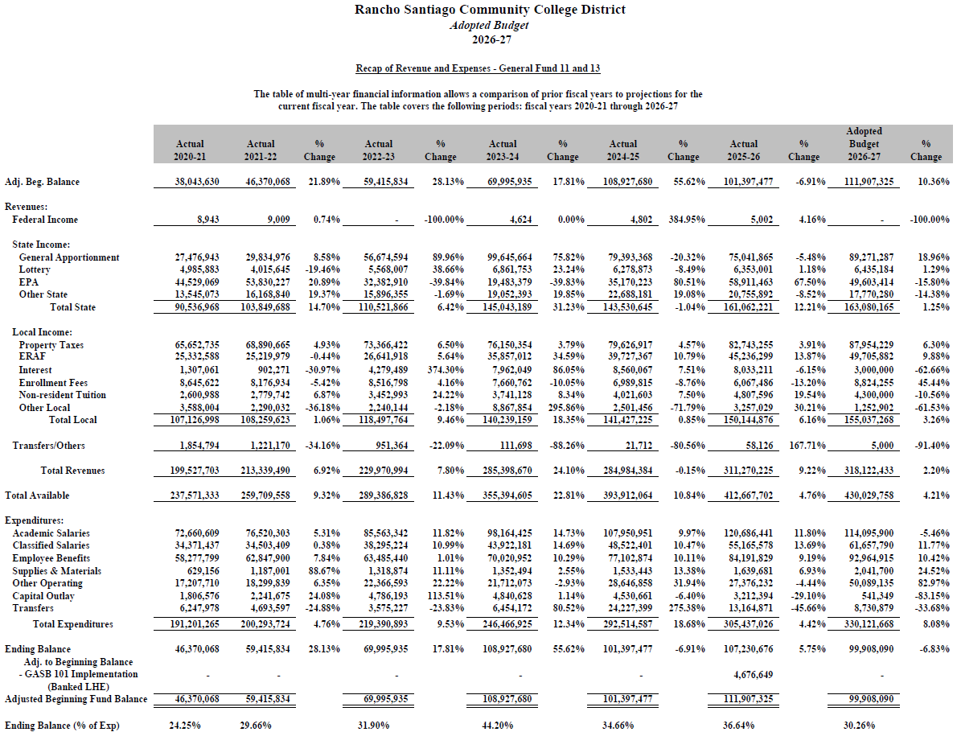
Adopted Budget 2026-27

Slide 40
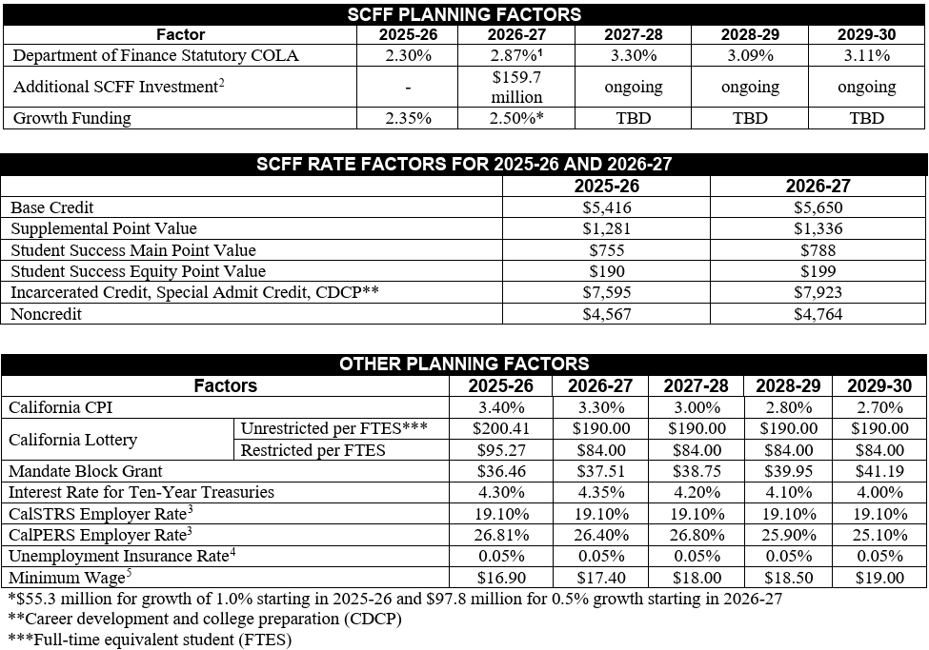
Adopted Budget 2026-27

Slide 41
Big Three Revenue Sources Comparison
Revenue Source | FY 2025-26 Actual vs Forecast | % Variance | FY 2026-27 July Actual vs Forecast | % Variance
Personal Income Tax | +$381 million | +0.2% | -$420 million | -4.7%
Corporation Tax | +$920 million | +1.9% | +$434 million | +42.7%
Sales & Use Tax | +$410 million | +1.2% | +$74 million | +5.1%
Adopted Budget 2026-27

Slide 42
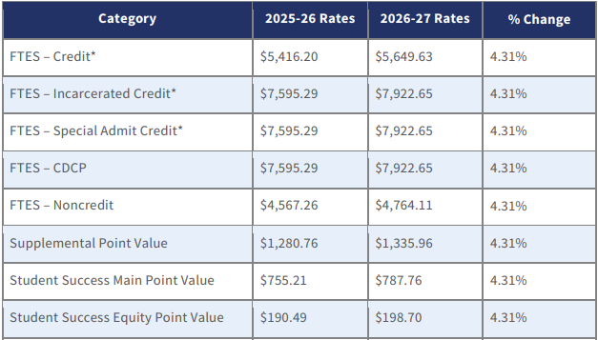
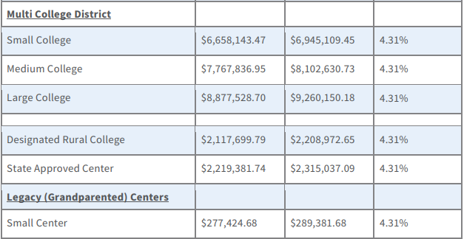
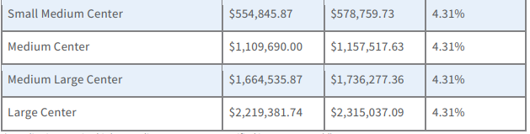
FY2026-27 SCFF Rates (incl. COLA)
Adopted Budget 2026-27

Slide 43
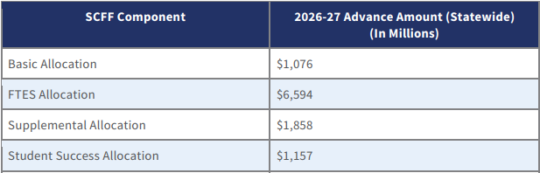
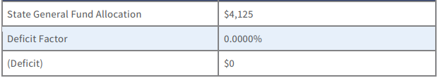
2026-27 Advance SCFF Summary
Adopted Budget 2026-27

