Slide 1
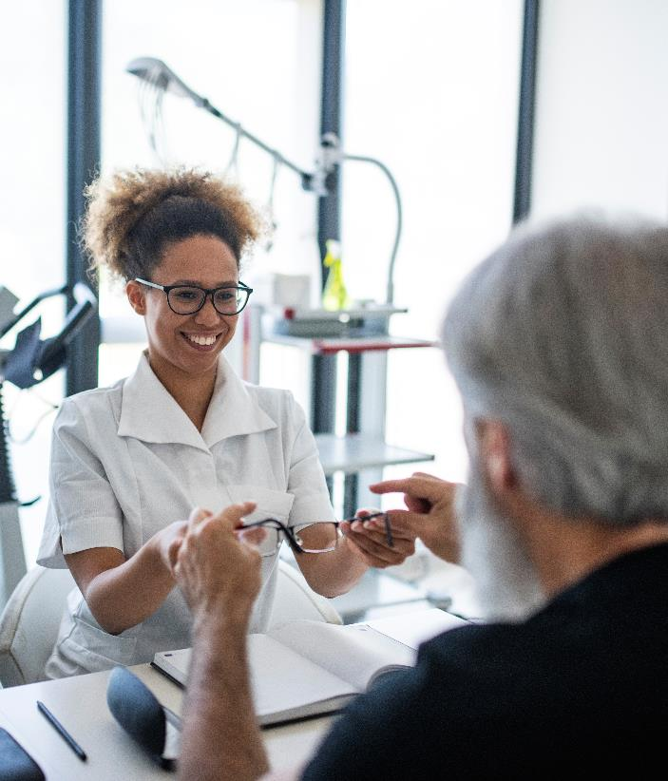

Rancho Santiago
Community College District
2024 Wellness Webinar
Notes:
Hello everyone! Thank you for joining us, and welcome to VSP’s Vision Care webinar! Today, we will be discussing the importance of an Eye Exam.

Slide 2

Did you know?
8 in 10 people (84%) rate vision as
the most important sense, and nearly everyone (97%) agrees that having healthy eyes is important.
But only half of the people surveyed get annual eye exams.
Notes:
To get us started, we’d like to share a couple of quick statistics.
Back in 2018, VSP conducted an elaborate study with the help of a research agency, and during that study, 8 out of 10 people (84% to be exact), rated vision as the most important sense. While nearly everyone agreed that having healthy eyes is important, only half of those people said they get an annual eye exam.
So even though most of us agree that sight is essential to our everyday lives, many tend to put getting that annual eye exam on the back burner. So today, we are discussing why getting our eyes checked on a regular basis is so important.
Source: Surprising Eye Health Stats, VSP Vision Care YouGov Study, 2018
https://www.vsp.com/eyewear-wellness/eye-health/eye-health-survey-results

Slide 3



Regardless of age, it’s important to get an eye exam.
VSP ® Vision Care fosters
eye care connections for a
lifetime of well-being.
The VSP WellVision Exam®
by an optometrist is an important
part of caring for your eyes, vision,
and overall health.
3
Classification: Restricted

Slide 4



Additional Reasons to Get an Exam
Eyecare is Healthcare
Eye exams should
be on your list of your annual appointments.
Signs of over 270 health conditions can be detected during an eye exam.
90% of blindness caused by diabetes is preventable through early detection.
Notes:
An annual eye exam should be on your list of yearly preventive care appointments—just like going to the dentist for a check-up and cleaning, or getting your annual wellness visit with your family doctor. Why? Because during an eye exam, your eye doctor not only looks at your vision, but also your eye and overall health. You see, just because you have clear vision, that doesn't always mean you have healthy eyes. Not to mention, signs of health conditions, over 270 in fact, can be detected early during an eye exam, even before you experience other noticeable symptoms. A VSP member recently shared a story with us about when her eye doctor noticed a gray ring around her cornea—which is a sign of high blood pressure. Her eye doctor encouraged her to see her primary care physician, who confirmed the diagnosis and provided treatment.
Your eye doctor is a key part of your health team. This is especially true if you have diabetes or pre-diabetes, as 90% of blindness caused by diabetes is preventable through early detection.
Centers for Disease Control and Prevention, Cost Effectiveness of Diabetes Interventions, March 2022
Cost-Effectiveness of Diabetes Interventions | Power of Prevention (cdc.gov)
Full Picture of Eye Health, American Optometric Association, March 2022

Slide 5
Additional Reasons to Get an Exam
Contact Lenses
Contact lenses are medical devices and should be prescribed by your eye doctor.
Protective Eyewear: Sunglasses and Safety Eyewear
Your eye doctor can recommend the right
type of lens and best
UV protection.
They can also recommend the right safety eyewear for lifestyles and work demands.
Blue Light
Filtering Glasses
Exposure to excessive blue light and digital screens can contribute to digital eye strain.
Anti-glare Lenses
Discover lens enhancements that can reduce glare and reflections.
Notes:
And for Contact lens wearers – Contact lenses are technically medical devices. So, if you wear contacts, a routine review with your eye doctor is essential.
Looking at or exposure to light sources without the right eye protection can cause serious and painful conditions to the eyes. It can even damage your retina. During an eye exam, you can ask your eye doctor to recommend the right type of lens and the best UV protection. Whether you’re out on the water or skiing the slopes—there is a sunglass lens right for your lifestyle or activity.
There is no scientific evidence that digital devices can damage the eye, but, excessive exposure to blue light can contribute to digital eye strain. Symptoms may include dry eyes, blurred vision, tired eyes, sore eyes, headaches, and watery eyes. Your eye doctor can help you select blue light filtering glasses, and, more importantly, during your exam, they can also help you understand the best way to use them, and prevent any unintended consequences from misuse or overuse.
Anti glare or anti-reflective coatings offer four types of coatings to help you see better and look better, including one to help you reduce your blue light exposure.
Tips for Choosing the Best Sunglasses - American Academy of Ophthalmology (aao.org)
Should You Be Worried About Blue Light? - American Academy of Ophthalmology (aao.org)

Slide 6

Chronic Conditions Are Common
118M
Americans have hypertension
94M
Americans have high cholesterol
37M
Americans
have diabetes
96M
Americans have prediabetes
and 84%
don’t know it
Classification: Restricted
U.S. statistics provided by Centers for Disease Control and Prevention
Notes:
Chronic conditions are common—more common than you might realize.
118 M Americans have Hypertension
96 million Americans have pre-diabetes, and 84% don’t know they have it.
And all these conditions can affect the function of your eyes. An eye exam is a non-invasive way to find out if something more serious is going on.

Slide 7

Vision Care is Healthcare
A WellVision Exam® from your VSP network doctor
can help detect early health and eye issues including:
Ocular Conditions
  Cataracts
  Diabetic retinopathy
  Glaucoma
  Macular degeneration
Systemic Conditions
  Diabetes
  High cholesterol
  Hypertension
Notes:
So, why is an eye exam such an important component in preventive care?
As we mentioned before, an eye doctor can detect over 270 conditions during a WellVision exam, even if you don’t have symptoms. Well, that has a lot to do with how your eyes are the only place in the body that provides a non-invasive way to see an unobstructed view of the blood vessels.
Eye doctors have the ability to detect signs of conditions like diabetes, high cholesterol, and hypertension during an eye exam.

Slide 8

Common Eye Conditions
Cataracts
A cataract is the clouding of the normally transparent crystalline lens. This can make vision blurry or reduce a patient’s ability to see colors. Cataracts commonly occur as patients get older but can also happen after an eye injury.
If untreated, cataracts can lead to blindness.
A few symptoms include:
Blurred or dim vision
Increased difficulty with night vision
Seeing “halos” around lights
Sensitivity to light or glare
Fading or yellowing of colors
Notes:
Next is cataracts. The most common cause of cataracts is age, and it’s become one of the leading causes of blindness among adults ages 40 and over in the US. A cataract is a cloudy area in the crystalline lens, which is the part of the eye that helps us refract light and focus our vision. It’s normally completely transparent. Cataracts can make vision blurry or reduce our ability to see colors. Cataracts commonly occur in older individuals but can also happen after an eye injury.
Cataracts are a very common vision problem that can usually be fixed with minor surgery. In addition to age, some secondary factors associated with cataracts are:
•family history
•smoking
•excessive alcohol use
•obesity
•chronic diseases like diabetes
•side effects of some medications
•excess use of steroid medications
•and, too much UV light exposure
Unfortunately, if untreated, cataracts can lead to blindness.

Slide 9

Common Eye Conditions
Diabetic Retinopathy
A complication of diabetes that causes damage to the blood vessels in the back of the eye and may lead to vision loss and blindness if not medically addressed.
Early detection and treatment can prevent
blindness in 95% of cases.
Diabetic retinopathy is the most common diabetic eye disease and is the leading cause of blindness in adults.
Centers for Disease Control and Prevention
Notes:
Diabetic Retinopathy is the most common cause of vision loss among people with diabetes and the leading cause of blindness among working-age adults.
Just over 11 percent of the U.S. population have diabetes, and 38 percent have prediabetes, which of course, if not treated often leads to type 2 diabetes.
An annual eye exam (with dilation) is strongly recommended for people with diabetes, as early detection of diabetic retinopathy is essential to prevent blindness.
VSP doctors use retinal screening to get a much larger view (200 degrees, in fact) of the retina, or the back of the eye in order to detect possible abnormalities or signs of disease, and provide early diagnosis and treatment.
We emphasize this condition because it is very common in the US, but also because early detection and treatment can prevent blindness in 95% of cases.
Sources: Centers for Disease Control and Prevention (CDC), 2022;

Slide 10

Common Eye Conditions
Glaucoma
Glaucoma is a group of eye a group of eye conditions that results in damage to the optic nerve, which can lead to progressive, irreversible loss of vision.
If untreated, can lead to optic nerve damage that results in progressive, permanent vision loss.
This vision loss starts with unnoticeable blind spots at the edges of the field of vision, which progresses to tunnel vision and then to blindness.
A dilated eye exam can diagnose glaucoma.
With early diagnosis, glaucoma can be managed.
Centers for Disease Control and Prevention
Notes:
Glaucoma is the second-leading cause of blindness, and it affects more than 3 million Americans.
By definition, Glaucoma is a group of eye conditions that results in damage to the optic nerve, which can lead to progressive, irreversible loss of vision.
This vision loss starts with unnoticeable blind spots at the edges of the field of vision, which progresses to tunnel vision and then to blindness. But, with early diagnosis, glaucoma can be managed.
The American Optometric Association recommends an annual eye exam that includes dilation for people who have an increased risk because doctors can diagnose glaucoma during a dilated, eye exam. People who have an increased risk of developing glaucoma include individuals who have a family history of the condition, are African American and over the age of 40, or are Hispanic and over the age of 60.
Ultimately, early detection, prompt treatment and regular monitoring can help control glaucoma, and reduce the chances of vision loss.
Don't Let Glaucoma Steal Your Sight, Centers for Disease Control, November 2020

Slide 11


Common Eye Conditions
Macular Degeneration
Age-Related Macular Degeneration (AMD) is a leading cause
of vision loss in older adults. It happens when aging causes damage to the macula, part of the retina that controls sharp, straight-ahead vision.
The patient may have blurry or wavy areas in
their central vision.
Macular Degeneration is a leading cause of legal blindness.
Centers for Disease Control and Prevention
Notes:
Macular degeneration is a type of eye disease that causes loss in central vision, the part of the eye that controls sharp, straight-ahead vision, which is what we use to drive, read, and do most of our daily activities. Macular degeneration is a leading cause of legal blindness in people age 65 and over. As many as 11 million people in the US have some form of age-related macular degeneration, and that number is expected to double to nearly 22 million by 2050.
Someone with macular degeneration may have blurry or wavy areas in their central vision.
Source: BrightFocus Foundation, January 2022

Slide 12
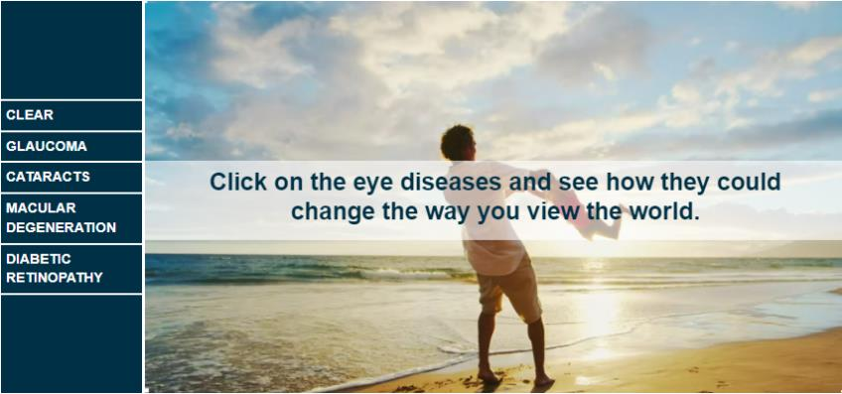
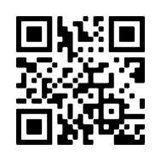
Eye Disease Simulator
Scan me!
Notes:
An eye disease can change the way you see what’s around you. On vsp.com, we have an eye disease simulator that gives you a look at what your vision would be like if you had one of these eye conditions.
To take a look, scan the QR code from your phone and share with a friend or family member.

Slide 13

Essential Medical Eye Care
Here’s what’s covered:
Fully covered retinal screening for VSP members
with diabetes.
Exams and services to treat immediate issues like pink eye and sudden changes in vision.
Treatment options to monitor ongoing conditions such
as dry eye, diabetic eye disease, glaucoma, and more.
This coverage is supplemental, and your medical insurance plan may be billed first. You may be able to coordinate with your VSP benefits to help reduce out-of-pocket costs. If your VSP network doctor is not contracted with your medical insurance plan, VSP has you covered with only the cost of your copay.*
*$20 standard copay for medical exams. Other covered services are covered-in-full, including retinal screening for members with diabetes.
Notes:
Under most plan types, VSP offers Essential Medical Eye Care. This is different than a WellVision exam, but it is important to be aware of. Essential medical eye care includes:
Retinal screening for members with diabetes who do not have diabetic eye disease.
Exams and services to treat more immediate issues like pink eye, and sudden changes in vision.
Treatment options to monitor ongoing conditions like dry eye, diabetic eye disease, glaucoma, and others.
This coverage is supplementary and in most cases your health insurance will be billed first. You may be able to coordinate with your VSP benefits in order to help reduce out-of-pocket costs. But, the great part about this aspect of your plan, is that if your VSP network eye doctor doesn’t participate with your medical insurance plan, VSP has you covered, with only the cost of your copay.

Slide 14
Your Choice Plan Design Today
Frequency (E/L/F) Calendar Year | Copays | Frame Allowance | Contact Lenses | Covered Lens Enhancements | Essential Medical Eye Care
12/12/12 | $15 Total | $150 $170 Featured Frame Brands $80 Costco/Walmart/ Sam’s Club | $150 (Fitting and Evaluation and Contacts) | Standard Progressives Polycarbonate for Children | $20
Average Savings of 30% on all other lens enhancements
Retinal Screening not to exceed $39 copay
20% savings on additional pairs of glasses same day as Exam
Notes:
Extra $40 2024 Extra $40 on bebe, Converse, Dragon and Nike brand frames Promotion Period: 09/01/2024 - 01/31/2025Amount: $40.00

Slide 15












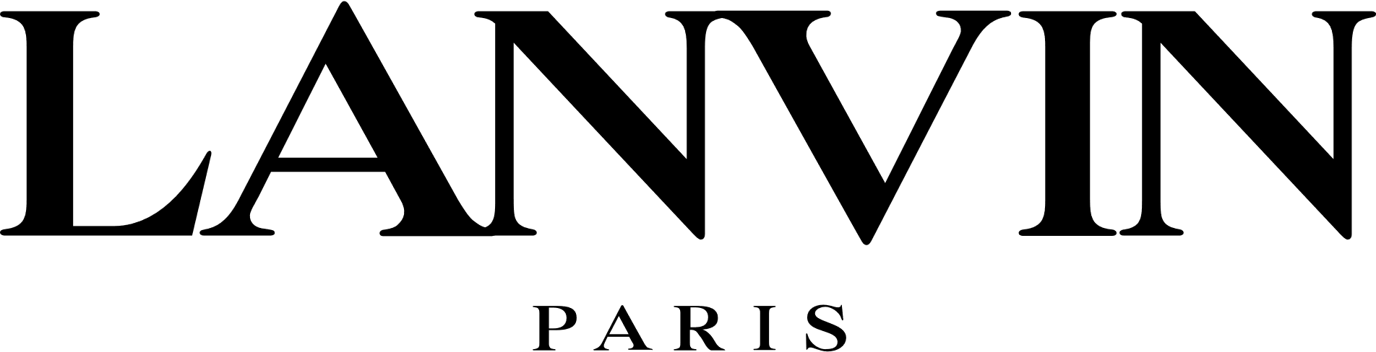






Members Save More on Featured Frame Brands
Additional $20
To spend on
featured frame brands at all network locations®
—
More frames,
covered in full
Notes:
23% selection rate
Extra $40 2024 Extra $40 on Calvin Klein, Calvin Klein Jeans, Draper James, Flexon and Lacoste brand frames Promotion Period: 04/01/2024 - 08/31/2024Amount: $40.00
Extra $40 2024 Extra $40 on bebe, Converse, Dragon and Nike brand frames Promotion Period: 09/01/2024 - 01/31/2025Amount: $40.00

Slide 16






















Exclusive Member Extras
Glasses & Sunglasses
Contacts | Lasik
Home & Financial Well-Being |  | Health & Wellness | Leisure & Lifestyle
Notes:
Extra $20 or Extra $40 for featured frame brands
Receive up to $1,200 off your LASIK procedure
Save up to $300 or more on your annual supply of contacts
Save thousands on hearing aids - Up to a 60% discount- sign up 4 extended family members
Save big with discounts on travel and entertainment throughout the year for you and your whole family
Shop on Eyeconic and save 20% on sustainable Eyewear
Get 20% off Dragon Snow Goggles
Extra $40 to spend on Calvin Klein, Calvin Klein Jeans, Draper James, Flexon, and Lacoste frames from any VSP doctor and in-network locations from April 1 through August 31, 2024.
NEW
At premier locations Glasses & Sunglasses- Get up to a $50 Rebate on Your Next Pair of Maui Jim Prescription Sunglasses
At all other private practice get up to $40 Rebate on your next pair of Maui Jim Prescription sunglasses
With VSP Simple Values, members get access to savings on health, wellness and entertainment expenses.

Slide 17
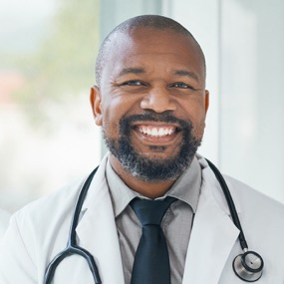


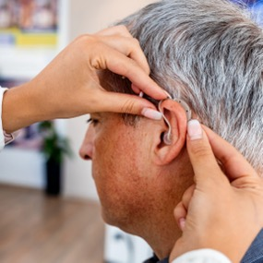
Hearing Aid Discount Program
Nationwide network
of more than 7,000 licensed hearing aid professionals
Straightforward, nationally fixed pricing on a wide selection of hearing aids
One year of free visits
for fitting, adjustments,
and cleaning
Eighty free batteries per hearing aid
Discounts on over-the-counter hearing aids are also available
Notes:
GOAL: Provide overview of TruHearing program.
Talking Points: VSP members can save up to 60% on the latest brand-name hearing aids through TruHearingTM, as part of our Exclusive Member Extras program.
Any questions about your plans and value adds that members have access to?

Slide 18
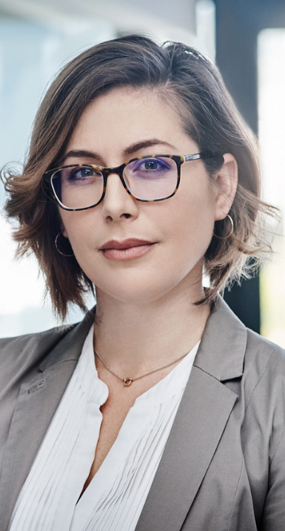


Convenient Access
With thousands of private practice doctors and over 700 Visionworks® retail locations nationwide, getting the most out of your benefits is easy at a VSP Premier EdgeTM location. And VSP® members are backed by the Premier Edge Promise, a worry-free eyewear guarantee.
With Even More Options
Exclusive offers
and savings
A wide selection of
featured frame brands
Advanced eye exam
technology, like retinal
imaging
Notes:
Generic Script:
No matter where you’re located, you have convenient access to a VSP provider.
As a member, you can maximize your benefits when you visit a Premier Edge location, including:
Exclusive bonus offers available only at Premier Edge locations
A wide selection of featured frame brands, backed by a one-year worry-free warranty if your glasses are broken or damaged
Access to the latest in high-definition technology with UNITY® digital lenses available
Advanced eye exam technology, like retinal imaging

Slide 19


Simplicity in Eye Health for VSP Members
Get an extra $40 to spend
on select frame brands
Get up to 40% OFF
lens enhancements
(anti-reflective coatings, progressive lenses, and
photochromic lenses)
All 750+ Visionworks® locations are
in-network with VSP ®
When you use your VSP benefits at Visionworks your glasses are covered:
• Breakage or damage¹
• Prescription changes²
• Love your look³
VSP members
always get
50% off second pair
Only at Premier Edge locations. Premier Edge is not available for some members in the State of Texas
1.$40 processing fee applies to replacement lenses if needed. 2.$40 processing fee applies to replace lenses (minimum Rx change required). 3.$40 processing fee applies
Notes:
Rancho Margarita
Lake Forest
Laguna Niguel
Fullerton
Santa Ana- Bristol Plaza
Fontana 2 stores
Riverside
Redlands
Sacramento
Folsom
Chino
Corona Hills
LA
San Dimas
Culver City
Bell Gardens
Cerritos
Visionworks exclusive discounts:
50% off a 2nd pair of glasses
40% off a complete pair of prescription glasses when not using insurance
100-day guarantee

Slide 20
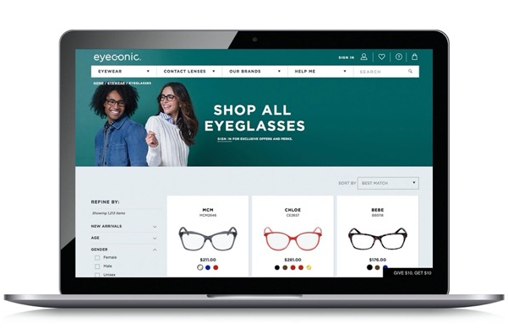
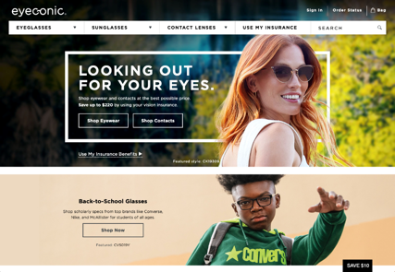

Eyeconic®
Eyeconic is the official VSP online store that seamlessly connects your VSP vision benefits to your account.
Eyeconic offers:
A huge selection of contact lenses and designer frames 24/7 – and the Virtual Try-On Tool.
Free shipping and returns*
20% off any out-of-pocket expenses on eyewear after your frame allowance is applied.
Specialty sizes that fit your needs.
Find your product, customize your order and we do the rest. Start saving today at eyeconic.com® today.
Eyeconic is a VSP-affiliated company
*Terms and conditions apply. Visit eyeconic.com/faqs for more details.
Notes:
Generic Script:
As a VSP-owned company, Eyeconic is the only website that seamlessly connects VSP vision benefits to a members’ account. By applying your vision benefits, you see savings in real time.
Save time and money on quality eyewear with a few easy clicks.
1. Connect your vision insurance
2. Select your product
3. Upload your prescription or provide your doctors contact information and we’ll take care of the rest.
Eyeconic offers a variety of well-known name brands and contact lenses. Choose from over 70 eyewear brands and over 1600 styles.

Slide 21

Using Your Benefit is Easy
Once you’re enrolled…
Create an account at vsp.com and review your personalized benefit information.
You can find a VSP in-network doctor by visiting vsp.com or
calling 800.877.7195.
At your appointment, simply tell them you have VSP—and we’ll take care of the rest! There are no claim forms to fill out when you see a VSP network doctor.
Notes:
Generic Script:
And using your VSP benefit is easy. Once your plan is effective, create an account on vsp.com to review your personalized benefit information and easily search for an in-network doctor so you can find a provider who's right for you. And don’t forget you can maximize your benefits when you visit a Premier Program location. Then, at your appointment, simply tell the doctor’s office you have VSP. There’s no ID card needed or claim forms to complete when you see a VSP network doctor.

Slide 22

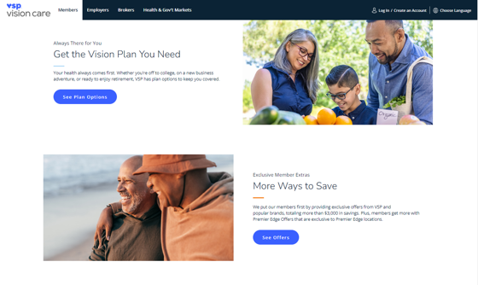
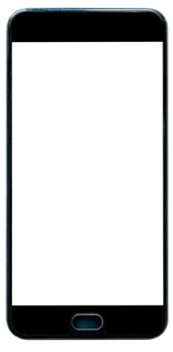
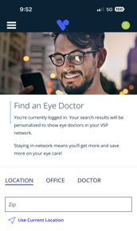
Anytime, Anywhere… It’s All About
Your Members
Find a VSP® network doctor
Discover special offers and savings
Access personalized dashboard
View plan coverage
Print member ID card
Sign up for emails to maximize benefits
Call or email Member Services
22
Notes:
GOAL: Highlight how VSP encourages your employees to use vsp.com or our easy-to-use VSP app to look out for their eyes and see how they can save money and stay healthy.
Talking Points: 24/7 access to a robust member portal to get answers to their benefit questions, find a doctor, and even shop for frames by registering at VSP.com or download the VSP app.

Slide 23


Find a VSP network doctor at vsp.com.
®
Notes:
Well, this concludes our presentation! Thank you all again for attending. At VSP, your overall eye health and wellness is our top priority, and that’s why we’re committed to ensuring that you experience a lifetime of not only good vision, but good health. Preventing vision loss and staying healthy starts by getting your VSP WellVision exam.
Before we go, we also want to mention that the information presented during this webinar, is for informational purposes, and is not medical advice, medical recommendations, diagnosis or treatment. Always be sure to seek the advice of your eye doctor, physician or other qualified health provider with any questions you may have about a medical condition.
To find an eye doctor, just visit our website at vsp.com. Thank you!

